Slide 1
Introduction to the French Revolution

Slide 2
Agenda
Recap –French Revolution
Vocabulary Review
Crash Course French Revolution
Guided Reading: Revolution Threatens the French King
French Revolution Storyboard

Slide 3
Recap
During block days, we completed vocabulary about the French Revolution. During the unit we will see these vocabulary words in action. The better you understand the vocabulary, the better you will understand the French Revolution

Slide 4
Vocabulary Review
http://quizlet.com/26492895/french-revolution-vocabulary-flash-cards/
Vocabulary Test on Monday

Slide 5
Video Clip
Overview of the French Revolution: http://www.youtube.com/watch?v=lTTvKwCylFY

Slide 6
In Your OneNote book
Title the page “Three Estates and Causes of the Revolution” and draw a line to split the page in half. Copy down the graphic organizers on the page. One in each section of the page.

Slide 7
1st estate
2nd estate
3rd Estate
Causes of the Revolution:
Divide your page into two parts. One side the graph and the other side Causes of Revolution

Slide 8
Guided Reading
Now open the Seven Summaries PDF File. As you are reading, pay attention We are going to be reading Section 1: Revolution Threatens the French King.

Slide 9
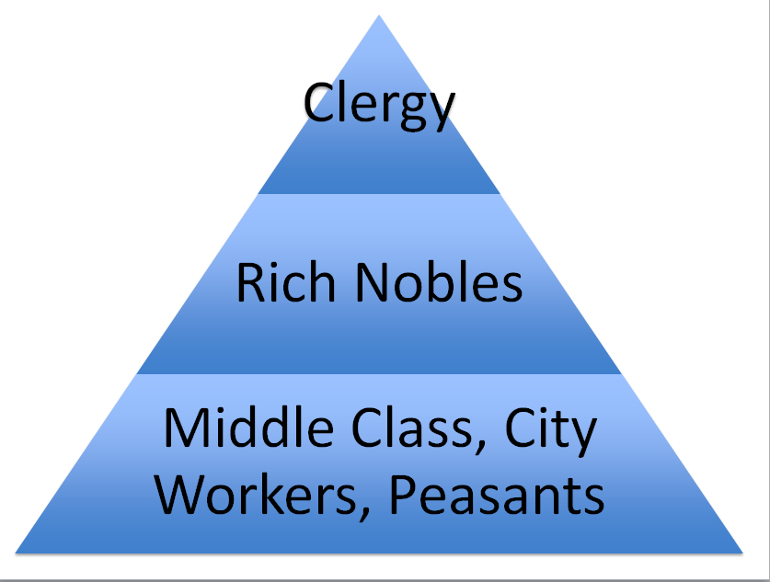
Now fill your graphic organizer

Slide 10
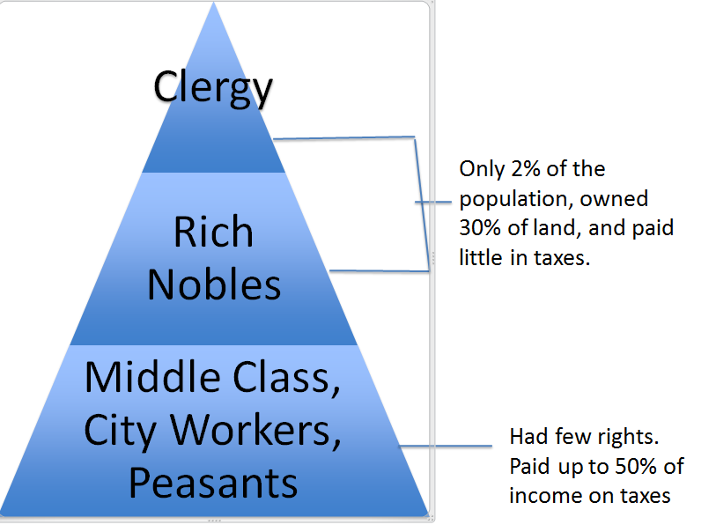
Add all this information in your page

Slide 11
Write the causes in the next column

Slide 12
French Revolution
Create a new page and title French Revolution Story board. Now on your page create a story board with nine slides. You may insert table with 1 column and 9 rows. ( just a suggestion).
After you create the story board frame, write the story of the French Revolution. I have given you the pictures and they are in order of the event. Your task is to paste the pictures in each frame and write the events of the story that matches your picture. You must read the pdf file to get the information
Storyboard

Slide 13
1789
In 1789, France….. (write all that was happening (causes) and also the king’s decision to tax the nobles)

Slide 14
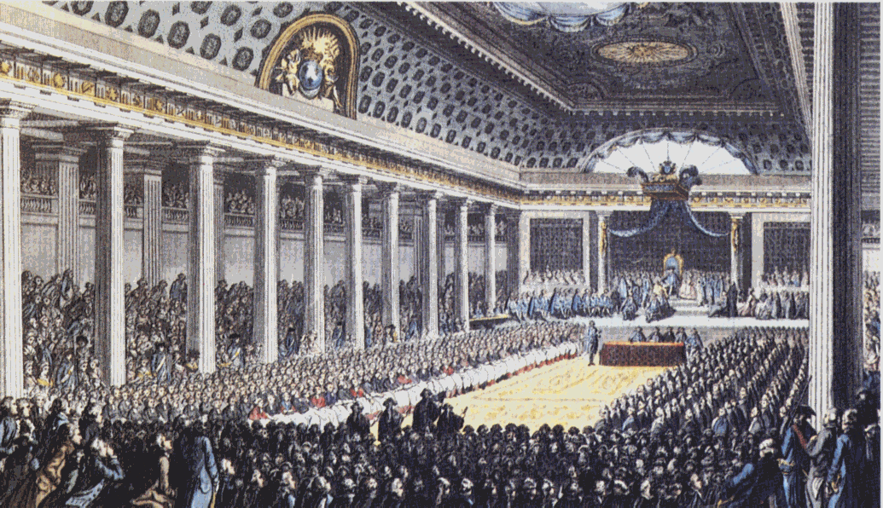
The Estates General May 5th, 1789
Explain why the Estate General was clalled? Don’t forget to mention dates in your story.

Slide 15
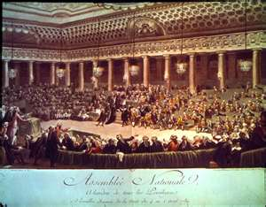
National Assembly Formed June 17th, 1789
Explain why the National assembly was formed (Reading)

Slide 16
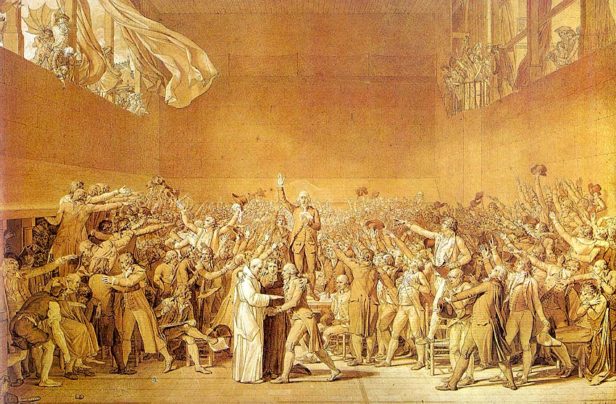
Tennis Court Oath June 20th, 1789
Explain this event in detail. Don’t forget the dates.

Slide 17
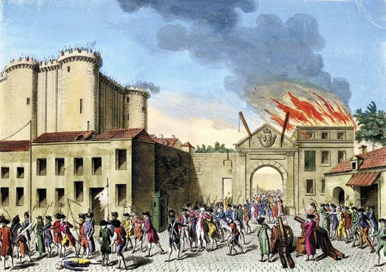
Storming The Bastille July 14th, 1789
Elaborate the details of this event. Don’t forget the date

Slide 18
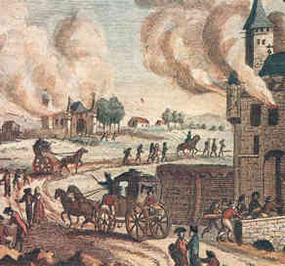
The Great Fear July 20th,-August 5th,1789
Explain the Great Fear. Chech your reading. Don’t forget the date

Slide 19
National Assembly Official August 4th, 1789
Here, explain what happens

Slide 20
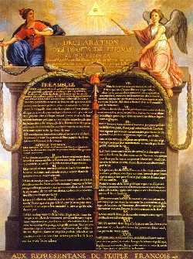
Declaration Of The Rights Of Man
August 26th, 1789
Don’t forget to explain the what happens to the king’s rule
20
Notes:
20

Slide 21
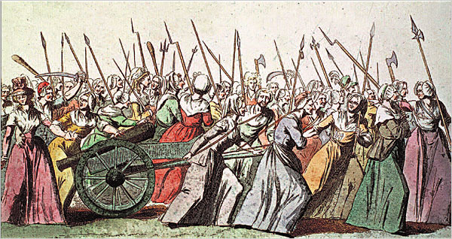
March To Versailles October 5th, 1789
Make this part of the story interesting and don’t forget the quote “If you don’t have bread then eat cake” –Queen Mary Antoinette

Slide 22
French Revolution Storyboard
As we read and learn more about the French Revolution, we are going to be making multiple storyboards. You are going to be required to copy down the text for each box, and to produce an illustration, with color, for each box.

Slide 23
Some sample script to jump start your story

