Slide 1
The Enlightenment leads to Revolution
The European Movement 1750-1900

Slide 5
http://education-portal.com/academy/lesson/the-war-of-spanish-succession-and-the-treaty-of-utrecht.html
Spanish War of succession
http://education-portal.com/academy/lesson/the-war-of-austrian-succession-summary-and-effects-on-the-world.html
War on Austrian Succession
http://education-portal.com/academy/lesson/the-french-and-indian-war-causes-effects-summary.html
French and the Indian War

Slide 12
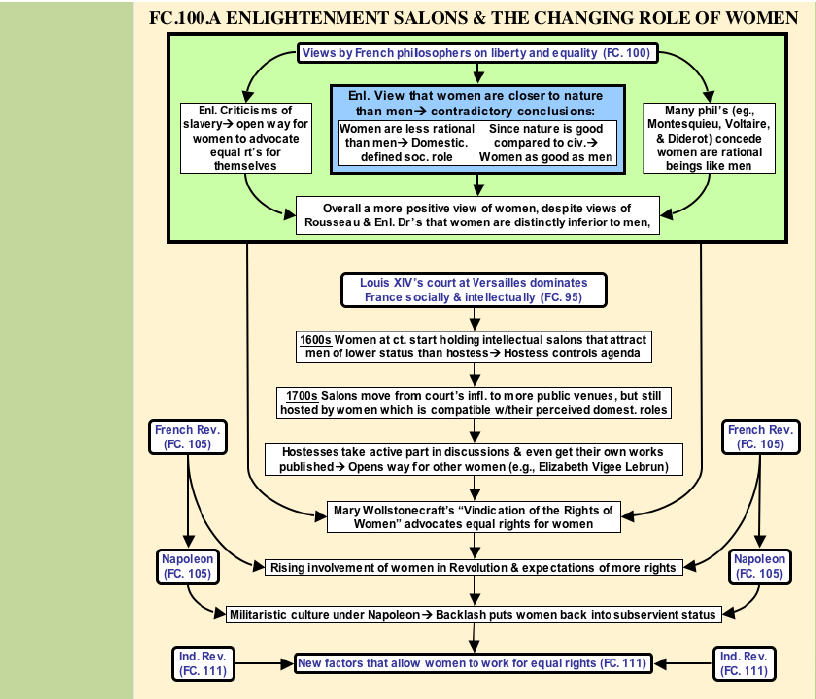

Slide 13
