Slide 1
1450 -1750

Slide 2
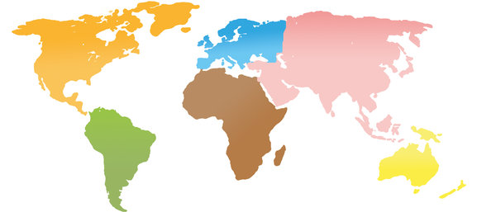
Long distance Sea routes
Tremendous expansion of commercial, cultural, and biological exchanges around the world.
Overland expansion of Muslim, Russian, and Chinese empires also increased global interaction.
1450-1750

Slide 3
D
EA
Russia
F
ASIA
B
ISLAMIC WORLD
Domesticated animals and crops
Japan
China
New national government
promoted economic development and stemmed foreign influence
Population
S
potato
LABOR
AFRICA
PORTUGUESE
P
These expanding contacts had major demographic and cultural consequences.

