Slide 1
http://www.genreonline.net/Genre_files/FrenchRevLogo.jpg
http://worldhistoryatyhs.wikispaces.com/French+Revolution
Ms. Ramos

Slide 2
French Revolution
10.2 French Revolution and its effects worldwide on political expectations for self-government & individual liberty
10.2.4 Explain how the ideology of the French Revolution led France to develop from constitutional monarchy to democratic despotism to the Napoleonic empire.
Ms. Ramos

Slide 3
Influence of Enlightenment & Am Rev
Q: What kind of gov’t did Enlightened thinkers like Locke, Montesquieu, Voltaire, and Jefferson NOT like? What kind did they like?
Q: What did Locke, and then Jefferson in the Declaration of Independence, say people should do if the gov’t doesn’t protect their rights?
Q: What would the Enlightenment & the American Revolution influence the French to do if they were unhappy with their gov’t?
They want democracy & willing to revolt to get it.
Ms. Ramos

Slide 4
Myhaikuclass.com: Blog
http://questgarden.com/47/02/8/070221202134/
Ms. Ramos

Slide 5
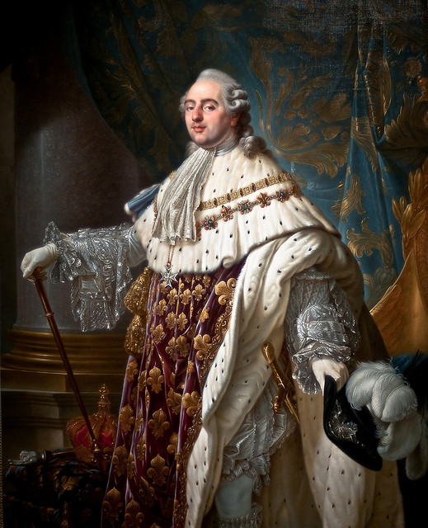
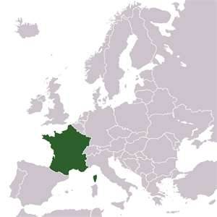
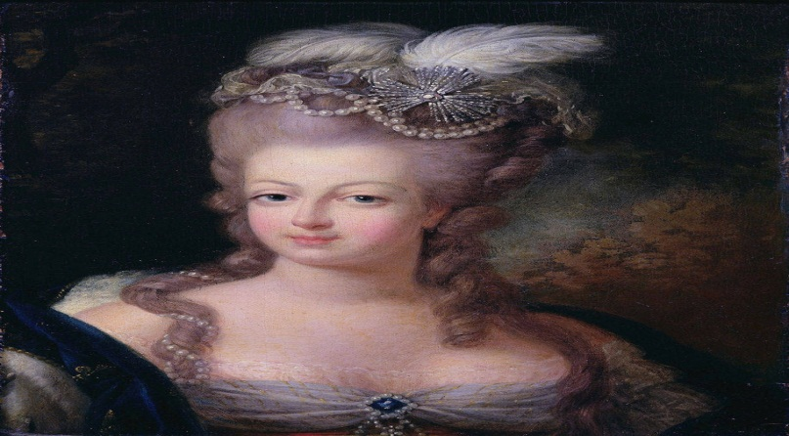

Slide 6
Estate System- Before the revolution, the estates were the social class
1st Estate – the clergy
150,000
owned 15% of the land
paid no taxes
2nd Estate – the nobility
350,000
owned 20% of the land
paid very few taxes
3rd Estate – everyone else
22,500,000- 98% pop
bourgeoisie (middle class) – 8%
sans-culottes (urban workers)
peasants (farmers)
Ms. Ramos

Slide 7
The Three estates
http://www.zunal.com/myaccount/uploads/three_estates_pic.jpg
Ms. Ramos

Slide 8
Louis XVI (1774-1792)
Good-natured but weak and indecisive
Limited intelligence
Lacked self confidence
http://belgianbeershrimper.wordpress.com/people/louis-xvi/
Ms. Ramos

Slide 9
Marie Antoinette
Hapsburg princess
Frivolous, meddlesome, and tactless
http://history.howstuffworks.com/european-history/french-revolution.htm/printable
Ms. Ramos

Slide 10
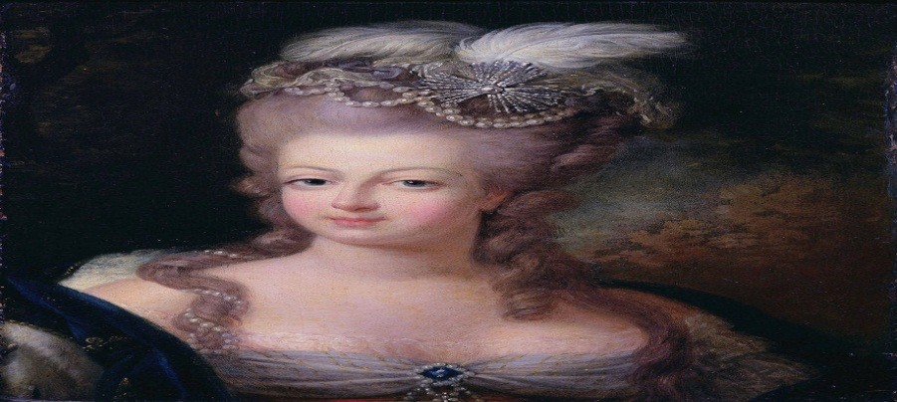
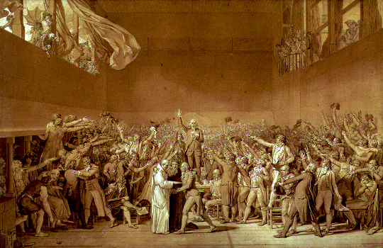
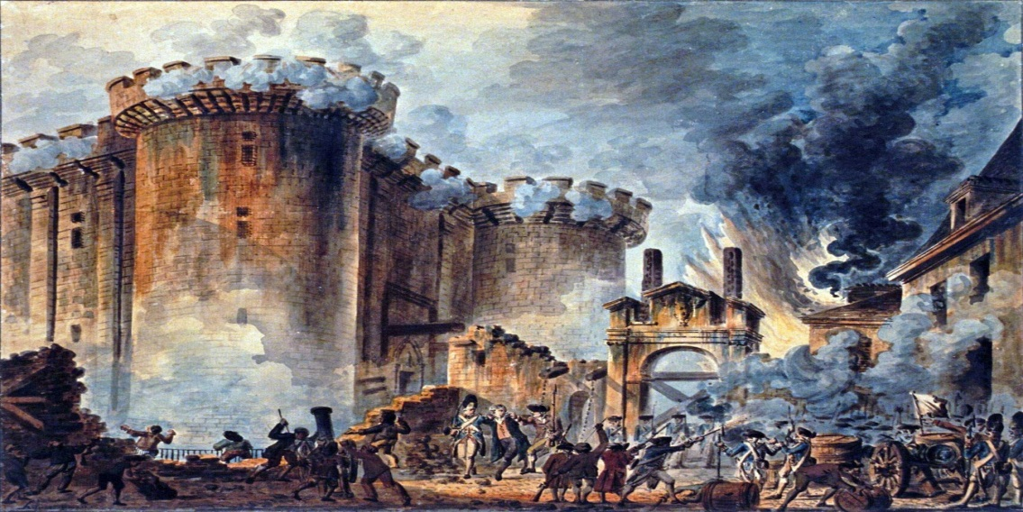
Convocation of Esates
The Tennis Court Oath
The storming of Bastille

Slide 11
Fiscal (Economic)Crisis
The reason why France was ‘poor’ was because of
excessive spending of King Louis XVI.
7 Yrs War & American Revolution
Bad harvest
Failed reforms of Necker(financial advisor)
Ms. Ramos

Slide 12
The French Revolution
The French were greatly influenced by the American Revolution

Slide 13
Revolutionary Beliefs: Liberty, Equality, & Fraternity
The radicals supported the idea of a democracy where all males could vote on the ideals of "liberty, equality, and fraternity"
Individual liberty
Demanded civil equality for all
Concept of fraternity which means all citizens regardless of social class, region, or religion share a common fate in society
Ms. Ramos

Slide 14
Summary

Slide 15
Stages of the French Revolution
1st Stage: National Assembly | Third Estate declares itself the National Assembly, vows to write new Constitution. (1789)
2nd Stage: Limited Monarchy | New Constitution of 1791 limits the monarchy, sets up a representative assembly.
3rd Stage: Radicals | 1792, Radicals take over. Maximillien Robespierre is leader. Reign of Terror, many die as result.
4th Stage: Directory | Moderates return to government. In 1795, five man Directory runs country. Government very weak.
5th Stage: Napoleon | 1799 Coup d'etat... takes control from Directory. 1802 - names himself Emperor of the French. Absolute government again.
Ms. Ramos

Slide 16
Stage 1
National Assembly
Ms. Ramos

Slide 17
Tennis Court Oath
June 20, 1789
Members of Third Estate declared themselves ‘National Assembly’
Attempted to draft a new constitution.
http://history.howstuffworks.com/european-history/french-revolution.htm/printable
Ms. Ramos

Slide 19
Storming of the Bastille
When the 3 estates were still meeting and working out the constitution, the king sends his army into Paris to terrorize the Parisians. Angered parisians attack the Bastille(prison)
http://history.howstuffworks.com/european-history/french-revolution.htm/printable
Ms. Ramos

Slide 20
Storming of the Bastille
Who: Paris mob
What: attack
When: July 1789
Where: prison
Why:
To release 7 revolutionarians
To get the weapons that were hoarded in the Bastille.
http://history.howstuffworks.com/european-history/french-revolution.htm/printable
Ms. Ramos

Slide 21
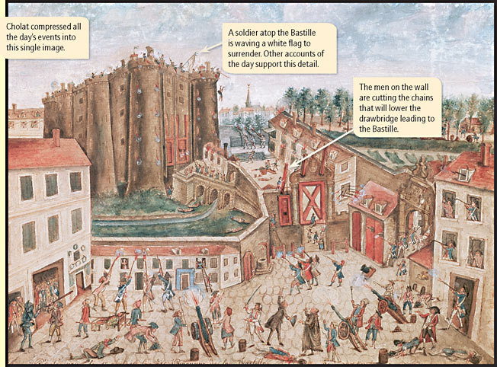
Storming of the Bastille
The fall of the Bastille demonstrated as the popular protest of the French Revolution.

Slide 22
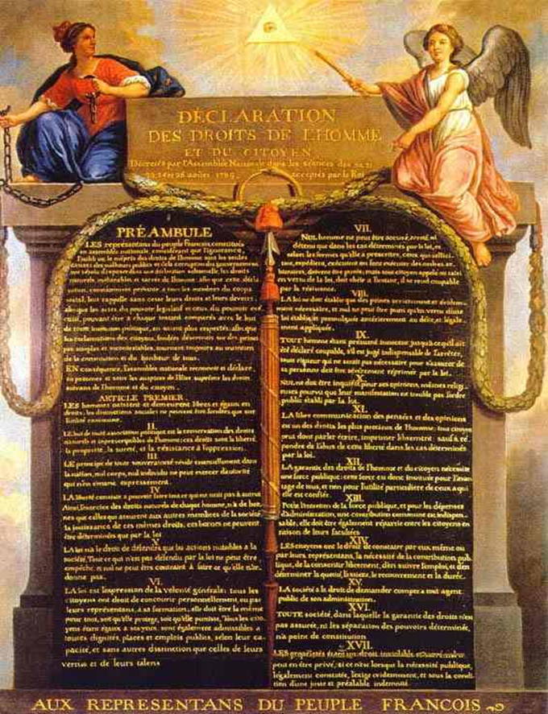
On Aug 1789, the National Assembly voted
to end feudalism
Abolish tithes(taxes)
end special privileges of the nobles and the clergy.
Declaration of the Rights of Man and the Citizen
Women
Slaves
How to impose laws
http://www.lemaze-studio.com/canvas/351002-1342882.htm
NEW
Ms. Ramos

Slide 23
http://history.howstuffworks.com/european-history/french-revolution.htm/printable
On October 5, 1789 mob of women marched from Paris to Versailles
Motivated by famine
Forced royal family to move to Paris
Ms. Ramos

Slide 24
Summary
After the French Revolution, the reign of Louis XVI went from an absolute monarchy to a constitutional monarchy. The establishment of the Declaration of the rights of man and Citizen, a constitution for France, gave power to the 3rd estate.

Slide 25
Stage 2
Limited Monarchy
Ms. Ramos

Slide 26
Constitutional France
National Assembly passed more than 2,000 new laws. (Third Estate)
1791: first constitution, based on a separation of powers.
elected assembly = legislative branch
Courts-judicial branch & King- executive branch
people finally had a say in their govt
Ms. Ramos

Slide 27
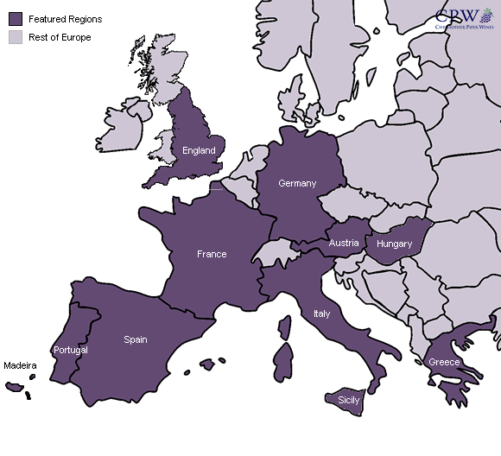
Emmigration of the Nobles

Slide 28
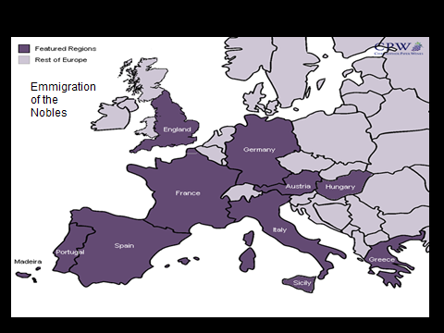
Flight of the King
http://www.photographersdirect.com/buyers/stockphoto.asp?imageid=2282791
June 1791 the royal family flees, but is returned to Paris
Weakens support for monarchy.
Ms. Ramos

Slide 29
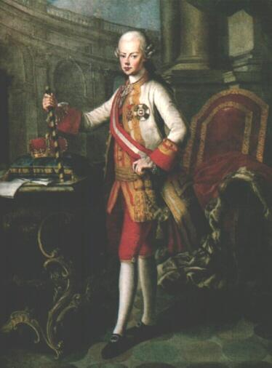
Austria’s Reaction –King Leopold

Slide 30
Austria’s reaction – King Leopold

Slide 31
Prussian and Austrian armies moved to take France
Citizen-soldiers drive them out of France
Radical reformers wanted toremove the King & est a new republic
Angry mobs attacked the King’s Palace
They soon became prisoners of the new government.
Ms. Ramos

Slide 32
The National Assembly became the National Convention & abolished the constitution- France became a republic.
Ms. Ramos

Slide 33
http://www.law.umkc.edu/faculty/projects/ftrials/louis/louisxvilinks.html
National Convention found Louis the XVI of treason & executed him
Ms. Ramos

Slide 34
Stage 3
Radicals and the reign of Terror
Ms. Ramos

Slide 35
Guillotine
http://franceshunter.files.wordpress.com/2010/06/b7e92b81a1c9d779060565cb2ce563bf.png
Ms. Ramos

Slide 36
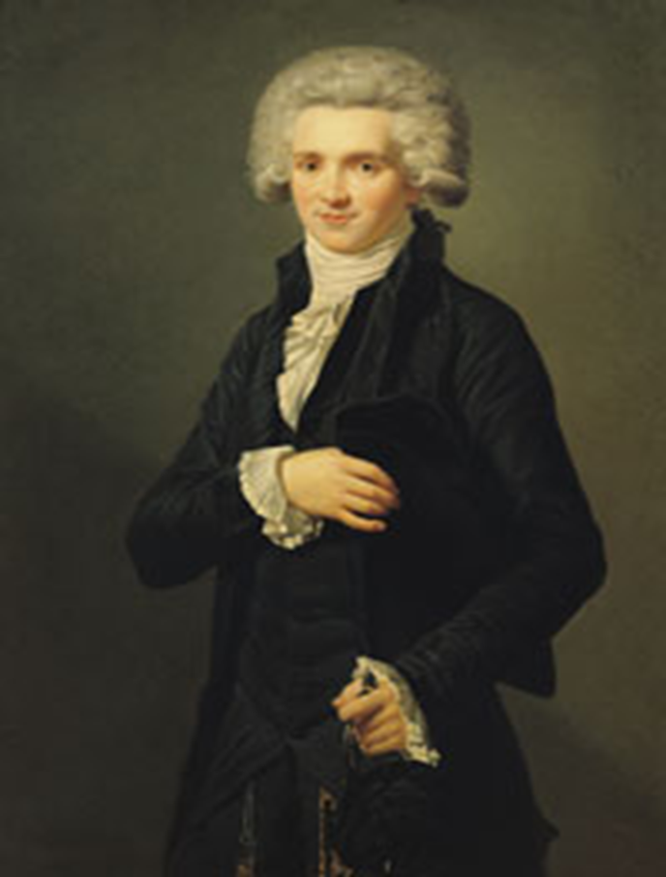
Reign of Terror
The Committee of public safety carried out the Reign of Terror. The leader of the Reign of Terror was Robespierre

Slide 37
http://worldhistoryatyhs.wikispaces.com/French+Revolution
King Louis would be one of 1,000s of victims of the Reign of Terror
Ms. Ramos

Slide 38
http://www.law.umkc.edu/faculty/projects/ftrials/louis/louisxvilinks.html
Marie is executed too
Ms. Ramos

Slide 39
Marie Antoinette's last inscription in her prayer book, which reads, "My God, have pity on me! My eyes have no more tears to cry for you my poor children; adieu! adieu!"
http://history.howstuffworks.com/european-history/french-revolution.htm/printable
Ms. Ramos

Slide 40
The Terror
As many as 40,000 people were executed
It was said the blood ran ankle deep in the heart of Paris
http://tvtropes.org/pmwiki/pmwiki.php/Main/ReignOfTerror
Ms. Ramos

Slide 41
The Terror Ends
As the threat of foreign invasion declined, many of the moderates argued that the Terror had gone to far
Robespierre’s enemies executed him and 12 of his followers and ended the terror.
Ms. Ramos

Slide 42
Stage 4
The Directory
1795-1799
Ms. Ramos

Slide 43
The Bourgeois (middle class)then formed the Directory, which tried to restore order in France
Ms. Ramos

Slide 44
Moderate constitution
Riots suppressed
Corrupt leadership
Chaos threatened
Ms. Ramos

Slide 45
Stage 5
Napoleon
Ms. Ramos

Slide 46
http://worldhistoryatyhs.wikispaces.com/French+Revolution
Ms. Ramos

