Slide 1
AFRICA 600-1450
Unit 3 Section 1

Slide 2
AFRICAN ENVIRONMENTS
The vast & diverse continent of Africa is home to many different cultures
During the period 600-1450 these cultures forged Africa's social, religious, and economic relationships with other cultures both within the continent and beyond
Africa cannot be looked at monolithically – throughout the continent similarities and differences abound
Likewise, dramatic changes brought about by trade are as visible as the cultural continuities.

Slide 3
AFRICAN ENVIRONMENTS
Building on generations of experience, the peoples of Africa used various techniques to adapt to the differing environments and climates of the continent, which produced incredible diversity among societies by 1200.
Africa is almost entirely in the tropical zone of the earth, and its cycles are rainy and dry seasons rather than hot and cold seasons
No matter what the climates (grassland, dense tropical rain forests of West & Central Africa or desert) – Africans were able to produce food
Most Africans lived in the moderate areas where some rainfall would be expected
Some were in settled agricultural societies
Others formed pastoral societies
The remaining were hunting, gathering and fishing

Slide 4
AFRICAN ENVIRONMENTS
The importance of African rivers cannot be overstated:
The Nile – which flows from central Africa to the north
The Niger in West Africa
The Zambezi in the south and the central African Congo
As well as large bodies of water which supported trading cities and smaller communities
By 1200 agriculture had been the dominant enterprise for centuries
Regional exchange of plants, fruits, and crops occurred thanks in part to the Bantu migrations, which brought grains and other plants south from West Africa
A larger network of trade brought products like bananas and yams to Africa from Southeast Asia and carried African exports to other regions
Example: Ethiopian coffee to the Middle East

Slide 6
PRECIOUS METALS
Another great strength of the African tropical regions was the mining of precious metals
Skillful craftsmen worked metal into a variety of objects
Copper and gold were the most valuable metals, but iron, the most plentiful metal in tropical Africa, was especially important
Made into hoes, axes, and knives for farming
Made into spears and arrows for hunting
Made into needles and nails for day-to-day life
Copper, plentiful in southeastern Africa, was used to make copper wire and decorative objects
Some of the most famous art coming out of West Africa were the copper and brass statues of the period dating to 1500
Gold became incredibly profitable as an export, particularly to India
Sources of gold were the Niger River and the hills south of the Zambezi River – archeologists have found thousands of mine shafts for mining of gold

Slide 7
Benin Bronze Sculpture
Examine this sculpture using Optic

Slide 8
NEW ISLAMIC EMPIRES IN AFRICA
The spread of Islam across North Africa and down into sub-Saharan Africa is one of the key developments of the period, both culturally and economically
North Africa was under Muslim rule by the 8th Century
Only gradually did Islam spread to sub-Saharan Africa, the land south of the Sahara Desert known to the Arabs as bilad al-sudan, “land of the blacks”
Muslim Berbers conquered Ghana in 1076;
The subsequent empire of Mali, which flourished from 1200-1500, was one of the richest and largest Muslim states, rivaled only by the Delhi Sultanate of India

Slide 9
Basics of ISLAM
Islam means “surrender” or “submission to the will of God”
Believers are Muslims – “one who submits”
God is Allah – same entity that would be the Jewish Yahweh or Jehovah, and the same entity that is the Christian God

Slide 10
More Basics
Founder
Key Info for Islam & Impact on Africa
Muhammad – “praised one”
Prophet of Islam that received what later became the Qur’an and then shared this message with the Arabian people
Considered by Muslims to be the final messenger of god
Began in Arabia (more discussion of the religion in Middle East Section)
Monotheistic Faith
5 pillars of Faith are required of the observant Muslims
Mosques (house of worship) advocated education
Increased literacy (both Arabic & local languages) and use of books
Expansion of study of science and medicine

Slide 11
SPREAD OF RELIGION
Other religions had influence as well;
In East Africa, Christianity maintained a stronghold in Ethiopia although the Christian Nubian kingdoms along the upper Nile conquered in the name of Islam
However, throughout the whole of Sub-Saharan region, and the east coast of Africa in particular, most Africans were introduced to Islam peacefully
Economic interaction produced personal relationships that in turn provided opportunities for conversion
The teachings of Islam and Islamic methods of managing empires and cities appealed to African merchants and political leaders

Slide 12
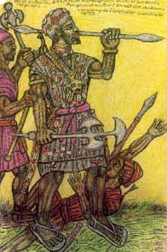
ADOPTION OF ISLAM
The 1st Sub-Saharan place where Islam was adopted was Takrur, in 1030
By 1200, King Sumanguru had increased the status of Takrur and in 1240, Sundiata of the Manlinke people defeated Sumanguru
Both Sumanguru and Sundiata were Muslims who had peacefully converted to Islam before the empire was established
Sundiata’s continued conquests brought about the birth of the Mali Empire

Slide 13
Mali Empire and Wealth
Like many other earlier & contemporary Muslim empires, Mali’s wealth derived largely from trade – not only from the sale of goods but also from the strategic control of the actual trade routes
As in Ghana, agriculture met basic needs; again, a river was the source of both physical & economic life
But Mali, with the trading area of the upper Niger as well as the gold fields of the Niger, controlled even more precious territory than Ghana did
Mali also had strong Muslim political and merchant classes that interacted well with North African Muslim traders
This combination of strategic control of key economic resources and established trading relationships brought astronomical wealth to the empire
Mansa Kankan Musa, who ruled Mali from 1312 – 1337, took so much gold with him on a pilgrimage to Mecca in 1324 that the value of gold in Cairo was reduced for years to come.

Slide 14
MANSA MUSA & IBN BATTUTA
http://www.youtube.com/watch?v=4TWOIkEygWM – Mansa Musa Video
Mansa Kankan Musa’s rule illustrates both Mali’s wealth and the extent to which Islam permeated all aspects of administrative life, from law to military systems.
Upon return from his pilgrimage, Musa sponsored the building of schools in many of the cities of the empire, and his successors ran a government that was praised for its effectiveness
One of the reasons historians know so much about Mali is because of the journals of ibn Battuta (1304-1369), a Muslim Scholar from Morocco
He journeyed to Mecca to complete the Hajj (pilgrimage to Mecca, the home of the prophet) and went on to explore the Muslim world in the Middle East, Africa, and Asia, traveling 75,000 miles in 29 years
His insights as the most traveled man of his time are invaluable in describing the Muslim world.
When ibn Battuta visited Mali, he credited the leadership of Mansa Suleiman, Mansa Kankan Musa’s successor, with the peace that permeated all the territories of the empire

Slide 15
FALL OF THE MALI
Unfortunately that peace did not last
The rule of Suleiman’s successors opened the way for revolt by the various peoples who resented their domination by the Malinke
The Tuareg people sacked the great city of Timbuktu in 1433, and by 1500 Mali was reduced to the home territory of the Malinke

Slide 16
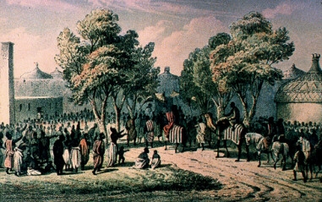
SPREAD OF ISLAM CONTINUES
The spread of Islam continued into central Africa despite the end of Mali
Example: the leaders of the Hausa city-states in central Sudan converted and made Islam their official religion
Kanem-Bornu, also in central Sudan, was another huge empire that continued to spread Islam in the late 15th century.

Slide 17
INDIAN OCEAN TRADE NETWORK
Between 1200 and 1500, the Indian Ocean trade network was the richest of the maritime trading routes.
Much of this growth was spurred by the development of wealthy states in Europe, Asia, and Africa at the time
In addition, the Indian Ocean trade network grew in prominence with the end of the Mongol Empire.
Once Mongol control was gone, and with it the guarantee of a smooth overland flow of goods, the maritime trade routes became more important
The Indian Ocean trade network connected Africa, Europe, Asia and the Middle East in layers of communication that brought a large part of the world together on an unprecedented scale, and it fostered the spread of Islam

Slide 18
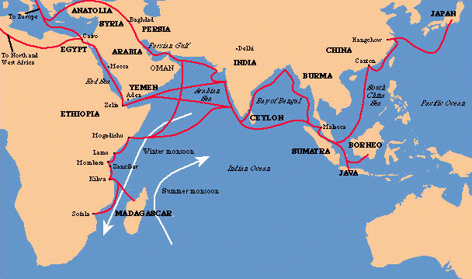

Slide 19
AFRICA & THE INDIAN OCEAN TRADE
Africa played a major role in this trade network
By 1500, between 30-40 city-states (Kilwa, Mombasa, & Mogadishu) grew up along the east coast thanks to Indian Ocean trade.
Ibn Battuta visited Kilwa and marveled at its beauty as well as the devotion to Islam
This thriving coast of trade became known as the Swahili Coast
Arabs & Persians called the people there “Swahili” after the Arabic sawahil al-sudan, which means “shores of the blacks”
This name is a great example of the interaction among different peoples that occurred along the Indian Ocean basin

Slide 20
GREAT ZIMBABWE
Cities on the Swahili Coast prospered in part because of the trade in gold, which came further inland, in southern portions of the continent
A state known as Great Zimbabwe, after the name of the capital city, relied on farming and cattle herding, but it also had considerable control of the gold trade south of the Zambezi River
Trade, first regional and then as part of the larger Indian Ocean trade network, brought real economic prosperity to Great Zimbabwe
Zimbabwe is known for massive stone structures build for the elite and to enclose the king’s court.
Zimbabwe declined in the 15th Century

Slide 21
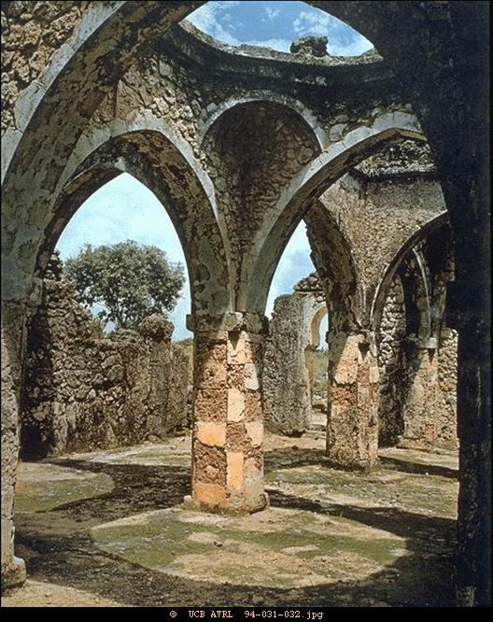
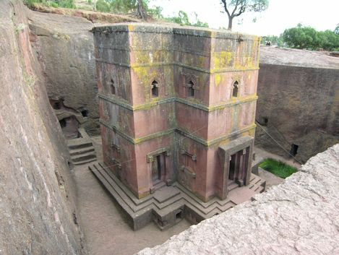
ISLAM ACROSS AFRICA
Although Islamic beliefs had a significant impact on society and culture in Africa, local cultures continued to thrive and sustain the diversity of the dynamic Sub-Saharan Africa
Local cultures also influenced the way outside religions were adapted in various regions and states
Example: Mosques in Africa were based on Middle Eastern designs but used materials local to the region
A mosque in West Africa did not look like a mosque on the Swahili coast
Christian churches also reflected diverse building styles

Slide 22
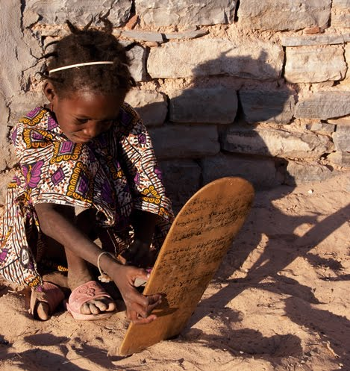
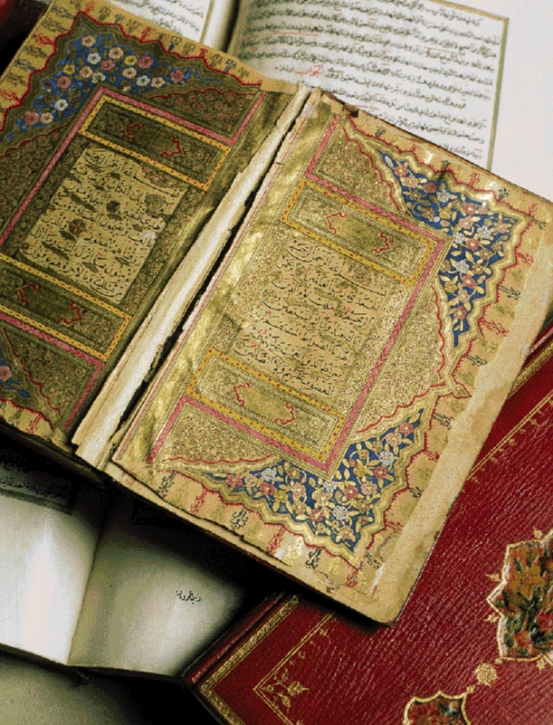
LEARNING LINKED TO RELIGION
Mosques and Churches were both houses of worship and centers of education
The spread of Islam in sub-Saharan Africa went hand in hand with an increase in literacy, first in Arabic and then in local languages written in Arabic characters
Islamic scholarship flourished in sub-Saharan Africa
In the West African city of Timbuktu, learning was so valued that books were among the hottest trading commodities

Slide 23
SLAVERY
With the increase in wealth came the growth of elite classes- and the demand for those to serve the elites
Mali, Bornu, and Ethiopia all participated in selling and transporting slaves across Africa and into the Middle East, India, and even China
It is estimated that some 2.5 million Africans crossed the Sahara and Red Sea as slaves between 1200 and 1500
The slavery that these Africans experienced was different from the slavery experienced under Europeans in later centuries.
These slaves had some opportunities to advance
Although some slaves did work like mining, most were trained to specialize in a service
As a result, some slaves became powerful & wealthy because of their military ability or other skills
For example: a slave general took power in the Songhai Empire, which succeeded the Mali Empire
Female slaves were household servants or concubines and some male slaves became eunuchs

Slide 24
WOMEN IN AFRICA
Women in tropical Africa had many roles
They farmed,
transported food, water and other materials needed for cooking,
made clay vessels for household purposes,
bought and sold food and crafts at markets
The impact of Islam on women in sub-Saharan Africa varied, reflecting the influence of local traditions and customs
Traveling in Mali, ibn Battuta was startled to see that women did not completely cover their bodies and veil their faces when in public and interacted with men who were not their husbands or family members
Islam’s influence on women throughout Africa was largely dependent upon the cultural traditions of the region

