Slide 1
The Age of European Exploration
What drove European voyages of discovery? What effects did these voyages have on Europe?

Slide 2
Beginning in the late 15th century, European explorers began venturing out into the world.
The explorers were primarily driven by economic motives – desire for wealth.
Gold and spices were the two most valuable commodities.
Received commissions from monarchs, looking to increase their own wealth and gain more prestige (national rivalry)
For many (the Pope), religion was also a motivating factor – desire for converts, Kingdom of Prester John, desire to compete with Muslim Ottomans/Venetians for trade.

Slide 3
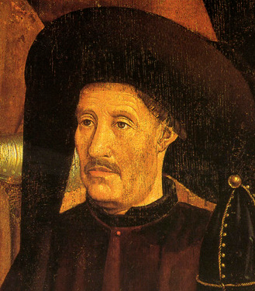
The Portuguese
Prince Henry “the Navigator”
Sponsored explorers who began sailing down the coast of Africa (gold, spices, god)
Traded slaves
Pope granted Portugal all revenues from Africa and Asia
1487 - Bartholomew Diaz rounds Cape of Good Hope
1498 – Vasco da Gama reaches India

Slide 4
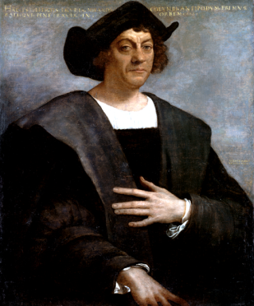
The Spanish
Genoese captain Christopher Columbus, ie. Cristoforo Colombo, Cristóbal Colón, convinced Ferdinand and Isabella to sponsor a trip to the East – by going West.
F and I had just completed the Reconquista, now hoped to outflank the Portuguese spice trade
Didn’t really expect him to return
He arrived in the Caribbean, convinced it was Asia
Amerigo Vespucci and Magellan continued to expand European reach.

Slide 5
Spanish Conquest
The Spanish defeated indigenous people of Central and South America by allying with other groups, using more advanced weaponry, and though effects of disease.
Cortes – Aztecs
Pizarro – Incas
Catholic Church became most powerful institution in the Americas.

Slide 6
Results
Wealth solidified Spanish power:
Mining: quinto (1/5 of revenue to the crown)
Agriculture: Hacienda/Plantation
Labour: Encomienda/Repartimiento, debt peonage, slavery
Other nations began to sponsor expeditions, fueling an economic boom (and inflation)
Introduction of non-native plant and animal species
Spread of disease (syphilis, measles, smallpox, etc.)
Economic and social disaster for Native Americans
Increased skepticism of ancient sources
Expansion of gov’t investment in industry
Increase in capitalism (and corruption)

