Slide 1
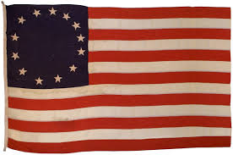
The American Revolution
1775 - 1781

Slide 2
Pre-Revolutionary America
13 Colonies – Claimed by Great Britain & King George III
Spain controlled most of North America West of Mississippi River

Slide 3
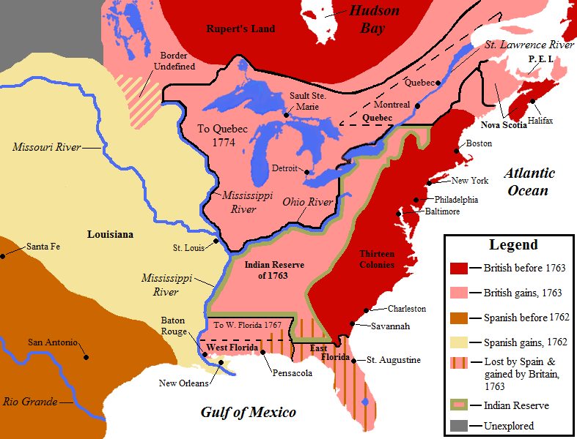
American before the War

Slide 4
Mo’ Money…
England starts to tax the colonies
Colonists felt their rights were being violated, because the English Bill of Rights said only Parliament can levy taxes
The colonists had no representatives in Parliament
The colonists felt their natural rights had been violated

Slide 5
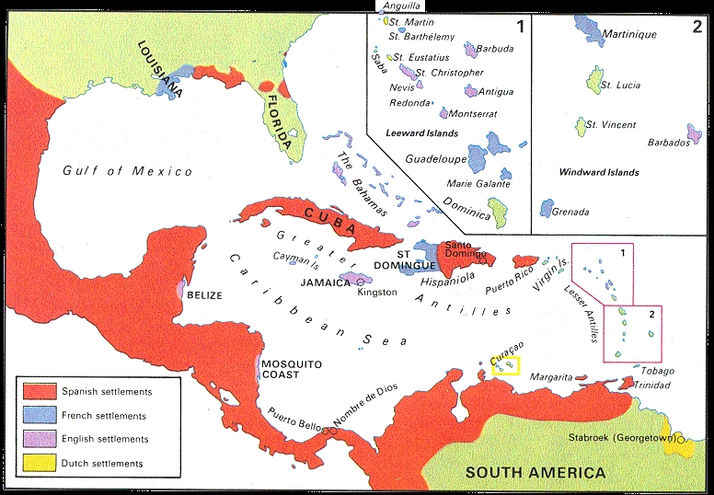
Mo’ Problems
Great Britain also controls Jamaica & most trade in the region

Slide 6
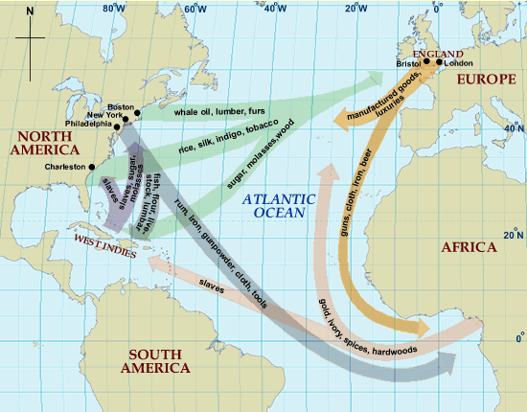
Golden Triangle

Slide 7
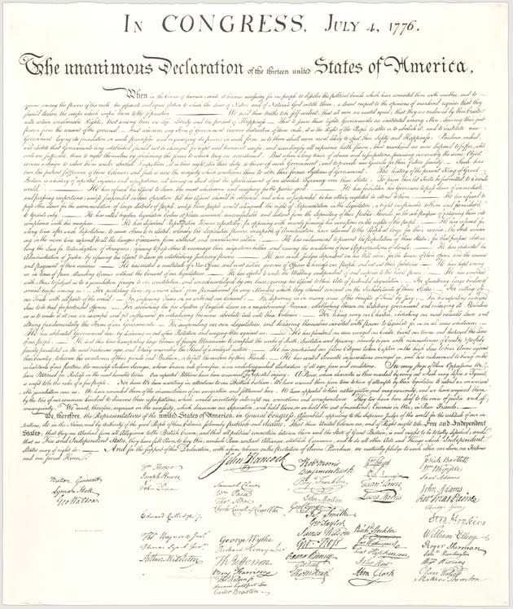
Declaration of War / Independence
On July 4, 1776, the Second Continental Congress approved the Declaration of Independence written by Thomas Jefferson
Declared men had Unalienable Rights of life, liberty, and the pursuit of happiness – Based on John Locke
The document claimed Great Britain had violated the people’s rights

Slide 8
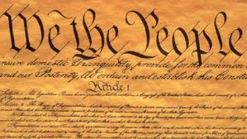
Impact of American Revolution: Constitution & Bill of Rights
The Constitution is a document detailing how the U.S. Government works
The American colonists also wanted to be sure that there were written guarantees defining the limits of the government and the rights of the individual
The Bill of Rights (First 10 Amendments) was adopted to amend the Constitution & protect individual rights of citizens – Influenced by English Bill of Rights & Magna Carta

Slide 9
Impact of the American Revolution: Aftermath
American Revolution is the first revolution that says people have rights
Fought over rights of men, taxes, and representation
Revolutions in France, Latin America, and South America followed
US Constitution becomes the inspiration for new governments around the world
America & Spain claim New Orleans and Northwestern Florida in 1783

