Slide 1
The Enlightenment
The Enlightenment was an intellectual movement that began in France
It was an intellectual movement that stressed reason and thought

Slide 2
Origins of the French Enlightenment
The roots of this French Enlightenment lay largely in resentment and discontent over the decadence of the French monarchy in the late 1600s.
Louis XIV and later kings were tyrannical rulers & they believed their rule was a Divine Right

Slide 3
The Scientific Revolution
During the Scientific Revolution, European thinkers tore down the flawed set of “scientific” beliefs maintained by the Church.
Scholars sought to discover New Ways of thinking about the natural world. Based on observation and a willingness to question accepted beliefs.

Slide 4
John Locke
He believed all humans were endowed with natural rights: rights you’re were born with.
People had a right to Life, Liberty & Property
Monarchs were not chosen by god
His ideas influenced U.S. Constitution, Declaration of Independence, & French Revolution

Slide 5
Baron de Montesquieu
He believed in 3 Branches of Government for England:
Executive (the monarch)
Legislative (Parliament)
Judicial (the courts of law)

Slide 6
Montesquieu
Believed government needed Separation of Powers
Each branch of government has its own set of powers

Slide 7
Montesquieu
Believed government should function through Checks & Balances
Branches of government cannot execute orders without other branches of government

Slide 8
Jean-Jacques Rousseau
Rousseau’s social contract was an agreement between Society & Government
In Rousseau’s theory, General Will represents what is best for the entire community
His ideas influenced the French Revolution

Slide 9
Thomas Hobbes
Wrote Leviathan, believed that Humans were naturally selfish & wicked
Without a strong government (Monarchy) there would be “war…of every man against every man, and life would be “solitary, poor, nasty, brutish & short.”

Slide 10
Mary Wollstonecraft
First advocate for Women’s Rights
Believed that society kept women in the role of ‘convenient domestic slaves’, and denied them economic independence

Slide 11
Voltaire
Enlightenment thinker who used Satire to lash out at the Clergy, Aristocracy, & the Government
Huge advocate for Tolerance, Reason, Freedom of Religion & Speech
Huge influence in U.S. Bill of Rights & French Declaration of Man and Citizen

Slide 12
Simon Bolivar
Led the colonies of South America to revolt against Spain
Believed in a Strong Central Government

Slide 13
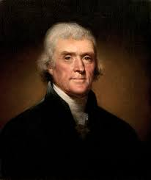
Thomas Jefferson
Founding Father
Architect of the Declaration of Independence
3rd President of the United States

Slide 14
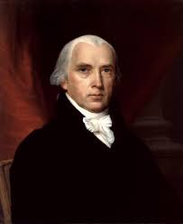
James Madison
Founding Father
Architect of the U.S. Constitution
Chief provider of the U.S. Bill of Rights (First 10 Amendments of Constitution)
4th President of the United States

Slide 15
Sir Isaac Newton
Scientist which created “Newton’s 3 Laws”
Changed the way how we understand the Universe

Slide 16
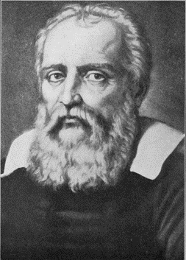
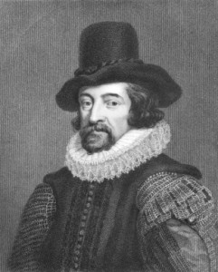
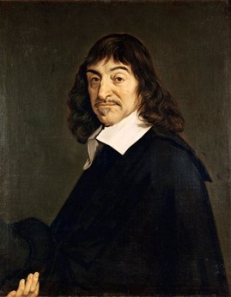
Galileo/Kepler Bacon/Descartes
Galileo Galilei (1564–1642) stated that the sun, not the earth, was the center of the solar system
Johannes Kepler (1571–1630) created laws of planetary motion, and that the planets moved in elliptical orbits
Francis Bacon (1561–1626) created the modern version of the Scientific Method
René Descartes (1596–1650), philosopher who said, “I think, therefore I am” - asserting that, he was at least a thinking being

