Slide 1
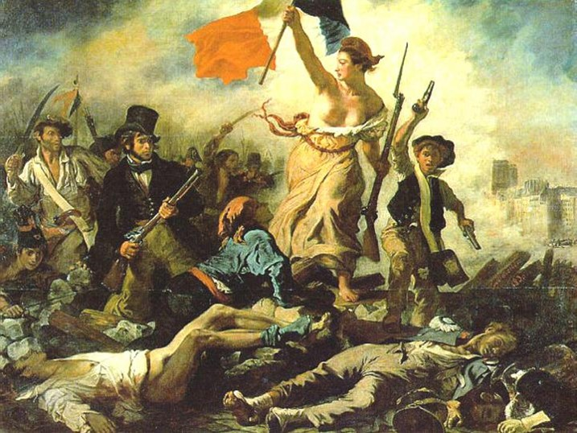

Slide 2
French Revolution
10.2 French Revolution and its effects worldwide on political expectations for self-government & individual liberty
10.2.4 Explain how the ideology of the French Revolution led France to develop from constitutional monarchy to democratic despotism to the Napoleonic empire.

Slide 3
Influence of Enlightenment & U.S. Revolution
Q: What kind of gov’t did Enlightened thinkers like Locke, Montesquieu, Voltaire, and Jefferson NOT like? What kind did they like?
Q: What did Locke, and then Jefferson in the Declaration of Independence, say people should do if the gov’t doesn’t protect their rights?
Q: What would the Enlightenment & the American Revolution influence the French to do if they were unhappy with their gov’t?
They want democracy & willing to revolt to get it.

Slide 4
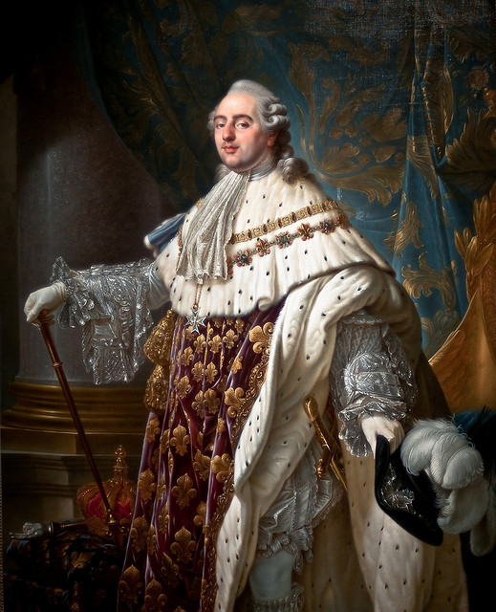
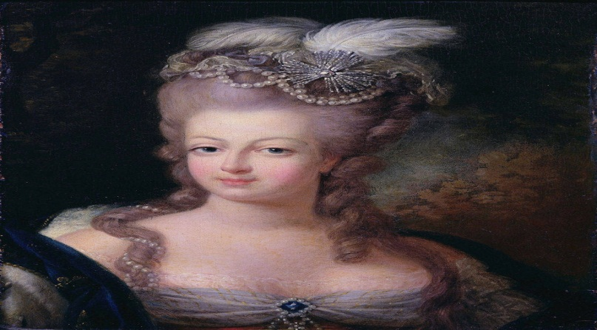

Slide 5
Estate System: Before the revolution, the Estates were the social class
1st Estate – the clergy
150,000
owned 15% of the land
paid no taxes
2nd Estate – the nobility
350,000
owned 20% of the land
paid very few taxes
3rd Estate – everyone else
22,500,000- 98% population
bourgeoisie (middle class) – 8%
sans-culottes (urban workers)
peasants (farmers)

Slide 6
The Three Estates

Slide 7
King Louis XVI
Good-natured but weak and indecisive
Limited intelligence
Lacked self confidence

Slide 8
Marie Antoinette
Habsburg Princess of Austria
Frivolous, aloof, meddlesome, & tactless

Slide 9
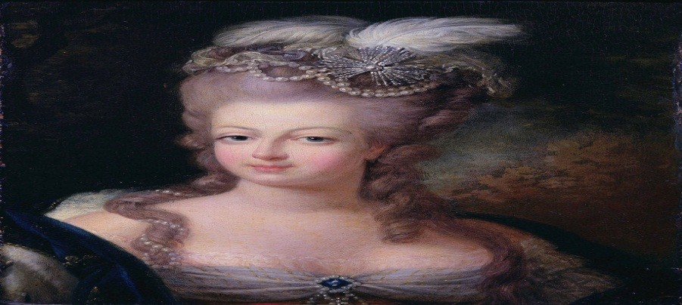
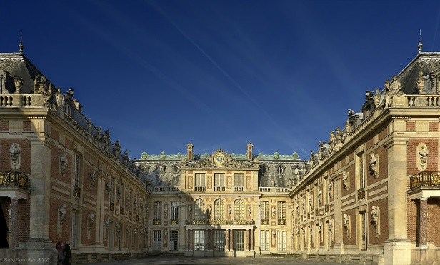
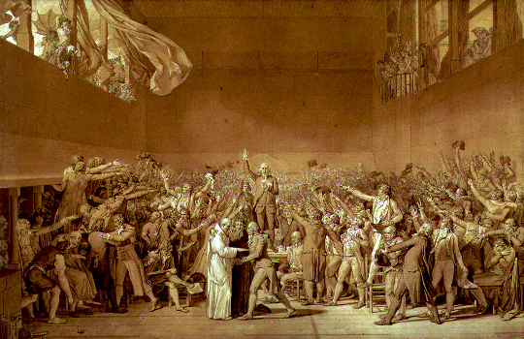
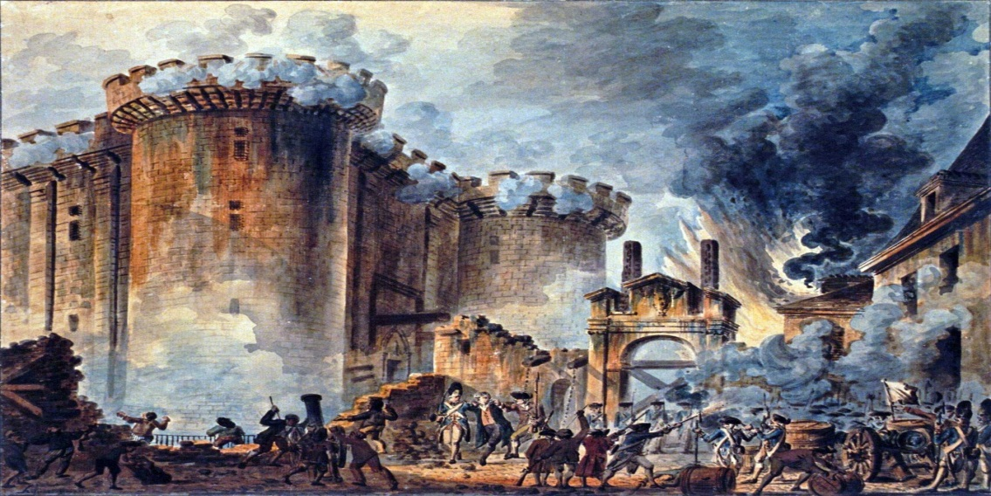
FRANCE
Royal Family
Versailles Palace
Tennis Court Oath
Storming of the Bastille

Slide 10
Fiscal (Economic) Crisis
The reason why France was ‘poor’ was because of:
Excessive spending of King Louis XVI
7 Yrs War & American Revolution
Bad harvest
Failed reforms (Jacques Necker)

Slide 11
Meeting of the Estates-General
King Louis XVI called for a meeting of the Estates-General at the urging of Jacques Necker
Louis called for a tax on the rich to help alleviate the debt in France
The 1st & 2nd Estate voted down the tax proposal
3rd Estate was Outraged

Slide 12
The French were greatly influenced by the American Revolution

Slide 13
Revolutionary Beliefs: Liberty, Equality, & Fraternity
The radicals supported the idea of a democracy where all males could vote on the ideals of "liberty, equality, and fraternity"
Individual liberty
Demanded civil equality for all
Concept of fraternity which means all citizens regardless of social class, region, or religion share a common fate in society

Slide 14
Summary
3 Estates [1st:Clergy, 2nd:Nobility, 3rd: Middle Class/Sans-Culottes (Urban Workers)/Peasants (Farmers)]
Excessive spending by the King, Helping USA, Starvation, Bad Gov’t
Spurred by the USA Revolution & Enlightenment thinkers, the French people believed in liberty, equality, and fraternity

Slide 15
Stages of the French Revolution
1st Stage: National Assembly | Third Estate declares itself the National Assembly, vows to write new Constitution. (1789)
2nd Stage: Limited Monarchy | New Constitution of 1791 limits the monarchy, sets up a representative assembly.
3rd Stage: Radicals | 1792, Radicals take over. Maximillien Robespierre is leader. Reign of Terror, many die as result.
4th Stage: Directory | Moderates return to government. In 1795, five man Directory runs country. Government very weak.
5th Stage: Napoleon | 1799 Coup d'etat... takes control from Directory. 1802 - names himself Emperor of the French. Absolute government again.

Slide 16
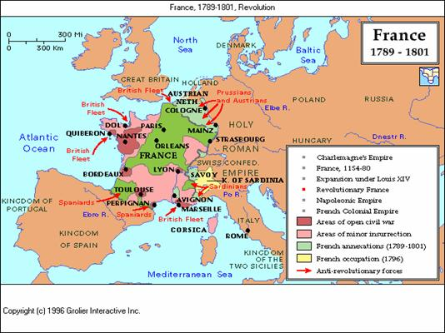

Slide 17
Stage 1
National Assembly

Slide 18
Tennis Court Oath
Members of Third Estate upset with medieval rules & lack of representation declared themselves “National Assembly” to pass laws & reforms
Attempted to draft a new constitution.

Slide 19
Storming of the Bastille
The Paris mob, hungry, because of the lack of food from poor harvests, took the law into their own hands.
On July 14th, 1789, the mob rioted and attacked the royal fortress prison called the Bastille

Slide 20
Storming of the Bastille
Who: 3rd Estate
What: Prison
When: July 1789
Where: Paris
Why:
To release 7 revolutionaries
To get the weapons that were hoarded in the Bastille.

Slide 21
Storming of the Bastille
This was the 1st Major Protest starting the Revolution
The Paris mob thought the Bastille as a symbol of the King’s power & Government.
The Paris mob killed the governor of the prison, Marquis de Launay. The Soldiers in and around Paris refused to stop the attack, showing that King Louis XVI had also lost control of the army.

Slide 22
Women March on Versailles
Fed up with the extravagance of the Royal Family, women of the mob marched on Versailles
The mob forced the Royal Family to move to Paris to sign an Oath of Loyalty

Slide 23
National Assembly
Declaration of the Rights of Man and the Citizen:
Created Due Process in Judicial matters
Sovereignty of All Frenchmen
Freedom of the Press & Speech affirmed
Did NOT address…
Women
Slaves
How to impose laws

Slide 24
Summary
During the French Revolution, the reign of Louis XVI went from an absolute monarchy to a constitutional monarchy.
The establishment of the Declaration of the rights of Man and Citizen, a constitution for France, gave power to the 3rd estate.

Slide 25
Stage 2
Limited Monarchy

Slide 26
Constitutional Monarchy of France
National Assembly passed more than 2,000 new laws. (Third Estate)
1791: first constitution, based on a Separation of Powers.
Elected Assembly = Legislative Branch
Courts - Judicial Branch & King - Executive Branch
Radicals supported the idea of Democracy where all males could vote

Slide 27
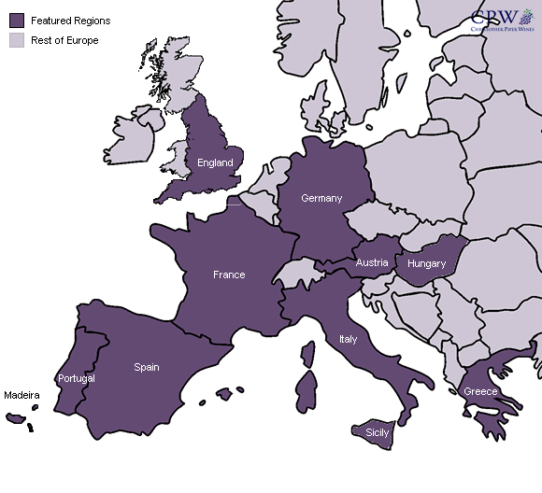
Emigration of the Nobles

Slide 28
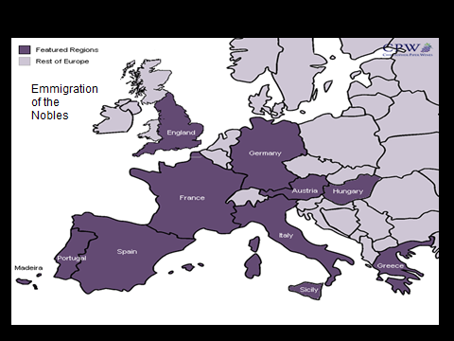
Flight of the King
The mob captured Louis XVI and his family, and imprisoned him in the Tuileries Palace in Paris
Forced King Louis to sign an Oath of Loyalty

Slide 29
Flight of the King
Louis attempted to escape to Austria, ruled by Marie’s brother
Louis was recognized on the route to Varennes, and Louis and his family was captured and brought back to Paris.

Slide 30
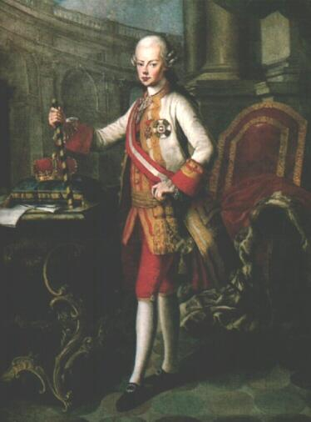
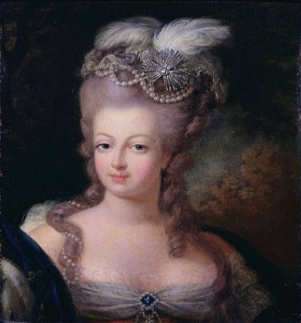
Austria’s Reaction –King Leopold

Slide 31
Austria’s reaction – King Leopold

Slide 32
War is Imminent
Prussian and Austrian armies moved to take France
Citizen-soldiers drive them out of France
Radical reformers wanted to remove the King & establish a new republic
Angry mobs attacked the King’s Palace
They soon became prisoners of the new government.

Slide 33
Change of Government
The National Assembly became the National Convention & abolished the constitution- France became a republic.
Absolute Monarchy
Republic
Constitutional Monarchy

Slide 34
Beginning of the Reign of Terror
National Convention found Louis XVI guilty of treason & sentenced him to Execution

Slide 35
Stage 3
Radicals and the Reign of Terror

Slide 36
Guillotine

Slide 37
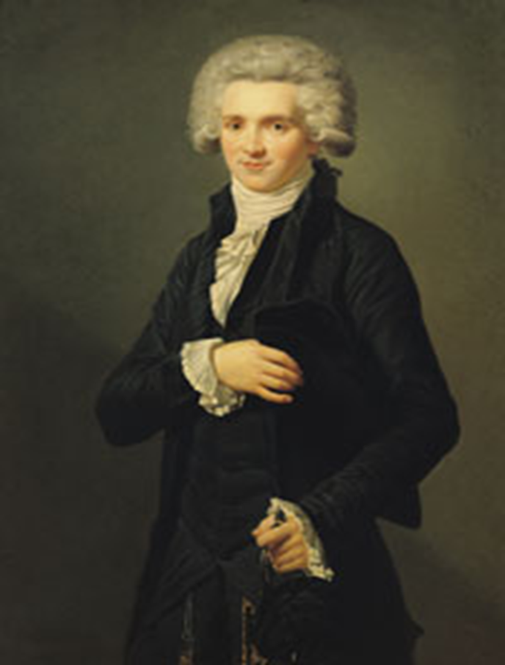
Reign of Terror
The Committee of Public Safety carried out the Reign of Terror. The leader of the Reign of Terror was Maximillien Robespierre

Slide 38
Death of the Royals
King Louis would be one of 1,000s of victims of the Reign of Terror

Slide 39
Marie Antoinette Convicted
Marie was later sentenced to death

Slide 40
Marie Antoinette's last inscription in her prayer book, which reads, "My God, have pity on me! My eyes have no more tears to cry for you my poor children; adieu! adieu!"

Slide 41
The Reign of Terror
As many as 40,000 people were executed
It was said the blood ran ankle deep in the heart of Paris
http://tvtropes.org/pmwiki/pmwiki.php/Main/ReignOfTerror

Slide 42
The Terror Ends
As the threat of foreign invasion declined, many of the moderates argued that the Terror had gone too far
Robespierre’s enemies executed him and 12 of his followers and ended the terror.

Slide 43
Stage 4
The Directory
1795-1799

Slide 44
The Bourgeois (middle class) then formed the Directory, which tried to restore order in France

Slide 45
Moderate constitution
Riots suppressed
Corrupt leadership
Chaos threatened
10 years of Chaos

Slide 46
Stage 5
Napoleon

Slide 47
Rise of a Conqueror

