Slide 1
FRENCH REVOLUTION
GALLERY WALK QUIZ

Slide 2
Instructions
Take out a Sheet of Paper & # 1 – 15
PUT YOUR NAME ON TOP
Skip 5 lines between ea. Number
You get 4 minutes/slide to write the following…
- ID Who/What Picture
- Write 3 Bullet Points to Summarize Event/Person
- Why are they important?

Slide 3
Slide 1

Slide 4
Slide 2

Slide 5
Slide 3

Slide 6
Slide 4

Slide 7
Slide 5

Slide 8
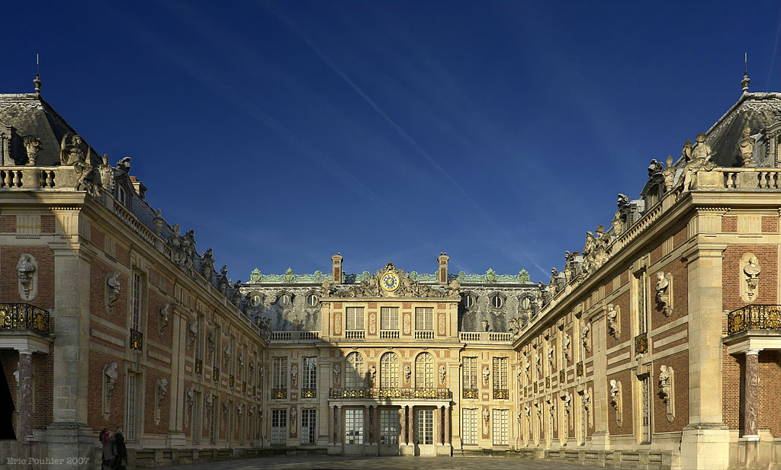
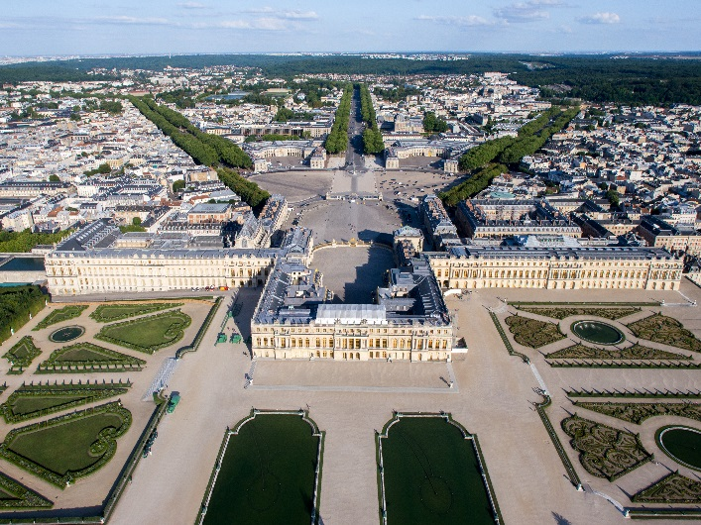
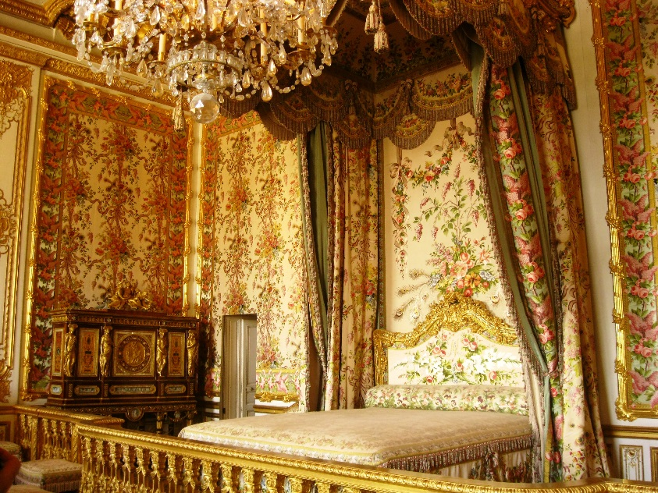
Slide 6

Slide 9
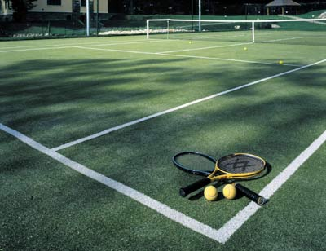
Slide 7

Slide 10
Slide 8

Slide 11
Slide 9

Slide 12
Slide 10

Slide 13
Slide 11

Slide 14
Slide 12

Slide 15
Slide 13

Slide 16
Slide 14

Slide 17
Slide 15

