Slide 1
Industrial revolution
DBQ TUTORIAL

Slide 2
PDF Document
http://www.archives.gov/education/lessons/worksheets/photo_analysis_worksheet.pdf
Please Click the above link for this assignment

Slide 3
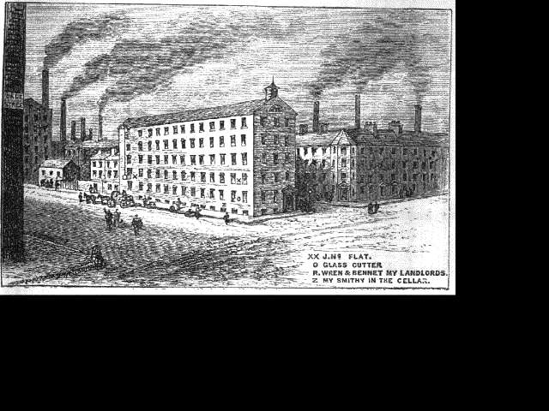

Slide 4
Assignment
Fill out the PDF for the following picture. Write a 1 page document describing what you saw in the picture. Use the information from the PDF & Text (Chpt 9 pg. 284 – 6) to answer the Essential Question:
How did Industrialization change the Textile Industry?
Labor Conditions / Production / Social Culture

Slide 5
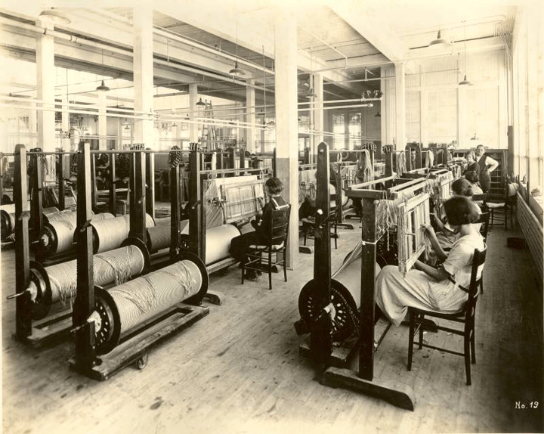
Pg. 285

