Slide 1
California General Election (But we will have the Mock Election here at J Hills) ☺
When – October 22, 2014
Where- In your homeroom class

Slide 2
Who are the CALIFORNIA CANDIDATES to grab the GOVERNOR’S SEAT?

Slide 3
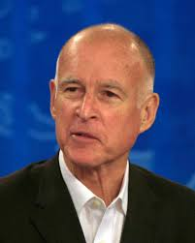
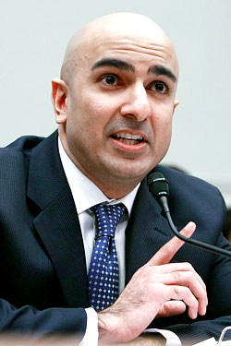
For GOVENORSHIP
“Jerry” Brown – Democratic
Neel Kashkari – Republican
A banker by trade, Kashkari served as Assistant U.S. Secretary of the Treasury for Financial Stability from October 2008 to May 2009. He currently works as an investment firm executive.
Current California governor since January 3, 2011. He had been previously elected governor in 1974 and had served two terms

Slide 4
PROPOSITION SUMMARIES
1, 2, 46 and 47

Slide 5
Prop 1 – Water Bond Authorizes $7.54 billions in bonds for state water supply projects for things such as water storage, ecosystem and watershed protection and restoration, and drinking water protection.
CON – California can’t afford Prop. 1’s misplaced spending. Does little to relieve the drought or improve regional water self-sufficiency. It threatens our rivers & streams. Private water users won’t pay for these dams; taxpayers shouldn’t either. Prop. 1 drains funding for schools, health care, roads, & public safety.
PRO – provides reliable supply of water for farms, businesses & communities, especially during droughts. It supports economic growth & protects the environment. It is organized and is guided by a understandable state water plan and does NOT raise taxes.
Both DEMOCRATS & REPUBLICANS support PROP 1

Slide 6
Prop 2 – State Budget Stabilization Acct. Requires annual transfers of state general fund incomes to budget stabilizing account. Requires half the incomes be used to repay state debts. Using remaining funds for emergencies or government spending rather than business or individual spending is limited.
PRO – Prop 2 creates a STRONG RAINY DAY FUND in the State Constitution that will force the Legislature & Governor to save money & pay down debts, which will shield TAXPAYERS from UNNECESSARY TAX INCREASES & PROTECT SCHOOLS from devastating cuts.
CON – Vote NO on 2 to PROTECT SCHOOLS. Prop 2 hides a DANGEROUS financial time bomb that will LIMIT districts’ ability to save. Prop 2 helps to keep California ranked 50th in the nation in per pupil spending.
Both DEMOCRATS & REPUBLICANS SUPPORT Prop 2

Slide 7
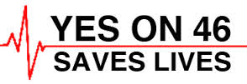
Prop 46 – Drug & Alcohol Testing of Doctors Requires drug testing of doctors. Requires review of statewide prescription database before prescribing controlled substances. Increases $250,000 pain/suffering limit in medical negligence lawsuits for inflation.
PRO – 46 saves lives. Prevents substance abuse by doctors & patients & holds negligent doctors accountable. Estimates show 18% of health professionals have an abuse problem in their lifetimes. Medical carelessness is the US’ 3rd largest cause of death. Prescription drug overdoses are epidemic.
CON – Trial lawyers wrote: Prop 46 to make millions from medical error lawsuits. We will pay, & could lose our trusted doctors – as many doctors & specialists are forced to leave California, moving to states with more affordable medical-liability insurance. Protect your wallet & access to healthcare.

Slide 8
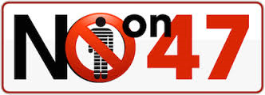
Prop 47 – Criminal Sentences. Minor Penalties Requires minor sentence instead of felony for certain drug & property offenses. Not accessible to persons with prior conviction for serious or violent crime & registered sex offenders.
PRO – Changes low-level nonviolent crimes, like simple drug possession & petty theft from felonies to minor sentences. Allows felonies (high convictions) for registered sex offenders & anyone previously convicted of rape, murder or child molestation. Saves millions of dollars every year & funds schools, crime victims, mental health & drug treatment.
CON – Potentially releases 10,000 felons from state prison. Reduces penalties for stealing guns & possessions of “date rape” drugs. Opposed by prosecutors, law enforcement, & the business community. Opposed by crime victims & sexual abuse victims.

Slide 9
PROP 1- WATER BOND
Authorizes $7.54 billions in bonds for state water supply projects for things such as water storage, ecosystem and watershed protection and restoration, and drinking water protection
PROP 2- STATE BUDGET STABILIZATION ACCT.
Requires annual transfers of state general fund incomes to budget stabilizing account. Requires half the incomes be used to repay state debts. Using remaining funds for emergencies or government spending rather than business or individual spending is limited
Jerry Brown
☺IT’S TIME TO VOTE ☺
Prop 47 – Criminal Sentences. Minor Penalties Requires minor sentence instead of felony for certain drug & property offenses. Not accessible to persons with prior conviction for serious or violent crime & registered sex offenders.
Prop 46 – Drug & Alcohol Testing of Doctors
Requires drug testing of doctors. Requires review of statewide prescription database before prescribing controlled substances. Increases $250,000 pain/suffering limit in medical negligence lawsuits for inflation.
N. Kashkari

