Slide 1
CCOT
Its like baking a cake

Slide 2
Read the question Carefully
Analyze the social and economic transformations that occurred in the Atlantic world as a result of new contacts among Western Europe, Africa and Americas from 1492 -1740

Slide 3
Clearly note time, place, categories
1492 (why?) -1750
Western Europe, Africa and Americas
Social, economic

Slide 4
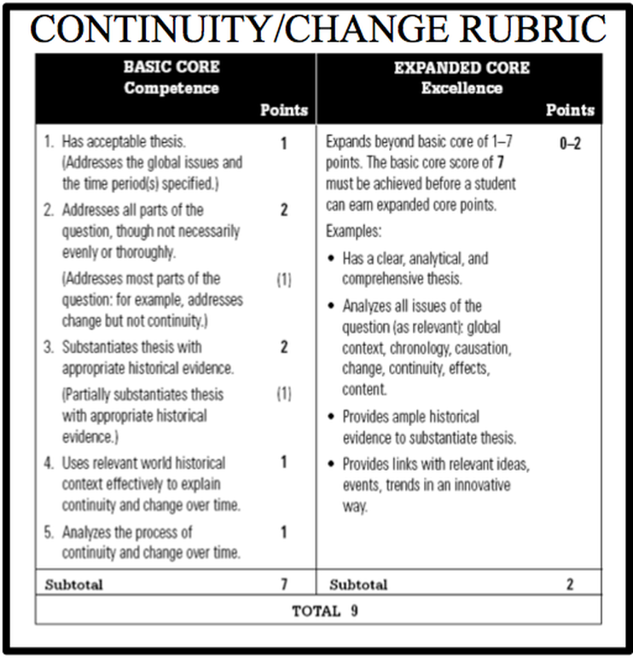
Point # 1 Thesis – 1 point
Must be explicit, address all parts of the question (including global issues and time period(s) specified with an argument/answer
Not just restatement of question!

Slide 5
Unacceptable
Sample 1:
“There were many transformations in the Atlantic world as a result of new contacts among Western Europe, Africa, and the Americas from 1492 to 1750.” This is merely a rephrasing of the question. “Many” is a virtually meaningless qualifier. Be more specific!
Sample 2:
“Columbus’ discovery of the New World had a huge impact on the future of the Atlantic world.” or “Europe dominated the Americas through military technology and political absolutism.” Off topic. The question asks the reader to focus on the social and economic transformations, NOT the degree of Columbus’ impact, or military & political developments. This illustrates why it is so important to read the question carefully and spend time organizing the essay BEFORE actually writing. Not only would this not earn the Thesis point, it might also distract the writer from earning point #3 (Evidence). Make sure to answer precisely what the question asks.
Sample 3:
Europe was going through a social and economic transformation from 1492-1750 as it moved beyond feudalism and into the modern era. Off topic. This thesis reflects a ‘European history’ point of view. Europe’s relationship to Africa and the Americas is a key part of this question, but a thesis devoted solely to only one continent is irrelevant. Too often students devote considerable effort to the Renaissance, Scientific Revolution, Reformation, Absolute Monarchy, English Civil War, etc. without relating it back to the rest of the Atlantic world.

Slide 6
Minimally Acceptable
“Between 1492-1750 Europe grew both socially and economically, while Africa and the Americas suffered.” Bare minimum of acceptability. It does address both social and economic considerations, but only vaguely.
Acceptable
As Europe came to economically dominate trans-Atlantic trade, their influence over social customs also expanded. This thesis sentence answers exactly what the question asks
Excellent
Although Europe quickly dominated the economic aspects of the Columbian Exchange, their social influence in Africa and the Americas developed more slowly. This thesis analyzes and differentiates specific categories of the two types of transformations, and would be eligible for the “Expanded Core” (Extra Credit) as a “clear, analytical, and comprehensive thesis.”

Slide 7
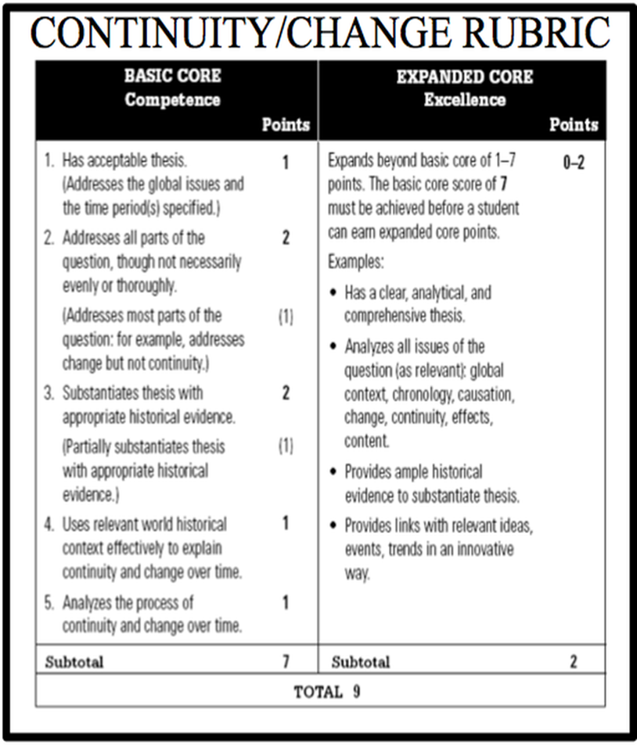

Point #2 Parts of the Question -2 Points
Addresses all parts f the question, though not necessarily
to earn 2 Points: Essay must accurately describe FOUR social and economic transformations that occurred as a result of new contacts in the Atlantic world from 1492- 1750. At least ONE must be social, and at least ONE must be economic.
To earn 1 point: describe ONE social and ONE economic transformation.
Note: 3 economic transformations would earn 0 points (there must be at least 1 social transformation)

Slide 8
Point #2 Parts of the Question – earn 2 Points
Examples and commentary
Note: The nature of this question makes it difficult to distinguish between a “transformation” and “evidence.” General long-term trends (Columbian Exchange, spread of diseases) usually counted as a transformation, while specific examples (potatos, smallpox) counted as evidence. Readers pay close attention to the verb to identify transformations. Statements that indicated a conclusion, connection, or cause & effect were the most obvious transformational verbs, and often indicated analysis (point #5) as well. Likewise, the distinction between social and economic transformations was subtle. Often the context of the statement framed readers’ interpretation.
Unacceptable: Students often rephrased a single transformation, repeating it in a later paragraph. Each transformation could only count ONCE. Readers had to pay close attention to the substance of the statement.
Acceptable: “As the slave trade increased, it changed the native population.” = social transformation.
“As the slave trade increased, it changed the native standard of living.” = economic transformation.
Excellent: An essay that addresses all parts of the question thoroughly or evenly.

Slide 9
Point #2 Parts of the Question -2 Points
Common Social Transformations (w/Evidence)
Common Economic Trans. (Evidence)
Columbian exchange
Slave trade
Spanish rule (encomienda, repartimento)
Spread of diseases (smallpox, measles, syphilis
Social stratification (peninsulars, creoles, mestizos, mulattos, zambos, etc)
Columbian exchange
Slave trade
Spanish rule enconmienda,repartimento)
Triangular trade
Mercantilism
Prerequisites for industrial revolution

Slide 10

Point # 3 Evidence earn 2 points
Substantiates thesis with appropriate historical evidence. 2pts
Include FOUR pieces of historical evidence related to social and economic transformations. The student must cite at least ONE piece of evidence for a social transformation and ONE piece of evidence for an economic transformation

Slide 11
Point # 3 Evidence
Partially substantiates thesis with evidence (1pt)
Include TWO pieces of historical evidence related to social and economic transformations. The student must cite at least ONE piece of evidence for a social transformation and ONE piece of evidence for an economic transformation.
The minimum requirement for how many transformations is determined by the reader/ teacher, NOT the student.

Slide 12
Point# 3 Evidence
Note: The nature of this question makes it difficult to distinguish between a “transformation” and “evidence.”
Unacceptable: The exchange of ideas caused both the American and French Revolutions. This ‘evidence’ is outside the time frame (post-1750).
Acceptable: “The spread of diseases among the native Americans motivated Europeans to find an alternative labor source, which they satisfied with the introduction of the African slave trade. (disease = transformation, slave trade = supporting evidence)
“The interactions of the Atlantic world caused a population decline in the Americas while Africa's population increased. The Aztecs and the Incas, for example, were not immune to new diseases such as smallpox which wiped out much of their society.” In this case, the transformation is the American population decline of which disease is a point of evidence.
“As a result of interactions in the Atlantic World, new cultural traditions appeared in the Americas. The slave trade brought Africans to the Americas where Africans mixed with native Americans and Europeans to form new languages and religions.” In this case, “new cultural traditions” constitutes the transformation while the slave trade becomes evidence of that transformation.
Note how the evidence should relate back to the thesis (from p. 1). It shouldn’t just “hang out there” unrelated to anything else in the essay.
Excellent: An essay that provides abundant historical evidence substantiating the thesis.

Slide 13
Point#4 Global Context earn 1 point
Uses global historical context effectively to show continuity OR change
The student uses global historical context effectively to show change or continuity in the Atlantic world from 1492 to 1750 by:
Placing the Atlantic world in the context of world history,
OR
Connecting the Atlantic world to global processes,
OR
Describing the interactions between at least two regions

Slide 14
Point#4 Global Context
This part of the rubric is based on the Habit of Mind, “Seeing global patterns over time and space while also acquiring the ability to connect local developments to global ones.” In other words, students should know how ‘Specific Example A’ compares with ‘Global Trend #1.’ (e.g. Does the example reflect or contradict the overall global trend? What are the major milestones/turning points in the development of the global trend?) This requires students to know what the global trends ARE, and then be able to cite specific examples that support their topic sentences.
Unacceptable:The slave trade was an example of an Atlantic world transformation from 1492-1750. The essay must explicitly describe the interaction between two specific regions. Simply rephrasing this statement to “The slave trade from Africa to the Americas was an example …” would have earned the point.
Acceptable: Note: Virtually any accurate, relevant statement that described a relationship linking Europe, Africa, and the Americas between 1492-1750 would satisfy this requirement.
Excellent: Analyzes all issues of the question (as relevant): global context, chronology, causation, change, continuity, effects, content. An essay that provides innovative links with relevant ideas, events, and trends.
The social status of women remained constant from 1492-1750 as European social customs were transplanted to the Americas. While a few students wrote about continuities, the vast majority did not. Thus, no continuities were required for the “Core” scoring. Continuities were included in the Expanded Core (Extra Credit).

Slide 15

Point# 5 Analyze change and continuity earn 1 pt.
Analyzes the process of change over time and/or continuity.
Analyze at least one social or economic transformation.
Unacceptable: Most essays didn’t include ANY analysis, only simple narrative that listed events in seeming isolation from each other.

Slide 16
Analysis Examples
Commentary
Sample A
The mercantalistic economies established in Europe redefined the economies of not only of European nations, but of American and African ones as well. Under mercantilism, European colonies in the new world were limited to trade only with their mother countries to ensure profit. The European monarchs would finance gold and silver expeditions in the Americas so that their national treasure would grow. In order to ensure productivity not only in American mines, but on plantations as well, Europe began to enslave Africans and send them to the Americas via the Middle Passage. The Middle Passage was part of a great trading triangle linking Europe, Africa, and America. African slaves were sent to America to work in captivity. America sent raw good to Europe and Europe sent money and good to allied African tribes to pay for slaves. The goods and money exchanged on the Great Circuit profited many European nations and African tribes. Plantation owners in America also became very wealthy. However, the exchange of goods, and not to mention people on the Great Circuit, also reshaped societies socially
Analysis in this paragraph is limited, but is present in the connection between the requirements of mercantilism and the productivity of plantations in the Americas. European motives (and trade restrictions) for trade are explored. The context of the Middle Passage within the larger trade patterns is described, but there is no evaluation or assessment of the slave trade.

Slide 17
Analysis Examples
Commentary
Sample Paragraph B
By 1492, Europe was on the verge of an economic explosion and Africa and America were relatively quiet in the global economy. Long before European contact in Africa, slaves and trans-Saharan slave trade were in existence. Portugese explorers came upon Africa to find this institution. An institution once belonging to Africa would become globalized. Europeans soon began to export slaves to their countries and eventually to the American economies. The slave trade put Africa on the map as a contending economic power. The slave workers fueled the American economies soon thereafter. The Europeans had difficulty in finding and maintaining native-American labor - slaves filtered into the Caribbean, Brazil, and the southern U.S. to serve on plantations. The sugar industry was growing in Europe and the slaves satisfied the Portugese sweettooth on the “engenhos” and in other lands. By creating the triangular slave trade, the Americans entered the global economy and Europe morphed into a more powerful one.
This paragraph weaves together multiple good writing characteristics.
• It places each continent into global context at the beginning of the time period. • The institution of slavery over time is nicely described within the larger framework of global trade patterns.
• The slave trade’s effect on Africa’s place in global community is directly noted, as well as the economic effect the slave trade had on the Americas, reinforcing the changing relationship among the three continents.
• Europeans’ motives are explored, and the paragraph finishes with a succinct summarization of the slave trade’s overall effect on both Europe and the Americas.

Slide 18
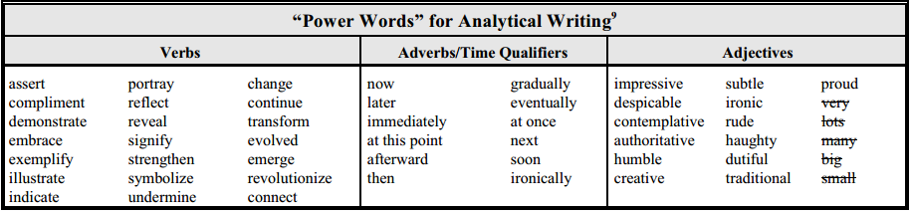
“Power Words” for Analytical Writing

