Slide 1
Chapter 14
Russian Revolutions

Slide 2
Setting the stage
The Russian Revolution was like a firecracker with very long fuse. The explosion came in 1917, yet the fuse had been burning for nearly a century. The cruel, oppressive rule of most 19th-century czars caused widespread social unrest for decades. Army officers revolted in 1825. Secret revolutionary groups plotted to overthrow the government. In 1881, revolutionaries angry over the slow pace of political change assassinated the reform – minded sour, Alexander II. Russia was heading toward a full scale revolution.

Slide 3
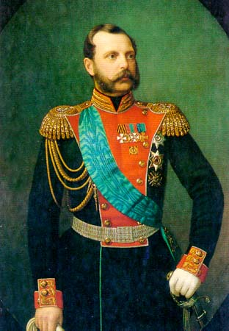
Czarist Regimes before the Revolution
Alexander II
Reforms and modernization ex. Freeing serfs
Assassinated in 1881 because the revolutionaties were angry over slow paced political change

Slide 4
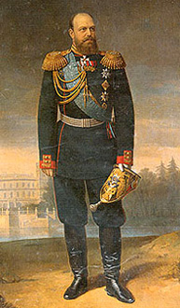
Alexander III –Autocrat-absolute ruler.
strengthens government with harsh methods
Enemies sent to Siberia( anyone who questioned his authority, worshipped outside the Russian orthodox church, spoke a language other than Russian)
Stops reforms and creates a police state, teeming with spies and informers.
Spies, pogroms- legal racism against Jews

Slide 5
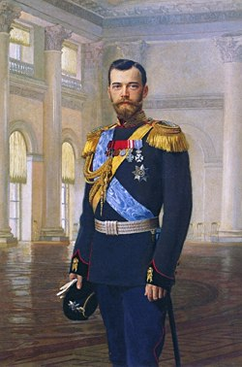
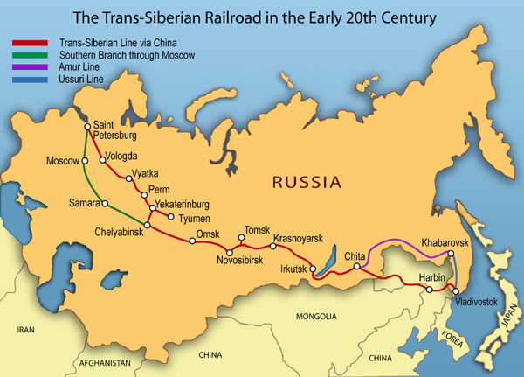
Nicholas II
Crowned in 1894
Slow industrialization
Did create Trans-Siberian Railroad – longest in world connecting European Russia in trhe west with Russian ports on the Pacific Ocean in the east

Slide 6
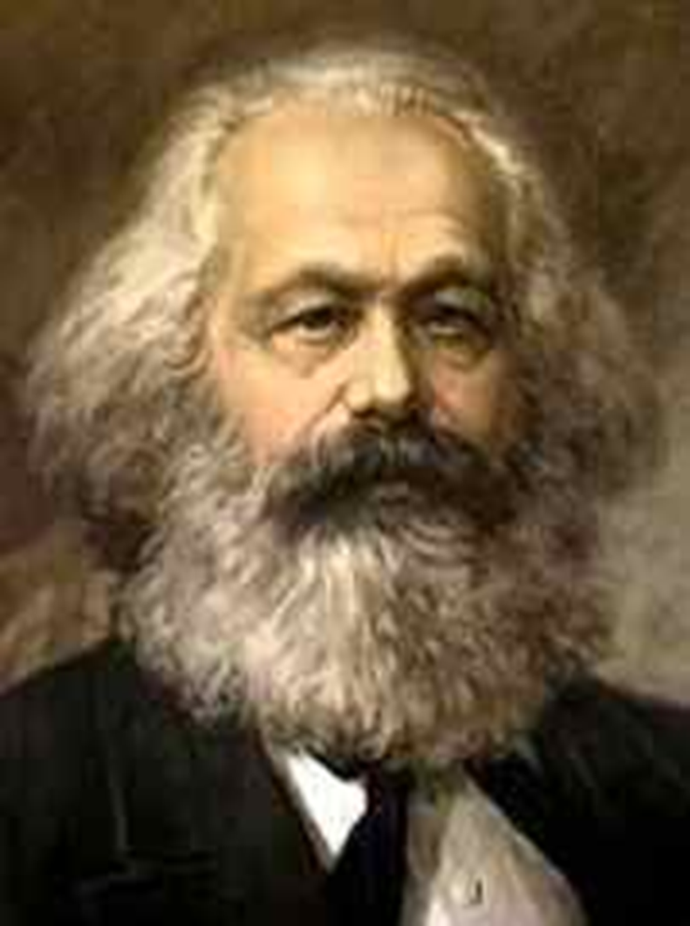
Russia Industrializes1863-1900 -Discontent
Rapid industrialization especially steel factories.
Factories brought new problems
Low wages, grueling working conditions, long hours, child labor.
Govt. outlawed labor unions
Low standard of living
Gap between rich and poor grew
Workers organized strikes.
Karl Marx – Communist Manifesto
Workers will revolt, overthrow government
Common people will be equal
Workers formed “dictatorship of proletariat.”This meant that the proletariat-the workers-would rule the country. Also a tyrannical dictatorship of individuals who would use all means, including Gulags, to maintain their power
Karl Marx, a Russian philosopher

Slide 7
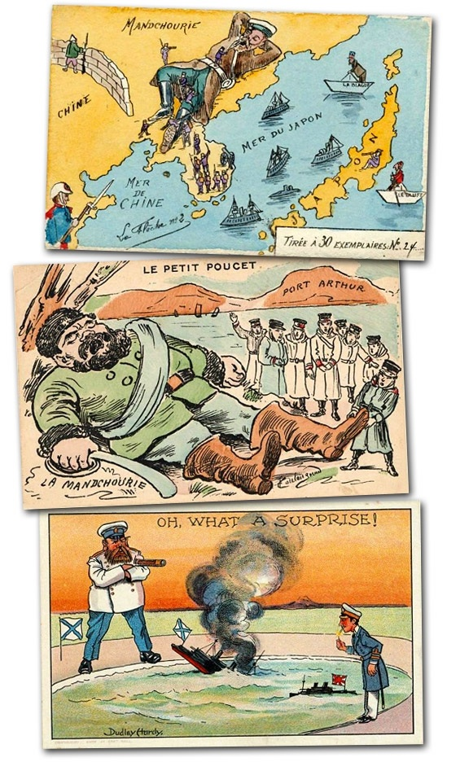
Crises at Home-1904 and 1917
Russo – Japanese War (late 1800s)
fought for control of Korea and Manchuria
Japan destroyed the Russian Navy at port Arthur , Manchuria in feb 1904
Russia is humiliated
Czar becomes more unpopular
Government seen to be weak and incompetent Oppostition groups challenged the power of the Russian Czar

Slide 8
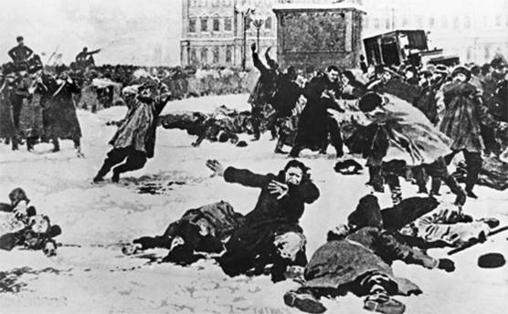
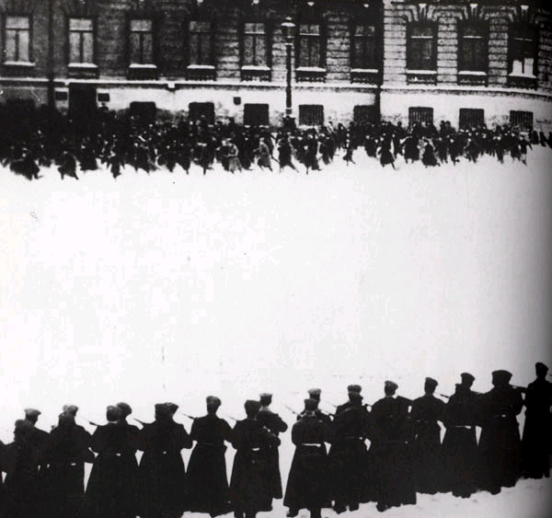
Crises at home
Bloody Sunday – 1905
200,000 Workers march to the Winter Palace
Demands - Better living and working conditions - end to war - a parliament
Soldiers fire on crowd killing 500
Sets off a wave of riots, strikes and murders

Slide 9
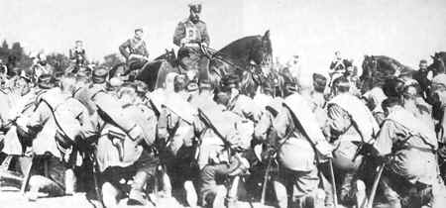
Crisis at Home
World War One Impact
Poorly trained/equipped army
4 million died the first year
Economy could not keep up with demand
Continuously Defeated
Nicholas II goes to the warfront to led troops

Slide 10
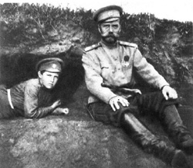
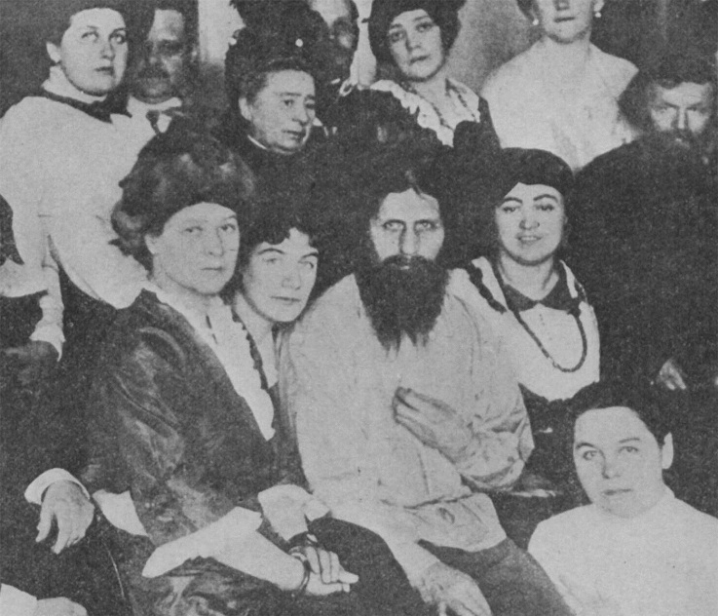
Criticism of the Czar
Poor military commander
Poor political leader
Left the Czarina in charge
Refused to accept advice from the Duma
Criticism of the Czarina
Inexperienced and incompetent ruler
Under the influence of Rasputin
Unpopular because she was German
Impact of WWI
Role of Rasputin
Claimed to be a healer
Disliked by many yet held influence over both the Czar and Czarina

Slide 11
Revolutionary Groups
Mensheviks
moderates
wanted support of the people to change government
Bolsheviks
small group of radicals
deeply committed to making changes at any cost
Leader – Vladimir Lenin

Slide 12
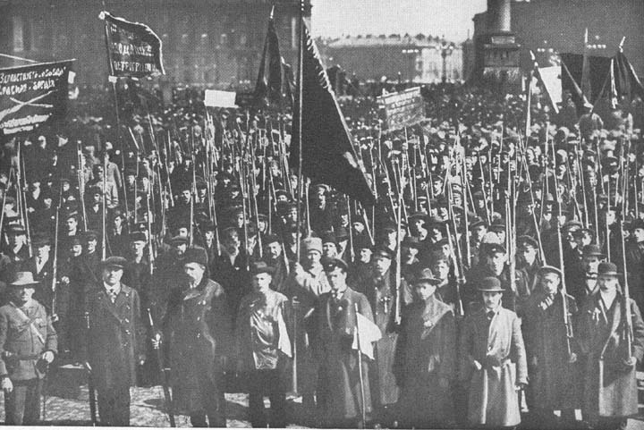
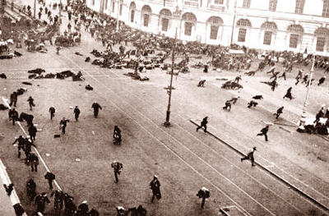
March Revolution
Shortage of food, shelter, fuel
Russian factory workers upset and strike
Workers marched to protest in Petrograd
Soldiers now joined protests
Tsar Nicholas II's disastrous handling of World War I leads him to abdicate (gives up) throne(1917).

Slide 13
Provisional Government
Leaders of the Duma established a provisional government. Alexander Kerensky headed it.
Refuses to end fighting in World War I
Loses public support
Soviets- local city councils consisting of workers, peasants and soldiers.
very powerful

Slide 14
1903- Revolutionary Groups Split -
Russian Marxist
Mensheviks
Moderate
Broad base of popular support for the revolution
Bolsheviks
More radical
Supported a small number of revolutionaries willing to sacrifice anything for change.
Leader-Vladimir Lenin
The Bolshevik Party embraced Communism , Karl Marx’s ideology-and eventually became the Communist Party

Slide 15
Vladimir Lenin
In 1887 when he was 17, and in spread the, Alexander, was hanged for plotting to kill the czar.
Lenin became a revolutionary and went against czar
Lenin escapes to Germany and gets trained by the Germans

Slide 16
Summary-Analyzing Causes Assignment
Just under your Cornell notes from yesterday write down a summary analyzing the causes of Russian revolution.

Slide 17
Lenin Returns
April 1917- smuggled in by the Germans
promises to end fighting if in power

Slide 18
Bolshevik Revolution
Slogan: “Peace, Land, and Bread”
Nov. 1917- took over government
Gave farmland to peasants
Gave factories to Workers
Signed Treaty of Brest-Litovsk
lost land and $$ to Germany
Causes Civil War to break out in Russia

Slide 19
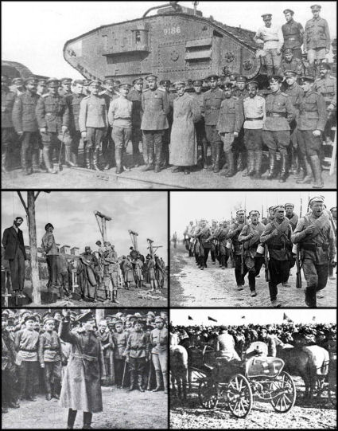
Russian Civil War
Red Army (Bolsheviks) vs. White Army
1918 to 1920
14 million died
fighting
famine
the Flu
Bolsheviks won under
the command of Leon Trotsky
Lenin in Power
July 1918 – Czar and family
executed

Slide 20
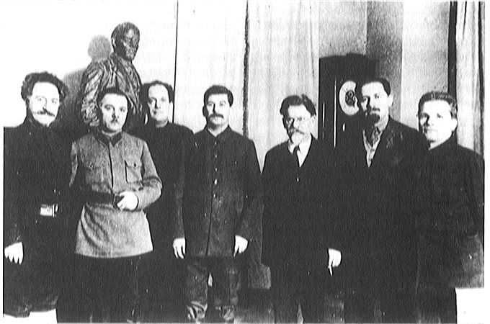
Lenin Restores order
Bolsheviks = Communist Party
Held all power, a dictatorship
Renames the country -Union of Soviet Socialist Republics (USSR)
1924 they created a constitution based on socialist and democratic principles.
Lenin remained the dictator.

Slide 21
New Economic Policy
The reforms under NEP was like a small version of capitalism.
Allowed peasants to sell their surplus crops istead of turning them over to the govt.
Gov’t controls all major industries, banks, & media
Small business operated under private ownwership.
Encouraged foreign investments.

Slide 22
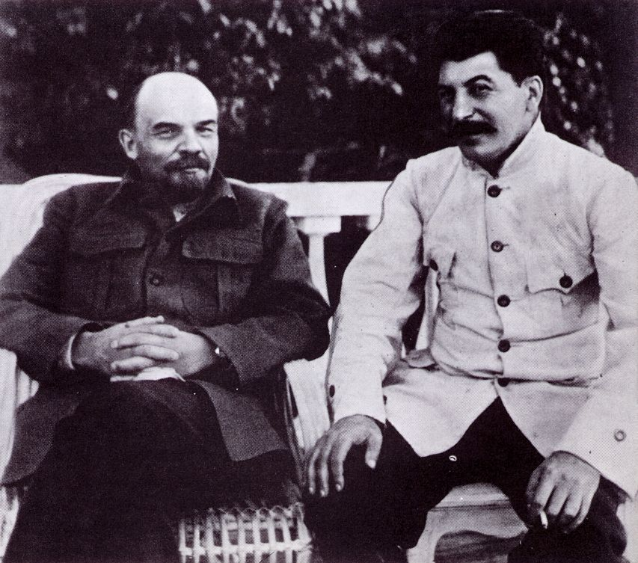
Power Change
. Lenin dies in 1924, suffered a stroke
1928 -Joseph Stalin in power
All opponents killed or in exile
Becomes the ruthless dictator of Russia.
Possible successors were
Leon Trotsky
2. Joseph Stalin

Slide 23
Communism is an ideology that seeks to establish a classless, stateless social organization, based upon common ownership of the means of production.
Government controls everything
No private property
Controls what people eat, watch, listen to, read, etc.
Positive side of communism
Everyone is given housing, jobs, a place to farm
Wealthy are stripped of their money and equal
No titles (Lord or Sir)
Borders don’t exist
Needs are met easier by government
People work together
Everyone is equal (theoretically)

Slide 24
Totalitarianism
Stalin maneuvers to become leader
Forces other soviets out of politics by threat or lies
Trotsky forced into exile by 1929
Stalin created a totalitarian state – a government that controls all aspects of life

Slide 25
Industrial and Agricultural Revolution
Five year plan
Rapid industrialization
People were given jobs, specific hours, forced to work and could not move
Government seizes 25 million farms from kulaks
Peasants refused to work – 10 million die or sent to Siberia

Slide 26
Police Terror
Stalin’s secret Police
Enemies were jailed, sent to Siberia, or killed
Great Purge – Bolsheviks, army leaders, and other influential revolutionaries
8 to 13 million deaths

Slide 27
Change in life
Propaganda spread throughout radio, speeches, Books, and movies
Censorship of all material not involved on promoting communism
No religious practices allowed, all figures destroyed
Women given equal rights
Women in charge of working and raising loyal communists
All education and information controlled by government
Teachers and artist were sent to labor camps to educate themselves to communism

