Slide 1
Chapter 14
Russian Revolutions

Slide 2
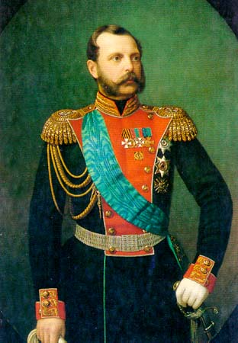
Czarist Regimes before the Revolution
Alexander II
Reforms and modernization ex. Freeing serfs
Assassinated in 1881

Slide 3
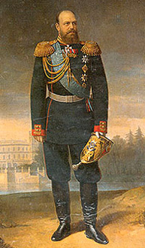
Alexander III
strengthens government with harsh methods
Enemies sent to Siberia
Stops reforms and creates a police state
Spies, pogroms- legal racism against Jews

Slide 4
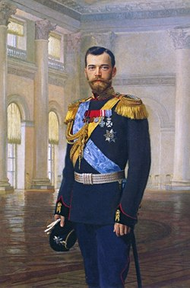
Nicholas II
Crowned in 1894
Slow industrialization
Did create Trans-Siberian Railroad – longest in world

Slide 5
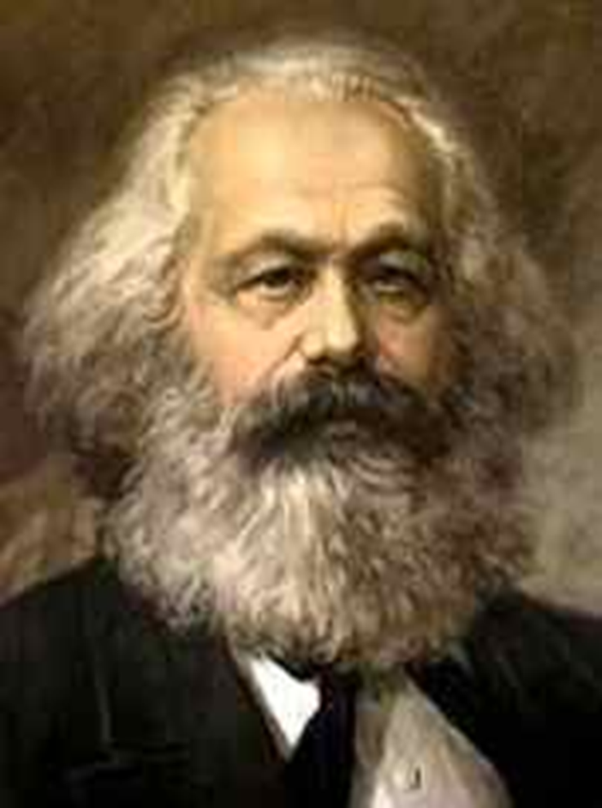
Discontent
Factories brought new problems
Wages, working conditions, hours
Low standard of living
Gap between rich and poor grew
Karl Marx – Communist Manifesto
Workers will revolt, overthrow government
Common people will be equal

Slide 6
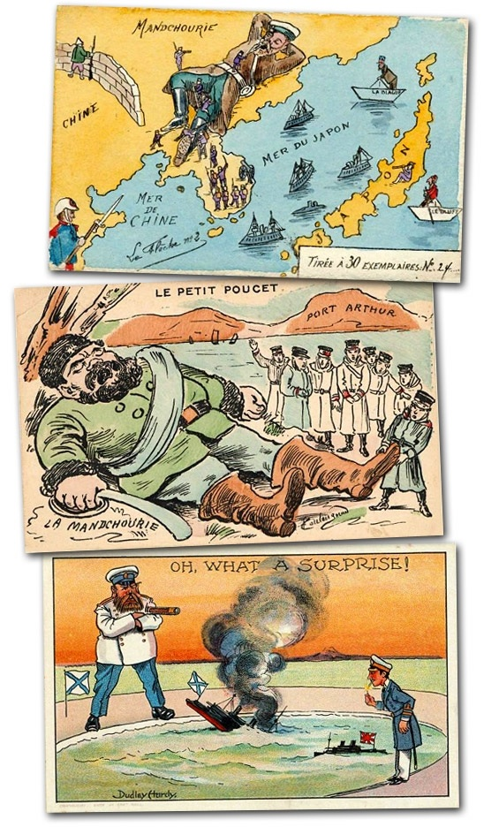
Crises at Home
Russo – Japanese War
fought for control of Korea and Manchuria
Japan destroyed the Russian Navy
Russia is humiliated
Czar becomes more unpopular
Government seen to be weak and incompetent

Slide 7
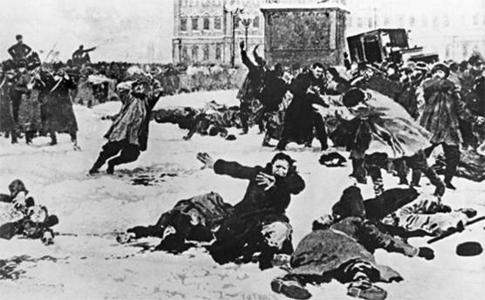
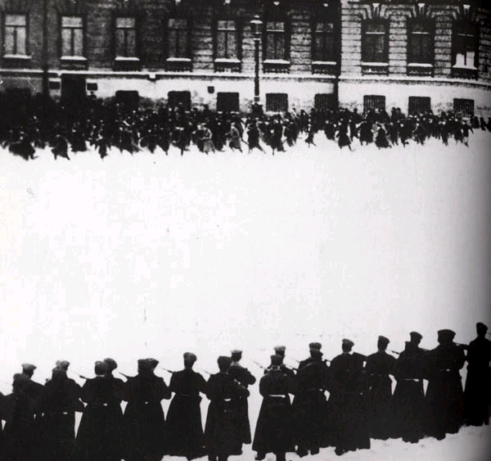
Crises at home
Bloody Sunday – 1905
Workers march to the Winter Palace
Demands - Better living and working conditions - end to war - a parliament
Soldiers fire on crowd killing 500
Sets off a wave of riots, strikes and murders

Slide 8
Title – Analyzing Causes Assignment
Complete the following question under your notes. Use complete sentences.
Page 434: Why did industrialization in Russia lead to unrest?
Define : Proletariat, Bolsheviks, and Mensheviks.

Slide 9
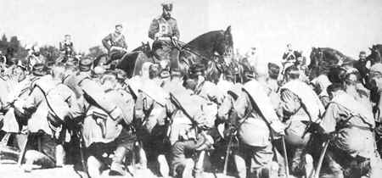
Crisis at Home
World War One Impact
Poorly trained/equipped army
4 million died the first year
Economy could not keep up with demand
Continuously Defeated
Nicholas II goes to the warfront to led troops

Slide 10
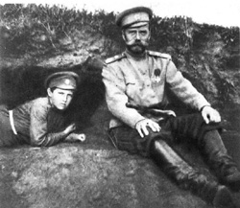
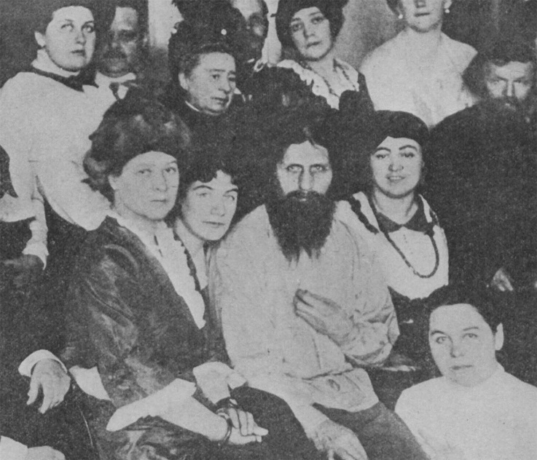
Criticism of the Czar
Poor military commander
Poor political leader
Left the Czarina in charge
Refused to accept advice from the Duma
Criticism of the Czarina
Inexperienced and incompetent ruler
Under the influence of Rasputin
Unpopular because she was German
Impact of WWI
Role of Rasputin
Claimed to be a healer
Disliked by many yet held influence over both the Czar and Czarina

Slide 11
Revolutionary Groups
Mensheviks
moderates
wanted support of the people to change government
Bolsheviks
small group of radicals
deeply committed to making changes at any cost
Leader – Vladimir Lenin

Slide 12
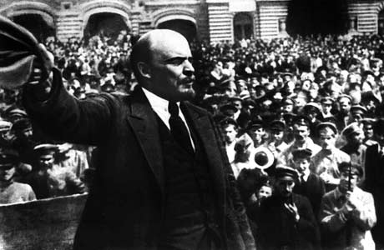
Vladimir Lenin
Excellent speaker, organizer.
Forced to flee Russia.
Waited for an opportunity to return.

Slide 13
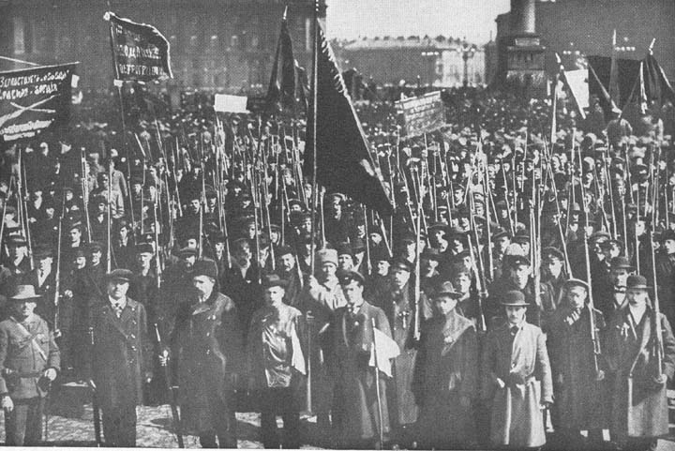
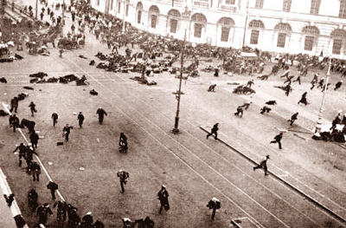
March Revolution
Shortage of food, shelter, fuel
Russian factory workers upset and strike
Workers marched to protest in Petrograd
Soldiers now joined protests
Czar abdicates (gives up) thrown (1917)

Slide 14
Provisional Government
Refuses to end fighting in World War I
Loses public support
Soviets- local city governments
very powerful

Slide 15
Lenin Returns
April 1917- smuggled in by the Germans
promises to end fighting if in power

Slide 16
Bolshevik Revolution
Slogan: “Peace, Land, and Bread”
Nov. 1917- took over government
Gave farmland to peasants
Gave factories to Workers
Signed Treaty of Brest-Litovsk
lost land and $$ to Germany
Causes Civil War to break out in Russia

Slide 17
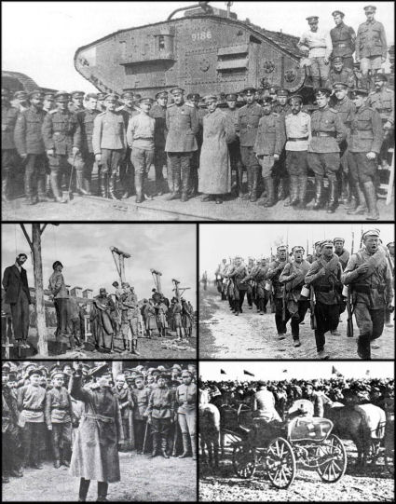
Russian Civil War
Red Army (Bolsheviks) vs. White Army
1918 to 1920
14 million died
fighting
famine
the Flu
Bolsheviks won
Lenin in Power
July 1918 – Czar and family
executed

Slide 18
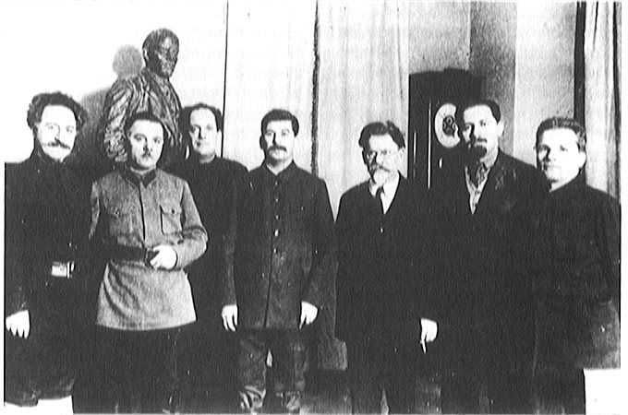
Lenin Restores order
Gov’t controls all major industries, banks, & media
Bolsheviks = Communist Party
Held all power, a dictatorship
Renames the country -Union of Soviet Socialist Republics (USSR)

Slide 19
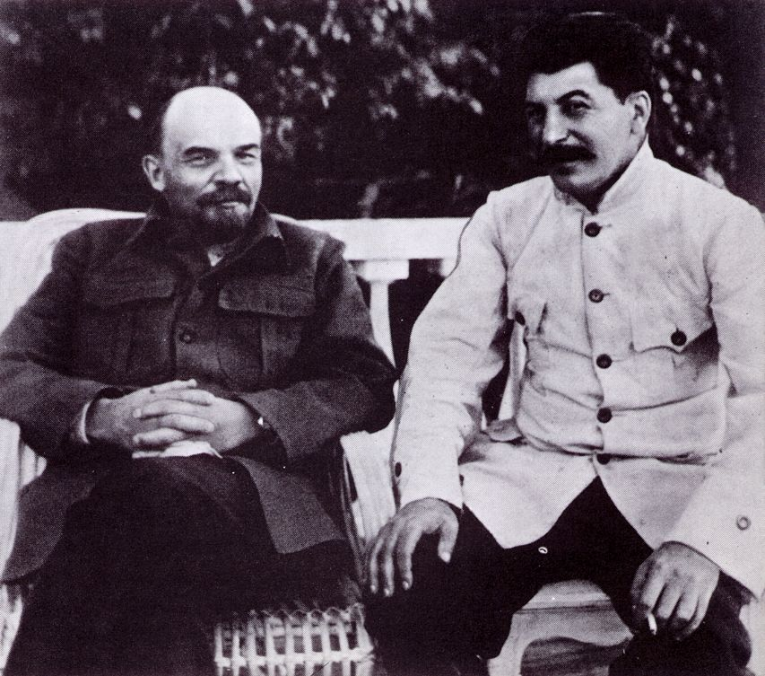
Power Change
Lenin dies in 1924
1928 -Joseph Stalin in power
All opponents killed or in exile

Slide 21
Communism is an ideology that seeks to establish a classless, stateless social organization, based upon common ownership of the means of production.
Government controls everything
No private property
Controls what people eat, watch, listen to, read, etc.
Positive side of communism
Everyone is given housing, jobs, a place to farm
Wealthy are stripped of their money and equal
No titles (Lord or Sir)
Borders don’t exist
Needs are met easier by government
People work together
Everyone is equal (theoretically)

Slide 22
Totalitarianism
Stalin maneuvers to become leader
Forces other soviets out of politics by threat or lies
Trotsky forced into exile by 1929
Stalin created a totalitarian state – a government that controls all aspects of life

Slide 23
Industrial and Agricultural Revolution
Five year plan
Rapid industrialization
People were given jobs, specific hours, forced to work and could not move
Government seizes 25 million farms from kulaks
Peasants refused to work – 10 mil die or sent to Siberia

Slide 24
Police Terror
Stalin’s secret Police
Enemies were jailed, sent to Siberia, or killed
Great Purge – Bolsheviks, army leaders, and other influential revolutionaries
8 to 13 million deaths

Slide 25
Change in life
Propaganda spread throughout radio, speeches, Books, and movies
Censorship of all material not involved on promoting communism
No religious practices allowed, all figures destroyed
Women given equal rights
Women in charge of working and raising loyal communists
All education and information controlled by government
Teachers and artist were sent to labor camps to educate themselves to communism

