Slide 1
Chapter 15 section 2 vocabulary

Slide 2
Economic Terms

Slide 3

Economy

Slide 4

Investment

Slide 5
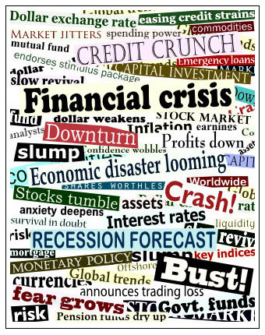
Economic Recession

Slide 6
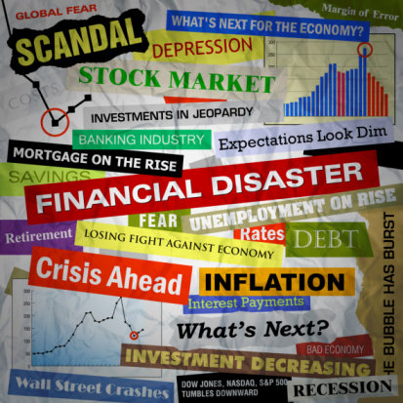
Economic Depression

Slide 7
Recession Vs. Depression
1
=10 times more

Slide 8
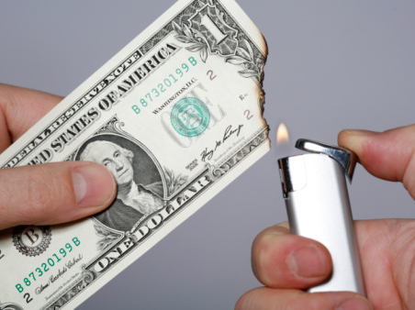
Inflation

Slide 9
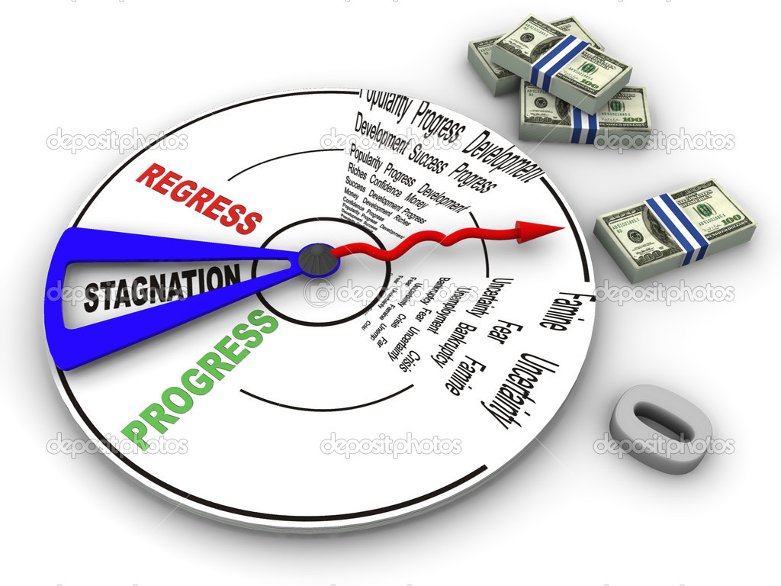
Economic Stagnation

Slide 10

UnEmployment

Slide 11
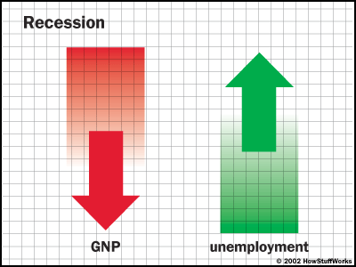

Slide 12
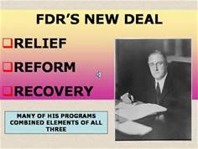
New Deal

