Slide 1
Lecture 2 The Late Middle Ages:1300-1450 Crisis and Conflict
What factors in the Late Middle Ages spurred change?

Slide 2
Three major factors that spurred change:
The Black Death
The Hundred Years War
Religious Breakdown

Slide 3
The Black Death
The bubonic plague struck at a weakened Europe already suffering from disease, lack of hygiene, overpopulation and crop failure.

Slide 4
The plague doctor's costume
The plague doctor's costume was the clothing worn by a plague doctor to protect him from airborne diseases. The costume consisted of an ankle length overcoat and a bird-like beak mask often filled with sweet or strong smelling substances (commonly lavender), along with gloves, boots, a brim hat and an outer over-clothing garment

Slide 5
Social and Economic Consequences
Isolation weakened social bonds
Economy initially suffered significantly, but soon adjusted
Higher wages for workers, especially artisans
Movement to cities
Lower agricultural prices
Weakened the power of wealthy landowners: responded with laws restricting wages, first movements to “enclose” common fields (wool), led to peasant revolts.
Cities and skilled industries thrived, especially guilds

Slide 6
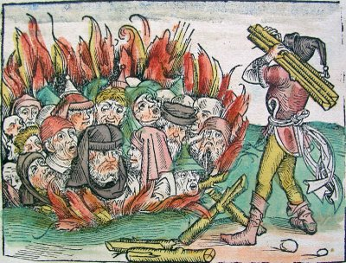
Best of the clergy died (staying behind to help the sick)
Jews were often blamed for the plague and persecuted
Flagellants – ritualistically beat themselves in public believing penance would bring divine intervention
Kings used weakness to promote centralization of power and a “national” agenda
Population did not reach pre-plague level until the mid-16th century
Literature and art reflected pessimism and obsession with universality of death. (Danse Macabre)

Slide 7
http://upload.wikimedia.org/wikipedia/commons/5/58/Bernt_Notke_Danse_Macabre.jpg

Slide 8
The Hundred Years War (1337-1453 CE)
First war of the newly centralized, national monarchies.
England and France bitter rivals in close proximity. Fought over:
English titles to French lands
Control of Flanders (the land)

Slide 9
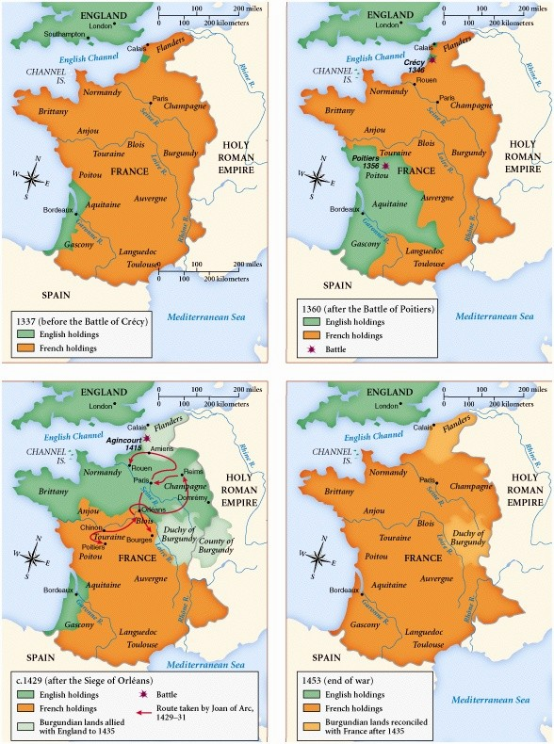

Slide 10
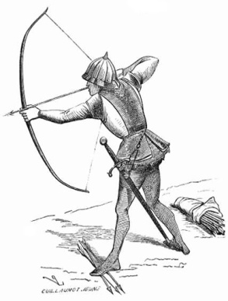
Edward III of England claims French throne after death of Charles IV
French place Philip VI of Valois on the throne
Most of the war was fought intermittently in France and in the Low Countries (Holland, Belgium)
English win stunning victories due to:
French divisions (money troubles, revolts)
Weak French kings (Charles VI “the Mad”)
Superiority of the English longbow

Slide 11
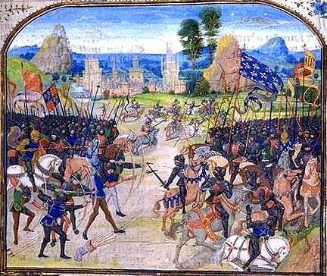
Battle of Poitiers 1365

Slide 12
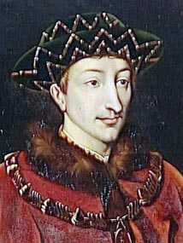
By 1415, Paris was threatened
Aside from loss of territory, France was threatened by a new state in its eastern territory, Burgundy, that allied with England
Eventually Henry VI of England proclaimed King of France and England (Treaty of Troyes, 1420) but not recognized by the French people.
The French back the Dauphin - Charles VII

Slide 13
Joan of Arc
French peasant girl claimed she heard voices of saints and persuaded Charles VII to allow her to be with the troops
French people rallied around her and the king (national symbol)
In 1429 inspired the French army to victory at Orléans during a crucial stage of the war
The French heir to the throne was crowned and the government was strengthened
Joan was captured by the Burgundians and burned at the stake as a heretic in 1431, later declared a saint.

Slide 14
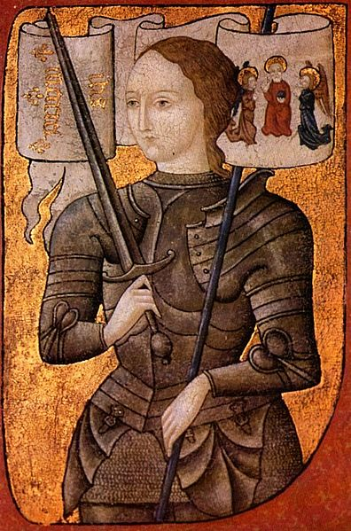
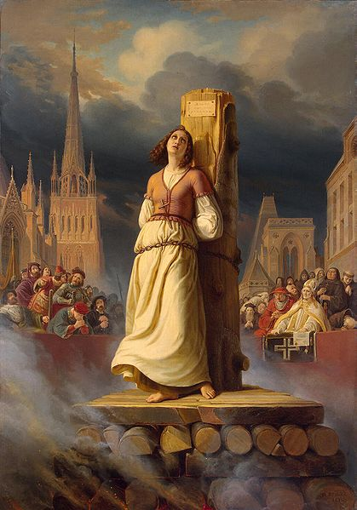

Slide 15
Results:
France permanently removed England from France (except for tiny region of Calais)
France economically and politically devastated
Peasants angry over the costs
The struggles of war began modern state- building in France and England (“New Monarchs”)

Slide 16
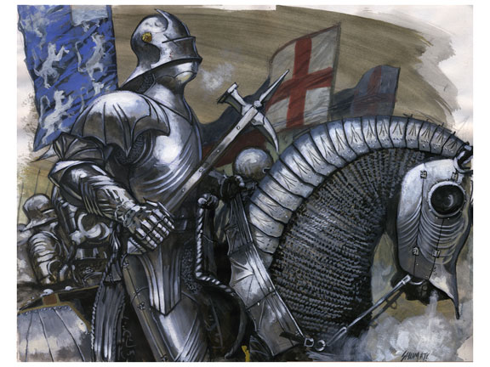
The Birth of Modern Warfare
In the Middle Ages, cavalry knights were the primary source of military power
Loyal nobles raised troops (from among vassals) to fight

Slide 17
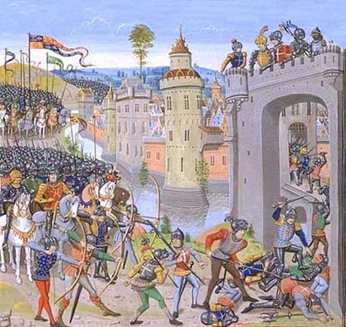
The Hundred Years war led to the growth of national armies, loyal to, and paid by, the state
Monarch hired mercenaries: fought for pay and spoils, not obligation
Artillery and infantry grew in importance
Taxes raised to pay for national armies

Slide 19
The Breakdown of the Church
Background
Religious authorities in many regions were more powerful than secular authorities
Pope Innocent III and his successors turned the church into a secular and political power: law courts (rota romana), and bureaucracy.
The interests of Rome began to dominate church life.
Set off centuries of conflict with national rulers.

Slide 20
Avignon Papacy “Babylonian Captivity” (1309-1377)
1305, a struggle between the pope and the French king led to the election of a French pope (Clement V) who moved his leadership to Avignon, France
7 successive popes resided at Avignon, France
Needed money, began selling indulgences for sins
This situation damaged papal prestige (esp. in England & Germany) since popes were believed to be unduly influenced by French kings

Slide 22
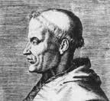
Early Critics of the Church
Setting the stage for the
emergence of Protestantism
Marsiglio de Padua:
Defender of Peace (1324)
a. Claimed the church should be subordinate
to the state
b. Believed the church should be run by
laymen and priests superior to the pope.

Slide 23
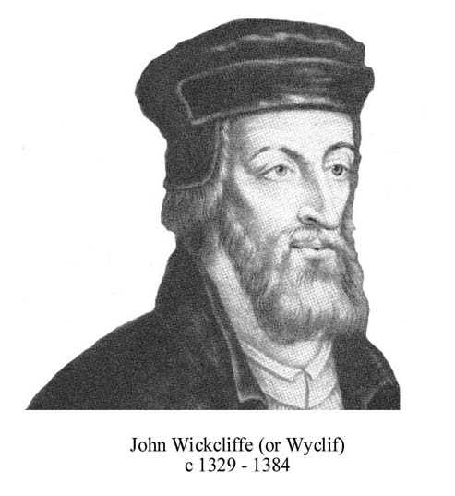
John Wycliffe (c.1330-1384)
a. Believed the church should only follow
Scripture, not money
b. Personal merit was the true measure of
religious purity
b. Wrote an English translation of Bible
c. His later followers were called Lollards
"Go and preach, it is the sublimest work, but imitate not the priests whom we see after the sermon sitting in the ale houses, or at the gaming table, or wasting their time in hunting. After your sermon is ended do you visit the sick, the aged, the poor, the blind, and the lame, and succor them according to your ability."

Slide 24
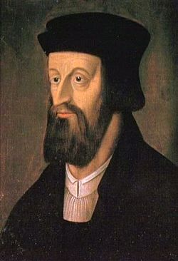
John Hus (c.1369-1415):
a. Led a nationalist movement
in Bohemia
(modern-day Czech Republic)
b. Ideas very similar to Wycliffe
c. Critical of tradition and superstition (transubstantiation)
d. Captured by authorities and burned at the
stake for his heretical views
e. Hussites: followers of Hus, staged large
rebellions.

Slide 25
Great Schism (1377-1417)
Further conflict occurred in 1377 with election of two popes—one in Rome, one in France—neither of whom recognized the other
England and Allies supported the Roman Pope, France and Allies the French Pope
Cardinals elected a new pope, now there were three…
Holy Roman Emperor convened a new council, deposed all three, and elected a new one (Martin V)
“Conciliar Movement” tried to control papal action using a representative assembly (Council of Basel)
All of this further hurt prestige of church and promoted secular national power

Slide 26
Life in Later Middle Ages
Family Life
Marriage: avg. age for men = mid-20s; women = 16-18
Divorce was unheard of in most countries
Economic reasons were most important for marriage (love not paramount until the 18th-19th centuries)
Women were subject to men, but could hold powerful positions in church and politics.

Slide 27
B. Work
Majority still involved in subsistence agriculture
Serfdom reduced in many areas, more free men (Black Death)
Agricultural cycles and church ritual closely linked
Small % of men were artisans in towns; protected by guilds
Women ran households and performed chores.

Slide 28
"Burdened with children and landlords' rent; What they can put aside from what they make spinning they spend on housing, Also on milk and meal to make porridge with To sate their children who cry out for food And they themselves also suffer much hunger, And woe in wintertime, and waking up nights To rise on the bedside to rock the cradle, Also to card and comb wool, to patch and to wash, To rub flax and reel yarn and to peel rushes That it is pity to describe or show in rhyme The woe of these women who live in huts”

Slide 29
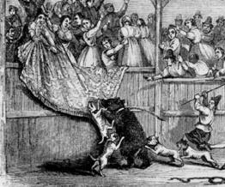
C. Recreation
Aristocracy – jousting tournaments
Common people—archery, wrestling, bull-baiting, bear-baiting; alcoholism rampant
Strictly regulated forms of dress and action

Slide 30
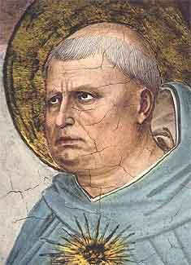
D. Modes of Thought
Scholasticism: Thomas Aquinas (1224-1274)
Scholasticism became the cornerstone of late-medieval philosophy
Aquinas attempted to reconcile faith and reason by using logic to support Christian doctrine
Sought to reconcile Aristotle’s scientific ideas with Christianity
Truth exists in works of the greats, study them, don’t question them
Scholasticism dominated Catholic philosophy for centuries
Challenged severely by Renaissance humanists in the later centuries

