Slide 1
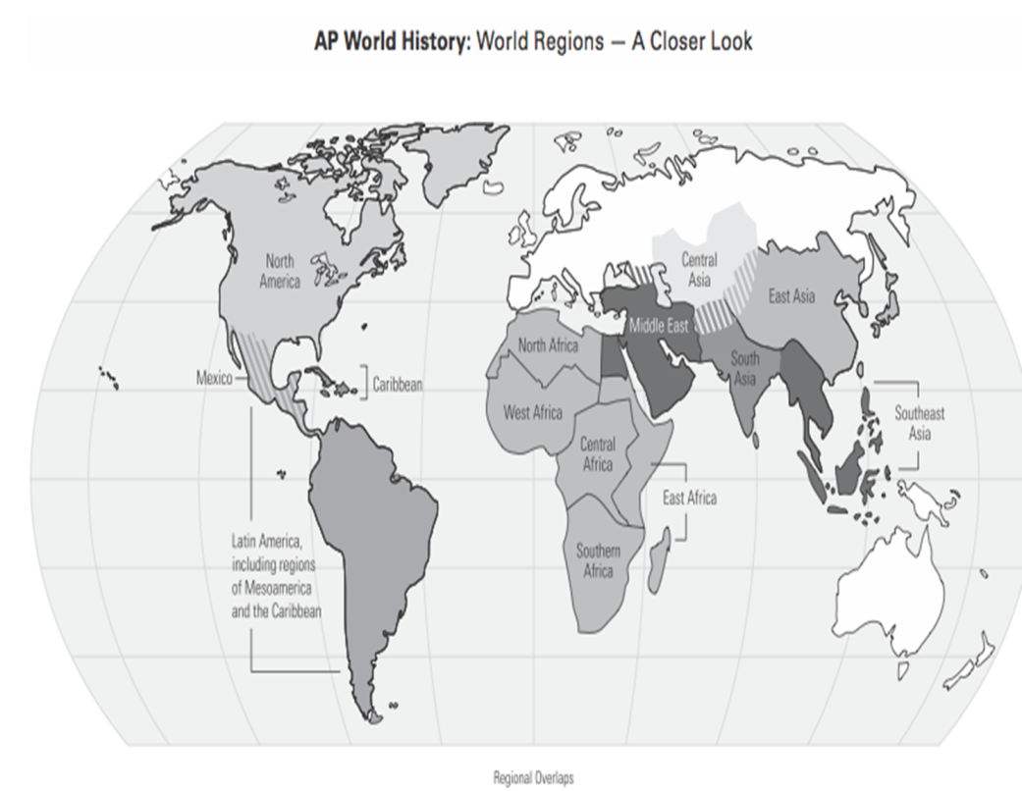
Period 5:
Industrialization and global Interaction 1750-1900

Slide 2

Age of Revolutions
Chapter 21
Enlightenment Influence on the American, French, Haitian and Latin American Revolutions

Slide 3
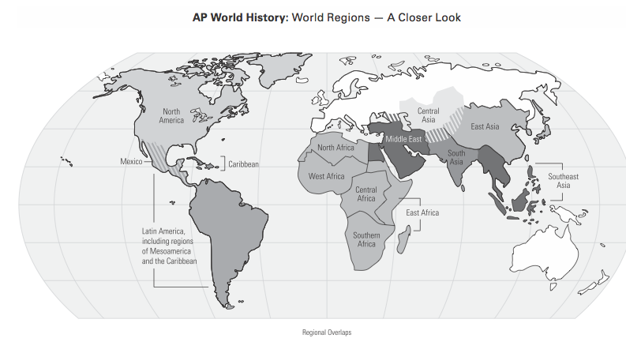
18th century=1700-1799

Slide 4
Key Concept 5.3 Nationalism, Revolution, and Reform
The eighteenth century marked the beginning of an intense period of revolution and rebellion against existing governments, and the establishment of new nation-states around the world Enlightenment thought and the resistance of colonized people to imperial centers shaped this revolutionary activity. These rebellions sometimes resulted in the formation of new states and stimulated the development of new ideologies. These new ideas in turn further stimulated the revolutionary and anti-imperial tendencies of this period.

Slide 5

Prelude to Revolutions
Protestant Reformation
Rivalry among the European powers intensified in the early 1600s as the Dutch attacked Spanish and Portuguese possessions in the Americas and in Asia.
British eventually superseded the Dutch commercially and defeated France in the Seven Years War
The unprecedented costs of the wars of the seventeenth and eighteenth centuries drove European governments to seek new sources of revenue at a time when the intellectual environment of the Enlightenment inspired people to question and to protest the state’s attempts to introduce new ways of collecting revenue.
Scientific Revolution
Social Inequity
  Slavery, serfdom
Rise of Middle Class
  New notion of wealth
  Trade
  Increased tension

Slide 6
I. The rise and diffusion of Enlightenment thought that questioned traditions in all areas of life often preceded the revolutions and rebellions against existing governments.
A. Thinkers applied new ways of understanding the natural world to human relationships, encouraging observation and inference in all spheres of life.
Intellectuals critiqued the role of religion played in public life, insisting on the importance of reason as opposed to revelation.
Example-
Voltaire
Rousseau

Slide 7
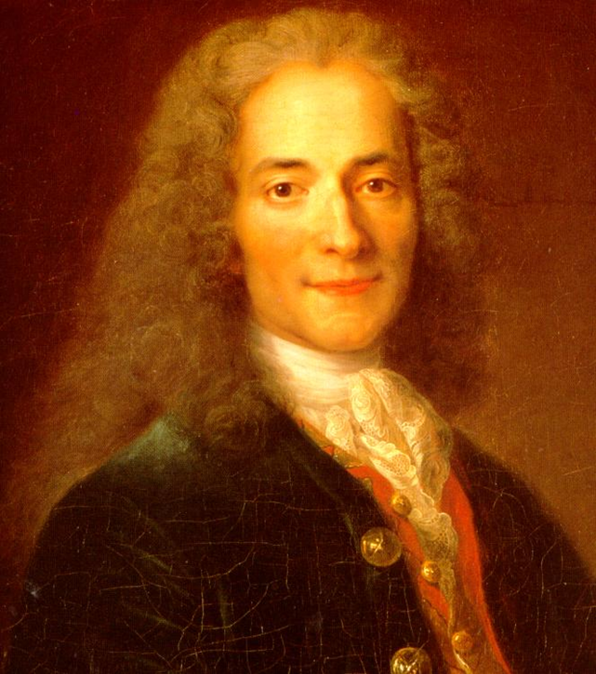
Voltaire
Most brilliant
Tolerance
  Religion
  Press
  Speech
  reason
“I do not agree with the words you say, but I will defend to the death your right to say it.”

Slide 8
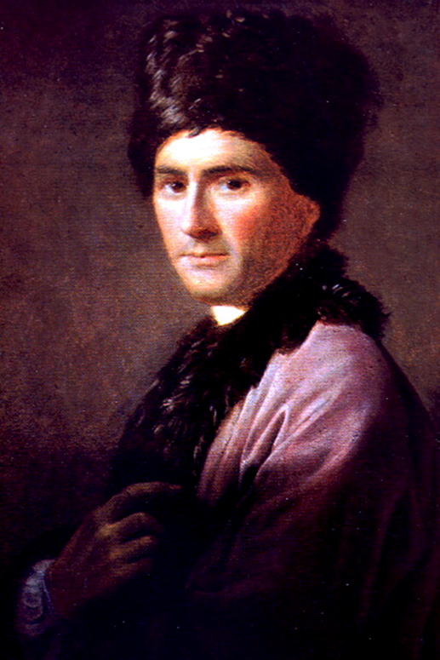
Jean Jacques Rousseau
:Collective society
Individual freedom
    asserted that the will of the people was sacred; people would act collectively on the basis of their shared historical experience
      -Social Contract
Equality for all!

Slide 9
C. Enlightenment thinkers developed new political ideas about the individual, natural rights, and social contract.
Example-
Locke
Montesque

Slide 10
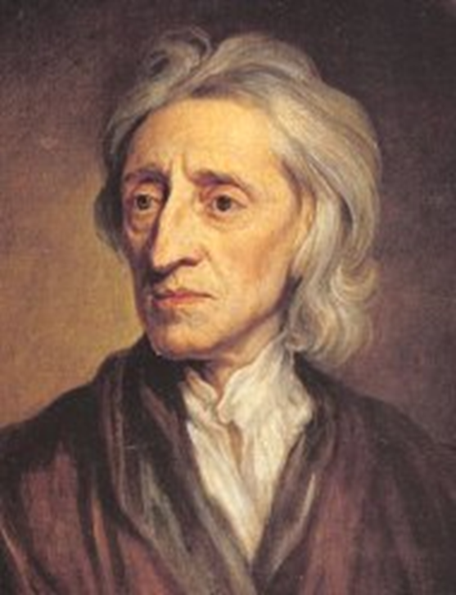
John Locke
    : individual
    argued that governments were created to protect the people
      Life, liberty, property
      Natural rights
      Overthrow govt.
Governmental power comes from consent of governed

Slide 11
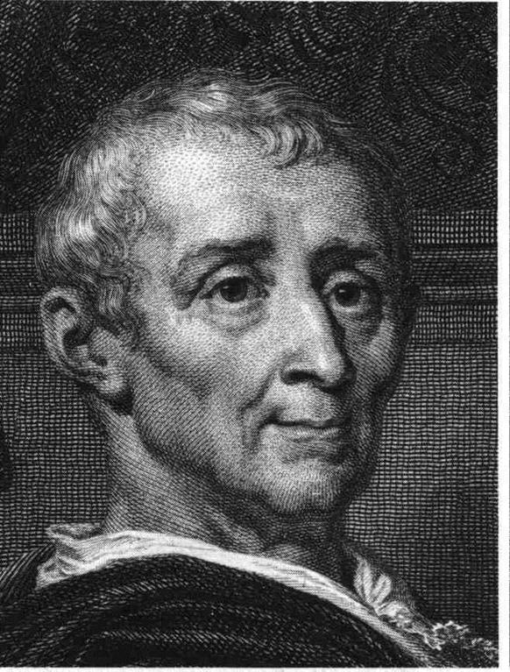
Montesquieu
Separation of powers
Checks and balances
Basis for US Constitution

Slide 12
The global spread of European political and social thought stimulated solidarities
Demands for women's suffrage and emergent feminism challenged political and gender hierarchies
Example-
Mary Wolstonrcraft’s Vindication of the rights of Woman

Slide 13
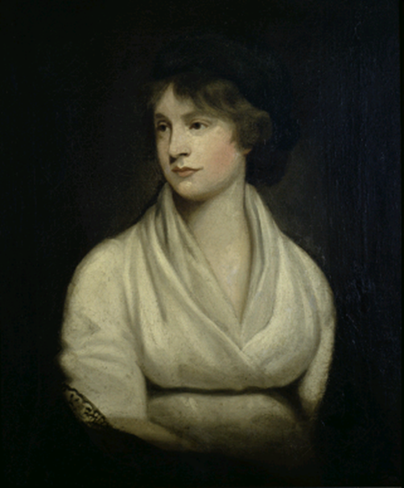
Mary Wollstonecraft
Women need education to become virtuous and useful.
Women should have the right to participate in politics.
Influenced women’s rights groups in Europe and North America. (egxample-The resolution passed at the Seneca Falls Conference in 1848)

Slide 14
Major Ideas of the Enlightenment
Idea | Thinker | Impact
Natural rights | Locke | Fundamental to U.S. Declaration of Independence
Separation of power | Montesquieu | Constitution: U.S. France, Latin America
Freedom of thought and expression | Voltaire | Bill of Rights, France, eliminate censorship
Women’s equality | Wollstonecraft | Women’s rights groups in North America and Europe
Religious freedom | Voltaire | Constitution, France, Eliminate censorship
Primary Document Analysis Activity Groups of 6
Each pair within the group analyses the document

Slide 15
Enlightened Despots
Catherine the Great of Russia and Frederick the Great of Prussia encouraged and patronized the ideas of Enlightenment thinkers and used Enlightenment ideas to reform their governments
Many Enlightenment thinkers communicated with each other and political leaders

Slide 16
Role of Women
Enlightenment thinkers believed in marriages based on love.
Women were instrumental in the dissemination of information.
  purchasing and discussing writings
  Parisian salons
  Educated

Slide 17
Growing Middle Class
Enlightenment ideas were attractive to the expanding middle class in Europe and Western Hemisphere
many thought of the Americas as a new uncorrupted center for social progress
Joint stock companies created opportunities for wealth
Extremely susceptible( inclined) to Enlightened thought

Slide 18
Question
What is enlightenment? How did scientific Revolution influence enlightenment?
The Enlightenment was the intellectual movement in which the methods and questions of the Scientific Revolution were applied to human society.

Slide 19
The
American
Revolution:
1775-1783

Slide 20
Frontiers and Taxes
after 1763 British had two problems:
      danger of war with the Amerindians
      need to raise more taxes for the colonists to pay for the wars and administration
attempted to raise revenue by new taxes and commercial regulations
      Stamp Act: all printed goods
      Sugar Act

Slide 21
Eve of Revolution
colonists replied with organized boycotts of British goods, protests and attacks of British officials
Boston Massacre: killing of five citizens by British
Boston Tea Party: response to British East India monopoly on tea

Slide 22
On the Eve of the Revolution ?
 | Britain | Americans
Advantages | ? | ?
Disadvantages | ? | ?

Slide 23

Military Strategies
The Americans
The British
Attrition [the Brits had a long supply line].
Guerilla tactics [fight an insurgent war → you don’t have to win a battle, just wear the British down]
Make an alliance with one of Britain’s enemies.
Break the colonies in half by getting between the No. & the So.
Blockade the ports to prevent the flow of goods and supplies from an ally.
“Divide and Conquer” → use the Loyalists.

Slide 24
Declaration of Independence
We hold these truths to be self evident: That all men are created equal; that they are endowed the their creator with certain unalienable rights; that among these rights are life, liberty and the pursuit of happiness; that, to secure these rights, governments are instituted among men, deriving their just powers from the consent of the governed.

Slide 25
The Revolution
Declaration of Independence
British sent military to calm the storm
  British won most battles
  could not control countryside
  unable to achieve political solution to the problems of the colonies
Amerindians served as allies to both sides
France entered war as U.S. ally
  naval support
Treaty of Paris (1783): unconditional independence to the former colonies

Slide 26
Benjamin, George, and Joseph
Benjamin Franklin
He was an American intellectual , inventor and politician.
During the American Revolution, he convinced the French to help the Americans.
He helped write the Constitution of the United States
George Washington
He led an army through the American Revolution
Although the British won most of the battles, he steadily built a skilled continental army and the civilian support.
Joseph Brant
Was the Mohawk leader who supported the British during the American Revolution.
Organized the most powerful fighting force along the Canadian border

Slide 27
Why
did the British
Lose???
Could not settle the tax crisis and overconfident

Slide 28
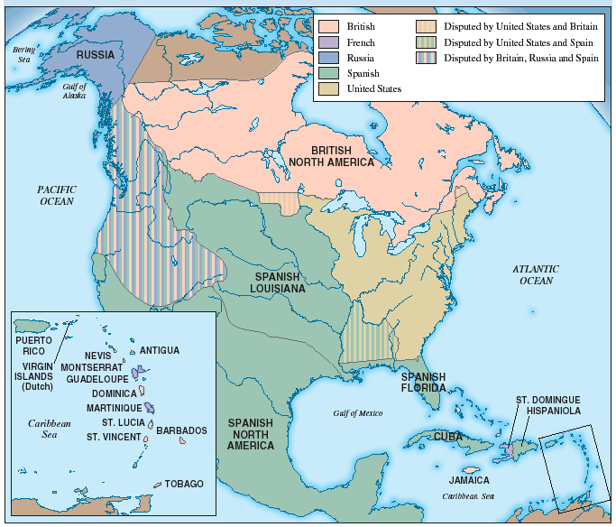
North America After the
Treaty of Paris, 1783

Slide 29
How did the Colonists manage to win?
Military assistance from France, both land and navy.
British committed most of their military to safeguard
their Caribbean colonies from the French threat.
Victory was at Yorktown in 1781
The Treaty of Paris (1783) –American Independence
The Amerindian tribes ceded to the new USA - lost
territory.

Slide 30
Articles
of
Confederation
Government:
1781-1789
America’s first constitution

Slide 31
Weaknesses of the
Articles of Confederation
A unicameral(SINGLE CHAMBER,LEGISLATIVE) Congress
[9 of 13 votes to pass a law].
13 out of 13 to amend.
Representatives were frequently absent.
Could not tax or raise armies.
No executive or judicial branches.
31

Slide 32
Three Branches of Government
Federal government
Presidential
Congress
Supreme Court
  Only a minority given full rights
  Protected slavery
  Women were excluded (except in ______ until 1807)
32

Slide 33
French Revolution
33

Slide 34
The Old Regime
The Privileged Estate or the First Estate
Roman Catholic Church- owned 10% of the land , paid about 2% of the taxes collected.
The 2nd Estate made up of rich nobles, owned 20% land, paid almost no taxes.
34

Slide 35
The Old Regime Cont.
The Third Estate- 97% of the population
The 1st group-the bourgeoisie were merchants and artisans.
The 2nd group- workers
The 3rd group- peasants formed the largest group.
  Paid ½ their income in dues to nobles, tithes to the church, and taxes to the govt.
35

Slide 36
Ist estate: 1%
2nd Estate:
2%
3rd Estate:
97%
36

Slide 37
What was the fundamental cause for French Revolution?
The fundamental cause for French
revolution was that there was a perception
that the political power and social privileges
were unfairly distributed

Slide 38
Force for Change during King Louis XVI
war debt
inequitable system of taxation
conspicuous consumption of the noble class
High unemployment and high bread prices, causing more money to be spent on food and less in other areas of the economy
famine and malnutrition
resentment of absolutism
resentment of bourgeoisie
resentment of clerical privileges
38

Slide 39
Estates General 1788
Louis XVI tried to raise taxes
Called Estates General, the French national legislature: who is going to win?
1 vote
1 vote
1 vote
39

Slide 40
Revolution Dawns
The National Assembly
The 3rd Estates delegates wanted change
They proclaimed the end of absolute monarchy & the beginning of representative govt.
Pledge to write a constitution to incorporate popular sovereignty.

Slide 41
Storming the Bastille
King sent troops to settle crowds
On July 14, a mob broke into Bastille (prison)
  The Revolution turned radical with the involvement of the peasants

Slide 42
Fear This!
Riots in Paris
People demanded the King & Queen come to Paris.
The King & Queen tried to escape to Austria.

Slide 43
Assembly Reforms France
The Rights of Man
National Assembly created a new constitution-The Declaration of the Rights of Man and of the Citizen.
  “men are born free and remain free and equal in rights.”
  “ liberty, property, security, and resistance to oppression.”
  equal justice, freedom of speech and religion.

Slide 44
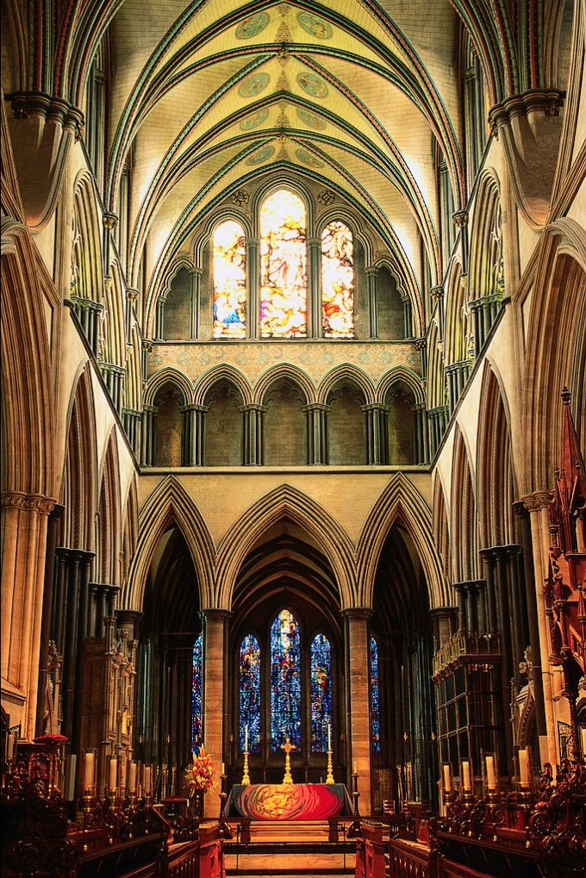
Changes in the Church
A State-Controlled Church
Government took over Church lands
Made priests employees of the state
Church lost land and independence
  sale of Church lands helped to pay off France’s huge debt.

Slide 45
Limited Monarchy
Sept. 1791- National Assembly created a Constitutional Monarchy:
  Monarch: executive power, enforce laws
  Legislative Assembly: create laws, approve/reject war

Slide 46
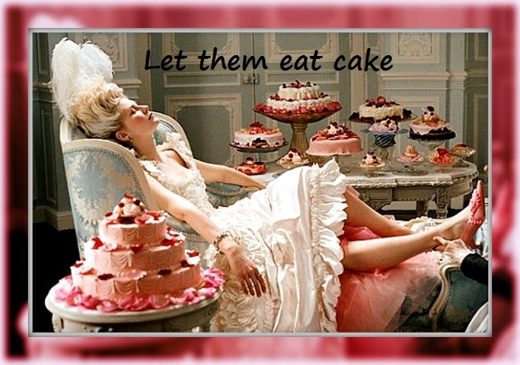
Economic Crisis

Slide 47
France at War
1792: other countries (Austria and Prussia)feared revolution
  Declared war on France
  Riots broke out all over France
Legislative Assembly got rid of the Constitution, dissolved monarchy and created a republic: National Convention
  Adult males given the right to vote
  Chaos plagued Paris
45

Slide 48

Rise of Jacobins
Not all of France agreed on the changes in government and society
Radical group developed: Jacobins.
  They called for the death of all those who supported the King.
King lost all authority
Tried for treason
Jan. 21, 1793 the King was beheaded by the guillotine.

Slide 49
Reign of Terror
Robespierre Assumes Control
One Jacobin leader, Maximilien Robespierre slowly gained power.
Robespierre and his supporters wiped out every trace of France’s past.
Robespierre became leader of the Committee Public Safety.
He governed France as a dictator-his rule became known as the Reign of Terror.
  Over 40,000 civilians died

Slide 50
End of the Terror: Directory
Many feared for their own safety
Robespierre was executed
Created new government
  power in the hands of the upper middle class
Directory: two-house legislature & an executive body of 5 men
many were corrupt
  made themselves rich at France’s expense.
They also found the right general to lead France’s armies- Napoleon Bonaparte.

Slide 51
Napoleon Grasps Power (1804)
Officer in French army
Put in charge of military in 1799.
Became part of directory
Eventually became dictator
coup d’ etat: A sudden seize of power

Slide 52
Changes Under Napoleon
Economy
Set up fairer tax code
Government and Society
Appointed officials by merit
Religion
Recognized Catholicism as the “faith of Frenchmen”.
Set up national bank
Stabilized currency
Gave state loans to business
Fired corrupt officials
Created lycess- government run schools.
Created the Napoleonic Code- set of uniform laws and eliminated many injustices.
Signed a concordat (agreement) with the pope- recognized the influence of church but rejected church control of national affairs.
Retained seized church lands.
Restricted individual rights such as speech and expression in the name of national security.

Slide 53
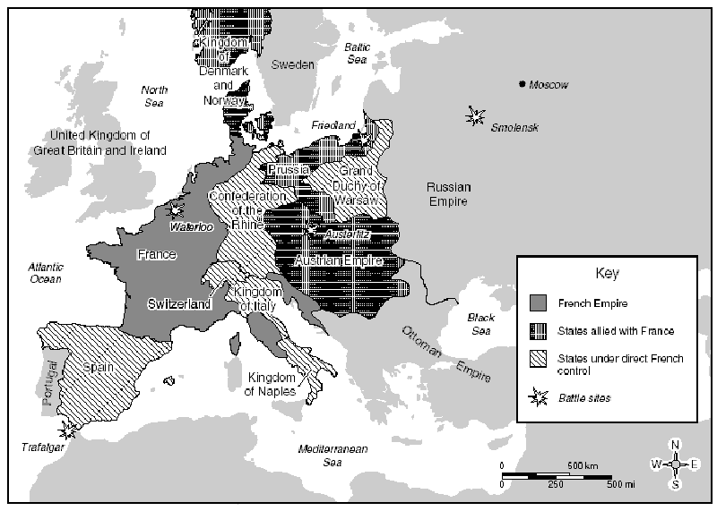
Napoleonic Empire

Slide 54
Fall of Empire: Napoleon’s three mistakes
The Continental System
He called for a blockade of all ports to Great Britain.
To make the European continent more self-sufficient.
To hurt Britain’s commercial and industrial economy.
Britain imposed its own blockade of Europe.

Slide 55
Mistake Two
The Peninsular War
Portugal was ignoring the Continental System.
Sent an army through Spain to attack Portugal.
The Spanish became angry and attacked the French army- Napoleon lost 300,000 soldiers in Spain.

Slide 56
Mistake Three
The Invasion of Russia
The Russian- French alliance fell apart- Napoleon marched troops into Russia.
Russians decided not to fight, they retreated towards Moscow- they practiced a scorched earth policy- burning grain fields and slaughtering cattle as they retreated.
Many of Napoleon’s troops deserted, froze to death or were killed by Russian raiders.

Slide 57
Napoleon’s Downfall
The Coalition Defeats Napoleon
A coalition of European countries(Austria and Prussia allianced with Gr. Britain ) marched into France & easily defeated Napoleon’s army.
Napoleon was sent into exile on the tiny island of Elba, of the Italian coast.

Slide 58
Europe’s Response
The effects of the French revolution was widely felt throughout Europe.
Stirred up ideas of nationalism and liberalism
Challenged old aristocratic order and power of the church
In 1814 diplomats from Britain, Russia, Austria, and Prussia met at the Congress of Vienna.

Slide 59
Metternich Restores Stability
Congress of Vienna
Prince Klemens von Metternich- Austria foreign minister headed the Congress of Vienna- a series of meetings looking to establish peace & stability in Europe.
Don’t want another “Napoleon”

Slide 60
Goals of Congress of Vienna
Metternich had 3 Goals for the meetings
Wanted to prevent further French aggression.
He wanted to restore a balance of power in Europe.
He wanted to restore Europe’s royal families to their thrones before Napoleon’s conquests.
Defeat liberal revolutions in Spain and Italy.

Slide 61
Creation of New Nations
The Austrian Netherlands & Dutch Republic formed the Kingdom of the Netherlands.
The German states were united to form the German Confederate.
Switzerland was recognized as an independent nation.

Slide 62
Balance of Power
Did not want to punish France too severely.
They allowed France to keep its overseas possessions, its army and its government.
Needed France to be strong

Slide 63
Power of Legitimacy
The Congress affirmed the power of legitimacy- agreeing to restore many rulers driven off by Napoleon, including restoration of monarchy in France
Louis XVIII was returned to power- he set up a constitutional monarchy.

Slide 64
Political Changes Beyond Vienna
Conservative Europe
Concert of Europe- A series of alliances devised by Metternich assured that nations would help one another if any revolution broke out.
Holy Alliance- The Czar of Russia, the Emperor of Austria, & the King of Prussia entered into an agreement.

Slide 65
Legacy of Vienna
The power of France decreased while the power of Britain and Prussia increased.
Nationalism began to grow in Italy, Germany, and Greece.
The nationalistic feelings would explode into revolutions, and new nations would be formed.

Slide 66
Nationalism, Reform and Revolution
Throughout the next three decades nationalist and revolutionary movements arose, most of them unsuccessful because conservatory order continued in control

Slide 67
Greek Independence
1821: Greek revolutionaries launched an independence movement against Ottoman Empire.
Appealed to Europeans forhelp.
Although many conservative leaders leaders like Metternich did not support the idea of democratic govt. in Greesce, many intellectuals and artists believed the cradle of western culture should be liberated from Ottoman oppression
In 1830, Britain, France and Russia pressured Ottoman Empire to grant Greek independence

Slide 68
Revolutions of 1848
Began in Paris followed by Italy, austria , and Prussia
Demands:
  Self-determination-democratic rights
  Economic opportunities
  Mostly by middle class
  But the conflicts of 1848 failed because monarchs continued to retain the support of aristrocrats and the military.

Slide 69
Reforms in Britain and France
Popular opinion and protest led French and British governments to allow for extended voting rights and increased labor and economic reforms

Slide 70
Inner circle Outer circle Activity
List the political theories of the Enlightenment.
How did the ideas of the Enlightenment lead to the American, French and Haitian Revolutions?
How did the Revolutions stem from one another?
How were social classes defined in the colonies and in France prior to the revolutions? How did they change during and after the revolutions?
How did the role of women change after the revolutions?
Why did the Enlightenment remain almost solely in the Western Hemisphere?

Slide 71
The Haitian Revolution
Colony of San Dominique (Haiti) was very rich and produced sugar, cotton, coffee, and other products.
Colony produced two third’s of France’s imports and exports.
Extremely high volume of slaves.Brutal repressive slave system.

Slide 72
Francois Dominique Toussaint L’Ouveture
The leader of the Haitian Revolution
Napoleon sent military to reestablish slavery
  At first it was a success, but later failed.
He freed slaves and gained effective independence for Haiti
Toussaint was captured and sent to France, where he soon died in prison.
Many still protested
women joined.
In 1804, Haiti declared independence
  Even thought they gained freedom, many died, the economy and authority were ruined.

Slide 73
The ideas of enlightenment thinkers influenced resistance to political authority, as reflected in revolutionary documents
Examples of revolutionary documents
America-
Declaration of Independence
France-The French Declaration of independence
Latin America- Bolivar’s Jamaica Letter

Slide 74
Question
In a social sense , what was the driving force for the revolutions to happen in the Americas, Frence and Latin America?
The growing power and culture of the bourgeoisie.

Slide 75
Key Concept 5.3 Nationalism, Revolution, and Reform
The eighteenth century marked the beginning of an intense period of revolution and rebellion against existing governments, and the establishment of new nation-states around the world Enlightenment thought and the resistance of colonized people to imperial centers shaped this revolutionary activity. These rebellions sometimes resulted in the formation of new states and stimulated the development of new ideologies. These new ideas in turn further stimulated the revolutionary and anti-imperial tendencies of this period.

Slide 76
http://www.youtube.com/watch?v=Hvds2AIiWLA

