Slide 1
Chapter 25
Land Empires in the Age of Imperialism
1800-1870

Slide 2
The Middle East: 1752 -1914 Key Concepts
During the 19th century the Ottoman Empire was faced with a series of political, economic, and social setbacks that led to a decline in its power.
Throughout the 19th century attempts at modernization such as the Tanzimat (“the reorganization”) and young Ottoman reforms, sought to strengthen the Empire.
Reforms did not include women, who were unable to increase their work or educational opportunities, and certain reforms caused them to lose economic powers they previously held.
Despite these widespread reforms, the Ottoman still lagged behind other more developed nations.
As the 20th century approached, the Ottoman Empire was labeled the “sick man of Europe,” and European leaders post the Eastern question: should the Ottoman Empire continue to exist; if not who should take over this territory?
Nationalist or Turkish reformers call the Young Turks gained increasing influence in the Empire. They supported a crackdown on ethnic minorities and closer alignment with Germany on the eve of World War I.

Slide 3
Key terms
Crimean war
Eastern question
Extra territoriality
Greek independence
Janissaries
Nationalism
“sick man of Europe”
Tanzimat
Ulama
Young Ottomans
Young Turks

Slide 4
Ottoman Empire
BEFORE (since1450)
CONTROLLED MOST OF MIDDLE EAST
STRONG CENTRAL AUTHORITY
RELIGION WAS BASIS FOR MOST LAW
CONTROLLED TRADE THROUGHOUT THE MIDDLE EAST
USED JANISSARIES IN MILITARY
Young Christian boys taken from
Balkans, converted to islam and
trained as elite military guard of Sultan

Slide 5
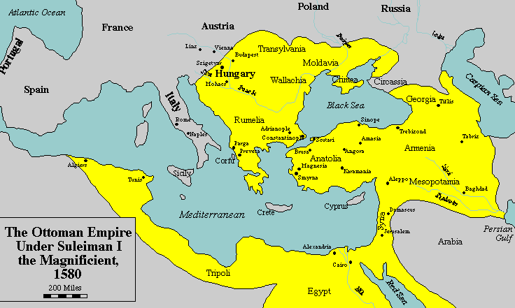

Slide 6
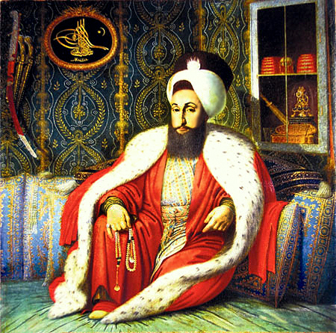
Ottoman Empire at the start of the 19th century
Weak govt led to regional powers-Arabia and Egypt(Napolean 1801)
The Janissaries resisted adoption of new western ideas
Stagnant economy and slow technological changes
Steeped in centuries
of tradition
The Ulama saw
modernization an
attack on Islam
Salim III
During the 19th century the Ottoman Empire was faced with a series of political, economic, and social setbacks that led to a decline in its power.

Slide 7
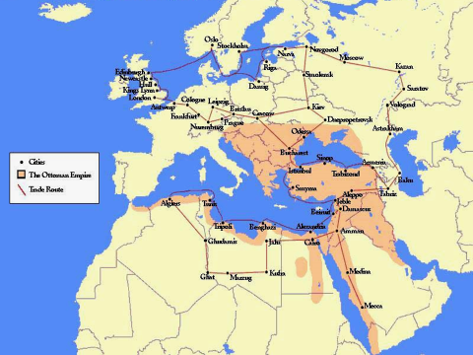
Sultan Selim III
1. Interested in the technological and military changes that were taking place in Western Europe
European-style military
Standardized taxation
Reinstitution of Ottoman control over provincial governors.
2. In Serbia (part of Ottoman Empire)
Janissaries acted as provincial governors and military forces disliked reforms on Serbian Orthodox Christian population.
Sultan takes the help of Bosnia to crush Uprising
and defeat the Janissaries.
Serbia becomes independent- shows weakness of
Sultan Selim III-janissaries and Ulama forced him to end
his reform program in 1806
He was imprisoned and later killed.
Funding-excise
tax on tobacco
and coffee
Opposition-Janissaries And Ulama
SERBIA

Slide 8
Mahmud II 1808-1839
Gain the support of the Ulama and janissary forces in Istanbul.
Limited reforms –slow change needed– to solidify his power.
Greece
Increase local groups were organizing against Ottoman controlled throughout the 1820s
European nations eager to reclaim the Greek and Roman traditions that had been identified as the source of Western civilization, aided grease to liberate from Ottoman control.
Mahmud sought Egypt’s Muhammad Ali’s help to defend the empire from European attack.
In the battle of Navarino, in 1829 the bulk of Ottoman naval fleet was destroyed by European powers who were determined to see an independent Greece
Greece

Slide 9
Mahmud modernizes ottoman military
Greece lost/Admired Egyptian military
Egypt attack Syria –succeed the Ottomans as dominant power in M.E
IT WAS TIME FOR DRASTIC MILITARY REFORMS
Steps
Dissolves the Janissary Corps
Limited the power of the Ulama
The turning point to the downfall of Mahmud-
His own rebuilt naval force, sided with Egyptian troops who attacked Anatolia (Modern turkey) and headed towards Istanbul, the capital.
Sought British and French help, who helped defend the capital and used financial threats to force Egyptian withdrawal from Ottoman Territory
The survival of Ottoman Empire now solely
depended on European Aid

Slide 10
Abdul Mejid –Tanzimat reforms –Europeans pleased
Tanzimat means reorganization.
1. Political rights for men – for example,
free public trials
A limited right of privacy
Equitable methods of tax collection
2. Reforms to Modernize Ottoman Empire
Strongly supported by European allies
Military training schools modeled on Western European methods- young officers trained in Europe.
Westerners were brought in to educate Ottoman elite.
National preparatory schools to funnel graduates into military colleges and universities.
French became the language of instruction.
Young educated men adopted Western-style of dressing.
Prominent elite embrace the westernization of Ottoman society- – read newspapers and French, travel to Europe, supported importation of military, industrial, and communications technology.
Tax on non-Muslims was abolished.
Codes specifying equal legal protection for Muslims, Jewish, and Christian subjects were passed.
European powers were increasingly interested in the status of Christians in the Empire – missionaries flowed into Ottoman territories in the second half of the 19th century.
New tax collection practices and the tax on farming– relieved hardship for the total population.
More legal codes replaced sharia, Islamic law
THE POWER OF THE Ulamas DECLINED AS DID THE lure OF RELIGIOUS EDUCATION,
FEWER STUDENTs ENTERED RELIGIOUS SCHOOLS

Slide 11
WOMEN STATUS AND Tanzimat REFORMS
Restricted rights of women.
No increased political participation
Fewer or no educational opportunities
Industrial labor and professional occupations, hallmarks of the new process of modernization, were not open to women.
No share in the competitive cash-based economy that developed due to industrialism.
Westernization of the court system led to a loss of powerful women.
Lost property and inheritance rights.
Despite these widespread reforms, the Ottomans still lagged behind other more developed
European nations, a fact that would threaten the Empire repeatedly
in the second half of the 19th century

Slide 12
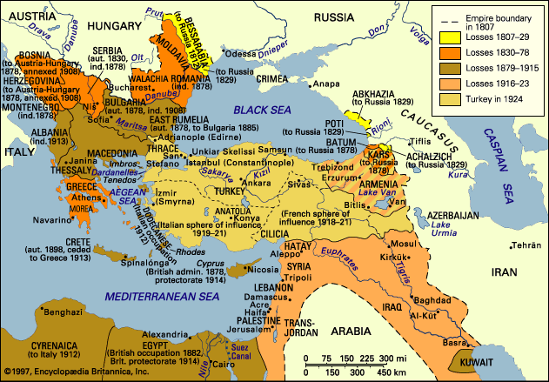

Slide 13
AP tip
Do industrialism and westernization give women more rights and opportunities?
When students first examine this idea, they think of Western Europe and the United States and quickly think “yes”; many factory jobs open up, women leave home and demand equal treatment and P, as well as increased access to the political process. Though this did happen in some societies, the process of westernization narrowed the role of some women in the Ottoman Empire. Industrialization did not lead to new opportunities in either the factories on the professions, which where the exclusive domain of men. In addition, the westernization of the court system led to women’s loss of power over inheritance and property and wealth by establishing trusts in the name of the sons and acting as executors. But with no standing in the new secular courts established by the Tanzimat reforms, women lost this power.

Slide 14
Crimean War:1853-1856
Causes:
Russia’s southward expansion
Religious differences-protectors of Orthodox Christianity
Weakness of Ottoman Empire-when Egyptian forces attacked Syria, Russia came to help the sultan, pushed back Muhamad Ali’s forces.
Treaty recognized Russia as defender of the Orthodox Church.
Desire for a warm water port

Slide 15
C
H
A
N
G
E
S
Russia discredited-ottomans considered them a threat.
Unity between Ottomans and Europeans as allies(esp. France )- In 1852 France was name protector of the Holy Sepulcher in Jerusalem.
Violated previous treaty made between Russia and ottomans
Leads to beginning of the Crimean war-Romania is lost in 1853 to Russia
Britain and France
help Ottomans.
Distrusted Russians –saw its expansion as a threat to overland access to trade through Central Asia.
Three years of war on land and sea
Setback in Russia’s troops- asks for peace.
Ends Russian Expansion
Crimean War Marked transition to modern warfare

Slide 16
The “ Sick Man of Europe” and the eastern Question
C
H
A
N
G
E
S
Tsar Nicholas
Fell behind militarily, economically, and technologically.
Western powers asked if the Ottoman empire should continue to exist- The eastern question- who should take control of its territory?
Economic Problems
-declining agriculture revenues
-large debt to foreign nations
-inflation
-widespread corruption.
Outcome
-Significant European presence in Ottoman empire –were exempted from the law of the land
-Young Reformers demanded action for violation of Ottoman Sovereignty,

Slide 17
Key terms
Crimean war
Eastern question
Extra territoriality
Greek independence
Janissaries
Nationalism
“sick man of Europe”
Tanzimat
Ulama
Young Ottomans
Young Turks

Slide 18
The Middle East: 1752 -1914 Key Concepts
During the 19th century the Ottoman Empire was faced with a series of political, economic, and social setbacks that led to a decline in its power.
Throughout the 19th century attempts at modernization such as the Tanzimat (“the reorganization”) and young Ottoman reforms, sought to strengthen the Empire.
Reforms did not include women, who were unable to increase their work or educational opportunities, and certain reforms caused them to lose economic powers they previously held.
Despite these widespread reforms, the Ottoman still lagged behind other more developed nations.
As the 20th century approached, the Ottoman Empire was labeled the “sick man of Europe,” and European leaders post the Eastern question: should the Ottoman Empire continue to exist; if not who should take over this territory?
Nationalist or Turkish reformers call the Young Turks gained increasing influence in the Empire. They supported a crackdown on ethnic minorities and closer alignment with Germany on the eve of World War I.

Slide 19
AP Tip
One of the most important skills in AP world history is the ability to recognize global patterns and processes such as industrialization, and analyze their effects in various regions. In many ways, attempts at reform and industrialization in the Ottoman Empire were similar to comparable efforts in the Americas, Africa, and Asia. All of these regions were forced to grapple with issues of modernization and industrialization in the 19th century. Western European nations were the first to use the new technology to change and retool their economic system and military power. The Ottoman Empire and other less-developed areas were especially interested in gaining new military technology. The creation of a global industrial market turned nations into either manufacturers of consumer goods are suppliers of raw materials for those goods. As suppliers of raw materials, the Ottomans were unable to generate enough wealth to become fully industrialized. Attempts at further industrialism had to be funded from Europe and the United States, leaving many underdeveloped nations in debt and with unwelcome European and American interests managing parts of their economy. The Ottoman Empire’s inability to industrialize and the causes of bacteria can be compared with the experience of many other areas that went through this global process in the 19th and 20th centuries

Slide 20
Russian Empire

Slide 21
Is Russia European??
Yes and No!
Only 3% lived in cities
Slow to industrialize
Fear of change prevented progress
European greatly feared Russia

Slide 22
Russian Serfdom
Since the reign of Ivan the Terrible (1533), the Russian Tsars had followed a fairly consistent policy of drawing more political power away from the nobility and into their own hands. This centralization of authority in the Russian state had usually been accomplished in one of two ways--either by simply taking power from the nobles and braving their opposition (Ivan the Terrible was very good at this), or by compensating the nobles for decreased power in government by giving them greater power over their land and its occupants. Serfdom, as this latter system was known, had increased steadily in Russia from the time of Ivan the Terrible, its inventor. By the time of Catherine the Great, the Russian Tsars enjoyed virtually autocratic rule over their nobles. However, they had in a sense purchased this power by granting those nobles virtually autocratic power over the serfs, who by this time had been reduced to a state closer to slavery than to peasantry.

Slide 23
TSAR
Boyars
Nobles
Peasants

Slide 24
Russia and Asia
by end of 18th century, the Russian Empire had reached the Pacific and borders of China
19th century: expansion continued south
conflict with China, Japan, Iran and Ottoman Empire
Britain attempted to halt expansion before Russia gained full control of all of Central Asia

Slide 25
Russian Changes and Expansion
Tsars assumed absolute power
Eventually emancipated the serfs (Alexander II)
No plan after emancipation, caused unrest
Attempts to westernize not supported
Pan-Slavism caused riffs in Russian culture and society

Slide 26
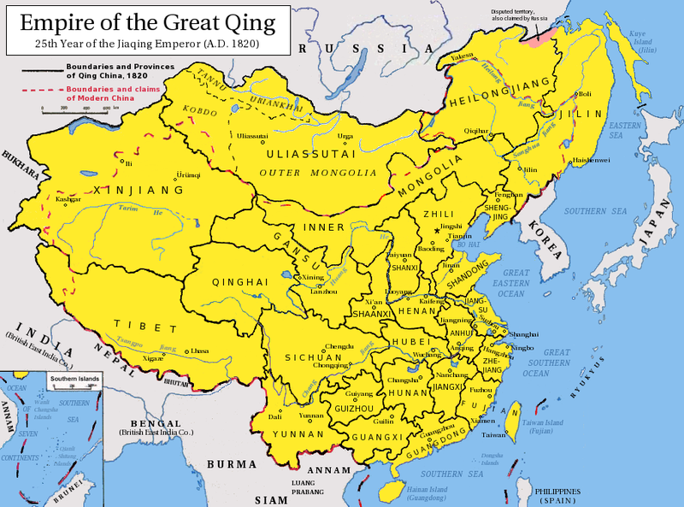
The Qing Empire
Canton

Slide 27
Problems
Agricultural economy
Population doubled
Environmental damage
Weak government/corruption
Foreign influence

Slide 28
Opium War
Causes:
Chinese believed Europeans were inferior
Ignored opium trade
British demand for Chinese goods
Demand for Chinese goods in Europe
Aftermath
Ban on opium
War: 1839-1842
British were better equipped/better weapons
Forced to sign Treaty of Nanking
demanded reparation payments, allowed unrestricted European access to Chinese ports, and ceded the island of Hong Kong to Great Britain)

Slide 29
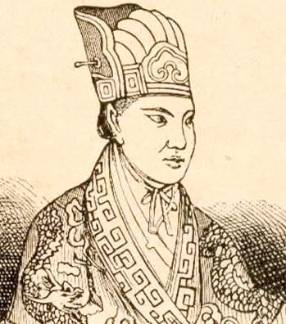
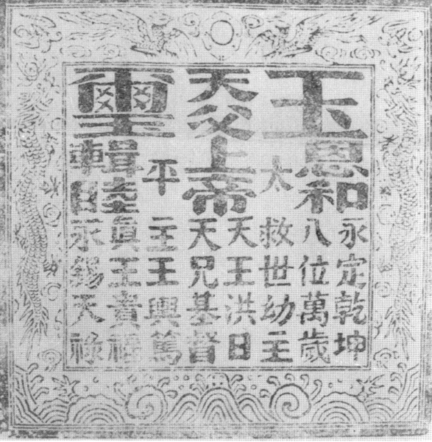
Hong Xiuquan
Royal Seal of TaiPing Revolution
Taiping Rebellion

Slide 30
Taiping Rebellion
poor farmland, endemic poverty and economic distress led to Hakka (Han) peoples to lowliest trades
Hong Xiuquan: could not pass administrative exam
began reading bible for answers
declared himself younger brother of Jesus Christ
established “Heavenly Kingdom of Great Peace” or Taiping
initially defeated imperial troops
captured Nanjing made capital of Kingdom
Qing able to defeat Taiping with combined forces of provincial governors and French and British forces
one of the world’s bloodiest civil wars
20-30 million deaths
depopulation
destruction of rich agricultural lands in central and eastern China

Slide 31
Decentralization
after the 1850s the expenses of wars and the burden of protection costs to Western governments made it impossible for the Qing to get out of debt
Tongs Restoration: Britain and France helped to financially stabilize Chinese economy
restore agriculture
reform military
industrialize manufacturing
eventually disintegrated into a set of large power zones
provincial governors exercised most political power

Slide 32
Boxer rebellion
Weakness of Qing Dynasty was clearly felt after the defeat in the Sino-Japanese war.
Empress Doweger Cixi seized power in a palace coup.
Supported the secret society known as the Righteous fist, or Boxers.
Goal
Get rid of all foreigners from China, including Christian missionaries.
Western powers and Japan put down Boxer rebellion
Revolutionary Movement
Sun Yat sen –Goal- to overthrow Qing Dynasy and establish socialist government with traditional Confucius philosophy
Sun became the president of New Chinese Republic in 1911

