Slide 1
Lecture 20: The Scientific Revolution
What are the historical origins of the Scientific Revolution?
How does scientific and technological innovation alter the course of human existence?

Slide 2
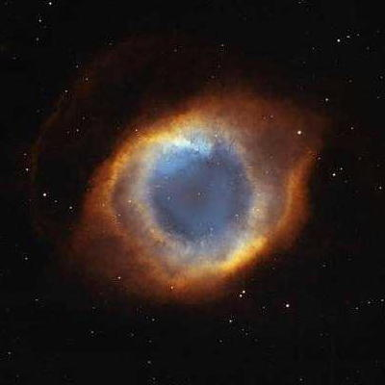
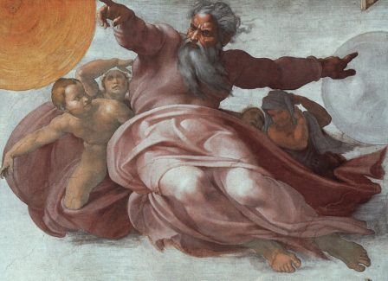
Introduction: Essential Understandings
“Scientific Revolution” coined in the 18th century (overly positivistic?)
As much a revolution in ways of “thinking about” and “doing” science as the actual scientific advancements
LONG time frame and geographic scope
Social, economic, political, cultural changes as well
Scientific and technological innovations of the 17th , 18th , and 19th centuries dramatically altered the course of human existence
Helped lay the foundations of the modern “scientific” world
“From a closed world to an infinite universe”

Slide 3
Answer Questions

Slide 4
Introduction: The Question that Transcends The Centuries
Religion, politics, science often in overlapping spheres - creates both conflict and cooperation within society (see closer look: sciences and arts on webpage)
Can Religion and Science co-exist?
Why does this question still dominate intellectual and spiritual authorities?
What, in your opinion, are the historical origins of this debate?

Slide 5
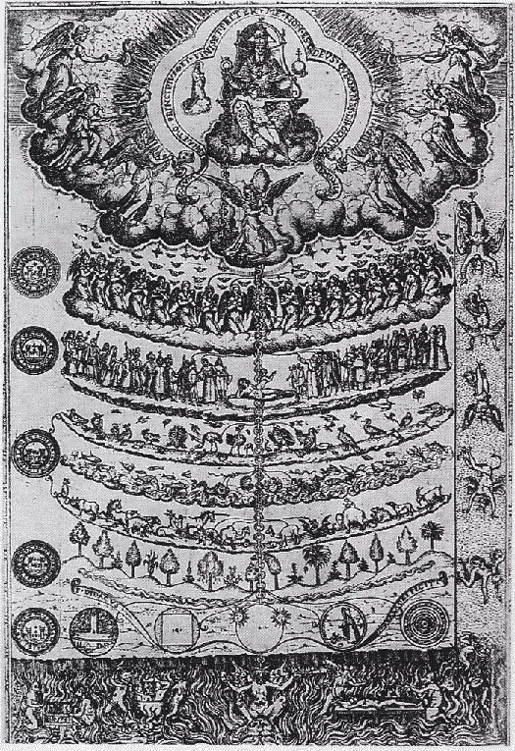
Creation of a New Worldview
First the “old” worldview:
Scholasticism
Start with pre-determined sources and outcomes
The Bible
Classical antiquity
Aristotle (384-322 BCE)
Ptolemy (83-161 CE)
Galen (129-200 CE)
The great “Chain of Being”

Slide 6
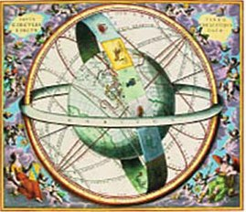
Creation of a New Worldview
Renaissance, Reformation, and Exploration began questioning of old knowledge & assumptions
Gradual replacement of religious & superstitious presumptions
Gradual rise of science & reason
Weakening authority of the R.C.C
Concept of “natural philosophy” (scientists)

Slide 7
Changes began in the areas of physics, astronomy and math - the “hard” sciences
The Ptolemaic/Aristotelian System (see Emperors astronomy on weebsite)
Based on the calculations of early astronomers as well as “common sense” (heaviness of objects)
Assumed the Earth was the center of the universe (geocentrism)
Fluid spheres contained moon, sun, planets and stars, God and angels
State of rest was natural

Slide 8
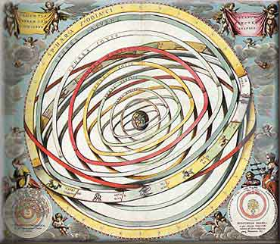
Geocentric Model

Slide 9
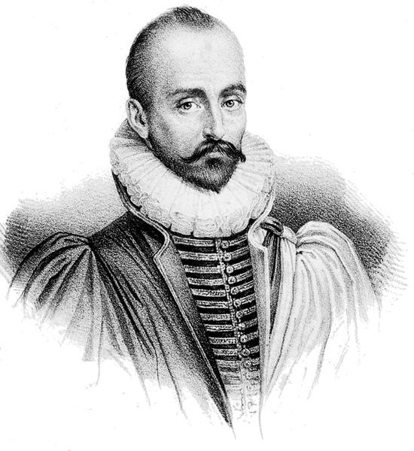
Emerging Skepticism
Michel de Montaigne (1533-1592)
"Que sais-je?" (What do I know?)
Nothing

Slide 10
Scientific Issues with the Ptolemaic model:
Retrograde motion (appearance of planets moving backward) because of the different speeds of planets – the model didn’t work.

Slide 11
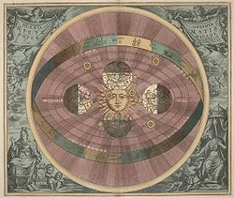
Heliocentric model

Slide 12
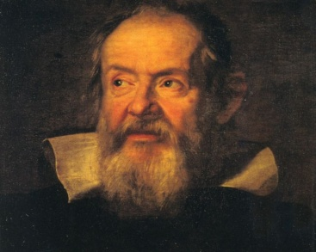
Galileo Galilei
1609 - Turned an advanced Dutch telescope towards the heavens
Saw all sorts of wonders (sun spots, moon mountains, moons orbiting planets, etc.)
Argued that these proved Copernican model (see Copernican universe on website)
Court mathematician, astronomer, philosopher. Very self-promoting (would have loved Twitter)
Argued that universe was subject to rational mathematical laws
He was condemned by the Catholic Church, investigated by the Inquisition, his books placed on the Index of Prohibited Books, and held under house arrest for years (see Galileo to the Grande Duchess on webpage)

Slide 13
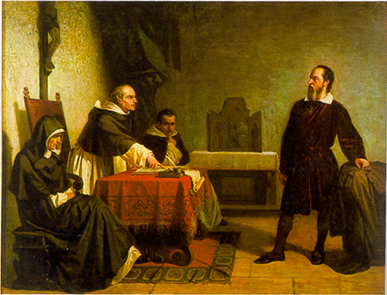

Slide 14
1. Get into Groups of 6
2. Each person chooses a philosopher (scientist) from the following – Copernicus, Brahe, Kepler, Galileo, Newton, Bacon
3. Fill out your chart
4. Share with the group

Slide 15
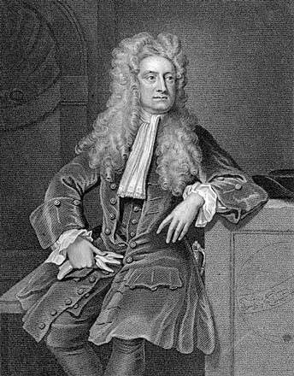
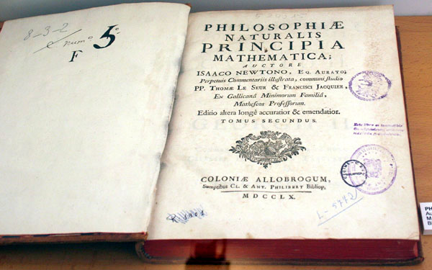
New Directions in Astronomy and Physics
Important question: how do the planets and heavens move in such an orderly way?
Isaac Newton 1687 - Mathematical Principles of Natural Philosophy (the Principia)

Slide 16
Planets and other bodies moved through gravity (mutual attraction) according to the rules of mathematics
Formed the basis of modern physics until Einstein
Also responsible for modern calculus
Newton’s Three Laws of Motion:
1. An object in motion will remain in motion unless acted upon by a net force, and an object at rest will remain at rest unless acted upon by a net force; this is also known as inertia.
2. Force equals mass multiplied by acceleration.
3. For every action there is an equal and opposite reaction.

Slide 17
The “Other” Sciences
Rationalism of math and physics influences other sciences
Use of the microscope (mid 17th century) opens up new avenues for discovery
Biology
Santorio Santorio – begins examining chemical processes in human body
William Harvey – discovers blood circulation
Giovanni Alfonso Borelli – mechanisms of muscular motion
Edme Mariotte – plants and sap
Linnaeus – systematic classification
Chemistry
Antoine Lavoisier – explains oxidation
Henry Cavendish - isolates hydrogen
Joseph Priestly - discovers oxygen

Slide 18
Novum Organum: New Instruments
"Printing, gunpowder and the compass: These three have changed the whole face and state of things throughout the world; the first in literature, the second in warfare, the third in navigation; whence have followed innumerable changes, in so much that no empire, no sect, no star seems to have exerted greater power and influence in human affairs than these mechanical discoveries.“
What three innovations have changed our modern world?

Slide 19
DO the Vertical surfaces assignment

