Slide 1
Chapter 24
Africa, India, and the New British Empire

Slide 2
New African States
Sokoto, Zulu, and Egypt.

Slide 3
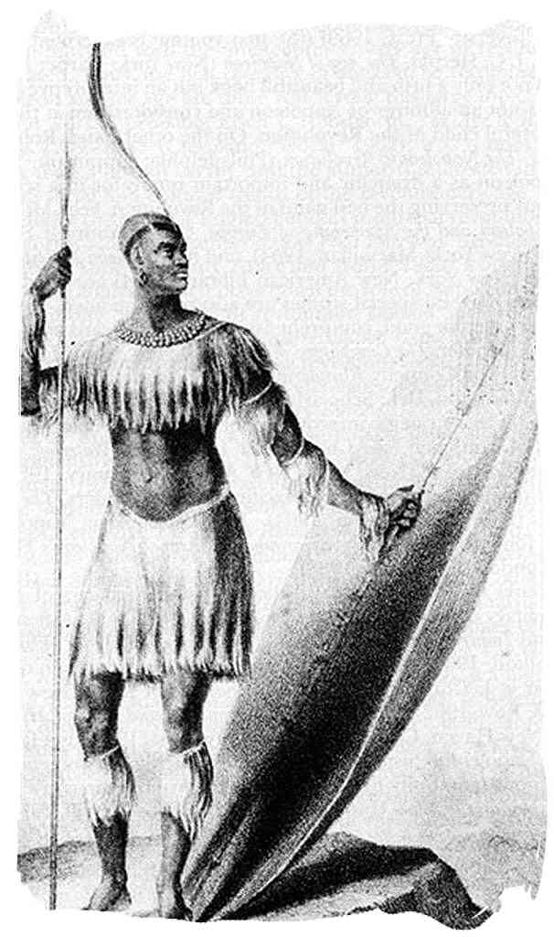
Zulu kingdom
Created by disputes over farmland.
Founded by Shaka.
Conquered with the combination of well equipped and trained fighters and exploitation of the resources of defeated enemies.
Great military order and discipline.

Slide 4
Sokoto caliphate
Created by Usuman dan Fodio.
Waged a holy war against the Hausa kings for being “unbelievers”.
Gained much support due to the Muslims unhappy by their social/religious class.
The Sokoto promoted Islam with schools, Great Library, and forced conversions.
Had a great amount of slaves.

Slide 5
The Zulu kingdom arose primarily from
Centralized African defense against the British
Internal conflicts over grazing and farmland
Conflicts over hunting lands and the gold rush
The spread of epidemic disease from the Americas.

Slide 6
Modern egypt
Muhammad Ali succeeded Napoleon as ruler.
Perused modernization of Egypt to match Europeans.
Created schools and a university.
Increased agricultural production.
Reformed landholding, administration, and the army.
Succeeded by his son, Ismail, whom also focused on westernizing Egypt.
Egypt’s revenues increased exponentially and exports doubled.
Muhammad Ali’s creation of modern Egypt was shaped by the shock of Napoleon’s occupation of Egypt
Modernization of Egypt led to huge debt to be paid to European nations –England and France

Slide 7
Modernization in Ethiopia
3. In the mid- to late nineteenth century Ethiopian kings reconquered territory that had been lost since the sixteenth century, purchased modern European weapons, and began to manufacture weapons locally.

Slide 8
By the 1840’s Ethiopian leaders made _________ a top priority.
Educational reform
Economic reform
The purchase of European weapons and local production of weapons
An alliance with Portuguese settlers

Slide 9
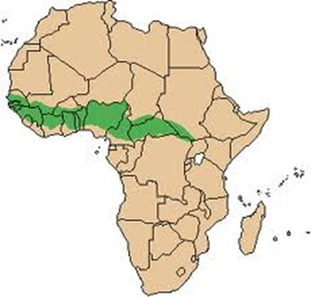
ALGERIA
Egypt
Ethiopia
Hausa State
______ Caliphate
Zulu

Slide 10
C. European Penetration
1. In 1830 France invaded Algeria; it took the French eighteen years to defeat Algerian resistance organized by the Muslim holy man Abd al-Qadir and another thirty years to put down resistance forces in the mountains.
2. European explorers carried out peaceful expeditions in order to trace the course of Africa’s rivers, assess the mineral wealth of the continent, and to convert Africans to Christianity. David Livingstone, Henry Morton Stanley, and other explorers traced the courses of the Nile, the Niger, the Zambezi, and the Congo rivers.

Slide 11
D. Abolition and Legitimate Trade
1. The British used their navy in order to stop the slave trade, but the continued demand for slaves in Cuba and Brazil meant that the trade did not end until 1867.
2. As the slave trade declined, Africans expanded their “legitimate trade” in gold and other goods.
3. The most successful new export was palm oil that was exported to British manufacturers of soap, candles, and lubricants. The increased export of palm oil altered the social structure of coastal trading communities of the Niger Delta.
4. Missionaries converted and founded schools for the recaptives whom the British settled in Sierra Leone while black Americans brought Western culture to Liberia and to other parts of Africa before and after Emancipation in the United States.

Slide 12
E. Secondary Empires in Eastern Africa
1. When British patrols ended the slave trade on the Atlantic coast, slave traders in the Atlantic trade began to purchase their slaves from the East African markets that had traditionally supplied slaves to North Africa and the Middle East.
2. The demand for ivory along the East African coast allowed African and Arab merchants hundreds of miles inland to build large personal trading empires like that of Tippu Tip.
3. Historians refer to these empires as “secondary empires”
4. Egypt’s expansion southward in the nineteenth century may also be considered a secondary empire. Muhammad Ali invaded the Egyptian Sudan in order to secure slaves for his armies.

Slide 13
Which of the following is the best description of trade patterns between Africa and Europe during the mid-19th century?
Slaves were the most important trading good that Europeans wanted from Africa.
Most parts of Africa were colonies of European nations that supplied raw materials for industrial production.
Europeans traded manufactured goods to independent African states for gold, ivory, and palm oil
Almost no trade existed between Europe and Africa after the slave trade had ended.

Slide 14
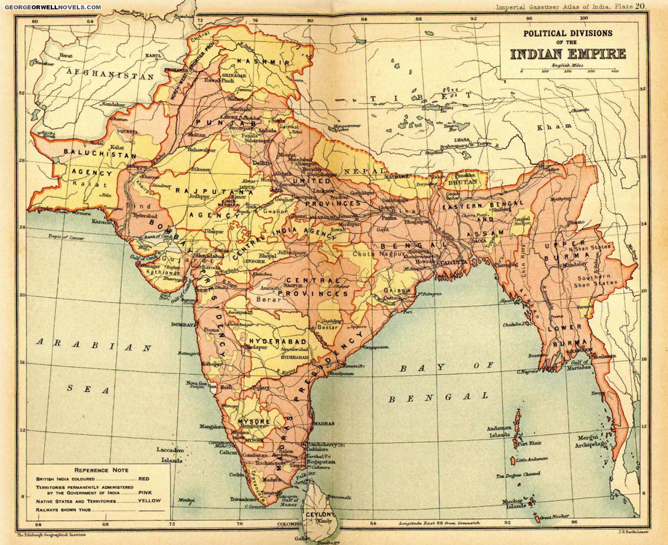
British raj
British control over India

Slide 15
Pre-British raj
Mughal power was extremely weak.
Iranian armies attack and loot Delhi.
Several Indian states declare independence.
Maratha Confederation possesses more land than the Mughal.
Nuwabs, deputies for the Mughal empire, controlled more land than the Mughal empire itself.
The British, French, and Dutch want to take advantage of the weakness and expand their trade.
“Company men” tried convincing the Nuwabs in any means necessary to allow them to set up their trading points.
Employed Indian warriors, called sepoys, to protect their warehouses.
Their armies became an influential force in India.

Slide 16
The creation and expansion of the British east India company
British set up trading post in Bengal.
Gained permission by the Nawab.
Nawab demands extra tribute for trading posts: attacks fort and treats the prisoners inhumanely in 1756.
British EIC retaliates.
Force led by Robert Clive overthrows the Bengal Nawab
Forces Nawab to allow the British EIC to control Bengal in 1765.
British EIC take over Arcot
Won the election of the nawab of Arcot over the French nawab.
The defeat of the Tipu sultan took control of South India.
British EIC overpowers the Maratha Confederation.
The British annexes several territories, creating an area called the “Bombay Presidency” after a long standoff between the EIC and the Maratha Confederation.

Slide 17
Economy of the British raj
Pros of British Rule
Increase of internal and external trade.
Expansion of Agricultural Production.
Cons of British Rule
British cotton goods produced in mills overshadowed the handicraft textile industry.
Many Indians could not keep up with the large change and rebelled constantly.
More Jobs
Opium, Coffee, and Tea.

Slide 18
Politics and the goal of the British raj
The overall goal of the British was to rebuild India under a British model. The problem, like the Mughal before them, was the customs deeply rooted in Indians.
Two sides of policies were created.
Emphasis on “Traditions”.
Emphasis on westernization.
Creation of a strong and efficient government.
Disarming of two million warriors and put them on normal jobs, mainly in agriculture.
Tolerance of Christian missionaries.
Private landownership.
Greater power given to Indian elites.
“Traditions”,
new and old, are used to both the Indian and British elites.
Women and low castes treated worse with higher taxes at the expense of the higher class.

Slide 19
Growing discontent of the common people
Women and lower castes gained less benefits from British reforms and gained more taxes and penalties from “traditions” imposed by the elites.
Christian missionaries annoyed the Muslims/Hindus.
Economy radically changed, causing unemployment/loss of wealth to some.
Ethnic conflicts in the recruitment of Sepoys.
Law of making recruits available for overseas service angered Hindus, who’s religion forbids ocean travel.
The new Enfield rifle’s ammunition packs were greased with animal fat, causing conflicts for both Muslims and Hindus.

Slide 20
Rebellion
1857-1858 a rebellion called the Sepoy Rebellion broke out.
Although the rebellion was put down, it had lasting effects on India.

Slide 21
Reaction to the rebellion
Complete government rework.
Traces of the Mughal and Company rule were destroyed.
Secretary to manage Indian policy put in London.
Government-General in Delhi acted as a viceroy.
The Indian Civil Service members took higher administrative and judicial posts.
A test must be taken in London to join, effectively excluding Indians.
Queen Victoria guarantees all Indians equal protection in law and religious and social freedom in 1858.
When Queen Victoria was announced “the Empress of India”, a Durbar took place.
These Durbars then happened every so often, usually in large events.
Durbars grandeur was to prove that the British were the new rulers.

Slide 22
Second wave of change
Heavy development of harbors, irrigation canals, etc.
Cleared forests for tea plantations.
Promoted the growth of cotton and jute (twine).
Better irrigation helped ease the rates of famine.
High growth in trade.
Promotion of new technology into India.
Steamboats, railroads, telegraph lines, and a new sewage system.
Exported raw materials to Britain, received finished products from Britain.

Slide 23
Indian nationalism
Pan-Indian nationalism promoted the deduction of the countries social and ethnic divisions.
Rammohun Roy created the Brahmo Samaj in 1828.
Supported reformation of several negative Hindu practices, like child marriage and the sati.
Created the Hindu Collage in Calcutta in 1816.
Indian National Congress established in 1885.
Wanted more Indians in the Civil Service.
Disliked British rule and prejudice.
Promoted religious and ethical unity.
Presented the opinions of the elite Indians, but did not have enough support to do anything.

Slide 24
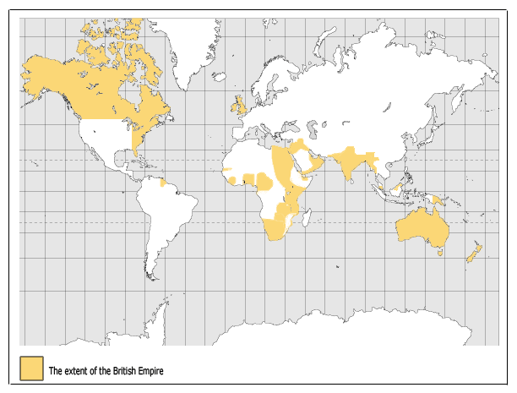

Slide 25
B. Imperial Policies and Shipping
1. Historians usually depict Britain in this period as a reluctant empire builder, more interested in trade than in acquiring territory.
2. Whether colonized or not, African, Asian, and Pacific lands were being drawn into the commercial networks created by British expansion and industrialization. These areas became exporters of raw materials and agricultural goods and importers of affordable manufactured products.
3. A second impetus to global commercial expansion was the technological revolution in the construction of oceangoing ships in the nineteenth century. Use of iron to fasten timbers together and the use of huge canvas sails allowed shipbuilders to make larger, faster vessels that lowered the cost of shipping and thus stimulated maritime trade.

Slide 26
C. Colonization of Australia and New Zealand
1. Portuguese mariners sighted Australia in the early seventeenth century, and Captain James Cook surveyed New Zealand and the eastern Australian coast between 1769 and 1778. Unfamiliar diseases brought by new overseas contacts substantially reduced the populations of the hunter-gatherer Aborigines of Australia and the Maori of New Zealand.
2. Australia received British convicts and, after the discovery of gold in 1851, a flood of free European (and some Chinese) settlers.
3. The British crown gradually turned governing power over to the British settlers of Australia and New Zealand, but Aborigines and the Maori experienced discrimination. However, Australia did develop powerful trade unions, New Zealand promoted the availability of land for the common person, and both Australia and New Zealand granted women the right to vote in 1894.

Slide 27
D. New Labor Migrations
1. British India was the greatest source of migrant laborers, and British colonies (particularly sugar plantations) were the principal destinations of the migrants.
2. With the end of slavery, the demand for cheap labor in the British colonies, Cuba, and Hawaii was filled by Indians, free Africans, Chinese, and Japanese workers. These workers served under contracts of indenture which bound them to work for a specified number of years in return for free passage to their overseas destination, a small salary, and free housing, clothing and medical care.
3. These new indentured migrants were similar to the European emigrants of the time in that they left their homelands voluntarily in order to make money that they could send or take back home or to finance a new life in their new country.

Slide 28
https://www.youtube.com/watch?v=Nosq94oCl_M&list=PLBDA2E52FB1EF80C9#t=297

Slide 29
Works cited
The Earth and Its People A Global History. Third ed. Boston: Houghton Mifflin College Div, 2006. Print.
"Google Images." Google. Web. 07 Mar. 2011. <http://www.google.com/imghp>.

