Slide 1
Lecture 3 Birth of the Renaissance and the Italian City States (1375-1527)
To what extent did the Renaissance represent a shift from the medieval to the modern world?

Slide 2
What is the Renaissance?
Considered by many to be the beginning of “modern” European History
Time of transition from medieval to modern world:
Occurred first in Italy and spread across Europe
Medieval | Renaissance
Fragmented Feudal Agricultural Church-based loyalty | Centralization Nation Commerce Secular

Slide 3
Origins of the term “Renaissance”
means “rebirth”
19th-century historian Jacob Burckhardt claimed the Renaissance period stood in distinct contrast to the Middle Ages
Most historians now think it was a continuation of changes already underway

Slide 4
Renaissance changes applied almost exclusively to the upper classes:
1. Upper classes had the luxury of time to spend learning the classics.
2. Peasantry was largely illiterate and Renaissance ideas had little impact on common people.
3. Working classes and small merchants were far too preoccupied with the concerns of daily life

Slide 5
Italian Renaissance
Italian cities survived Late MA in good shape (trade, banking, etc.)
Major political unit was the “city-state”: free, independent, and rich.
Most ruled by despots or oligarchies
Competition between them ensured balance of power
Birth of modern diplomacy (embassies, etc.)
Each hired condottieri (private mercenary generals) to fight wars
Promoted themselves through sponsorship of art and culture (basically bankrolled the Renaissance)
Five major city states: Florence, Milan, Rome (Papal States), Naples, Venice.

Slide 6
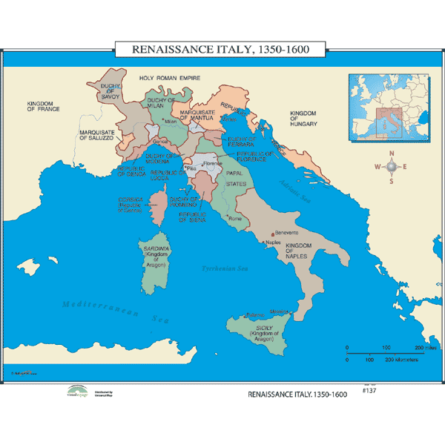

Slide 7
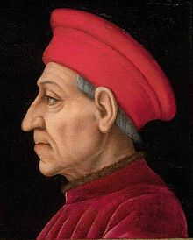
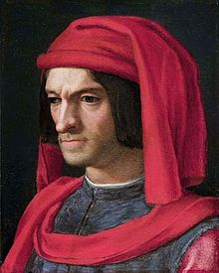
Florence
Center of the Renaissance during the 14th and 15th centuries.
A republic, ruled by the signora (council of rich guild leaders)
Faced social crisis in late 14th century, Chiompi Revolt by lower classes
Eventually dominated by the Medici family:
Cosimo de’ Medici (1389-1464): Most powerful of
the Medici rulers,
allied with other powerful families of
Florence and became unofficial ruler
of the republic
Lorenzo de’ Medici (the “Magnificent”) (1449-92): patron of the arts

Slide 8
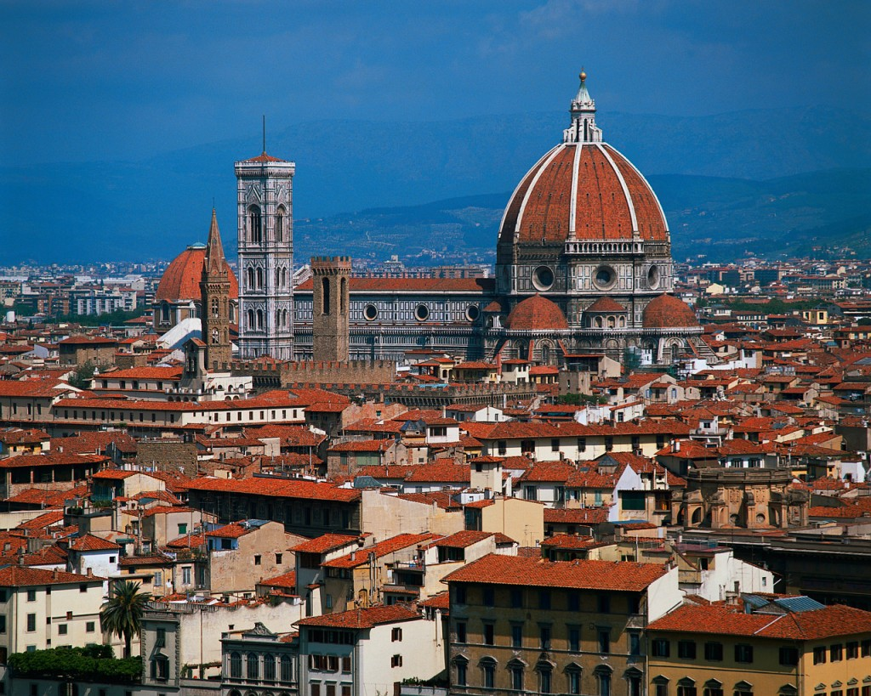
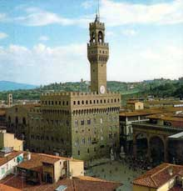
Duomo Palazzo Vecchio

Slide 9
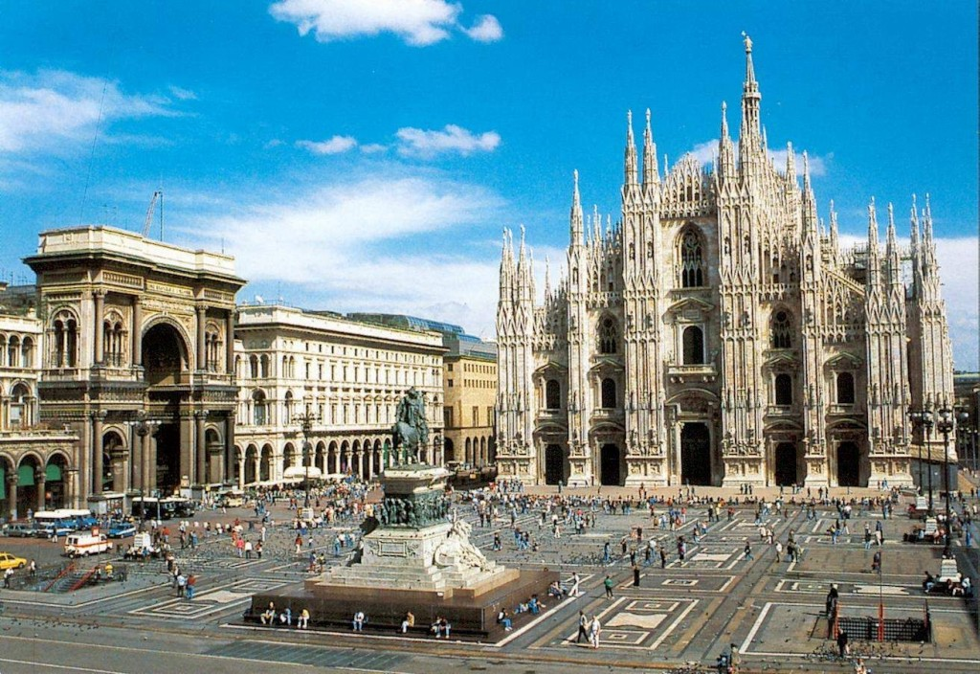
Milan
Factions in the city promoted podesta, or strongmen to maintain social order and keep trade flowing
Visconti then Sforza families ruled

Slide 10
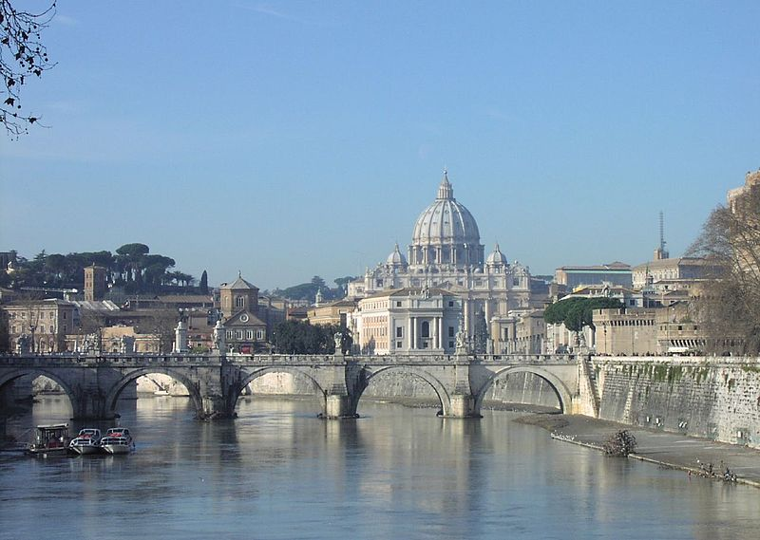
Rome/Papal States
Directly controlled by the Vatican
Popes were both religious and political leaders
Tended to focus on the secular over the religious, to put it mildly.

Slide 11
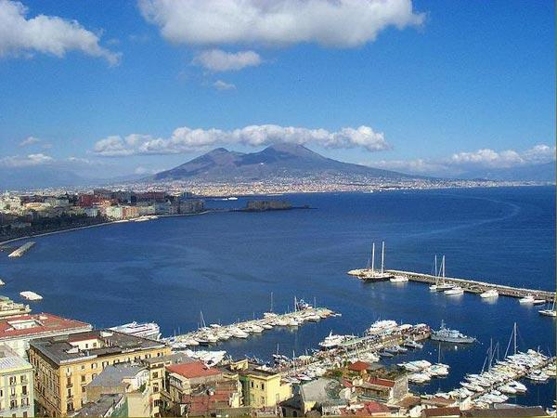
Naples
Included southern Italian region of Naples and the island of Sicily
Only Italian city-state to officially have a “king” (scary guy…)
Foreign influence: Controlled by France between 1266-1435, controlled by Spain after 1435

Slide 12
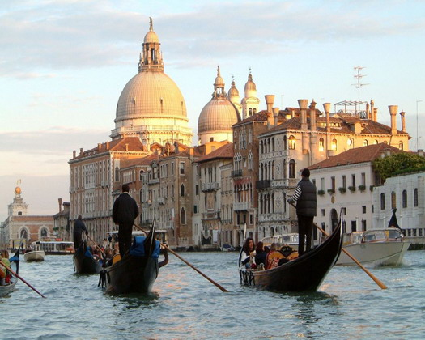
Venice
La Serenissima (the serene republic)
Richest trading and naval power
Resented by the rest of Italy
Run by a council of merchants (Council of Ten), led by an elected “Doge”

