Slide 1
Cold war
1945-1975

Slide 2
The United Nations
After World War II Western leaders perceived the Soviet Union as the center of a world revolutionary movement
United Nations was formed as a way of preventing future global conflicts. (Member nations had to renounce war and territorial conquest).
General Assembly, representative body of all member states
– Security Council, 5 permanent members (China, France, Great
Britain, U.S., & Soviet Union) and 7 rotating members
The United Nations provided a venue for face-to-face debate between the two sides in the Cold War.

Slide 3
The decolonization of Africa and Asia greatly swelled the size of the General Assembly
This became an arena for expressing opinions and whose resolutions carried great weight in the early years of the United Nations.
The influx of new members made the General Assembly more concerned with poverty, racial discrimination, and the struggle against imperialism than with the Cold War,
Therefore, the Western powers increasingly ignored the General Assembly.

Slide 4
Why the Cold War was “cold?”
The Cold War was a conflict between the capitalist and communist nations of the world that lasted from the end of World War II into the 1990's.
The Cold War is rather ironic because the main instigators in the conflict, the United States and the Soviet Union, the superpowers, never actually engaged in open warfare with one another, hence the usage of the term “Cold War.” This is not to say, however, that many lost their lives over what boiled down to economic and political ideology.

Slide 5
Capitalism and Communism
Between 1944 and 1946 the western capitalist countries created a new international monetary system in which supply and demand determined prices and that included a system of exchange rates, an International Monetary Fund, and a World Bank.
The Soviet Union, suspicious of Western intentions, established a closed monetary system in which the state allocated goods and set prices for itself and for the communist states of eastern Europe.

Slide 6
The Choice
Many leaders of newly independent nations, having won the struggle against imperialism, preferred the Sovit union’s socialist example to capitalism of their colonizers-differing economic models led to Cold War Rivalry

Slide 7
America and friendly Western European Countries
The United States economy recovered and prospered during and after World War II.
The economy of Western Europe, heavily damaged during World War II, recovered in the post-war period with the help of the American Marshall Plan($12.5 billion in aid to friendly European countries )

Slide 8
Soviet and Eastern Europe recovery after WW2
Recovery was rapid at first due to command economy creating a structural basis for modernization and growth.
Bureaucratic control grew less responsive and at the same time the measure of modernization was measured by consumer goods production (1970s) rather that tons of coal and steel- a huge gap with the West identified.
Socialist nations suffered as well as they followed Soviets collectivism , and controlled economy.

Slide 9
The Ideologies
USA
USSR
Democracy and capitalism
Believed that nations had the right of self-determination
Rebuild European governments to ensure stability and new markets for U.S. goods
One political party controlled the government, which also controlled the economy
Rebuild its war‐ravaged economy using Eastern Europe
Keep Germany divided and weak
In a sense, the Cold War began because of . . .
• Ideological differences (democracy vs. totalitarianism & capitalism vs. communism)
• Disagreements on what to do about postwar Europe
• Fear of each other’s real intentions

Slide 10
The Ideological Struggle
Soviet & Eastern Bloc Nations [“Iron Curtain”]
US & the Western Democracies
GOAL → spread world-wide Communism
GOAL → “Containment” of Communism & the eventual collapse of the Communist world. [George Kennan]
METHODOLOGIES:
Espionage [KGB vs. CIA]
Arms Race [nuclear escalation]
Ideological Competition for the minds and hearts of Third World peoples [Communist govt. & command economy vs. democratic govt. & capitalist economy] → “proxy wars”
Bi-Polarization of Europe [NATO vs. Warsaw Pact]

Slide 11
Causes of the Cold War
An event that took less than one second to unfold shaped the remainder of the 20th century and the beginning of the 21st.
The destruction of two Japanese cities, Hiroshima and Nagasaki, with the use of atomic bombs, ended WWII.
The unveiling of this super-weapon caused the Allied nations of the world to realign themselves in an effort to either gain access to atomic technology or to secure it and keep it from others.
This arms race for atomic and then nuclear weaponry is considered a long-term cause of the Cold War.

Slide 12
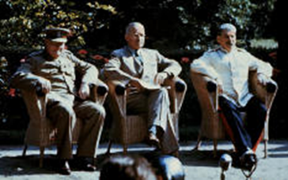
There were a number of immediate causes at the end of WWII that were also responsible.
Josef Stalin refused to allow free elections in the Soviet-controlled territories and imposed communism instead, creating satellite states.
The United states, Great Britain, and France rejected the practices of Stallin.
Stalin was considered to be as untrustworthy, sinister, and evil as Hitler had been.

Slide 13
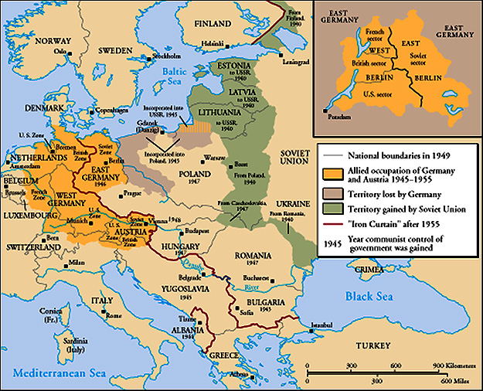
The “Iron Curtain”
Winston Churchill described the spread of communism and the control of Stalin by saying,
From Stettin in the Balkans, to Trieste in the Adriatic, an iron curtain has descended across the Continent. Behind that line lies the ancient capitals of Central and Eastern Europe. -- Sir Winston Churchill, 1946

Slide 14
Truman Doctrine
Europe was divided into eastern and western blocs. President Truman settled on a policy of containment which is called the Truman Doctrine. Containment was the idea that the spread of communism and Soviet control must be stopped, or contained. Stalin viewed this as a threat, which created a conflict that would last nearly half a century.

Slide 15
Reason for Germany to get divided
In the aftermath of WWII, Europe was in a state of ruin, with people living in constant hunger and abject poverty. The United States sought to relieve some of this suffering through economic aid called the Marshall Plan.
This aid package included the rebuilding of Germany, which stalin saw as a threat.
Therefore, Germany was divided into an eastern and western half.

Slide 16
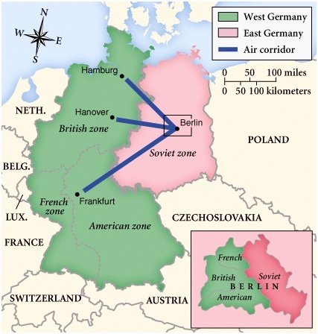
Post-War Germany
The city of Berlin itself was also divided. The western half of Germany and Berlin was rebuilt by the Marshall Plan, while the Soviet-controlled eastern portion was ignored. Stalin tried to keep Western aid out of Berlin, but failed when Allied planes flew around the clock missions for one year, supplying West Berlin.

Slide 17
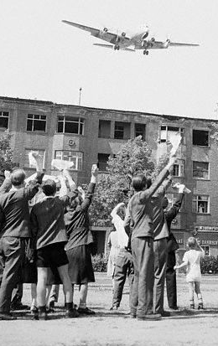
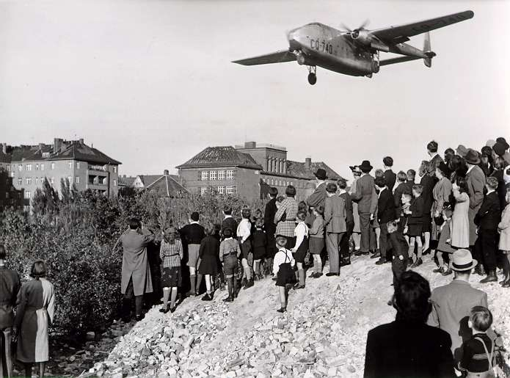
Berlin Blockade & Airlift (1948-49)
The Berlin Airlift is considered the first victory for the west in the Cold War. The Soviets went so far as to construct a wall in the center of the city in the 1960's.
The Berlin Wall's stated purpose was to keep capitalism out, but was in reality a wall to keep people from escaping the brutal life under Soviet rule. . The policies of both sides created greater tension between the superpowers and by the 1950's military alliances had been formed with each side expecting the other to attack.

Slide 18
NATO VS WARSAW PACT
The United States, Canada, and most of the free nations of Western Europe formed NATO, the North Atlantic Treaty
Conversely, the Soviet Union created the Warsaw Pact, an alliance between the USSR and its satellite nations. The satellite nations were more of a buffer zone used to protect from invasion than a true alliance system.
The military alliances also engaged in an escalating arms race in which each side tried to outpace the other in nuclear arms production and strength. In fact, both sides had enough to destroy the planet ten times over in what Churchill called a "balance of terror." Fortunately, neither side was willing to take the final step to actually firing upon the enemy in anger.

Slide 19
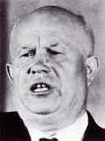
Major Events of the Cold War Throughout the World
The Soviet Union had problems maintaining control over its satellite states.
Life was virtually unbearable despite the promises of communism, and any group willing to fight the Soviets had the support of the United States.
In 1956, shortly after taking power with the death of Stalin, Nikita Khrushchev, ordered Soviet troops into Hungary to put down a rebellion. Hungarian freedom fighters had believed the West would help. It did not, which allowed the Soviet government uncontested control in eastern Europe.
In 1968, the Soviets invaded Czechoslovakia under the leadership of Leonid Brezhnev, who claimed that the Soviet Union had the right to involve itself in the affairs of any communist country.
This is known as the Brezhnev Doctrine.

Slide 20
Cuban Missile Crisis
The world teetered on the brink of destruction during the Cuban Missile Crisis of 1961.
Fidel Castro had allied himself with the Soviet Union for economic support and protection from the United States.
The U.S. had been involved in the Bay of Pigs invasion, which had failed.
Khrushchev then began building Soviet missile installations in Cuba.
Upon discovery, the United States confronted the Soviet Union and demanded the missiles be removed. (of course USA had to remove its missiles from Turkey)
For nearly two weeks, nuclear war was imminent. Eventually, diplomacy succeeded and war was averted.

Slide 21
The Korean War
The Korean War was the first instance of open warfare which pitted communism against capitalism. The U.S. believed in the domino theory, which stated that nations sharing borders with communist countries were in eminent danger of falling under the sway of that country.
In Korea, Soviet and American occupation of zones north and south of the thirty-eighth parallel led to the establishment, in 1948, of a communist North Korea and a noncommunist South Korea.
North Korea’s invasion of South Korea in 1950 marked the beginning of the Korean War,
In the Korean War the United States came to the aid of South Korea while China sent troops to assist the north. A truce in 1953 fixed the border again at the thirty-eighth parallel, but no peace treaty was concluded.
North Korea had become a communist state with the backing of Mao Zedong's China. South Korea had chosen democracy in the wake of WWII.

Slide 22
The Vietnam Conflict
The Vietnam Conflict was similar to the Korean War. Communist Northern Vietnam had invaded democratic Southern Vietnam in the early 1960's. Northern forces, the Viet Cong, were under the leadership of Ho Chi Minh and were receiving aid from the Soviet Union and China. As guerrilla tactics were proving effective against American forces, the U.S. escalated the conflict by sending in more troops. This escalation, and the subsequent invasions of Cambodia and Laos, turned the American public against its government. Finally, under the leadership of Richard Nixon, American troops left Vietnam, ending the war in the early 1970's.

Slide 23
Detente
The Cold War experienced an easing of tension in the 1970's called détente. However, this relative peace was shattered with the Soviet invasion of Afghanistan in 1979. The USSR was forcibly exerting its power in a effort to establish Afghanistan as a communist state. For ten years, a poorly trained and equipped Soviet army was repeatedly beaten by Afghan guerrilla forces being supplied by the United States. The Soviet economy was completely disrupted and the Soviet public demanded an end to the war. Many comparisons can be made with this conflict and the one between the United States and Vietnam.

Slide 24
The Nuclear Threat
In 1963 Great britain., USA and USSR agreed to ban the testing of nuclear weapons in the atmosphere, in space and in waters.
1968 USA and USSR proposed a world treaty against further proliferation of nuclear weapons. The Nuclear Non Proliferation treaty was signed by 137 nations.

Slide 25
The Race for Nuclear Supremacy
The existence of weapons of mass destruction affected all aspects of the Cold War confrontation
This would cause paranoia in the United States and spread fear of nuclear destruction throughout the world.
Fear of nuclear war seemed about to be realized when the Soviet Union deployed nuclear missiles in Cuba in response to American deployment of such missiles in Turkey, but Kruschev backed down and withdrew the missiles from Cuba.

Slide 26
Helsinki Accords
The goal of USSR was European acceptance of political boundaries of the Warsaw nations.
The Helsinki Final Act- commonly called Helsinki Accords affirmed-
No boundaries should be changed by military force.
Formal declaration calling for economic, social and governmental contacts across the iron curtain
and for cooperation in humanitarian fields, a provision that paved the way for dialogu about human rights.

Slide 27
Space Competition
Space exploration was another offshoot of the nuclear arms race, as the ability to launch satellites and to send manned rockets into space was understood to signify equivalent achievements in the military sphere.

Slide 28
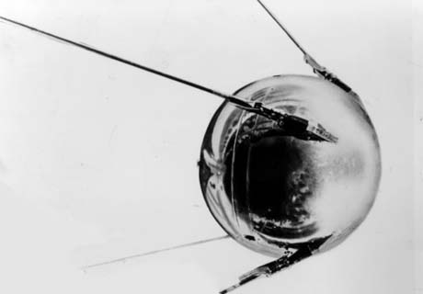
Sputnik I (1957)
The Russians have beaten America in space—they have the technological edge!

Slide 29
America responded with its own satellite three months later.
1969 two Americans, Neil Armstrong and Edwin E. Aldrin revived the American pride by becoming the first humans to walk on the moon.

Slide 30
20th Century Decolonization and Nationalism

Slide 31
Global Events influential in Decolonization
Imperialism
Growing Nationalism
World War I
World War II
Cold War

Slide 32
World War I
Promises of self-determination
Use of colonial soldiers in trenches
Locals filled posts left by colonial powers during war
Financial strain on empire
Treaty of Versailles

Slide 33
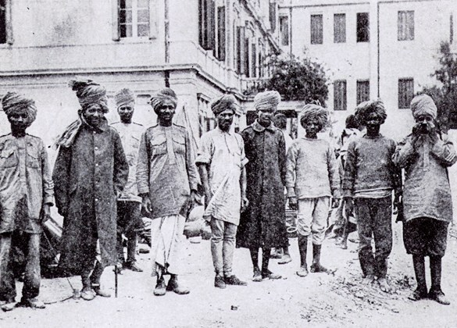
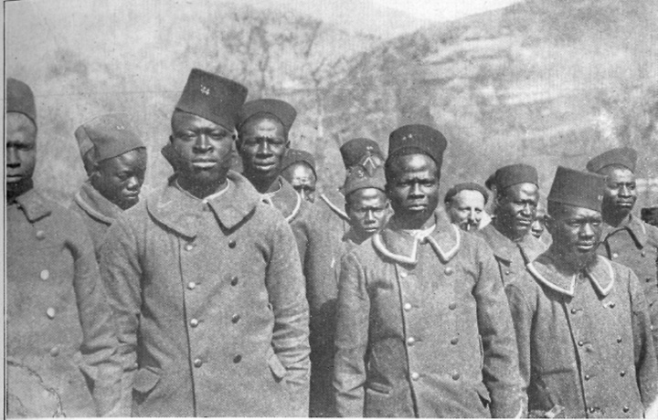

Slide 34
World War II
Increased nationalist uprisings following WWI and as a result of the global depression
Costs of empire
US support of anti-colonial liberation movements
Atlantic Charter (1941) “right of all people to choose the form of government under which they live”
Soviets condemned colonialism

Slide 35
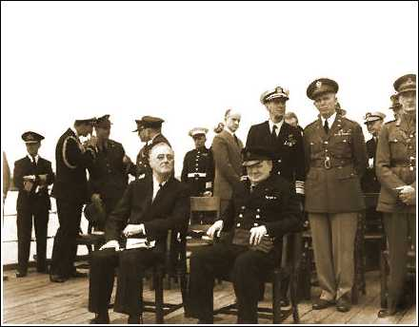
Atlantic Charter, 1941

Slide 36
Cold War
Provided inspiration a blend of capitalist and socialist economies and agendas.
Provided arms to those who sided with one or the other (proxy wars and arms races).
Encouraged violent recourse for some as a result of the power politics of cold war competition.

Slide 37
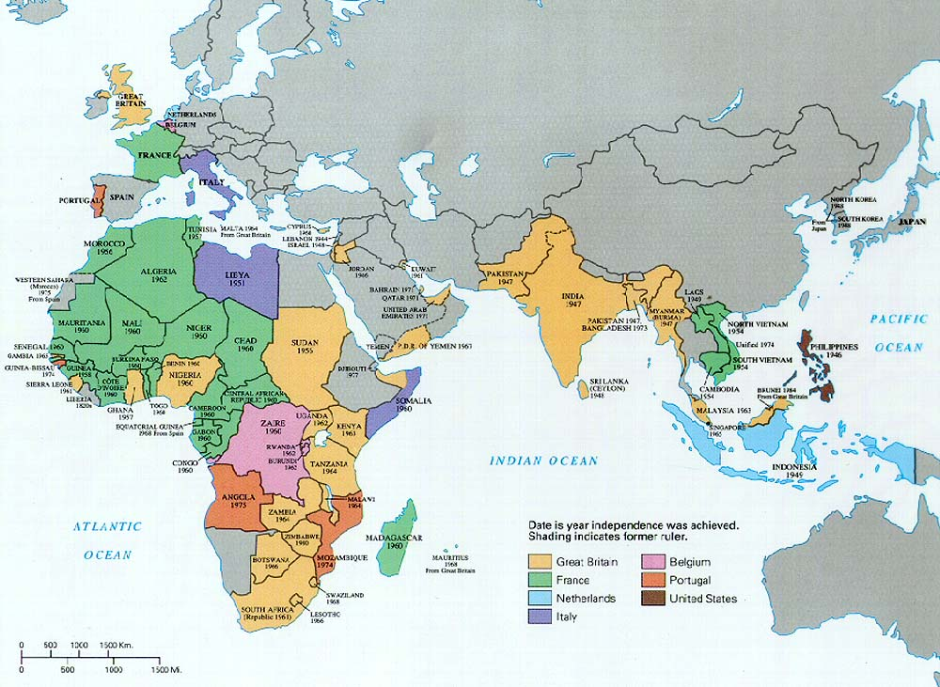

Slide 38
Process of Decolonization and Nation- Building
Surge of anti-colonial nationalism after 1945. Leaders used lessons in mass politicization and mass mobilization of 1920’s and 1930’s.
Three patterns:
Civil war (China)
Negotiated independence (India and much of Africa)
Incomplete de-colonization (Palestine, Algeria and Southern Africa, Vietnam)

Slide 39
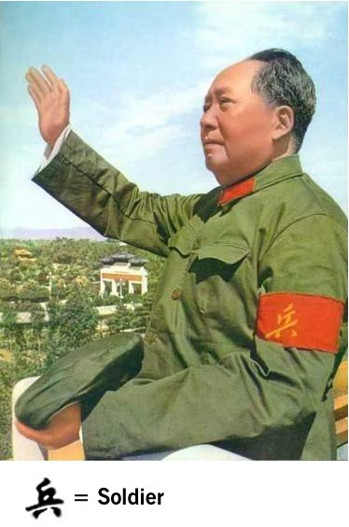
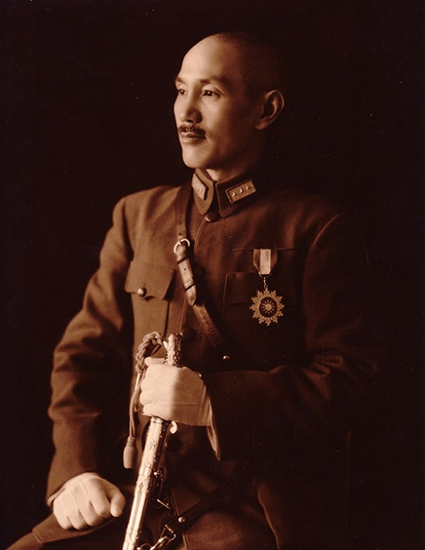
China Case study (Read Ch 17 section 2 pg538->)
Japanese invasion interrupted the 1920’s and 1930’s conflict between the Communists (Mao Zedong) and the Nationalists in China (Chiang Kai-shek)

Slide 40
China Case study
During the war,Communists expanded peasant base, using appeals for women (health care, divorce rights, education access, graduated taxes, cooperative farming).
Growth of party during the war in part through use of anti-Japanese propaganda.
Resumption of civil war after Japanese surrender.
1949 Great People’s Revolution- Mao
Nationalist leaders fled to Taiwan.

Slide 41
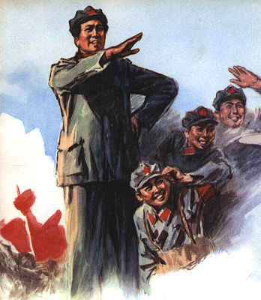

Slide 42
Negotiated Independence in India and Africa
Independence with little bloodshed in India and much of colonial Africa in decades following World War II.
Why? At what cost?

Slide 43
India Case Study Background (Read Ch18 section 1 CP World)
India and other Asian colonies were the first to establish independence movements.
Western-educated minorities organized politically to bring about the end of modification of colonial regimes.

Slide 44
India: History of the Movement
Indian National Congress party founded in 1885. (Elite group not mass movement)
Growth of Indian national identity- presented grievances to the British.
Congress party attracted mass following which opposed shift from the production of food to commercial crops.
Gandhi and Congress leadership tried to prevent mass peasant uprising (as was happening in China) by keeping power centered on middle class leaders.

Slide 45
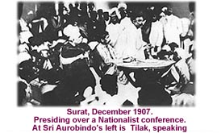

Slide 46
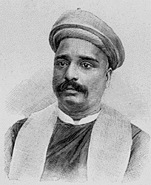
Militant Nationalists
B.G. Tilak urged a boycott of British manufactured goods and used threats of terrorism.
Attracted a violent conservative Hindu following.
Tilak was exiled and his
movement was repressed by
the British.

Slide 47
Peaceful Protests
Mohandas Gandhi and other western educated lawyers led peaceful alternative.
Nation-wide protest against colonialism through boycotts and campaigns of civil resistance.
His efforts were not well received by the Muslims who formed a separate organization in 1906, The Muslim League.
Muhammad Ali Jinnah (Muslim League) insisted on partitioned state (Hindu and Muslim).

Slide 48
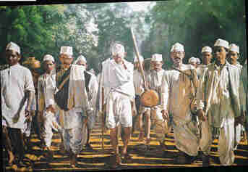
Continued Indian Resistance
Salt March, 1931
Government of India Act 1935

Slide 49
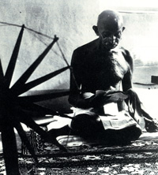
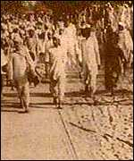
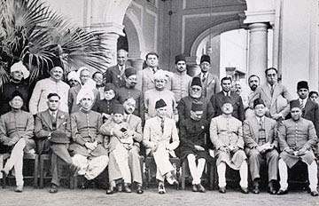
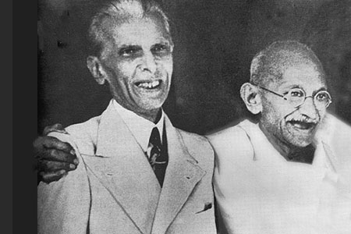

Slide 50
Indian Independence
August 1947 Pakistan and India gained independence.
Mass killings of Muslims and Hindus (1 million) followed by mass migrations (12 million). (Gandhi fasted to prevent war-> assassination)
Jawaharlal Nehru, first Prime Minister,began modernization campaign.

Slide 51
Decolonization in the Middle East- Palestine and Israel (Read ch 18 section 4 of CP History book page 583
Zionism
1917 Balfour Declaration
Immigration of Jews to Palestine
European Holocaust
Increase of migration
1947- end of British mandate of Palestine and failed UN partition solution
1948 establishment of Israel
Regional conflicts->

Slide 52
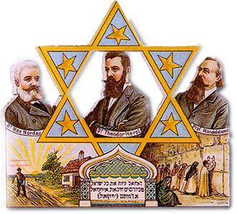
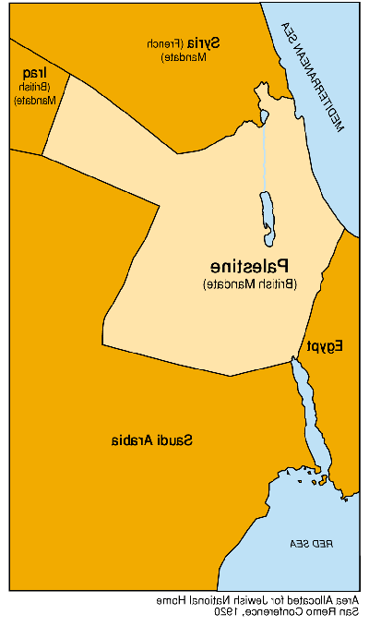
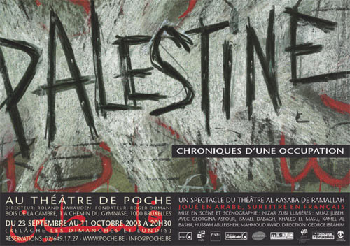
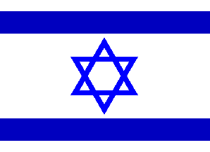

Slide 53
Egypt (Read ch 18 sec 4)
1906 Dinshawai incident aroused nationalist passions.
Actions post- Indep (1936) not sufficient.
Coup d’etat in 1952 Gamal Abdel Nasser
Nationalization of Suez 1956 protested by Israelis, British and French but diplomacy won over eventually.
Nasser= symbol of pan-Arab nationalism.

Slide 54
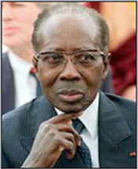
Africa for Africans (Read Ch 18 sec 3 CP World p578)
Nationalists composed of ex-servicemen, urban unemployed & under-employed, and the educated.
Pan-Africanism and Negritude
Senghor (Senegal) and Dubois (African-American)

Slide 55
De-colonization in Africa
1957, Gold Coast (renamed Ghana) independence, led by western- educated, Kwame Nkrumah.
By 1963, all of British ruled Africa, except Southern Rhodesia, was independent.

Slide 56
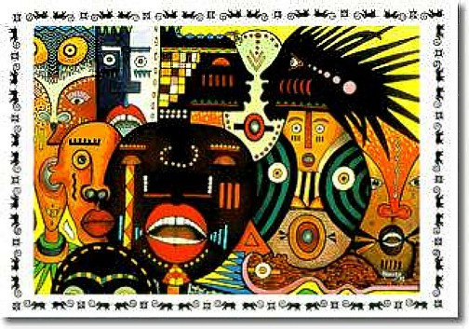
De-colonization in French-ruled Africa
Initially more resistant than the British.
Encouraged closer French ties- assimilation, not autonomy.
Not willing to go far enough in granting rights.
With exception of Algeria, by 1960 had granted independence.

Slide 57
Leopold Sedar Senghor
Western educated Francophone intellectual from Senegal
Poet who became first president of Senegal.
Advocated democratic socialism and negritude.
Negritude: validation of African culture and the African past by the Negritude poets. Recognized attributes of French culture but were not willing to be assimilated into Europe.

Slide 58
Violent and Incomplete Decolonizations
Presence of European immigrant groups impeded negotiations, leading to violence. For example, Kenya, Palestine, Algeria, and southern Africa
Vietnam’s de-colonization complicated by France’s colonial ties and cold war politics.

Slide 59
Kenya
Presence of settlers prevented smooth transition of power.
Kenya (20,000 Europeans only) led to violent revolt.
Mau-Mau Revolt, 1952, led by Kikuyus suppressed by British.
1963 independence granted to black majority, led by Kenyatta.

Slide 60
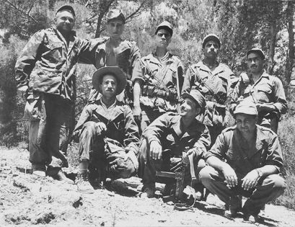
Algeria
Appeal of Arab nationalism
Large French settler population
1954- 1962 war between FLN (nationalist party) and French troops
“part of France”
300,000 lives

Slide 61
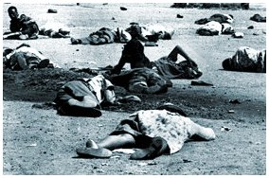
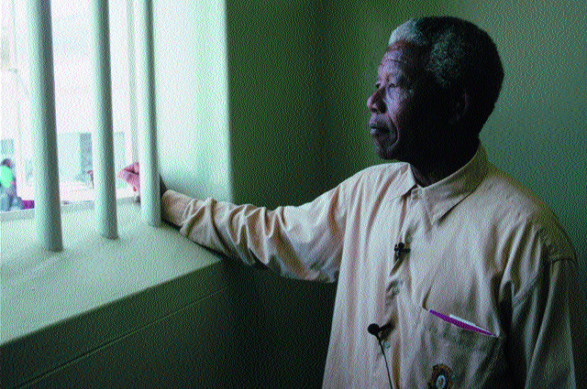
South Africa (separate lesson TBA)
4 million white residents
Afrikaner-dominated (white) National Party won 1948 election
Apartheid
No protests tolerated (African National Congress, Mandela, Sharpeville massacre 1960)
1990’s black government elected

Slide 62
Vietnam (Read ch 17 sec 3 CP world p542)
French rule since 1880’s –rice, mining, and rubber exports
Rise of foreign educated intelligentsia (Ho Chi Minh)
Formation of Viet Minh in 1941
Guerrilla War with France (1946-1954)
Divided country in 1954 led to gradual US entry to contain communism.

Slide 63
Women as leaders in the Movement
Women fought alongside men in whatever capacities were permitted in Algeria, Egypt, China, Vietnam,India and elsewhere.
China, 1942:
“ The fighting record of our women does not permit us to believe that they will ever again allow themselves to be enslaved whether by a national enemy or by social reaction at home.”
Women given constitutional rights but social and economic equality rarely achieved in postcolonial developing nations.

Slide 64
Literature and Decolonization
Expressions of nationalism and rejections of western superiority.
Gandhi, “ I make bold to say that the Europeans themselves will have to remodel their outlooks if they are not to perish under the weight of the comforts to which they are becoming slaves.”
Chinua Achebe, Things Fall Apart
Senghor, “Snow upon Paris”
Aime Cesaire, West Indian poet, founder of Negritude “Return to my Native Land”

Slide 65
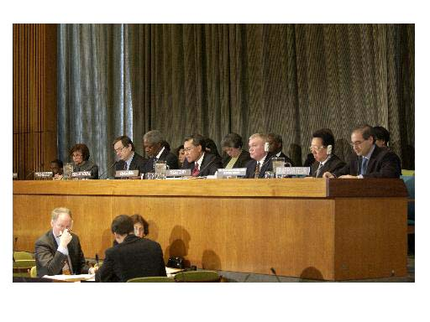
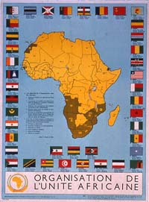
International Organizations and Decolonization
League of Nations
United Nations
Organization of African Unity (1963)

Slide 66
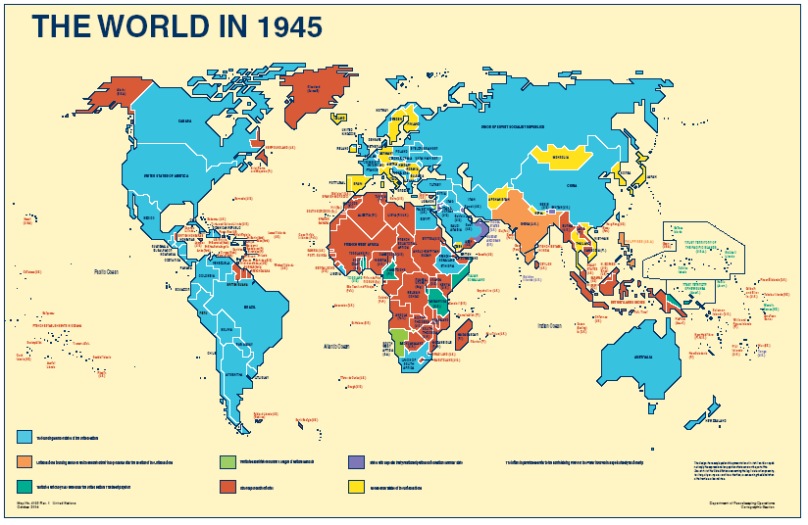

Slide 67
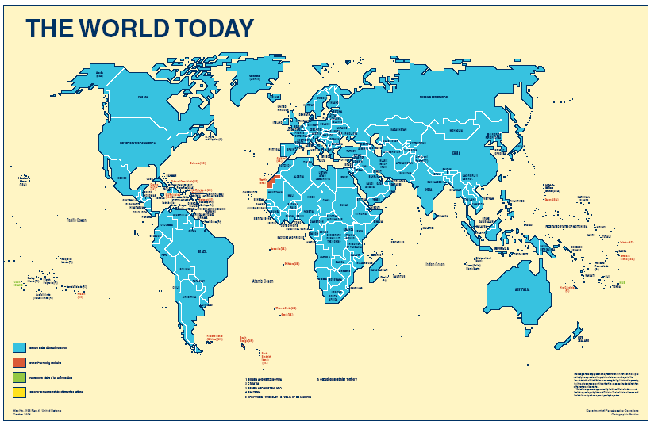

Slide 68
Fall of Empire: Fall out and Legacy
Colonial footprint
Problems of Transition
Problems of Identity

Slide 69
Challenges of Independence
Ethnic disputes
Dependent economies
Growing debt
Cultural dependence on west-> religious revivalism as backlash
Widespread social unrest
Military responses to restore order
Population growth
Resource depletion
Lack of middle class in some locales
Education deficit and later, brain drain.
Neo-colonialism through economic debt.

Slide 70
Conclusions
Decolonization was sometimes a violent process- dependent in large part on how many settlers had come to the colony.
In many parts of world, decolonization was not revolutionary. Power passed from one class of elites to another. Little economic and social reform occurred.
Significant challenges faced independent nations.
Western economic dominance of the global trade system continued unabated. WHY?

