Slide 1
Agenda
World War II Timeline
World War II Notes

Slide 2
World War II Timeline
Directions: Set aside 2 pages in your interactive notebook. Over the next two weeks, your DNA is going to be copying down World War II Events.
September 18, 1931- Japan invades Manchuria.
October 2, 1935-May 1936- Italy takes over Ethiopia.
March 7, 1936- Hitler sends troops to the Rhineland
July 7, 1937- Japan invades China
March 11-13, 1938- Germany incorporates Austria.
September 29, 1938- Munich Agreement. Germany acquires the Sudetenland.
March 14-15, 1939- Hitler breaks Munich Conference by have Germans occupy area outside of Sudetenland.
April 7-15, 1939- Italy takes over Albania.

Slide 3
Notes

Slide 4
World War II in Europe
The expansion on Japan, Italy, and Germany put strain on international relations.
Appeasement policy is going to enable Hitler to do what he wants.
Hitler is able to absorb most of Czechoslovakia in 1939 breaking the Munich Conference agreement.
Hitler’s nonaggression pact with Soviet Union signed on August 23, 1939 allows Hitler to focus on Western enemies.
September 1, 1939- Hitler invades Poland.
September 3, 1939- France and Great Britain declare war on Germany.

Slide 5
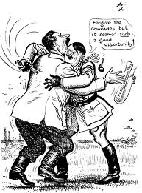
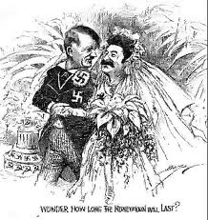

Slide 6
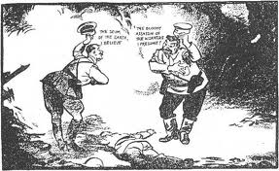
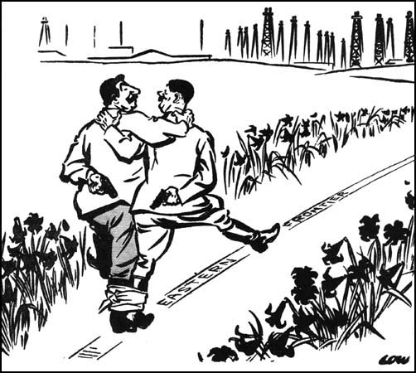

Slide 7
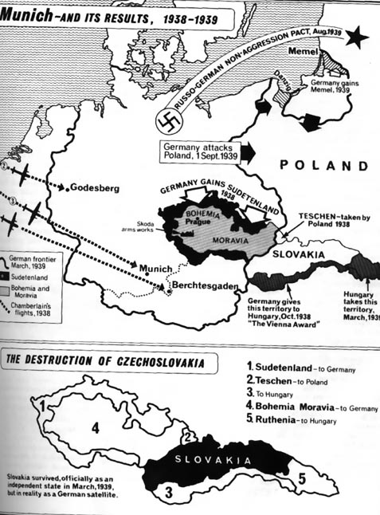

Slide 8
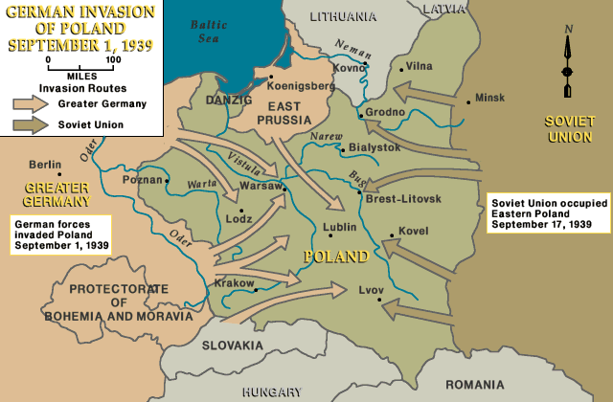


Slide 9
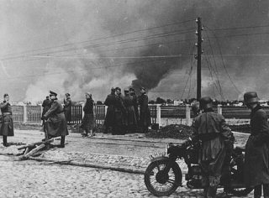
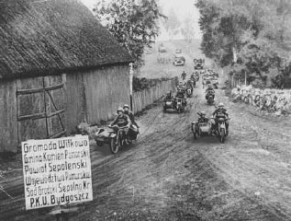
Blitzkrieg
September
1939

Slide 10
The German Blitzkrieg
http://www.youtube.com/watch?v=8ha0qKquG2E

Slide 11
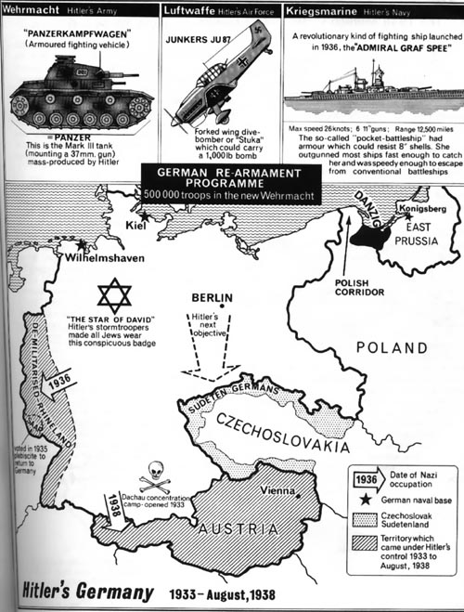

Slide 12
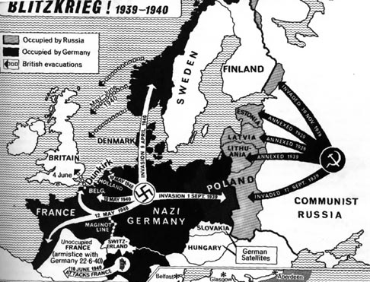

Slide 13
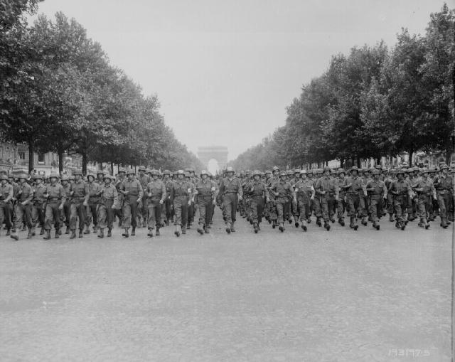
Nazi soldiers march through Paris
France surrenders June, 1940

Slide 14
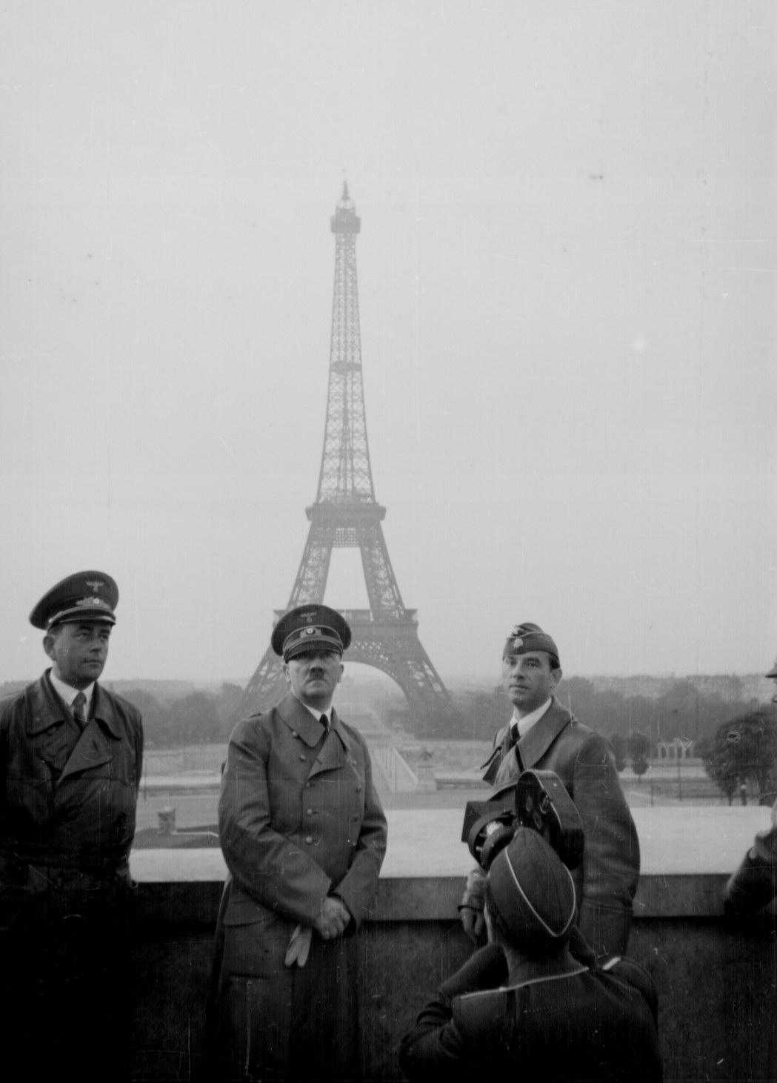

Slide 15
From Atonement
British and French soldiers leave the country:
http://vimeo.com/37392284

Slide 16
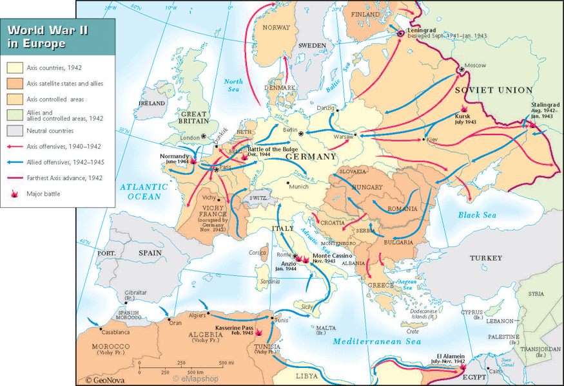

Slide 17
Battle of Britain
August-October 1940 = Germans bombed Great Britain
Targets = air bases, shipyards, industries, cities
Goal = break British morale before invading Britain
British Royal Air Force
Hitler ends air attacks

Slide 18
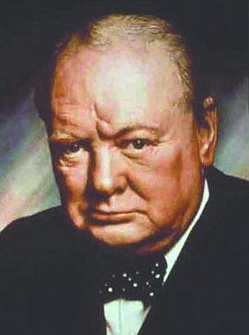
Winston Churchill
“We shall defend our island, whatever the cost may be, we shall fight on the beaches, we shall fight on the landing grounds, we shall fight in the fields and in the streets, we shall fight in the hills; we shall never surrender.”

Slide 19
Operation Barbarossa
June 1941 Germany invades the Soviet Union
The Battle of Stalingrad began on August 23, 1942
On February 2, 1943, some 90,000 frostbitten, half-starved German troops surrendered to the Soviets.
Stalingrad’s defense had cost the Soviets over a million soldiers.
The city was over 99 percent destroyed
The Germans were now on the defensive, with the Soviets pushing them steadily westward.

Slide 20
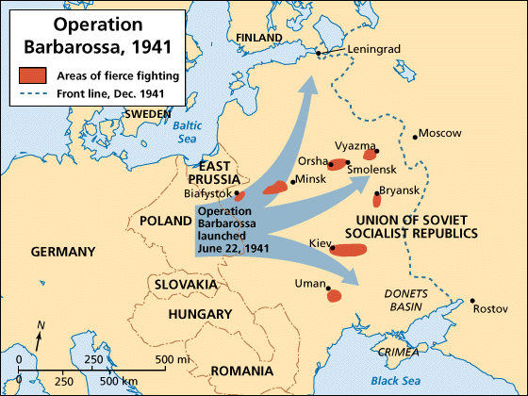
www.myndrs.com/teachers/rscott/History/powerpoints/Hist12-nn-greatbattles-WWII.ppt

Slide 21
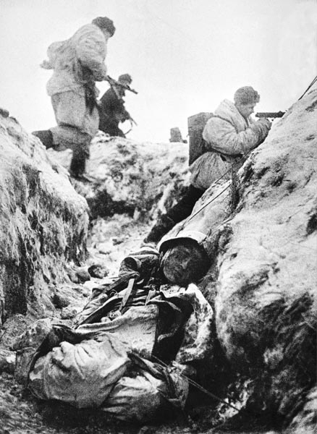
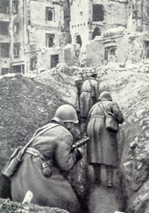
Street Fighting

Slide 22
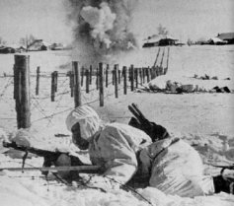
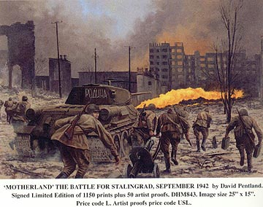
Outside and Inside

Slide 23
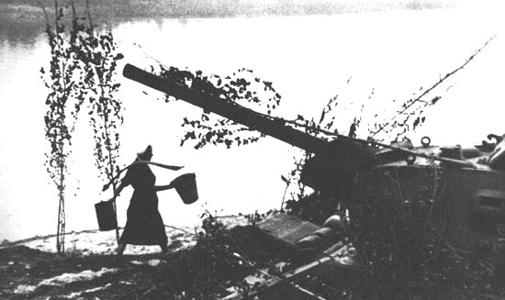
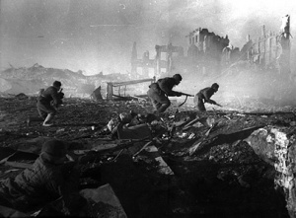
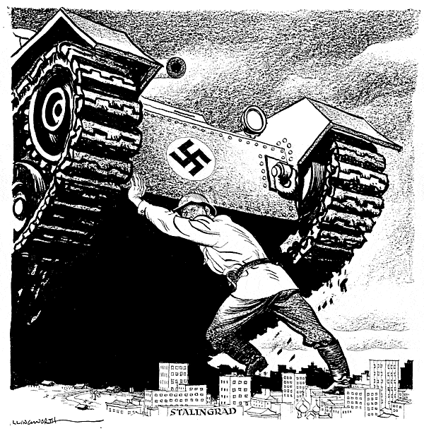
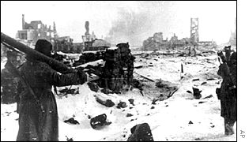

Slide 24
Battle of Stalingrad
https://www.youtube.com/watch?v=z4KuIVnGRFk

Slide 26
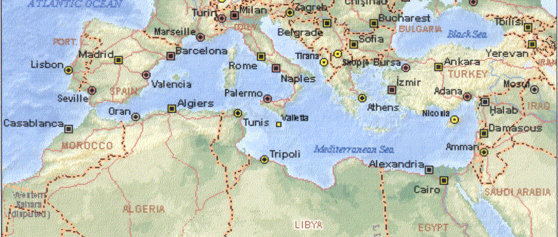
Allied Invasion of Africa: Operation “Torch”
Rommel Surrenders
Allied invasion
Nov ’42 By Ike
El Alamein
May ‘ 43
British Victory
November ’42
By Monty
El Alamein

Slide 27
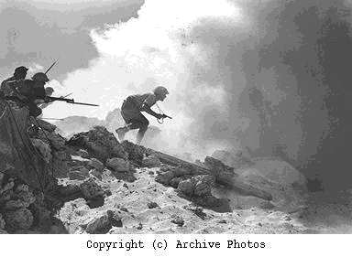
EL ALAMEIN
Fighting in Africa
November 1942-May 1943
Allied troops landed in Algeria and Morocco
Germans driven out of N Africa by May 1943
Oct.-Nov.1942
British Victory
DEFEATED GERMAN GENERAL ROMMEL the “Desert Fox”, prevented from capturing Suez Canal
TURNING POINT FOR WAR IN AFRICA

Slide 28
Invasion of Italy
After victory in Africa, the Allies conquered Sicily and moved into Italy
Allies landed south of Rome at Anzio, fought for four months and broke through German defenses in April 1945

Slide 30
Normandy Invasion (D-Day)
June 6, 1944
During this time, Soviet Union was pushing into Poland and Allies were pushing North in Italy
Generals Dwight D. Eisenhower and George Patton influential in leading attack
3 million ally troops to attack
Largest land-sea-air operation in history

Slide 31
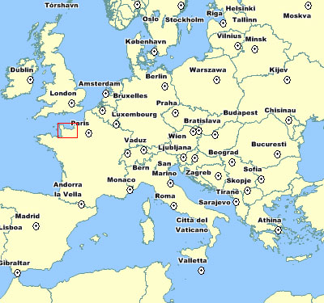
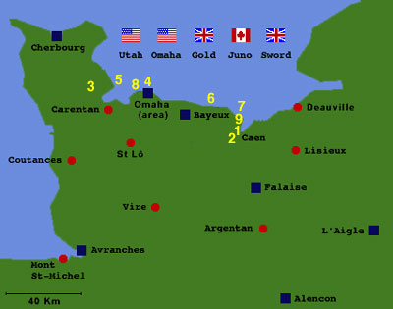
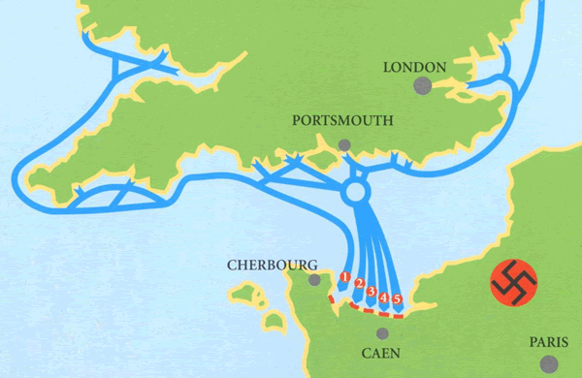

Slide 32
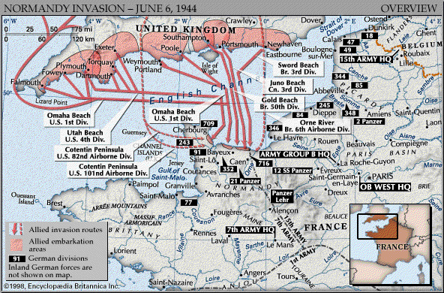

Slide 33
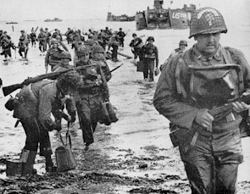
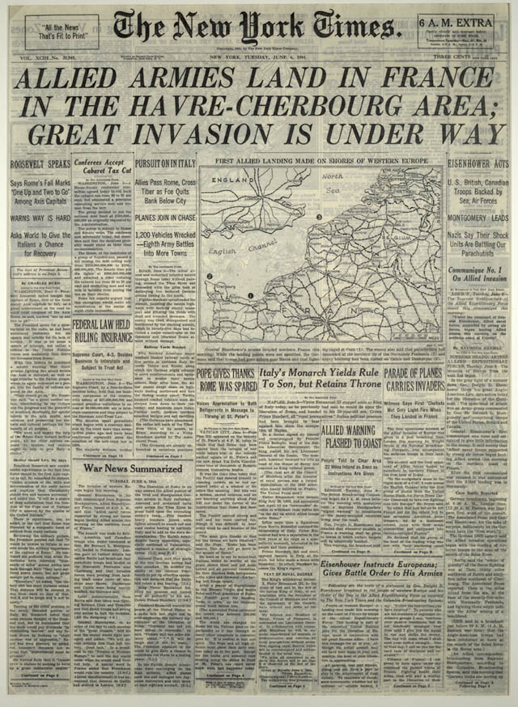
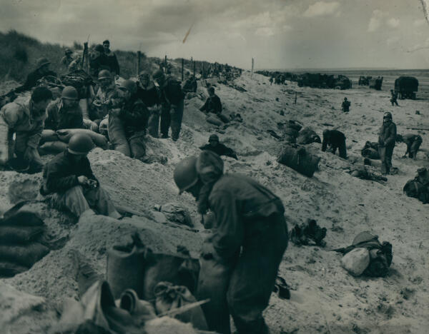

Slide 34
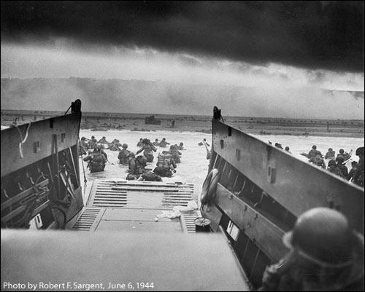

Slide 35
Normandy Invasion cont.
D – Day
Ø 60 mile stretch of beach
Ø 156,000 troops
Ø 4,000 landing craft
Ø 600 warships
Ø 11,000 planes
Ø Omaha beach known as one of the most
brutal areas

Slide 36
The D-Day Museum in Portsmouth, England claims a total of 2,500 Allied troops died, while German forces suffered between 4,000 and 9,000 total casualties on D-Day.
The Heritage Foundation in the U.S. claims 4,900 U.S. dead on D-Day
The U.S. Army Center of Military History cites a total casualty figure for U.S. forces at 6,036. This number combines dead and wounded in the D-Day battles
John Keegan, American Historian and Author believes that 2,500 Americans died along with 3,000 British and Canadian troops on D-Day
By the end of the of the entire Normandy Campaign, nearly 425,000 Allied and German troops were killed, wounded, or missing.

Slide 37
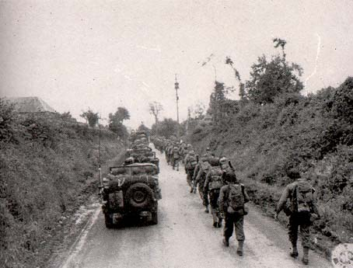
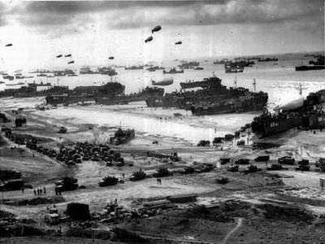
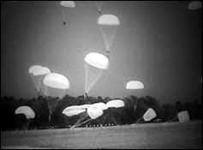
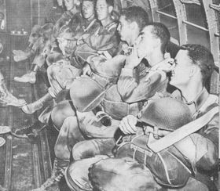

Slide 38
Normandy Invasion cont.
The battle continues
W/in 1 month, a million more troops
September 1944, France was freed from
Nazi control

Slide 39
From Saving Private Ryan

Slide 40
Victory in Europe
Germany was now in a 2-front war, Soviets from the East and American/British forces from the West
Battle of the Bulge = December 1944 = Germans counterattacked along Belgium front, Allied lines pushed back creating a “bulge”, after several weeks Americans win

Slide 41
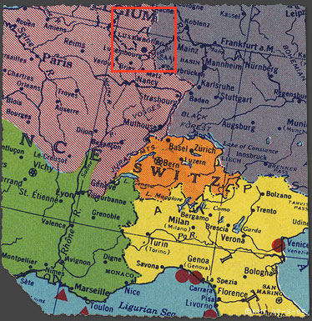

Slide 42
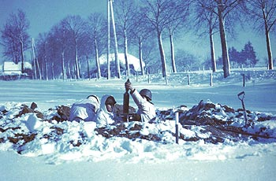
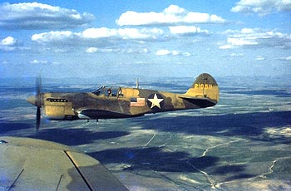
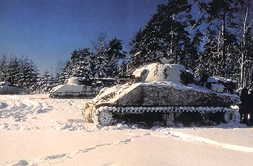
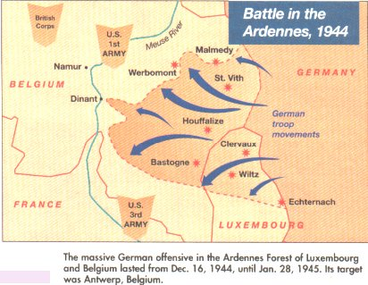

Slide 43
The End of the War in Europe
Late 1944 = Germans driven out of Soviet Union into Poland
February 1945 = Soviets just outside Berlin
April 30, 1945 = Hitler commits suicide in Berlin
May 7, 1945 = Germany signed unconditional surrender
May 8, 1945 = V-E Day “Victory in Europe

