Slide 1
Revolution Brings Reform and Terror

Slide 2
Agenda
Recap
Photo Analysis
Guided Reading: Revolution Brings Reform and Terror

Slide 3
Recap
Yesterday we saw the causes of the French Revolution. We read about the 3rd Estate of France wanting more power in France, and taking the Tennis Court Oath to do so. We also talked about how French citizens, fearful from retribution from the King, stormed the Bastille and started to arm themselves. We also talked about women, upset at the prices of bed, protesting against the King and Queen.

Slide 4
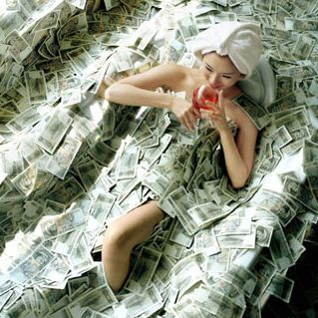
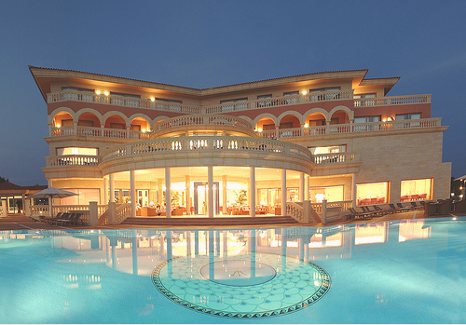
What do you see in these pictures?
What social class are they in today? In French Revolution France?
What percentage of their income should they pay for taxes?
What rights should they have?

Slide 5
What do you see in these pictures?
What social class are they in today? In French Revolution France?
What percentage of their income should they pay for taxes?
What rights should they have?

Slide 6
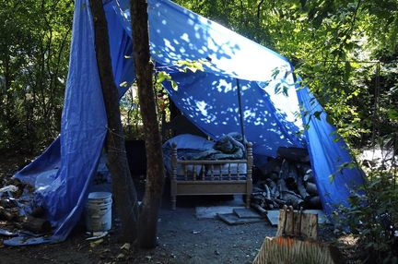
What do you see in these pictures?
What social class are they in today? In French Revolution France?
What percentage of their income should they pay for taxes?
What rights should they have?

Slide 7
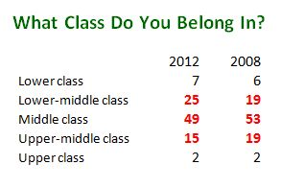

Slide 8
Which group should pay the least and most amount of taxes?
Which group would you want making decisions for the country?
Which group should have the most and least amount of rights?

Slide 9
Guided Reading
Yesterday we read about how the revolution began and how a Great Fear spread across France. Today, we are going to read about what happened next. Open up to a blank page in your notebook and divide it in half.

Slide 10
Changes as a result of the Revolution:
Copy the Questions. Leave space for the answers
Why did new laws about the Church divide the Revolution?
Why did Louis XVI try to escape?
Why did the new constitution give the king very little power?
Why would kings of other countries want to restore power to Louis XVI?
Why would Maximilien Robespierre order the death of people who did not agree with him?

Slide 11
Changes as a result of the Revolution:

Slide 12
Why did new laws about the Church divide the Revolution?
Why did Louis XVI try to escape?
Why did the new constitution give the king very little power?

Slide 13
Why would kings of other countries want to restore power to Louis XVI?
Why would Maximilien Robespierre order the death of people who did not agree with him?

Slide 14
French Revolution
Storyboard

Slide 15
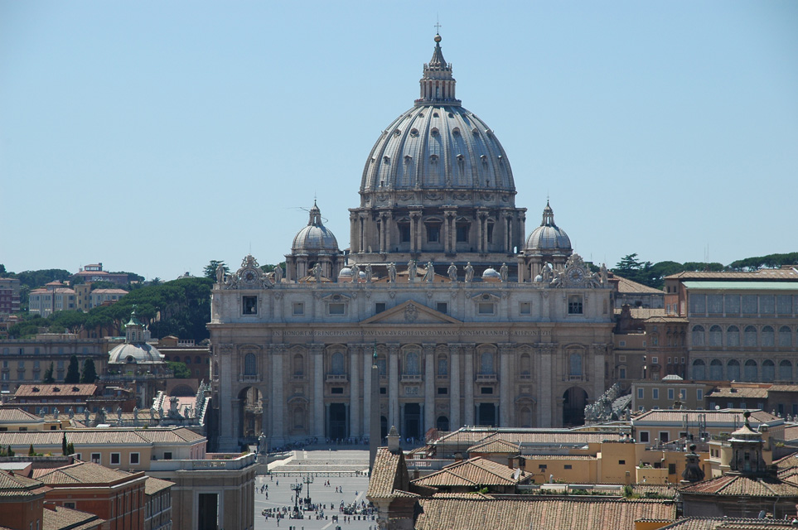
1790 Church Controlled
15
Notes:
15

Slide 16
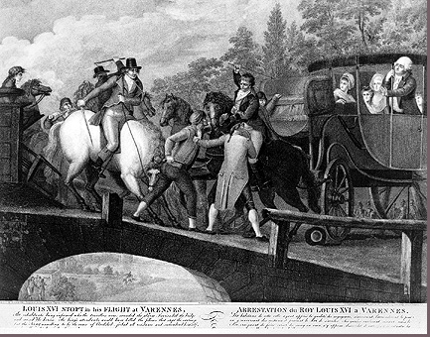
June 20th, 1791
16
Notes:
16

Slide 17
French Constitution 1791 Legislative Assembly Formed

Slide 18
French Factions Begin
TODAY:
1790s:
The Plain (swing votes)
Montagnards (“The Mountain”)
Girondists
Monarchíen (Royalists)
Jacobins

Slide 19
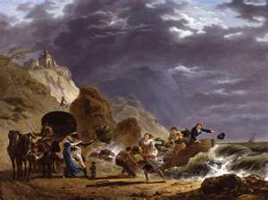
1791 Emigres Noble Flee France

Slide 20
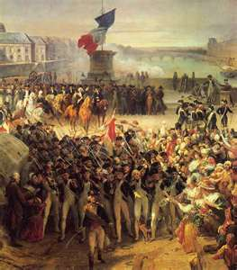
1792 Prussia & Austria War To Restore King Louis XVI

Slide 21
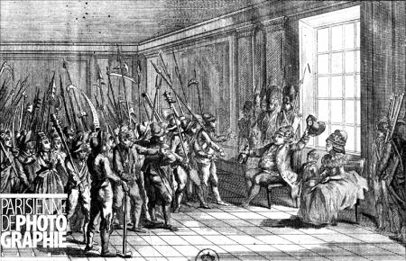
Tuilleries Invasion August 10th, 1792

Slide 22
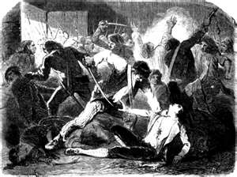
September Massacres 1792

Slide 23
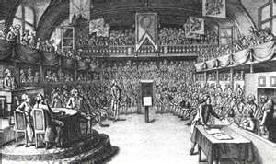
September 21st, 1792 National Convention Formed

Slide 24
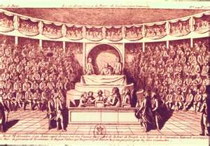
King Louis Trial For Treason December 10-11th, 1792

Slide 25
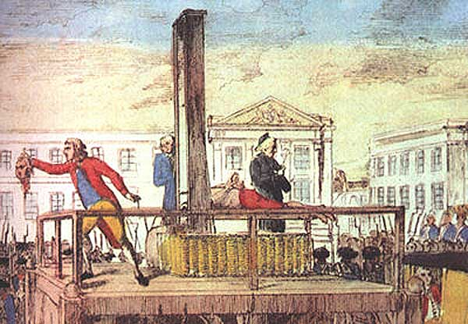
King Louis XVI
January 21st, 1793
25
Notes:
25

Slide 26
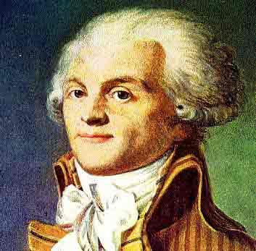
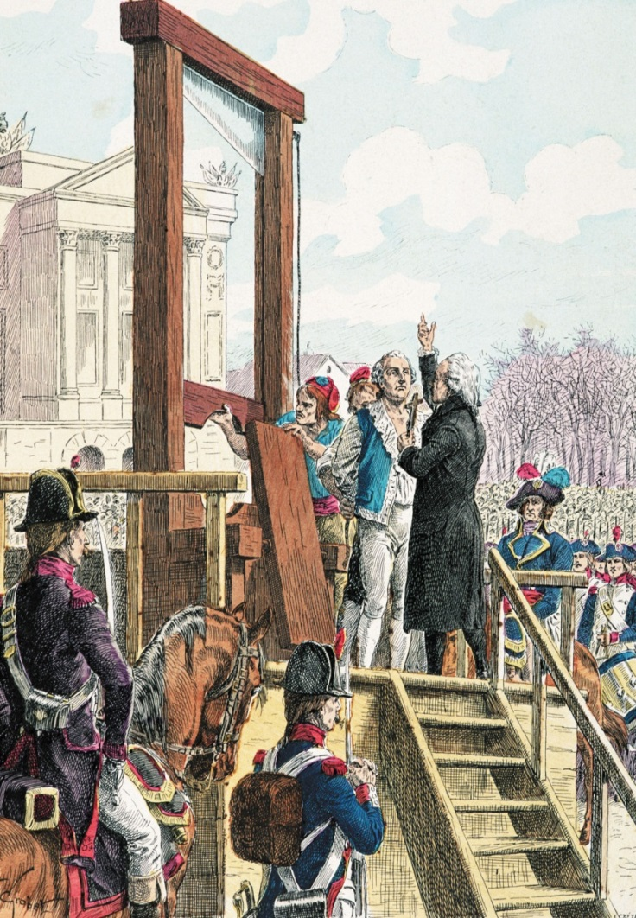
The Reign of Terror July 1793 Begins
26
Notes:
26

Slide 27
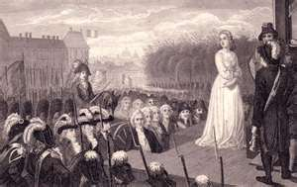
October 16th, 1793
Marie Antoinette’s Execution

Slide 28
July 28th, 1794 Robespierre is Guillotined
28
Notes:
28

Slide 29
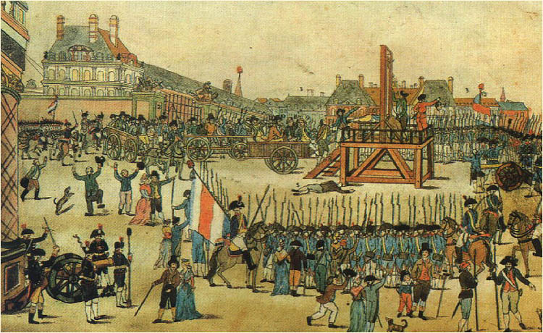
The Reign of Terror July 1794 Ends
29
Notes:
29

Slide 30
French Revolution Storyboard
As we read and learn more about the French Revolution, we are going to be making multiple storyboards. You are going to be required to copy down the text for each box, and to produce an illustration, with color, for each box.

Slide 31
French Revolution Storyboard II
Kings in other countries feared the French Revolution would spread to their lands, and wanted to use force to restore control back to Louis XVI | In 1792, the National Convention, sentenced Louis XVI to death.
The National Convention ordered thousands of French people into the army. | The Committee for Public Safety carried out the Reign of Terror, killing thousands.

