Slide 1
Reforming the Industrial World

Slide 2
Agenda
DNA- Vocabulary Match-up
Notes: Economic Systems
Drawing Economic Systems

Slide 3
DNA- Match the Word to the Definition
1. The branch of knowledge concerned with the production, consumption, and transfer of wealth.
2. Author of the Communist Manifesto, a radical type of socialism.
3. The resources—including land, labor, and capital—that are needed to produce goods and services
4. An economic system based on private ownership and on the investment of money in business ventures in order to make a profit.
5. An economic system in which the factors of production are owned by the public and operate for the welfare of all.
6. An economic system in which all means of production—land, mines, factories, railroads, and businesses—are owned by the people, private property does not exist, and all goods and services are shared equally.
Communism
Socialism
Karl Marx
Capitalism
Economics
Factors of Production

Slide 4
The Industrial Revolution So Far
http://www.youtube.com/watch?v=aTLAmEbxlKg

Slide 5
Economic Systems
Essential Question: What were the economic systems that developed during the Industrial Revolution?
Questions,
Subtitles,
Headings,
Etc.
Class Notes
2 1/2”
3 to 4 sentence summary across
the bottom of the last page of the day’s notes

Slide 6
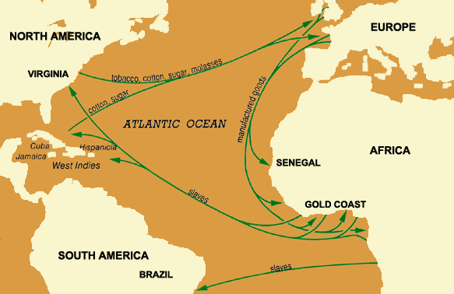
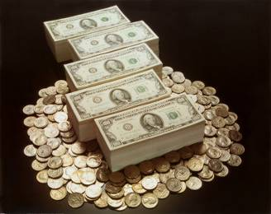
What is Economics?
The science of how people seek to satisfy their needs and wants by making choices based on scarce resources
Essentially, how people interact and trade with one another

Slide 7
Capitalism vs. Socialism
Here is the Crash Course guy about economic systems.
http://www.youtube.com/watch?v=B3u4EFTwprM

Slide 8
The Industrial Revolution opened a wide gap between the rich and the poor
Business leaders believed that governments should stay out of business and economic affairs
Reformers felt that governments needed to play an active role to improve conditions for the poor
Workers demanded more rights and protections
The Need for Reform

Slide 9
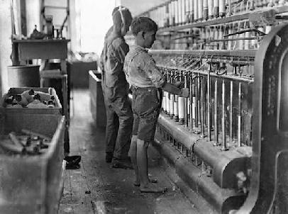
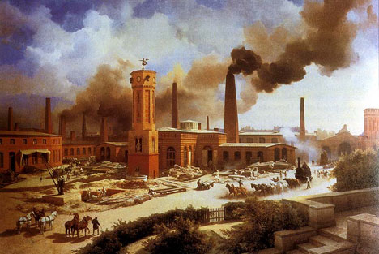
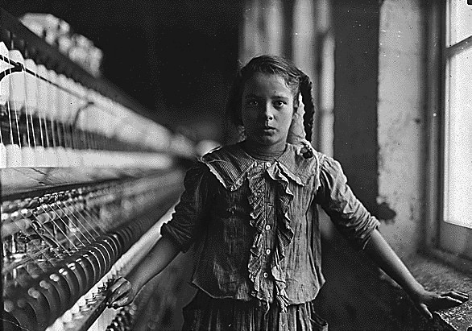
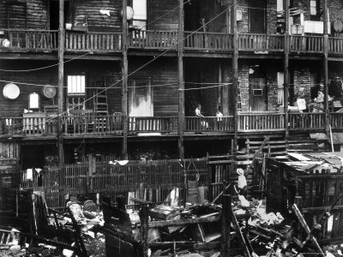

Slide 10
Believed in laissez-faire- economic policy of letting owners of industry and business set working conditions without interference
Believed government regulations interfered with the production of wealth
Believed in private ownership of property and business
Opposed government efforts to help poor workers such as minimum wage and better working conditions because it would lower profits.
Capitalism

Slide 11
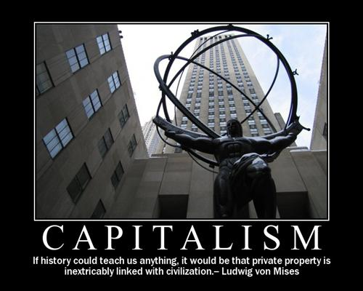

Slide 12
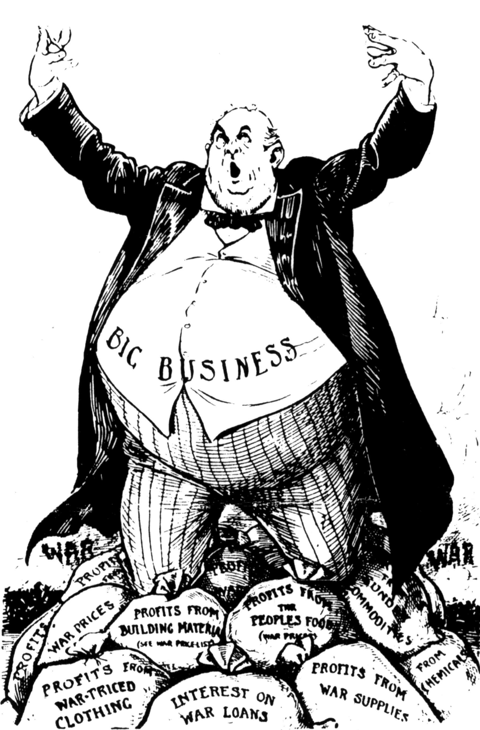
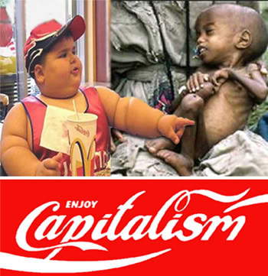
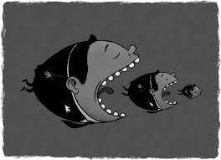

Slide 13
Non History Break
http://www.youtube.com/watch?v=dnPIOAQVqZM#t=220

Slide 14
Unlike Capitalists, other believed the government should intervene in economic affairs
Socialists wanted the government to plan the economy
Believed that government control of factories, mines, railroads, and other key industries would end poverty and promote equality
Believed public ownership would help workers no longer be at the mercy of their employers.
Socialism

Slide 15
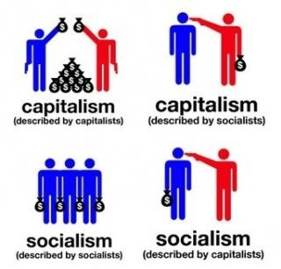
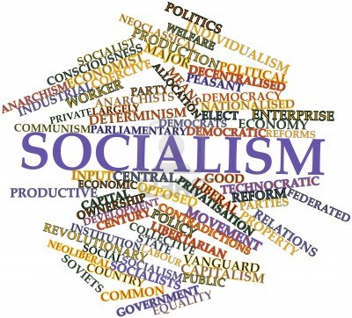

Slide 16
Radical type of socialism introduced by Karl Marx and Friedrich Engels
Believed the wealthy (bourgeoisie) controlled the wealth while the workers (proletariat) preformed backbreaking labor under terrible conditions
Believed the workers should be in charge and that would bring economic equality to all
Believed that a classless society would develop as a result of communism
Communism

Slide 17
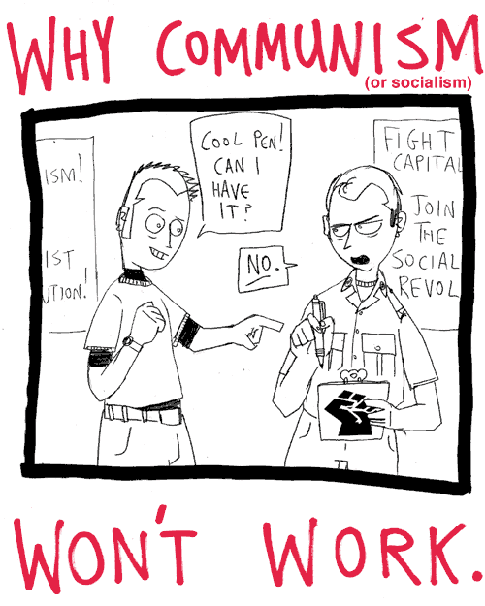
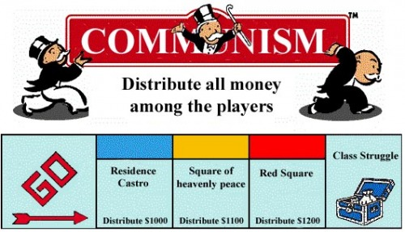
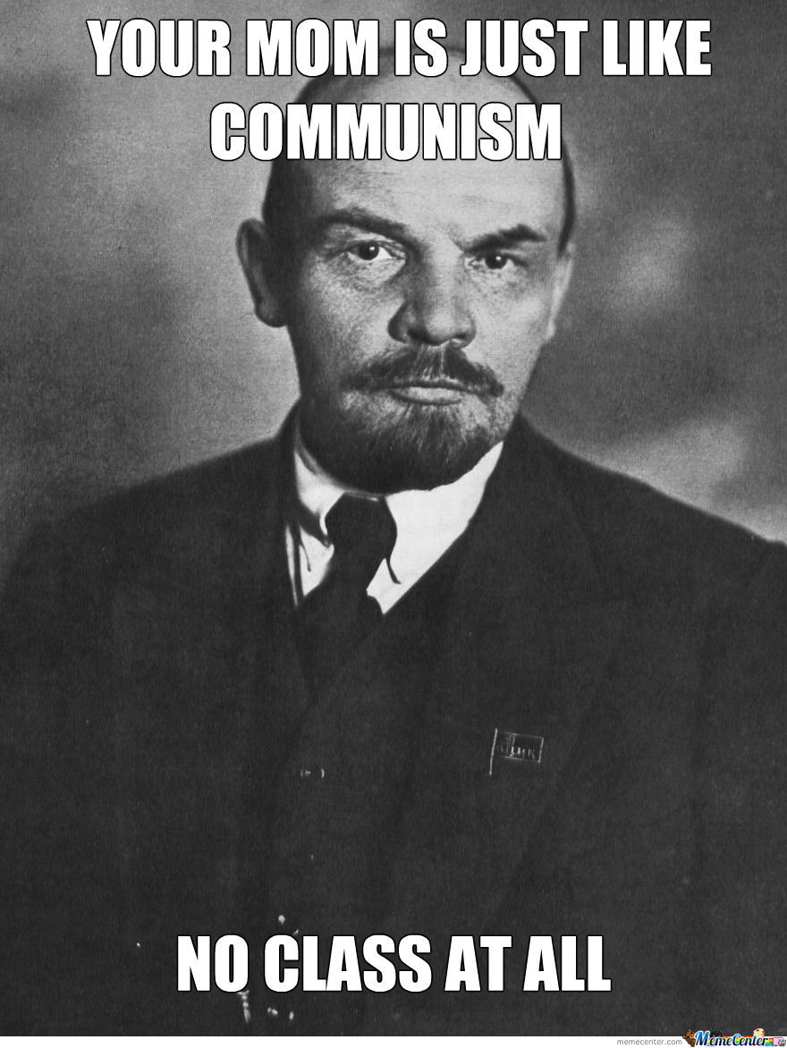
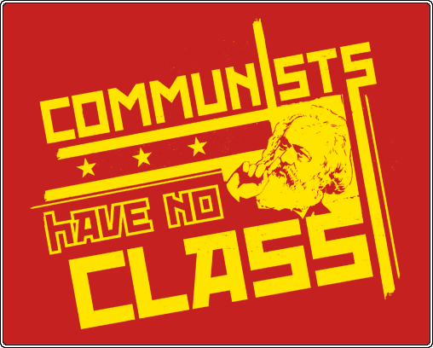

Slide 18
Summary

Slide 19
Drawing Economic Systems
Capitalism | Socialism
Communism | Utopianism
Laissez-Faire | Social Democracy

Slide 20
Capitalism
You have two cows. You sell one of them and buy a bull. The cow and the bull have a great love life, they create more cows. You make money selling the cows.

Slide 21
Socialism
You have two cows. The government takes one of them and gives it to your neighbor.

Slide 22
Communism
You have two cows. The government takes both of them and gives you part of the milk.

Slide 23
Utopianism
You have two cows. Everyone uses the milk and shares what they have

Slide 24
Laissez-Faire
You have two cows and the government doesn’t tell you what to do with them.

Slide 25
Social Democracy
You have two cows. The government makes sure your cows produce milk, and provides you with education and healthcare.

