Slide 1
Create A Country
To better understand how and why countries went to war against each other, starting the “Great War”, we are going to create countries in this class.
Get into a group from 1 to 4 people. I am going to give you and your group a sheet of paper with questions to answer. Talk about them and answer them. 1 question asks you to make alliances with other countries, so you will have to talk with other countries.
On the back, as a group, come up with 5 reasons why you would go to war with another country. We will discuss this part as a class.

Slide 2
Why Would Your Country Go To War

Slide 3
The Next Day

Slide 4
What should the countries do?
United Colonies and Utopia both claim that France and Jamaica are their colonies.
United Colonies and Utopia, how are you going to solve this problem?
Hordan, you are allies with Utopia, do you support the decision?

Slide 5
What should the countries do?
Liberty Country and the Conchords both have Russia as their colony and both have big militaries. Only one country can colonize Russia.
Liberty Country and Conchords, how are you going to solve this problem?
The Best Nation, you are an ally of both countries, which country are you going to support and why?

Slide 6
What should the countries do?
Patazo your country sells drugs and the Best Nation sells drugs. Patazo wants to invade the Best Nation. The Best Nation has two powerful allies in Liberty Country and Conqueror.
Patazo what are you going to do?
The Best Nation, what are you going to do?
Liberty Country and Conqueror, what are you going to do?

Slide 7
What should the countries do?
Hordan has a large Army, strong Navy, and a great Air Force. Palevan has a military focused of air assault, with ground troops, and special operatives. Both countries want to show the world they have the best military.
Hordan and Palevan, what are you going to do to show the strength of your military?

Slide 8
What should the countries do?
Bob you have a Democracy and think it is the best kind of government. Utopia you have a Monarchy and think it is the best kind of government.
Bob and Utopia how are you going to settle your differences?

Slide 9
What should the countries do?
Liberty Country decides to invade Hordan
The Best Nation and Conchord are allies with Liberty Country. What are you going to do?
Utopia and Palevan are allies are Hordan. What are you going to do?
Bob, United Colonies, and Patazo, you are not allied with any country. Who are you going to support?

Slide 10
Propaganda Poster
Declare War on one of the countries in the class and make a propaganda poster to get support from the citizens of your country. I will give your country a blank sheet of paper.

Slide 11
Propaganda Posters Mobilize the Home Front

Slide 12
Enlistment Posters Join the War!

Slide 15
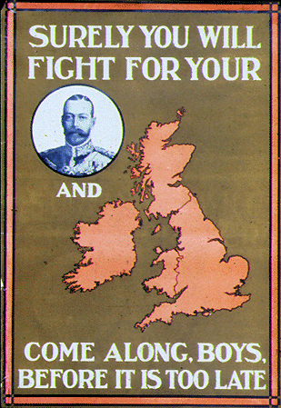

Slide 18
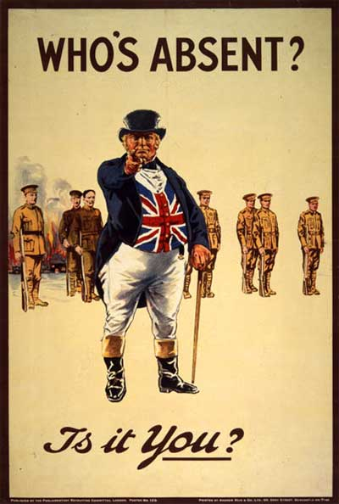

Slide 19
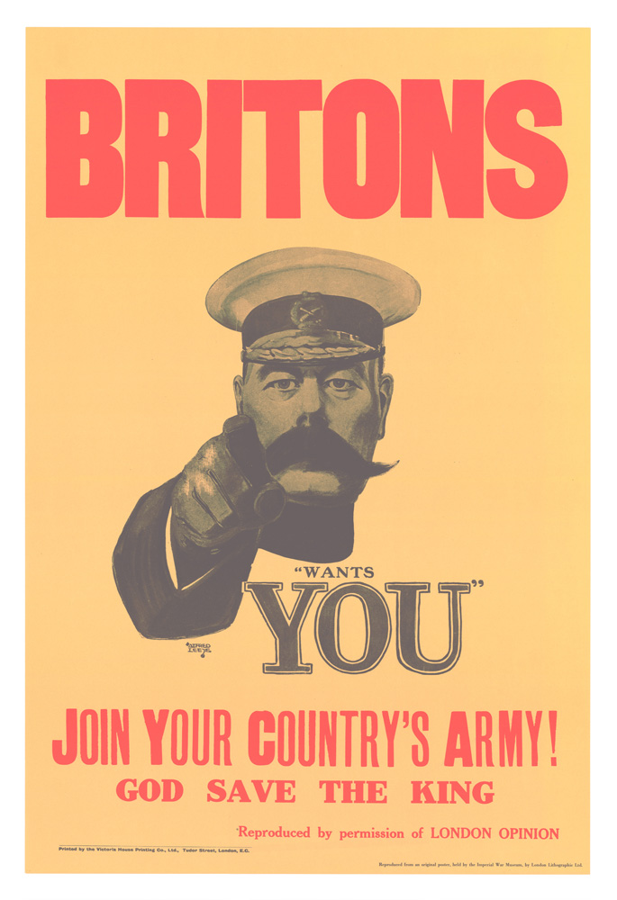

Slide 22
Enemy as Evil Posters Stop the Enemy!

Slide 23
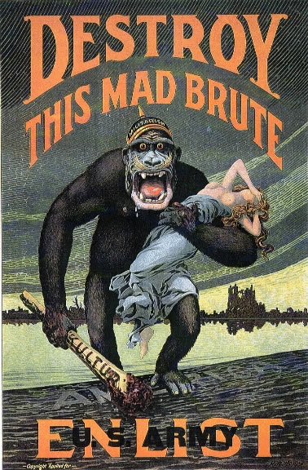

Slide 24
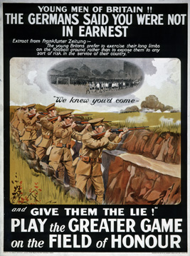

Slide 29
Support Posters Help the Troops!

Slide 31
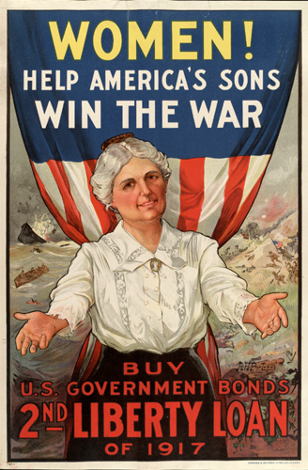

Slide 32
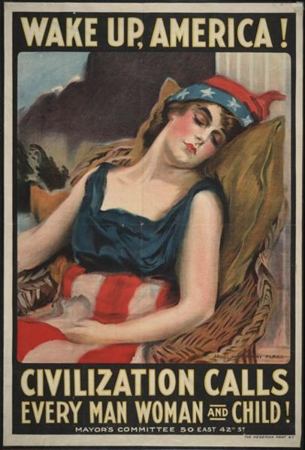

Slide 33
Fill in for the Men Home Font Posters!

Slide 36
Save Food Posters Feed the Troops!

Slide 37
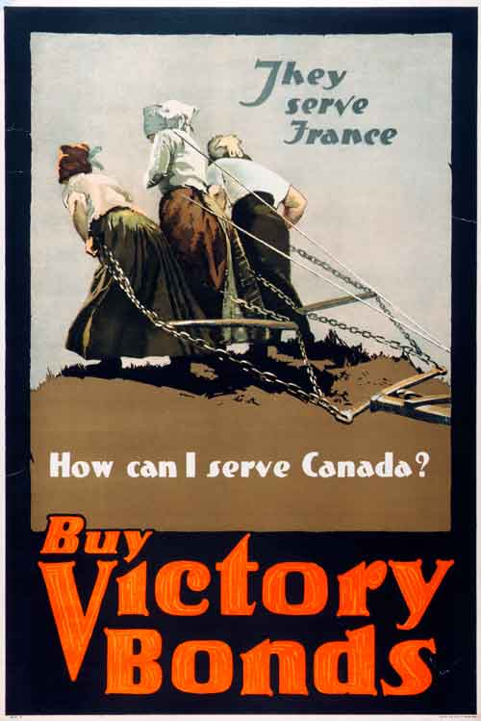

Slide 38
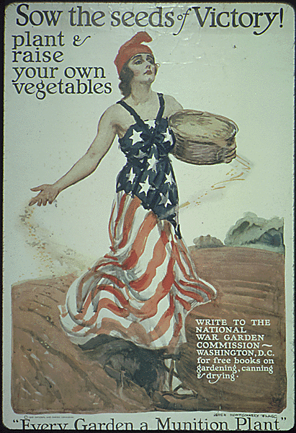

Slide 41
Financial Support Posters Buy Bonds!

Slide 42
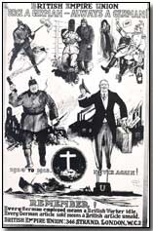

Slide 44
