Slide 1
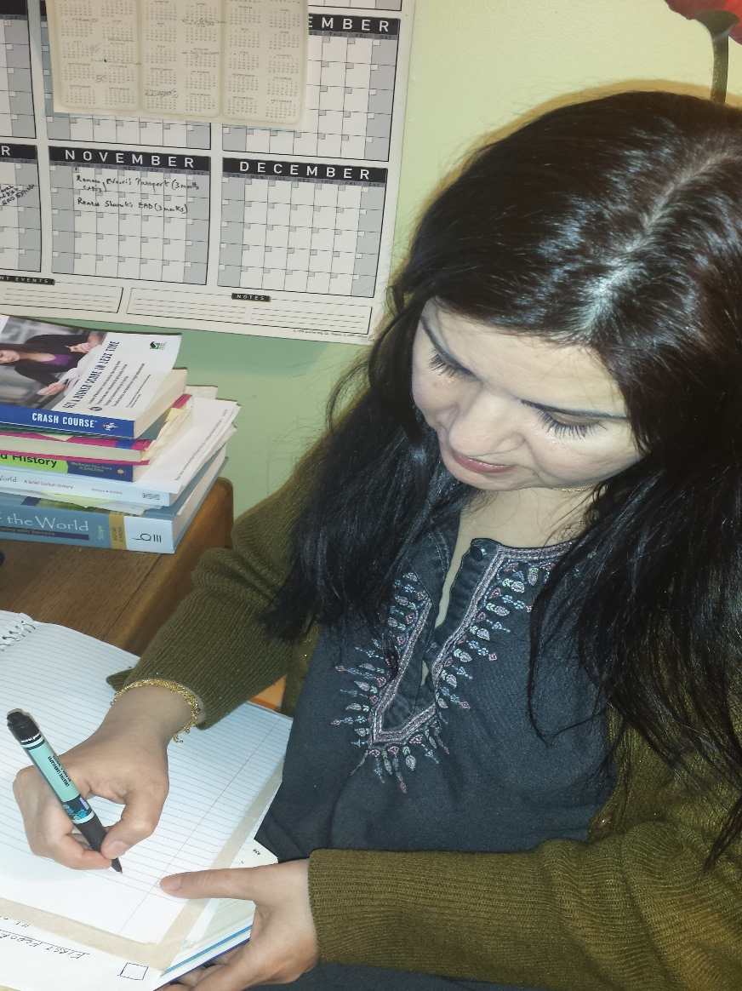
OMG World History is like my fav class EVERRR!!!
DORK!

Slide 2
DBQ
Super Easy!

Slide 3
THIS ESSAY DOES NOT MEASURE YOUR HISTORY KNOWLEDGE!

Slide 4
This essay tests your HISTORIAN SKILLS.
Can you
take evidence that is presented to you,
form an opinion and
Report on a reliability of the evidence
They don't want you to be a historian, they want you to be INDIANA JONES.

Slide 5
It is as simple as…
We simply use the help of the given documents to answer the given question.

Slide 6
1. GROUP THE DOCUMENTS.
These documents are meant to help you reach a conclusion based on the question asked.
Read the question.
Read through the documents in 10 minutes provided
Butcher the test booklet. -underlining key words, authors, dates: Anything that might help you find other documents like this one.
Your PRIME DIRECTIVE is to group.

Slide 7
Grouping
There will be multiple ways to group the documents.
You are NOT expected to find them all.
You only need to find two or three ways that the documents work together.
Once you've found your groups, the rest of the essay writes itself.
YOUR GROUPS ARE YOUR BACKBONE
Mention them in the THESIS and then elaborate on why each document fits into the group (and therefore answers the question) in the body.

Slide 8
What else?
POINT OF VIEW
EXTRA DOCUMENTS.

Slide 9
2. POINT-OF-VIEW
Do you believe everything you hear?
People lie to your face every single day.-documents do too!
The sources of the documents may have hidden agendas as to why they are telling you what they are telling you.
The AP wants you to be able to recognize that not everything you read is 100% true.

Slide 10
Analysis of documents
analyze the sources of the documents.
The introduction to each document will be your #1 source of the author's point of view.
Look at their occupation, name, title, job, rank, or whatever is listed there.
There will be at least two or three documents with blatant bias based on their points of view
As you bring up the documents in your essay (and you have to use all of them), immediately list after each document if it is trustworthy

Slide 11
For example
"The Emperor of Rome (Document 1) thinks that Rome is the greatest city on the planet. However, the Emperor may be biased due to the fact that he is the ruler of Rome and would therefore not be the most trustworthy source on Rome."

Slide 12
3. WHO's VOICE IS NOT BEING HEARD?
THIS IS THE EASIEST POINT OF THE AP TEST
. At the end of your essay, look back through the documents and determine who is not there. What would help you shape your opinion on this topic? You are only getting 6-12 documents.
If you had the opportunity to get two or three or four more documents to help you out, what would they be? and how would they be helpful?

Slide 13
Template
IT WOULD BE HELPFUL TO HEAR FROM BLANK BECAUSE BLANK…
IT WOULD BE HELPFUL TO HEAR FROM A WOMAN BECAUSE A FEMININE PERSPECTIVE WOULD AID IN THE ANALYSIS OF THIS TOPIC.
IT WOULD BE HELPFUL TO HEAR FROM A MERCHANT BECAUSE A MERCHANT FROM A FOREIGN LAND WOULD BRING A DIFFERENT VIEW
IT WOULD BE HELPFUL TO HEAR FROM A KING/EMPEROR BECAUSE THE LEADER OF ONE OF THESE LANDS WOULD ADD A UNIQUE PERSPECTIVE.

Slide 14
More templates
IT WOULD BE HELPFUL TO HEAR FROM A MAP/CHART/GRAPH ON THIS TOPIC BECAUSE A VISUALIZATION OF THE TOPIC AT HAND WOULD AID IN THE ANALYSIS.
IT WOULD BE HELPFUL TO HEAR FROM A RELIGIOUS TEXT BECAUSE (THE RELIGION OF THE AREA)'s PERSPECTIVE ON THIS ISSUE IS CRUCIAL.
IT WOULD BE HELPFUL TO HEAR FROM A TRAVELLING MONK BECAUSE A FOREIGN, LITERATE PERSON FROM ANOTHER LAND WOULD HAVE A UNIQUE PERSPECTIVE.
(Note:This does not have to be specific document like the Magna Carta or Constitution, just make a generic one)

Slide 15
Lets look at the rubric

Slide 16
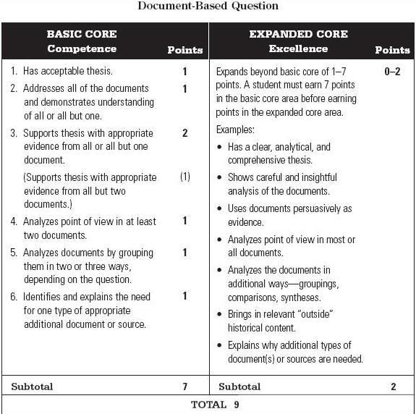

Slide 17
DBQ rubric
You can score 9 points on the DBQ
you can score 7 points on the" Basic Core".
If you earn all 7 Basic Core points, you might be able to earn two additional “Expanded Core" bonus points.

Slide 18
DBQ: THE MISSION
Write of 5 body paragraph essay – intro/thesis paragraph, three body paragraphs based on 3 groupings of documents and a conclusion paragraph.
Group the documents in at least three different ways which help answer the prompt.
Write a complex thesis which answers all parts of the prompt and includes three ways to prove your ARGUMENTS.
Attempt to use all the documents in your essay. Supported your thesis with them. Analyze them.
Identify bias and author's point of view at least 3 times in your essay

Slide 19
THE THESIS
Your thesis must be a specific and explicit answer to the prompt. It must address all parts of the question.
If you don't have a thesis or you have a really bad one it could cost you two basic core points!
Tends to be the "killer" point for many students who don't answer ALL parts of the prompt.

Slide 20
Thesis
Example prompt:
Based on the following documents, analyze the responses to the spread of Buddhism in China. What additional kind of document(s) would you need to evaluate the extent of Buddhism’s appeal in China?
Unacceptable, “There were many responses to the introduction of Buddhism into China ”“This thesis is too vague . “Many” is a virtually meaningless qualifier that doesn’t take a “position.”
“Buddhism had a large impact on China.” Off topic. The question asks the reader to focus on type of responses to Buddhism, NOT the amount of impact Buddhism had in China.

Slide 21
Good, Bad and the Ugly THESIS
Official Description Commentary | Point #
Has an acceptable thesis. The thesis should reflect a sophisticated understanding of the complexities within a question. Thesis should be located in the beginning of the essay ( 1st paragraph) For Ms. Khan-Thesis Should: Address all parts of the question. Take a position on the question Set out categories of discussion. | 1 Thesis
Minimal acceptable: “Chinese reacted to Buddhism in both positive and negative ways.” Bare minimum of acceptability. There are at least two categories, but good historical analysis should be more descriptive than just ‘good’ and ‘bad.‘
Acceptable “Chinese peasants responded positively towards Buddha’s message, but aristocrats and those with vested interest in the status quo rejected Buddhism.” This thesis shows the student understands the socio-economic differences within Chinese society (peasants vs upper class)

Slide 22
“Wow Moment”
Excellent “Although Chinese peasants initially welcomed Buddhism, as it gave them shelter during political uncertain times, as imperial security improved government authorities increasingly saw Buddhism as a threat to their political power and moved to discredit it. Excellent! This is certainly a ‘Change over time” thesis (first ‘A’, then ‘B’) that also incorporates the socio- economic awareness of the previous example. This thesis would likely be eligible for the “Expanded Core” (Extra Credit) as a “clear, analytical, and comprehensive thesis.”

Slide 23
Obviously, you should always write your thesis AFTER you've grouped your documents.
Change over time
Socio-economic
Positive vs Negative

Slide 24
Use

Slide 25
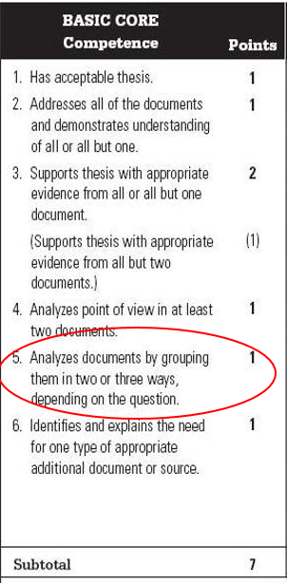
Grouping the Documents
Example
Groups Provided:
" Analyze the religious, political, and social reasons for the rise of the Protestant Reformation in the 16th century.“
Groupings not provided:
“Analyze the reasons for the rise of the Protestant Reformation in the 16th century."
Basic core # 5 – analyze documents by grouping them in two or three ways, depending on the question.
Some DBQs have ready-made groups; some DBQs will require you to come up with the groupings yourself.
There are usually several different ways that you can correctly group the docs.

Slide 26
Common methods of grouping documents include organizing by gender, time, social class, occupation, geography, nationality, culture, similar points of view, or religion.
Make sure all of your groupings ANSWER THE PROMPT!
Documents may be used in more than one group you do not need an even number of documents in each group.
Always include at least three documents per grouping. It will prevent a failed group if you misinterpret one document.
If you get stuck, use PIRATE or SPICE as your “safety net” groupings.
Be careful of being too formulaic.

Slide 27
Although Chinese peasants initially welcomed Buddhism, as it gave them shelter during political uncertain times, as imperial security improved government authorities increasingly saw Buddhism as a threat to their political power and moved to discredit it.

Slide 28
USING DOCUMENTS
Every document should be mentioned at least one time in your essay.
"Demonstrates understanding" means you interpret it correctly (discuss/analyze it).
Don't quote the documents excessively – use the document as evidence to support your argument.
To get the grouping point, you need at least three documents per group.

Slide 29
Use of documents
Use of document is defined as citing, quoting, paraphrasing, listing, summarizing, mentioning, analyzing, interpreting, or critiquing the documents in any way.
For example, “the Anonymous Chinese scholar's (Doc#3) defense of Buddhism reflects the growing criticism of Buddhism as political order and stability was reestablished in China. As Tang officials reasserted their power, there was more pressure placed on Buddhists to show evidence why Buddhism was compatible with more traditional Confucianism.”
Always include parenthetical citation after you have used the document. Why?

Slide 30
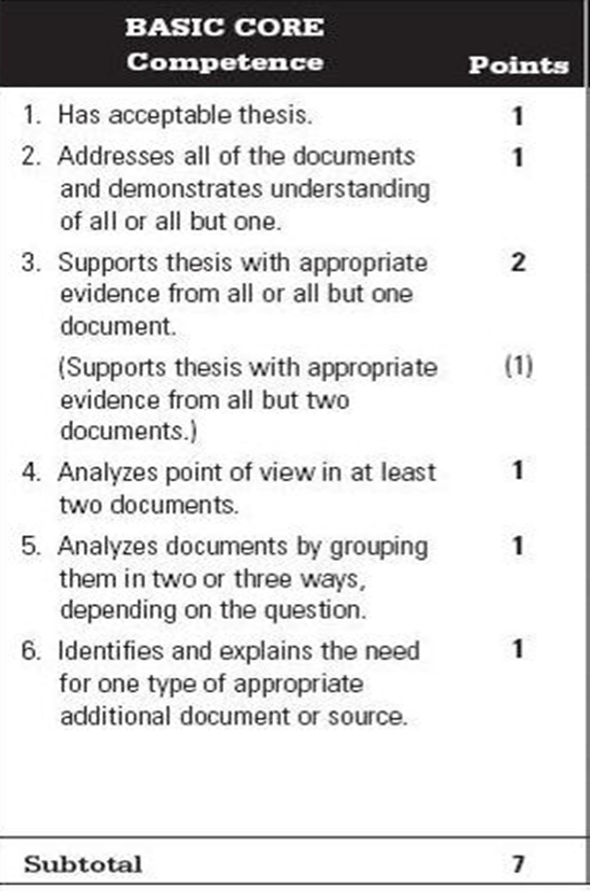
Point of view Analysis-POV
Part of writing an effective DBQ essay is treating the documents as personal interpretations of history and analyzing the point of view of the authors.(SOAPSTONE METHOD HELPS)
Students must do this at least three times in their essay. (Preferably 5 or more).
Use the SOAPSTONE method to analyze the point of view of the authors

Slide 32
A.S.A.P (Attribute the Source +analyze POV)
“Zhi Dun’s argument supporting Buddhism (Doc#2) is understandable, given the politically tumultuous time in which it was written. When political leaders cannot be trusted to provide security, those without material resources are more likely to turn to spiritual teachings, especially ones that make sense of meaningless suffering.”

Slide 35
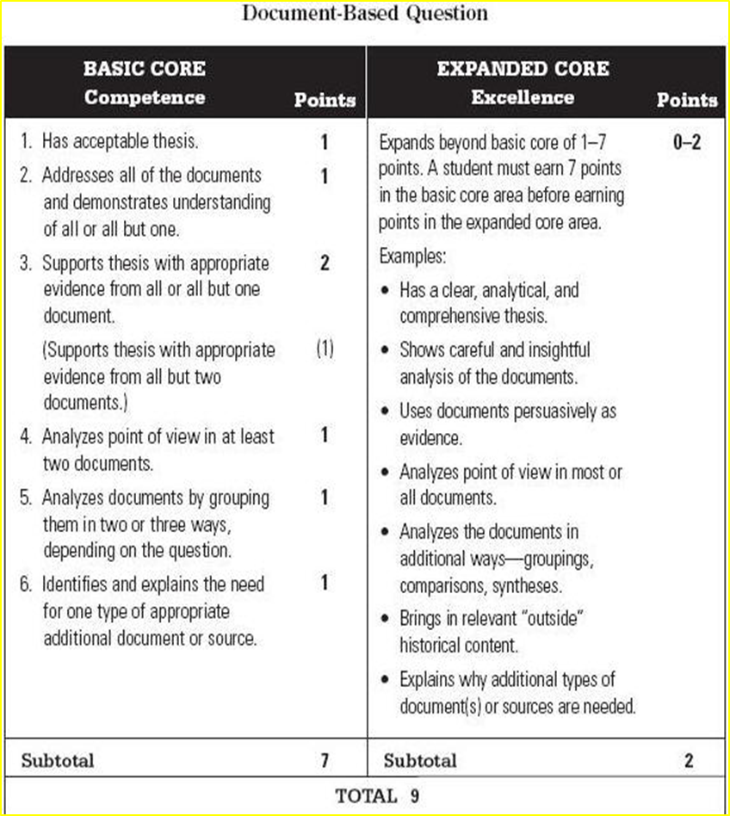
Expanded Core
If you achieve all seven basic core points, you can earn up to an additional 2 points on your essay through the expanded core.
Basic core shows competence. Expanded core demonstrates excellence in writing!

Slide 36
Expanded core
Up to two points are given based on how well a student accomplishes the examples given for the expanded core.
Unlike the basic core, the expanded core can be viewed as somewhat subjective.
Concentrate on these four expanded core criteria (easiest way to earn expanded core points):
1. Persuasive use of documents as evidence
2. Addressing all parts of the question thoroughly
3. Analyzing point of view or bias in most of the document
4. Bring one additional outside historical document.- EASY 1 point

Slide 37
DBQ review step-by-step!
Read and understand the prompt.
Quickly tackle the documents to look for categories to form your THESIS – make notes or a quick chart.
Draft your thesis and note your groups. Make sure your thesis and groupings answer all parts of the prompt.
Determine which documents will work for POV analysis. Attempt to write POV analysis statements for most documents.
Draft your topic sentences. Write your essay!

