Slide 1
OMG World History is like my fav class EVERRR!!!
DORK!

Slide 2
Writing the DBQ
AP World History

Slide 3
THE DBQ
First essay you'll see on the AP world exam
essays based on a set of various documents (usually 10 to 12). Documents may include written or visual primary sources (quotes, letters, speeches, decrees, laws, political cartoons, drawings, maps, photos, etc.)
The DBQ counts for approximately half of the essay section or about ¼ of your entire AP Exam! (Twice as important as each of the other two essays – which count about 1/8 each). The DBQ is "muy importante!"
70

Slide 4
DBQ rubric
You can score 9 points on the DBQ
you can score 7 points on the" Basic Core".
If you earn all 7 Basic Core points, you might be able to earn three additional “Expanded Core" bonus points.

Slide 5
DBQ: THE MISSION
Write of 5 body paragraph essay – intro/thesis paragraph, three body paragraphs based on 3 groupings of documents and a conclusion paragraph.
Group the documents in at least three different ways which help answer the prompt.
Write a complex thesis which answers all parts of the prompt and includes three ways to prove your ARGUMENTS.
Attempt to use all the documents in your essay. Supported your thesis with them. Analyze them.
Identify bias and author's point of view at least 3 times in your essay

Slide 6
THE THESIS
Your thesis must be a specific and explicit answer to the prompt. It must address all parts of the question.
If you don't have a thesis or you have a really bad one it could cost you two basic core points!
Tends to be the "killer" point for many students who don't answer ALL parts of the prompt.

Slide 7
Thesis
Example prompt:
Assess the impact of the discovery of the Americas on world civilization. Determine to what extent these contacts were beneficial or disruptive.
(SIMILAR QUESTION)
Based on the following documents, discuss the positive and negative impact on the world of the discovery and conquest of the Americas by Europeans. What type of additional documentation would access the impact of the Americas on world History?
It is not sufficient to merely state in your thesis, “Discovery of Americas had several positive and disruptive impacts on the world civilization with regards to ecomomy, migration, population, religion and society."You have not given specific, explicit answer to the question and will lose points on basic core 1 and 3.
What were the impacts??? Be specific!!

Slide 8
THESIS
A better thesis would be…
"Despite the fact that the discovery of the Americas by the Europeans was beneficial to the world in respect to the growth of population in Eurasia, rise of the strong middle /business class in the old world, and spread of Christianity in the New world, it had several negative impacts which affected the world in which we live in especially with regards to slave trade which led to everlasting racial and economic divide across the globe as well as the spread of epidemics which led to depopulation in the New world.”
This (complex) thesis gives a specific, explicit answer to the prompt and provides three groupings of documents which help support the thesis:
group 1 – Positive and negative impact of Columbian Exchange
group 2 – increase in economic, religious, population growth
group 3 – weakening of society (slavery, racial divide), epidemics, depopulation (leading to the rise of slavery )

Slide 9
Obviously, you should always write your thesis AFTER you've grouped your documents.
– Positive and negative impact of Columbian Exchange
increase in economic, religious, population growth
– weakening of society (slavery, racial divide), epidemics, depopulation (leading to the rise of slavery )

Slide 11
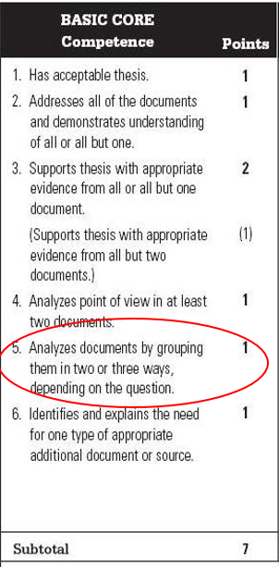
Grouping the Documents
Example
Groups Provided:
" Analyze the religious, political, and social reasons for the rise of the Protestant Reformation in the 16th century.“
Groupings not provided:
“Analyze the reasons for the rise of the Protestant Reformation in the 16th century."
Basic core # 5 – analyze documents by grouping them in two or three ways, depending on the question.
Some DBQs have ready-made groups; some DBQs will require you to come up with the groupings yourself.
There are usually several different ways that you can correctly group the docs.

Slide 12
Common methods of grouping documents include organizing by gender, time, social class, occupation, geography, nationality, culture, similar points of view, or religion.
Make sure all of your groupings ANSWER THE PROMPT!
Documents may be used in more than one group you do not need an even number of documents in each group.
Always include at least three documents per grouping. It will prevent a failed group if you misinterpret one document.
If you get stuck, use PERCI or PERSIA or SPRITE as your “safety net” groupings.
Be careful of being too formulaic.

Slide 13
"Despite the fact that the discovery of the Americas by the Europeans was beneficial to the world in respect to the growth of population in Eurasia, rise of the strong middle /business class in the old world, and spread of Christianity in the New world, it had several negative impacts which affected the world in which we live in especially with regards to slave trade which led to everlasting across the globe racial and economic divide as well as the spread of epidemics which led to depopulation in the New world.”

Slide 14
USING DOCUMENTS
Every document should be mentioned at least one time in your essay.
"Demonstrates understanding" means you interpret it correctly (discuss/analyze it).
Don't quote the documents excessively – use the document as evidence to support your argument.
To get the grouping point, you need at least three documents per group.

Slide 15
Use of documents
Use of document is defined as citing, quoting, paraphrasing, listing, summarizing, mentioning, analyzing, interpreting, or critiquing the documents in any way.
For example, “Francesco Guicciardini, Italian historian in his book explains how the old dogma that faith in Christ was spread by apostles became contradictory after the New world was found as Christianity was unknown to the native Americans.(DOC.1).
Always include parenthetical citation after you have used the document. Why?

Slide 16
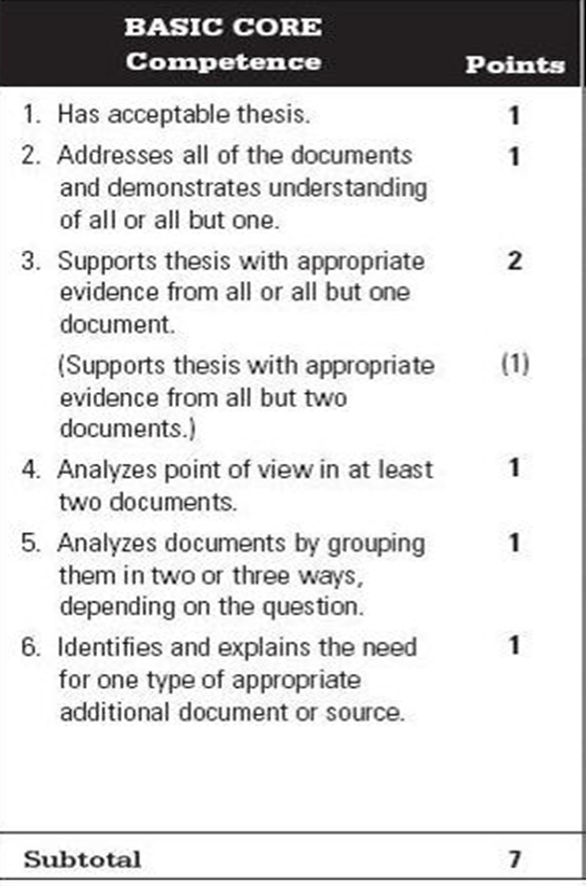
Point of view Analysis-POV
Part of writing an effective DBQ essay is treating the documents as personal interpretations of history and analyzing the point of view of the authors.(SOAPSTONE METHOD HELPS)
Students must do this at least three times in their essay. (Preferably 5 or more).
Use the SOAPSTONE method to analyze the point of view of the authors

Slide 18
EXAMPLE DOCUMENT (Doc 5)
Source: A chronicle kept by the Cakchiquel Mayas for the descendants, recording the impact of a European disease on their people, early 16th century.
"Great was the stench up the dead. After our fathers and grandfathers had succumbed, half of the people fled to the fields. The dogs and the vultures devoured the bodies. The mortality was terrible. Your grandfathers died, and with them died the sons of the king and his brothers and King's men. So it was that we become orphans, oh, my sons! So we became when we were young. All of us were thus. We were born to die! "

Slide 19
A.S.A.P. (Attribute the Source + analyze POV)
The Cakchiquel Mayas during the 16th century is characterizing to their descendants that they were people living in a well established society and strong family values but their life was destructed by the coming of the Europeans who brought the epidemics (DOC.5)
Obviously, the Maya chronicler wanted to portray to his future generation that they were highly civilized people, so that they do not assume the subordination of their people by the Europeans was by default.

Slide 23
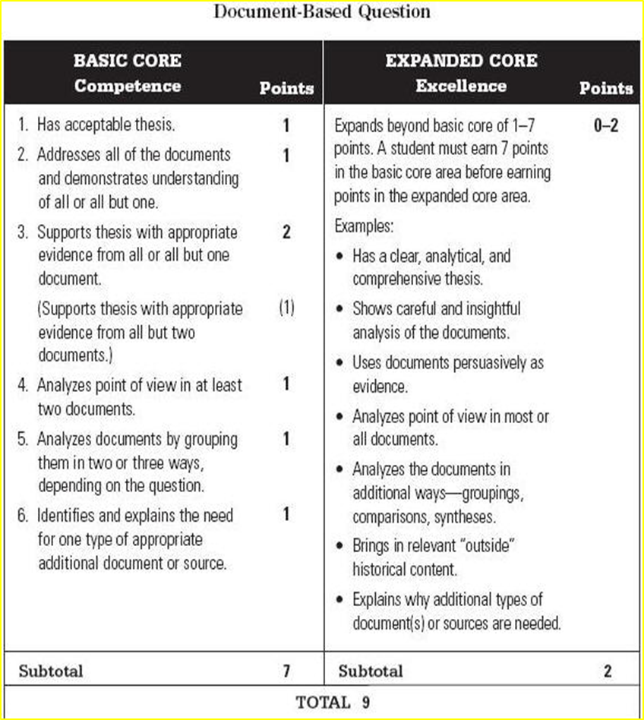
Expanded Core
If you achieve all seven basic core points, you can earn up to an additional 2 points on your essay through the expanded core.
Basic core shows competence. Expanded core demonstrates excellence in writing!

Slide 24
Expanded core
Up to two points are given based on how well a student accomplishes the examples given for the expanded core.
Unlike the basic core, the expanded core can be viewed as somewhat subjective.
Concentrate on these four expanded core criteria (easiest way to earn expanded core points):
1. Persuasive use of documents as evidence
2. Addressing all parts of the question thoroughly
3. Analyzing point of view or bias in most of the document
4. Bring one additional outside historical document.- EASY 1 point

Slide 25
DBQ review step-by-step!
Read and understand the prompt.
Quickly tackle the documents to look for categories to form your THESIS – make notes or a quick chart.
Draft your thesis and note your groups. Make sure your thesis and groupings answer all parts of the prompt.
Determine which documents will work for POV analysis. Attempt to write POV analysis statements for most documents.
Draft your topic sentences. Write your essay!

