Slide 1
DEVELOPMENT OF COMMUNICATION AND TRADENETWORKS
600 BCE-600 CE

Slide 2
TEST TIP
TRADE IS ONE OF THE MOST RECURRING THEMES IN AP WORLD HISTORY. YOU WILL DEFINITELY SEE QUESTIONS AND POSSIBLY ESSAYS THAT ASK ABOUT TRADE

Slide 3
A. THE LAND NETWORKS OF AFRICA, EUROPE, AND ASIA
GEOGRAPHY
Geography determined what was exchanged, where it was exchanged, and by whom it was exchanged

Slide 4
1. CLIMATE AND TOPOGRAPHY
CLIMATE AND TOPOGRAPHY DETERMINE WHERE VALUABLE MINERALS ARE FOUN, TYPES OF PLANTS THAT CAN BE GROWN, AND WHERE SEAPORTS, MOUNTAIN PASSES, AND OASESEXIST SO THAT RAW MATERIALS MAY BE PROCESSED AND SOLD.
MERCHANTS NEEDED TO TRANSPORT THESE GOODS WITH Relative safety across regions

Slide 5
2. Trade happens because people want goods
For example salt has always been an important trade good, used not so much to flavor food at it is used today, but to preserve food in the millennia before refrigeration. People travelled great lengths to get it– some travelled from Southwest Asia or Central Africa across the sahara desert to northwest Africa to get it
Merchants were willing to make difficult treks in hopes of receiving a nice payoff for their effort
Visualize the afro-Eurasia trade Rome to china
The silk or tea, or spices, or salt was relayed from town to town until it reached its destination

Slide 6
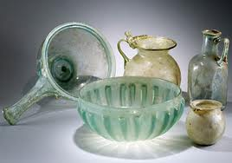
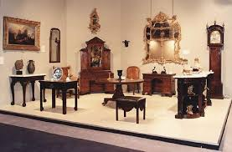
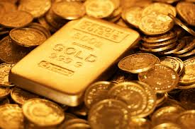
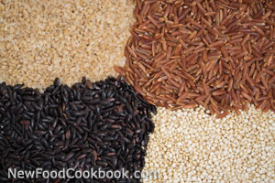
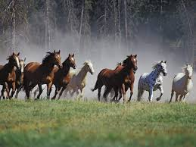
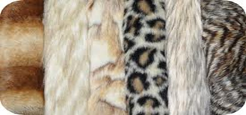
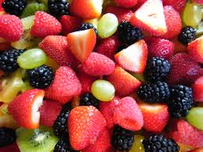
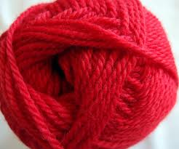
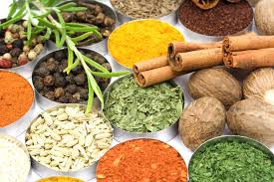
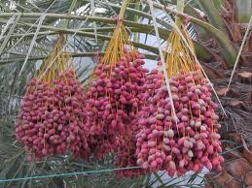
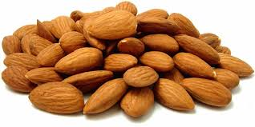
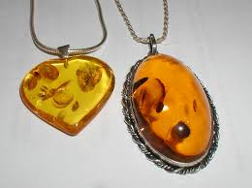
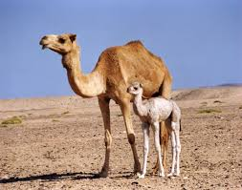
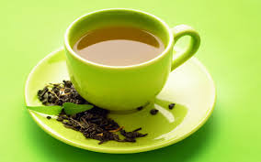
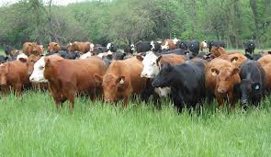
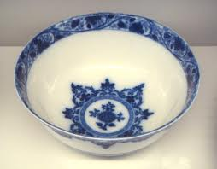
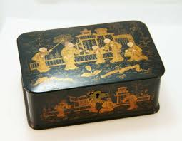
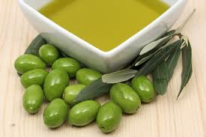
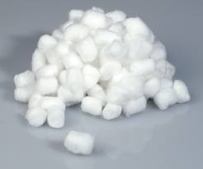
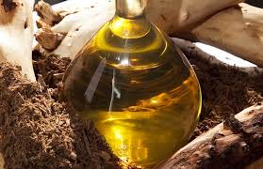
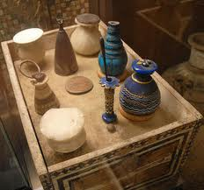
b. The silk roads

Slide 7
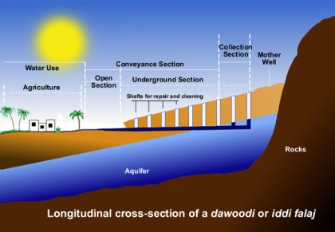
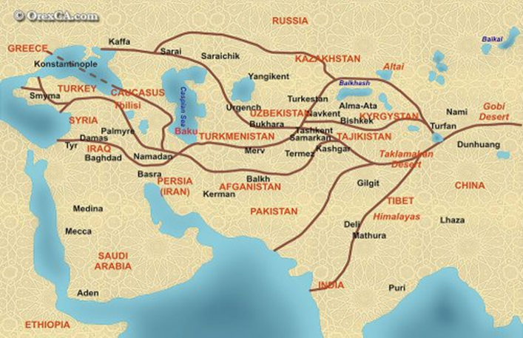
EFFECTS OF EXCHANGE OF GOODS
THEW EXCHANGE OF GRAINS AND FABRICS ACROSS EURASIA CHANGED FARMING TECHNIQUES AND ALLOWED TO GROW CROPS IN NEW REGIONS
Idea spread to
Southwest Asia

Slide 8
Spread of Buddhism along silk road
Merchants and missionaries from south Asia introduced Buddhism along silk roads which had a long lasting effects on east and south east Asia
When han empire began to decline,
people in china converted to Buddhism

Slide 9
Diseases along silk road
Pandemic (wide spread) diseases –bubonic plague frequently crosses afro-Eurasia along trade routes
This could also be ne of the reasons for the fall of han dynasty.

Slide 10
Other branches of silk road
Tea and horse caravan roads extended from southern china to South Asia –not popular but vital roads

Slide 11
Test tip
The effects of trade and the items traded along the silk roads are important topics of ap history exam

Slide 12
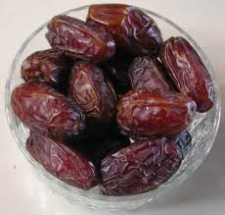
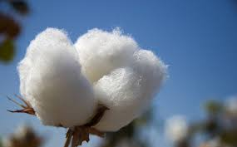
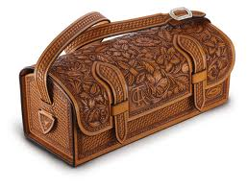
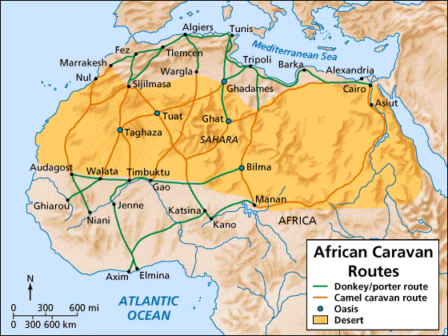
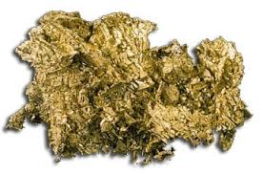
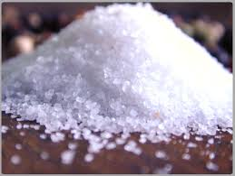
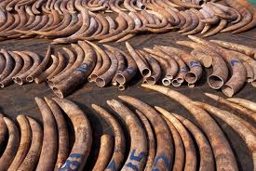
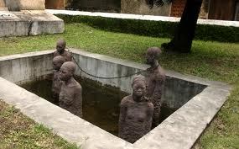
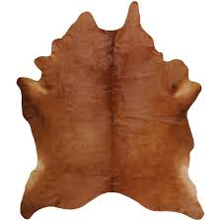
c. Sahara caravan routes
Commerce across north Africa
Along Mediterranean, cities and ports rich in vegetation and resources

Slide 13
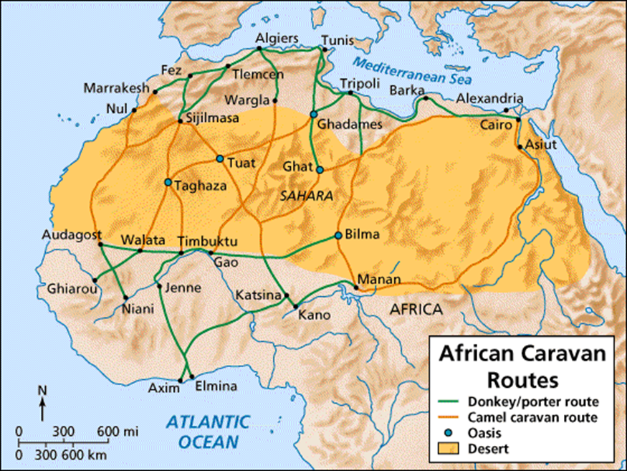
2. Introduction of camels
In n Africa around the turn of the calendar from BCE to CE, the camel was introduced as a means of transporting goods. This led to major increase in the amount of trade that occurred between west Africa and Southwest Asia
In the next period CE 600 –CE 1450, Islam was spread into Trans-Saharan region along trade routes just as Buddhism spread into East Asia

Slide 14
North south Eurasia roads
Merchants carried merchandise such as cotton, spices, and rice from south Asia; spices from south east Asia ; horses and textile (cloth) to and from central Asia.
These routes connected Baltic sea, Russia and the black sea trade connections
Constantinople was the center of trade

Slide 15
ii. The sea networks

Slide 16
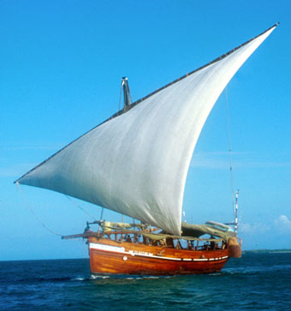
a. The Indian ocean trading network
The Indian ocean trade network was the largest until the Europeans began crossing the Atlantic in the 1400s.
Connected Southeast Asia and China to Africa, the Middle East, and South Asia
Buddhism-S Asia to East and South east Asia
Trade items (refer previous slide)
2. Trade depended on monsoon currents (winds)
Small nut seaworthy ships used by Arab merchants called the dhows, used triangular lateen sail to follow winds

Slide 17
Test tip
In the past, ap world history exam s, questions on the effects of trade and the items traded across the Indian ocean have frequently been included

Slide 18
b,. Mediterranean and black sea trading
2. The black sea, with Asia on its eastern shore and Europe on the western shore, was another imp. Trading area before, during, and after classical era.
Constantinople as center
Goods carried from blac sea area to silk roads, the Mediterranean and Russia
In the next period you will learmn merchants unwittingly carried bubonic plague into western Europe.
Mediterranean sea network begins with the Egyptians and Phoenicians and continued by Greeks, romans Byzantines
Trade goods (see previous slide)
Out of Africa ( trade goods??)
Christianity spread to eastern and western Europe and Africa by merchants and missionaries, but especially by boats that carried cargo and people across Mediterrannean.

Slide 19
iii. Exchanging goods in the Americas
Contrasting facts
Far fewer people in the Americas
Fewer types of large domesticated animals- wheel was never developed for transportation until the 15th CE
Llama and alpacas as pack animals for Andes mountains; other parts of America, dogs pulled sledges.
The narrow and jungle covered terrain of the Isthmus of panama made trade from South America into Central and north America difficult
Good exchanges were probably made in relay fashion, from one village and city to another, and not by merchants on long-distance trade missions.
American corn (maize0 was first developed and then spread to regions north and south along trade connections
The areas in the Americas with the most trade activity were among the Maya and Teotihuacan in Mesoamerica and within the Moche civilization of the Andes

