Slide 1
Friendly Reminders
Keep your electronics away. If I see them I will take them, and depending on what you bribe me with, you might have to get it back from the office.
Pay attention when you are supposed to pay attention and talk when you are supposed to talk. Remember, when I am talking, you need to be listening. You will have time this period to talk, I promise.

Slide 2
Recap
Last week, we took a test on how the Greeks, Romans, Jews, and Christians influenced the world with their ideas on government, laws, and how to make a better world. We are going to continue talking about this theme of ideas in our next unit.
The next slide has the important vocabulary that you should learn them and know what they mean. In order to master this chapter’s vocabulary, please take the help of the text book and do the vocabulary-definition-illustration activity in this same powerpoint. Save it in your H Drive and submit in th dropbox in haiku.
When you write the definition, you should tell me for example John Locke-Who was he? Why is he important? How is his thinking beneficial to us. Then search the google and add an image that goes with your definition.
You have online textbook which you will find the link on the right hand side of the agenda page on khanlearning.weebly.com and class copy of textbook on the shelf.

Slide 3
Glossary:
Scientific Revolution
Enlightenment
Secular
U.S. Bill of Rights
Textbook
John Locke- pg. 196
Montesquieu- pg. 197
Rousseau- pg. 197
Voltaire- pg. 196
Mary Wollstonecraft- pg. 199
Simon Bolivar- pg. 249
Magna Carta- pg. 25
Natural Rights- pg. 25
English Bill of Rights- pg.23
Thomas Jefferson- wrote the Declaration of Independence.
U.S. Constitution- The fundamental principles and established precedents that governs the United States.
James Madison- Influential in the writing of the U.S. Constitution.
Unalienable rights- Rights people are born with that cannot be taken away by government.
The Declaration of Independence- A document declaring the U.S. to be independent of the British Crown, signed on July 4, 1776
Checks and Balances- Branches of government checking the actions of each other

Slide 4
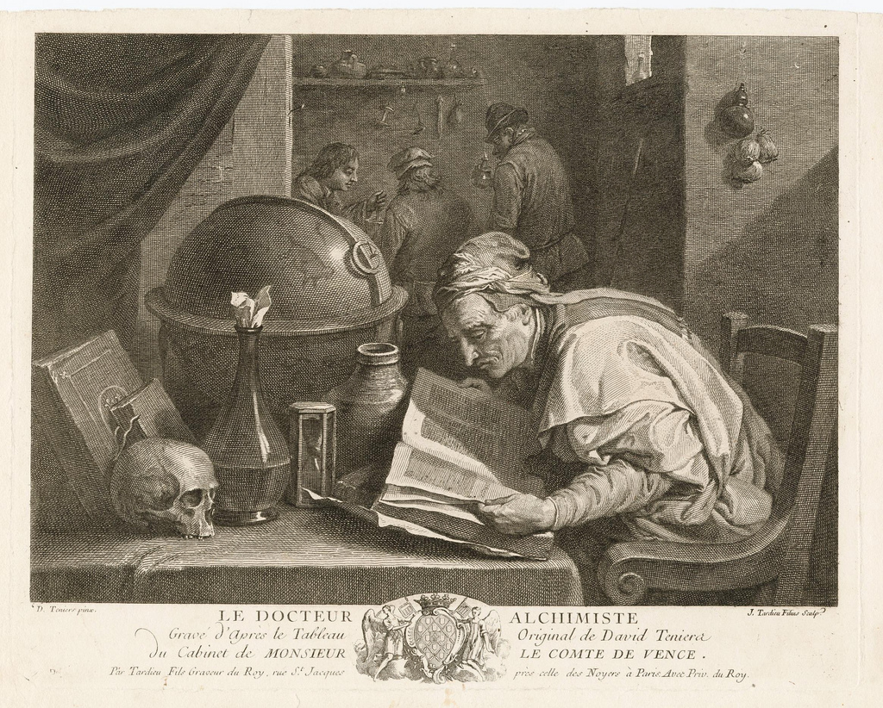
Example : Scientific revolution
I got this from google search and minus wiki
I have cited this as well
Working Definition: By tradition, the "Scientific Revolution" refers to historical changes in thought & belief, to changes in social & institutional organization, that unfolded in Europe between roughly 1550-1700; beginning with Nicholas Copernicus (1473-1543), who asserted a heliocentric (sun-centered) cosmos, it ended with Isaac Newton (1642-1727), who proposed universal laws and a Mechanical Universe.
Citation
Dr. Robert A. Hatch “The Scientific Revolution”15/09/2015http://users.clas.ufl.edu/ufhatch/pages/03-Sci-Rev/SCI-REV-Teaching/03sr-definition-concept.htm
Robert Connif. Strange Behaviors “The Scientific Revolution’s Unexpected Debt To Alchemy” 15/9/2015<https://strangebehaviors.wordpress.com/2014/01/22/the-scientific-revolutions-unexpected-debt-to-alchemy/>
Cite your source as taught by the librarian. Use the handout given by her or you will find in the T Drive under library folder.

