Slide 1
GROUP ASSIGNMENTS
Responsibilities within the group

Slide 2

facilitator
The Facilitator, is the person who will guide the group along when it gets bogged down or off-task. He/She will steer the group towards the group’s goal(s)

Slide 3

recorder
The Recorder takes the notes of what happens in the group. If any instructions are verbally given by the instructor, it is the Recorder’s job to write them down for the group, and shares that information with them.

Slide 4
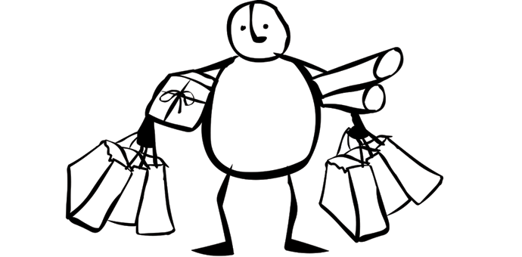
materials
The Materials person, gets all supplies for the group. He/She also collects and puts away all supplies the group has used for the class period. If any supplies are needed outside of class, the Materials person also picks up those supplies for the group.

Slide 5

reporter
The Reporter speaks for the entire group. If the instructor asks what happened during the group session the Reporter, stands up and speaks for the group. Any games that happen that involve the group, the Reporter is the person who answers the question for the whole group.

Slide 6

harmonizer
The Harmonizer keeps balance in the group. Whenever there is conflict between members of the group, the Harmonizer will keep the peace.

