Slide 1
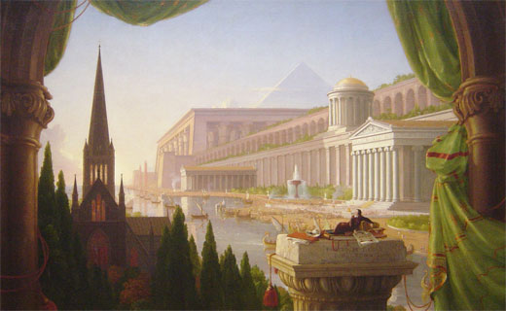
Lecture 1 Key Influences on European History
What factors influenced the creation of European civilization?

Slide 2
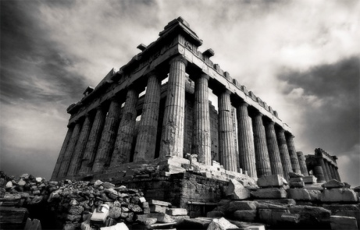
The Classical Greeks (700-400 BCE)
polis (or city-state)
independent political units, defensible and agricultural, made up of “relatives” declaring common ancestry.
Ruled by oligarchies (wealthy group), who chose tyrants in times of trouble.
Literate society, worshiped similar gods.
Athens and Sparta emerged as the leaders.
Men like Solon, Pericles, Socrates, Plato, Aristotle and Pythagoras invented (to some extent) political, philosophical, and scientific ideas that shaped Europe. (ie. reason and democracy)

Slide 3
The Romans
- 509 BCE Rome forms the “Republic” (non-democratic, but closer)
- Economic, political and social crisis leads to overthrow of Republic and rise of the Roman Empire (46 BCE)
- Admired the Greeks, and built on their accomplishments, mostly in math and civil engineering (roads, bridges, aqueducts).
- Expands too far and collapses in the 5th Century CE.

Slide 5
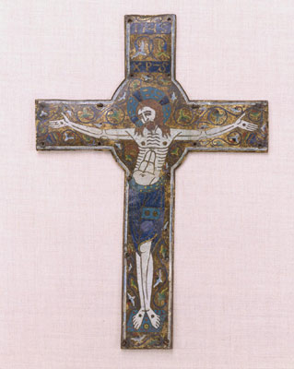
Christianity
- Likely the single most important factor in shaping the western world.
- Began in the Middle East as an off-shoot of Judaism
- Jesus gained a large following, especially among the poor of the Roman Empire
- After Jesus’ death and claimed resurrection, the religion spread across the Empire.
- Groups of Christians were led by Bishops (Bishop of Rome = Pope)

Slide 6
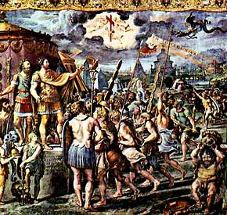
- Christianity was persecuted, but continued to grow, Emperor Constantine converted in 303 CE.

Slide 7
The Dark Ages (450-1000 CE)
- “Barbarian” tribes sacked Rome, but adopted Roman cultural ideas, especially Christianity
- Roman ideas also continued in the East (Byzantium)
- In the Middle East, Islam begins rising in the seventh and eighth century CE and threatens the Western World.
- Church (especially Roman Pope) strengthens itself in the chaos: allying with the Franks.
- Frankish King Charlemagne briefly reunited Western Europe under the Holy Roman Empire.
- Western Catholic Church split from Eastern Orthodox Church
- Vikings began attacking everywhere…

Slide 8
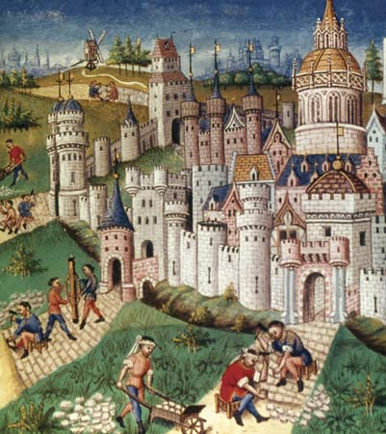
The High Middle Ages (1000-1300 CE)
Intellectual, cultural, political growth and stability: better climate, more agriculture, reduced attacks, etc.
Towns begin to grow, merchants begin to trade more extensively (guilds)

Slide 9
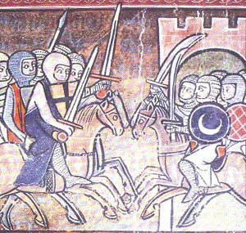
Crusades fail, but stimulate Europe with new ideas. (gunpowder, Arabic numerals)
National monarchies begin to grow in power (England, France), conflicting with the landed aristocracy
Universities expand and begin using classical texts (saved by the Arabs)

Slide 10
Medieval Religion
Strong sense of mortality
Art reflected the inevitability of divine judgment
Humans are all naturally damned (Eve)
Everyone is going to hell unless they follow Church rules
Cathedral building, Monks and Nuns
Superstition is prevalent

Slide 11
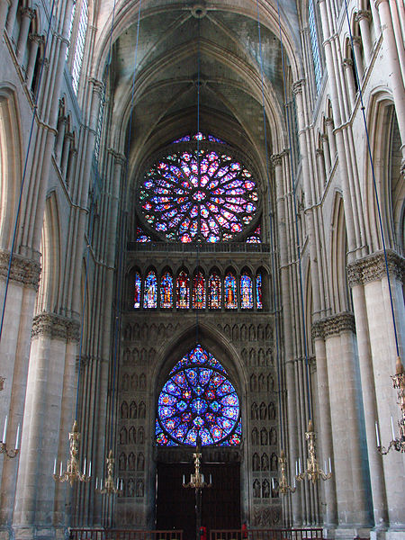
Cathedral at Reims, France

Slide 12
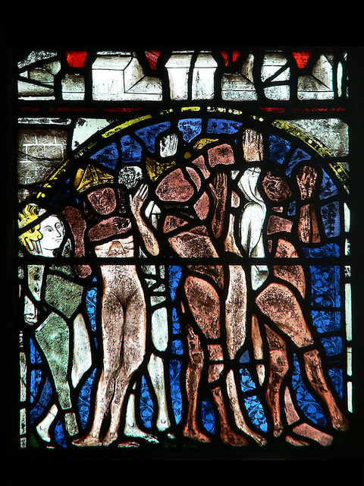
Tewkesbury, England 1338.

Slide 13
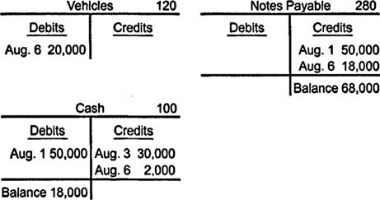
Medieval Economics
Arabic numerals allow for double-entry bookkeeping
Allows for the development of modern trade and banking. (bankers spurred on the Renaissance)

Slide 14
Medieval Social Structure: The Feudal System
During the Middle Ages, European society was organized in a hierarchical structure.
Differed from area to area, but basically each level of society had obligations to those above or below it.
There was little social mobility.

