Slide 1
Mongols Review
Chapter 12
What you really need to know

Slide 3
1. Largest Continuous Land Empire
Superior bows and horsemanship-superior usage of horses
Kinship ties; powerful clans dominated weaker families
Conquest-
Mass slaughter and starvation under siege.
Diplomacy.
IMPACT
It promoted the spread of ideas and movement of
people in Eurasia.
Pax Mongolica
Exposed Europeans to Gunpowder for the first time.

Slide 4
Genghis Khan 1200s
unites the tribe of nomads to the superior force of Mongols
He followed the shamanistic
beliefs of his ancestors,
but all religions were tolerated
in his empire.

Slide 5
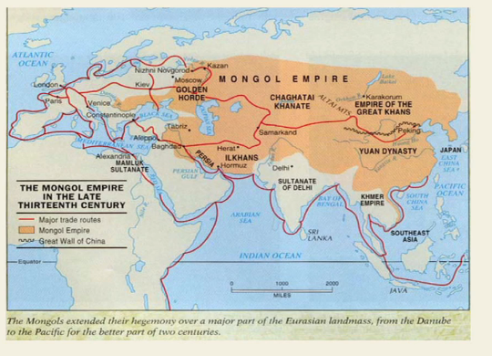
Mongol Khanates
Golden Horde- Russia was divided into numerous petty kingdoms centered on trading cities.
Impact-isolated Russia from Western Europe and developments of Renaissance and Reformation
Chagatai- Central Asia
Persian Ilkhanate- In 1258 Mongols go in and take over Abassids Caliphate-800000 people killed
China- Yuan dynasty- Kublai Khan-1271-1368
-forbidden to learn Mongol language and marry Mongols.
-Marchants enjoyed the privileged status
-brought foreign administrators into China and put them in charge.

Slide 8
Status Women
Women from prestigious families were often powerful in negotiation and management.

Slide 9
Decline of the Mongols in Persia and China
Collapse of the ilkhanate
In Persia, excessive spending and overexploitation led to reduced revenues
Failure of the ilkhan's paper money
Factional struggle plagued the Mongol leadership
The last ruler died without an heir; the ilkhanate collapsed
Decline of the Yuan dynasty
Paper money issued by the Mongol rulers lost value
Power struggles, assassinations, and civil war weakened Mongols after 1320s
Bubonic plague in southwest China in 1330s, spread through Asia and Europe
Depopulation and labor shortage undermined the Mongol regime
By 1368, the Chinese drove the Mongols back to the steppes
Surviving Mongol khanates
The khanate of Chaghatai continued in central Asia
The Golden Horde survived until the mid-sixteenth century

Slide 10
After the Mongols

Slide 11
A. Tamerlane the Whirlwind (1336-1404) built central Asian empire
The lame conqueror, Timur was self-made; rose to power in 1360s; established capital in Samarkand
Tamerlane's conquests
First conquered Persia and Afghanistan
Next attacked the Golden Horde
At the end of the fourteenth century, invaded northern India
Ruled the empire through tribal leaders who relied on existing bureaucrats to collect taxes
Tamerlane's heirs struggled and divided empire into four regions

Slide 12
B. The foundation of the Ottoman empire
Osman
Large numbers of nomadic Turks migrated to Persia and Anatolia
Osman, a charismatic leader, carved out a small state in northwest Anatolia
Claimed independence from the Saljuq sultan in 1299
Ottoman conquests in the Balkans in 1350s
Sultan Mehmed II sacked Constantinople in 1453, renamed it Istanbul
Absorbed the remainder of the Byzantine empire
During the sixteenth century, extended to southwest Asia, southeast Europe, and north Africa

