Slide 1
The Northern Renaissance
In what ways does the Northern Renaissance reflect Italian Renaissance Principles? In what ways does it differ?

Slide 2
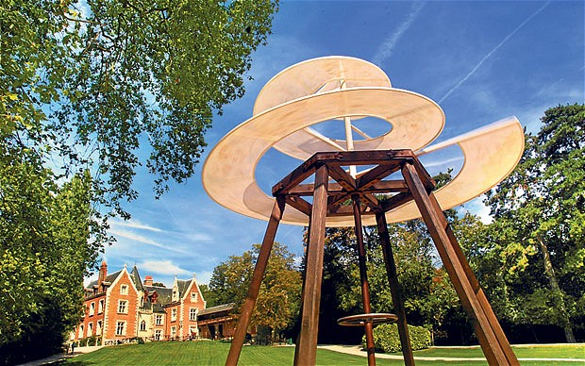
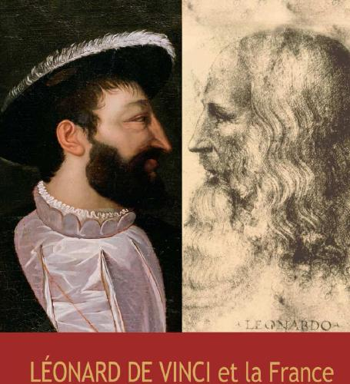
Ideas of Humanism began to spread out from Italy
Moved in the wake of travelling scholars, merchants, and artists hired to northern courts (Francis I and Leonardo)
French invasions of Italy also helped spread ideas

Slide 3
Renaissance with a Northern Twist
There were some key differences and commonalities between the Northern and Southern Renaissance:
Commonality
Both focused on the basic concepts of humanism (studying the ancients to gain wisdom, faith in the power of man and learning, questioning of tradition, taking action, etc.)

Slide 4
Differences
NR Humanists came from more diverse social backgrounds
NR was less focused on classical works
NR was more focused on religious reform, especially in German states:
Idea that people could understand Bible and God without priestly intervention
Desire for the “pure” forms of religion and religious texts
Brotherhood of the Common Life: Dutch religious group who gave up worldly goods and lived together, “lay piety”, mass education of the poor

Slide 5
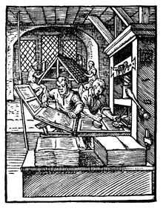
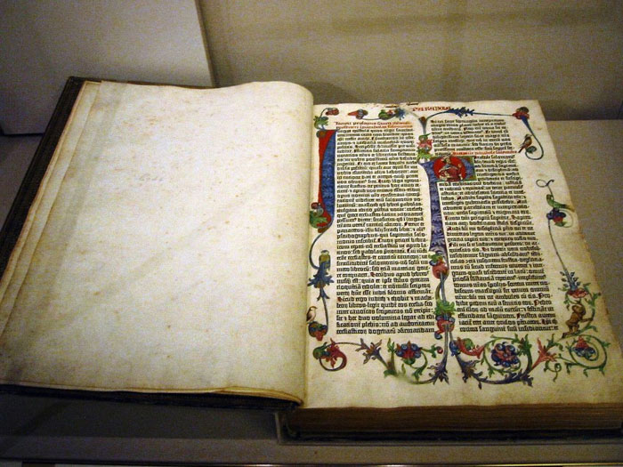
NR benefitted from Guttenberg’s invention of the printing press (movable type)
Often used for printing religious texts (even new Bibles) that challenged traditional Church texts
Ideas of the NR spread quickly across Europe (Germany, France, Spain, England – each with their own spin)

Slide 6
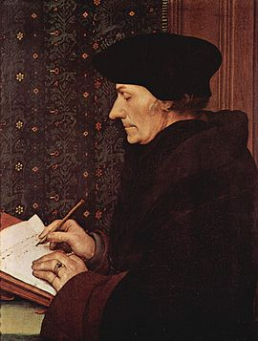
Desiderious Erasmus (1466-1536): Prince of Northern Humanism
Most famous NR Humanist
Educator, writer
Prepared short dialogues in Latin and Greek designed to teach the “good life” - Colloquies and Adages

Slide 7
Adages…
To call a spade a spade
Time heals all wounds
To have an iron in the fire
Between a rock and a hard place
No sooner said than done

Slide 8
Devout Catholic, tried to unite classical ideals (humanity and virtu) with Christian values (love, piety).
Believed in simple ethical piety - just like Christ “philosophia Christi”
Becomes known as “Christian Humanism”
Satirized the clergy and religious superstition and dogma
Believed Man could discover the truth about God and nature by closely reading the Bible and classical sources himself
Helps lead to the Protestant Reformation
“Erasmus lay the egg that Luther hatched”

Slide 9
Erasmus…
On education…
To be a school master is an office second in importance to a King
On mankind…
By the nature of man, we mean, as a rule, that which is common to man as such: the characteristic ... of being guided by reason. But we may mean something less broad than this: the characteristic peculiar to each personality, which we call individuality.
On religion…
I find that in comparison with the Fathers of the Church, our present-day theologians are a pathetic group. Most of them lack the elegance of language, and the style of the Fathers. Content with Aristotle, they treat the mysteries of revelation in the tangled fashion of the logician. Excluding the Platonists from their commentaries, they strangle the beauty of revelation.

Slide 10
Erasmus on God’s relationship with man and free will…
The mercy of God offers everyone favorable opportunities for repentance. One needs only to attach the rest of one’s will to God’s help, which merely invites to, but does not compel to, betterment. Furthermore, one finds the opinion, that it is within our power to turn our will towards or away from grace—just as it is our pleasure to open or close our eyes against light. It is incompatible with the infinite love of God for man, that a man’s striving with all his might for grace should be frustrated.

