Slide 1
Philosopher Flipchart
Fold the two sheet of white paper I gave you into four squares each.
Cut out the 8 squares.
Using the People of the Enlightenment-1600 & 1700’s, cut out the 5 people and where they are from.
Glue the Name and Location on the bottom of 5 of the squares.
Using the width of your thumb, fold the top of each of the 8 squares.
Write Main Ideas at the top of each square, under the crease.
Copy down the Observation and Hypothesis for each philosopher in their box.

Slide 2
Locke | Government exists to preserve life, liberty and property. Monarchs not chosen by God Influenced the Declaration of Independence, The U.S. Constitution, and the French Revolution
Hobbes | Life without government is solitary, poor, nasty, brutish, and short.
Montesquieu | When the legislative and the executive are united in the same person, there is no liberty Government must have separation of powers- 3 branches. Believed in checks and balances.
Rousseau | Government is contract between people and the rulers. Rules should be strictly enforced and government should protect rights. Ideas supported the French Revolution
Voltaire | Life is better with liberty Freedom of speech and religion, separation of church and state Ideas influenced U.S. Bill of Rights and French Declaration of Man and Citizen

Slide 3
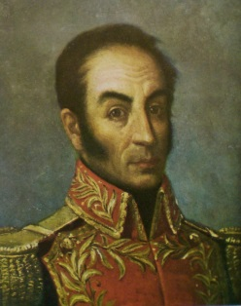
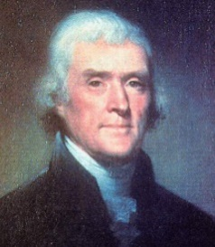
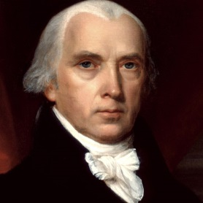
Main Ideas
Believed in limited government and separation of powers.
All people should be involved in making decisions.
Wrote the Declaration of Independence
Thomas Jefferson
United States
Main Ideas
Believed in limited government and separation of powers.
Believed in strong-central government
Helped South American countries break from Spain
Simon Bolivar
Venezuela
Main Ideas
Believed in limited government and separation of powers.
Known as the father of the U.S. Constitution and authored the U.S Bill of Rights
James Madison
United States

