Slide 1
Post Clasical China and East Asia
600 CE -1450 CE

Slide 2
After the Fall Of Han Dynasty
Period of turmoil and Chaos
Non-Chinese nomads ruled much of China
a foreign religion, Buddhism, surpassed Confucian teachings

Slide 3
Sui Dynasty
After centuries of turmoil following the Han dynasty, the Sui emerged to restore peace and order
Built a strong central government with work done by peasants
Public works included palaces, granaries, and repair of defensive walls; most elaborate project was the Grand Canal
Grand Canal: a series of artificial waterways that connected Hangzhou to Chang’an (almost 2,000 kilometers), said to be forty paces wide with service roads running on either side. These waterways accounted for large expenditures from the government treasury; money came from taxes and dividends from Grand Canal, which linked northern and southern economies, and the people of China reaped its benefits for years to come
610s: rebellions broke out in northern China
618: emperor Sui Yangdi was assassinated and dynastu ended

Slide 4
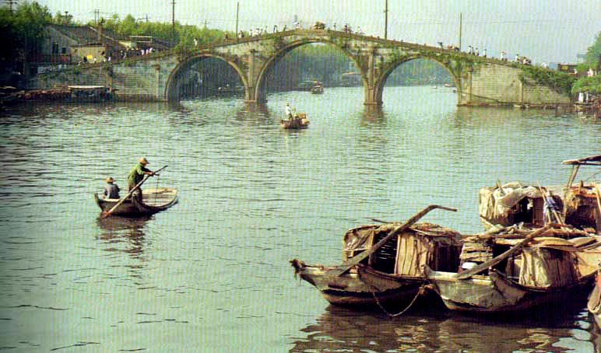
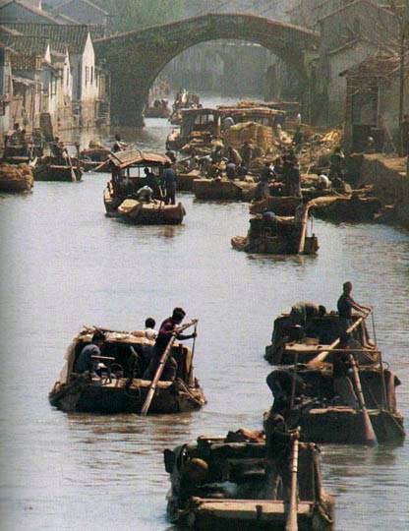
The Grand Canal

Slide 5
Tang Dynasty
a. Restored peace and stability after the fall of the sui dynasty
b. Second emperor, Tang Taizong (627-649), saw himself as a Confucian ruler and preserved Confucian Tradition.. His successes led to belief that this period was unusually prosperous and peaceful. He built impressive capital at Chang’an
c. Maintained empire through a system of roads with horses, human runners, inns, postal stations, and stables- Transportation and Communication Network
d. Equitable distribution of agricultural land kept land out of the hands of wealthy elite - Equal-Field System
e. Government jobs in extensive bureaucracy were merit based, determined through a series of civil service examinations- Bureaucracy of Merit
f. Military conquests included Manchuria, Tibet, Korea, and the northern part of Vietnam –Tang built a huge empire than earlier Han

Slide 6
State of Buddhism under Tang
imperial attempt to suppress Buddhism within the Chinese empire
Buddhism survived the repression, but in a reduced state without the political influence of the early Tang years

Slide 7
Song Dynasty
Followed the Tang Dynasty; first emperor, Song Taizu, started policy of distrust of military leaders – focused on civil service exams (based on Confucian philosophy), industry, education, and the arts
Financial problems faced by the Song: bureaucracy too big
Military problems: scholar bureaucrats’ limited military experience led Song to military failures

Slide 8
Agricultural Development
There was a surge in production due to fast-ripening rice from Vietnam that allowed them to produce two crops a year.
Other changes: heavy iron plows, harnessed oxen or water buffaloes, manure, irrigation systems, terraced mountainsides
Rapid population growth led to urbanization.

Slide 9
Technology
Porcelain: lighter, thinner, aesthetically pleasing, “china”
Metallurgy: iron production increased, used for weapons, tools, construction
Gunpowder: mix of charcoal, saltpeter, sulphur, and arsenic; created flamethrower, bombs, cannon
Printing: block-printing, movable type, disseminated information
Naval Technology: waterproof oils, watertight bulkheads, small rockets, and magnetic compass

Slide 10
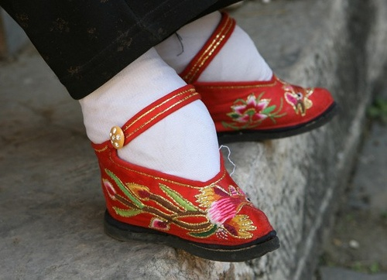
Society
Veneration of ancestors became more elaborate. This strengthened family ties.
Foot binding spread among the upper class in the Song era. Women of privilege were placed under tight supervision of their husbands or fathers.

Slide 11
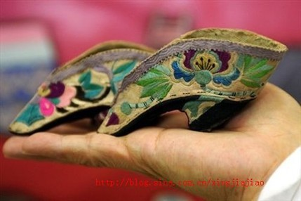
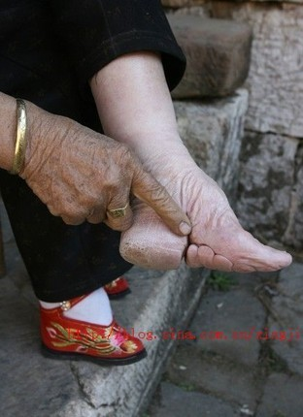
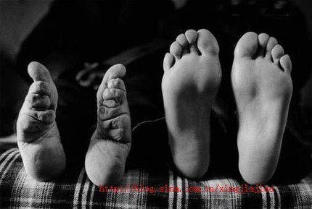

Slide 12
Market Economy
Trading of goods, prices set by supply and demand
Letters of Credit (flying cash), promissory notes (IOUs), checks, paper money due to shortage of copper coins
Cosmopolitan society: merchants from all over eastern hemisphere, Silk Roads

Slide 13
Buddhism in China
Confucianism and Daoism didn’t disappear, but Mahayana Buddhism came into China by way of missionaries on the Silk Roads.
Dunhuang
Monasteries
Buddhists used vocabulary of Daoism to explain doctrine. Ex: dharma=dao, nirvana=wuwei

Slide 14
Buddhism in China
Chan Buddhism was created (Zen in Japanese).
Pilgrimages to India
Daoists and followers of Confucius did not like Buddhism which over time led to the closing of monasteries and expulsion of Buddhists during Tang dynasty.

Slide 15
Neo-Confucianism
The Song dynasty supported Confucianism in hopes of limiting foreign religions.
Confucians studied Buddhist texts.
Zhu Xi: philosopher who blended traditional Confucius thought with ideas of Buddhism

Slide 16
Neo-Confucianism
Developed in response to the growing popularity of Buddhism
Scholars of the Song dynasty combined their studies of Confucian beliefs with the writing of Buddhism; continuation of civil service examination staffed government positions
Buddhism was appealing because it offered a tradition of logical thought as well as a conversation regarding issues such as nature, the soul, and the relationship between the individual and the cosmos
Neo-Confucian philosopher Zhu Xi (1130 – 1200) wrote Family Ritual, a detailed set of instructions for weddings, funerals, and other family ceremonies stressing appropriate personal behavior and social harmony
Neo-Confucianism is important because it shows the influence that Buddhism had on Chinese society and throughout East Asia over a long period

Slide 17
Chinese Influence in Korea
China invaded, but Silla kingdom held them off. China became the overlord to Korea (tributary system). Korean merchants could trade in China.
Tribute embassies brought back many ideas: organization of government, capital city, Chinese writings, Confucianism, Chan Buddhism
Royalty and aristocrats had much more power and influence in Korea, no bureaucracy based on merit

Slide 18
Chinese Influence in Vietnam
Tang forces took over Vietnam.
Vietnamese adopted agricultural methods, irrigation systems, Chinese schools and administrative techniques, Confucianism and examinations, Buddhism
They entered into a tributary relationship, but weren’t happy and revolted many times. When Tang dynasty fell, they regained independence.
Vietnamese women played a more prominent role in society than Chinese women.

Slide 19
Early Japan
Never invaded by China but strongly influenced
Nara: Clan claimed imperial authority, centralized Japanese politics, modeled court after Chinese, equal-field system, supported Confucianism and Buddhism, made capital like Chang’an.
Still practiced their own religion, Shinto.

Slide 20
Early Japan
Heian: emperors were just figureheads, the Fujiwara family ruled
Students learned Chinese, literature in Chinese, court records in Chinese!!!
Tale of Genji: by a woman Murasaki Shikibu, in Japanese, about court life
Clans got into a war, Minamoto family won and instituted the shogun.

Slide 21
Medieval Japan
Kamakura and Muromachi periods=medieval period (1185-1573)
Feudalism: decentralized, warlords and their clans, samurai
This is a deviation from Chinese influence.

