Slide 1
Key Concept 6.2

Slide 2
The 20th century began with Europeans occupying empires around the globe and confident that things would stay that way. In 1900, the United States and Japan were rising powers, while Russia and China were crumbling from within. The two world wars and one global Cold War later, European hegemony had declined dramatically, and China's power was rapidly rising. What a difference a century can make! Between those historical bookends, European colonies around the world gained independence in Russia became the first of many communist nations. After World War II, the Union of Soviet Socialist republics (USSR) and the United States led their allies through decades of global tensions. At the beginning of the 21st-century, Cold War worries had faded, but new challenges to political, social, and economic stability emerged.

Slide 3
Key concept 6.2: Global Conflicts Shake World Stability
World historians often look at the two world wars as one event with the pause in the middle. Other major wars in history had similar patterns. For example, the Crusades and the hundred years war took long "timeouts" before restarting hostilities.

Slide 4
The AP European history and AP US history exam go into greater depth regarding the World Wars, while the AP world history exam focuses more on the global causes and consequences.

Slide 5
When World War I ended in 1918, the survivors prayed that it would indeed be the "war to end all wars." No war involving Europe had ever caused so much widespread destruction of lives, property, and empires. The creation of a global league of Nations at the war's end, designed to keep the peace, give many people hope that governments and individuals had learned their lesson and would find ways to avoid future wars. Their hopes were short-lived.

Slide 6
1. Causes of World War I
MAIN
Militarism
Alliances
Imperialism
Nationalism
The Industrial Revolution spurred the mass production of weapons that could kill at faster rates, and from longer distances, than ever before. The French developed a machine gun that could shoot 300 bullets amended, and the Germans built a cannon that could fire projectiles over 50 miles. National pride among the "great powers" of Europe started an unofficial competition among governments to see who could produce the best weapons.
Rather than to risk going it alone in armed conflict, the great powers formed to competing military alliances in the early 20th century: Russia, England, and France formed the Triple Entente and Germany, Italy, and Austria-Hungary formed the Triple Alliance. Geographically, the intolerant was positioned on Germany's eastern and western borders, leading that nations leaders to develop "first strike" plans in both directions
By the end of the 19th century, the colonial powers of Europe had competed for decades overland in Africa and Asia. But the beginning of the 20th century, wrangling continued over ever – diminishing amounts of unclaimed territories, leading to increased competitions and suspicions among European nations.
Tensions rose inside the Austro Hungarian Empire, the Ottoman Empire, and the Russian Empire from ethnic groups that wanted to break off and form their own nations. In addition, leaders of the newly unified nations, such as Germany and Italy, naturally had great pride in their countries and expressed it through imperialist expansion and weapons buildup.

Slide 7
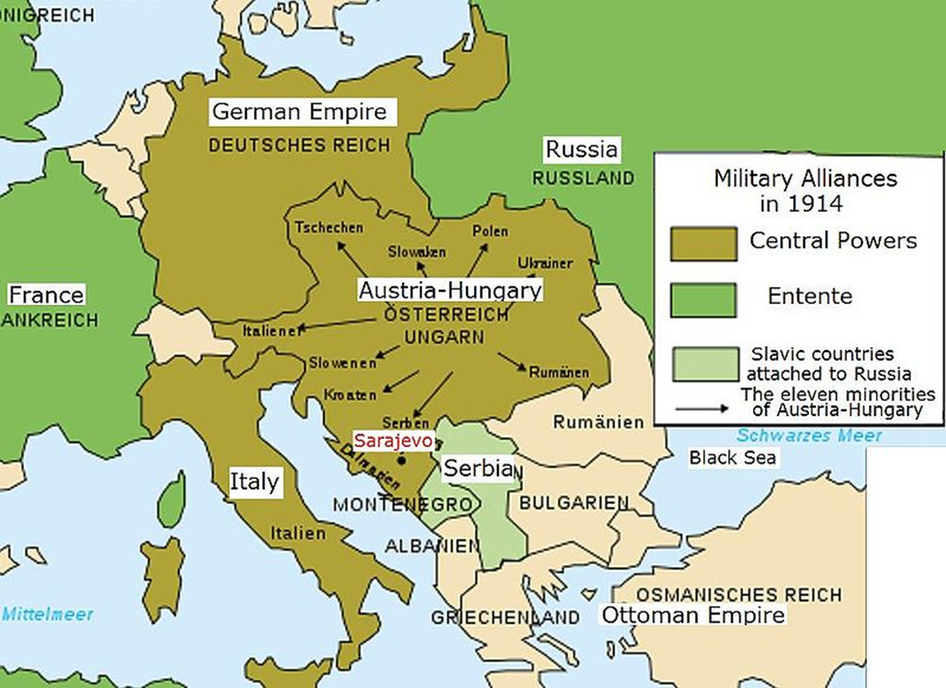
All these factors (imperialism, nationalism, the arms race, and the alliance system) led to heightened tensions in Europe by 1914.

Slide 8
The Central Powers had short-term advantages at the start of World War I:
They were connected geographically; The Allies were separated.
Germany had the best trained and best equipped army in the world going into the war.
The German industrial system was better suited folk conversion to wartime production than were those of the Allies.

Slide 9
The Allies had long-term advantages at the start of World War I:
The Allies had more men of military age than did the Central Powers.
The Allies had more factories, but converting them to war production took time.
The Allies had a stronger Navy and therefore able to enforce a blockade of the ports of the Central Powers.

Slide 10
2. Features of World War I…
i. No one expected a long war. Germany attacked France and Russia simultaneously, expecting a quick retreat that would establish Germany as the unquestioned power in Europe.
When that did not occur, the two sides hunkered down into defensive positions in France (the Western front) and Russia (the Eastern front) by the end of 1914.
By 1915, fighting spread to the Ottoman Empire and the European colonies in Africa.

Slide 11
2.Features of WW1…
ii. The new weapons of World War I – including the machine gun, poison gas, the airplane, and the submarine – led to changes in tactics and philosophies about the rules of war.
The machine guns rapid killing power forced combatants on all sites into defensive trenches, but despite the enormous losses, military leaders repeatedly sent long lines of men charging across "no man's land," the open fields that lay between the opponents.
The result was four years of shocking numbers of deaths and injuries. In the battle of the Somme in France, 20,000 British soldiers died the first day, and 60,000 died before the first soldier reached the German trenches. After four months of continuous battle, after 1.5 million men from both sides were killed, wounded, missing, or captured.
An unintended consequence of this kind of slaughter was a lowering of the value of humanity in the war. Civilians came to be considered legitimate targets in "total war" – where the full economic production and political power of nations were engaged in military victory. Submarines torpedoed enemy civilian ships – like the British steamship Lusitania – and canons indiscriminately fired huge artillery shells into cities far away.

Slide 12
2. Features of WW1
iii. One effect of European global colonization was the use of soldiers recruited from Africa and Asia to fight in the war.
India committed 1 million troops to aid the British forces.
Military campaigns ensued in the colonies, especially in Africa, with German soldiers and their African recruits battled British and French soldiers and their African recruits.
Australian soldiers joined their British counterparts at the field Allied assault on Gallipolli , in the Ottoman Empire.
The British also convinced Arabs to unite with them against the Ottomans in Southwest Asia, promising Arab independence from the Ottomans as a reward.

Slide 13
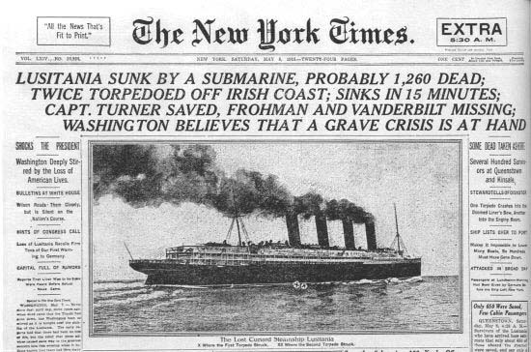
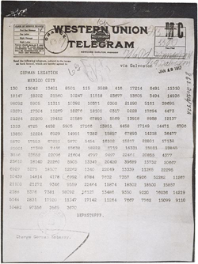
2. Features of WW1
iv. In 1917, the United States entered World War I on the Allies' side "to make the world safe for democracy," and idealistic pledge made by US president Woodrow Wilson.

Slide 14
America Enters war
By late 1918, the addition of US soldiers pushed the central powers to the breaking point, and an armistice was signed. An armistice is an agreement that all sides will lay down their arms and leave the battlefield without declaring a winner- or loser.
Wilson hoped for "peace without victory," believing that punishing Germany after the war would lead to resentment and another war.
After the fighting stopped, however, England and France declared themselves the winners and Germany the loser.

Slide 15
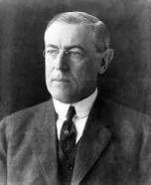
v. President Wilson proposed the Fourteen Point plan, designed to stop future wars through a checklist of international agreements. The key competent was an international aid organization – the League of Nations – that was set up to settle differences between member nations before they erupted into armed conflict. The U.S. Congress refused to join the very League that Wilson created. Thus, the League was crippled from the outset.

Slide 16
3. Consequences of World War I
i. Approximately 20,000,000 soldiers and civilians died in the war, which was fought in Europe, Southwest Asia, and Africa. The political, social, economic impact of the loss of so many people shaped many Europeans attitudes about war for the next two decades. In the 1930s, for example, a large number of citizens and politicians in England and France favored appeasement, giving in to an aggressor nation rather than challenging it and risking war.

Slide 17
ii. The Treaty of Versailles approved the league of Nations but, yielding to pressures from angry citizens back home, the leaders of England and France also dictated terms to the central powers and focused on punishing Germany (so much for "peace without victory"). Germany was required to take full blame for starting the war, drastically reduced its military forces, and pay billions in war reparations to England and France.

Slide 18
After the War: Peace Treaties
Results: Treaty of Versailles
Germany lost land on all borders
German military forces restricted
Germany to pay reparations for war
“war guilt”
League of Nations
Creation of new nations
Paris Peace Conference: Woodrow Wilson (U.S.), Georges Clemenceau (France), David Lloyd George (Britain)
U.S.: 14 points
Self-determination
League of Nations
Re-draw map of Europe
Use nationalism to determine government
British and French: revenge and control of Germany

Slide 19
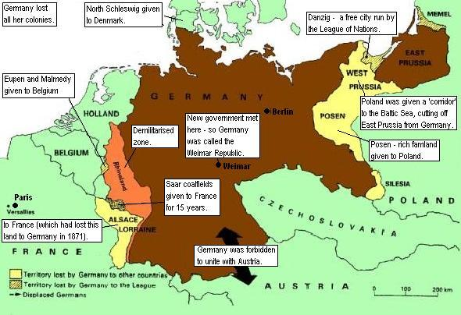

Slide 20
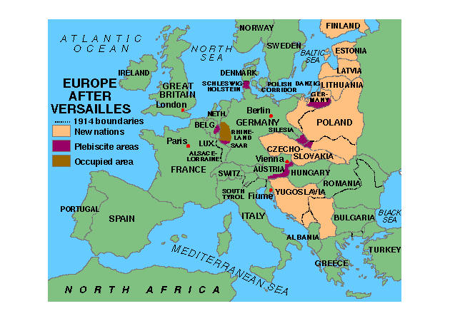

Slide 21
League of Nations

Slide 22
Reaction of Germany
Developed a strong sense of resentment towards the Allied nations, especially after their economy imploded in the 1920s due to harsh reparation demands from the English and French.
The German currency, the Mark, plummeted from a rate of four to the dollar in 1914 to over a trillion to the dollar by late 1923.
The allies required Germany to ditch its constitutional monarchy and set up Republic – known as the Weimer Republic.
The government was too frail and fragmented to deal effectively with the unprecedented economic crisis. These events caused many Germans to seek radical alternatives to the Weimer Republic and to seek revenge against England and France.

Slide 23
iii. Several international treaties between the world wars sought to limit the expansion of military might and thus reduce the chance of war.
The five powered treaty, the London conference of 1930, the Geneva conventions, and the Kellogg's Brian Pact were the most famous.
The first two treaties limited the number of battleships each nation could have. Japan rejected the limits because it was allotted fewer ships than the United States and England.
The Geneva conventions set rules for war, particularly the treatment of prisoners of war.
The Kellogg – Briand \Pact outlawed war.

Slide 24
iv. Many of the African and Middle Eastern colonies controlled by Germany and the Ottoman Empire were reassigned by the league of Nations to France and England, who established a mandate system of rule over them.

Slide 25
Under this system,
France and England were the guide to Middle Eastern colonies of Syria and Lebanon (France), Palestine and Jordan (England), and Iraq (England) until the League decided the colonies were ready for independence.
The reality of the situation was that these areas were simply added to the British and French colonial collection.
African mandates formally under German control were Southwest Africa and Tanganyika.
These moves prompted more nationalist feelings in the people living in the colonies in the Middle East and Africa, and also in Southeast Asia.

Slide 26
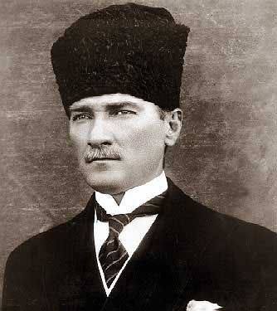
v. The Russian, Austrian, Ottoman, and German empires fell during or just after World War I.
Austria's once – huge empire was divided into several nations, including Yugoslavia, Hungary, and the smaller Austria.
The Democratic nation of Turkey was established by nationalists led by Mustafa Kemal, who went by the title "Ataturk."

Slide 27
Rise of Modern Turkey
To avoid further colonization by European countries, Mustafa Kemal united Turkish forces together
Forced dislocation of all non-Turks
Forced modernization/westernization:
European laws
Clothing
Women’s rights
Suppressed Islamic authority
Changes not favored rural areas

Slide 28
vi. To Allied Nations, the United States and Japan, emerged from the war with their industrial capacity and colonial possessions in tact, unlike most of Europe, and with poised to rise to the top of the world's economic ladder.

Slide 29
Colonial Subjects
viii. Arming their colonial subjects to support the war effort may not have been in Europe's best interest because at the end of the war, nationalist leaders in African and Asian colonies had military training and equipment.
Adding to their inclinations towards independence, many elites had learned about European ideals, such as self-rule, while attending European schools before the war.
Another encouragement for leaders of colonial independence movements was found in a key feature of the FourteenPoint plan – a call for "self-determination" for nationalist groups. This Wilsonian concept was specifically intended for groups in Europe, but none of the colonial subjects in Africa or Asia worried about that detail.

Slide 30
ix. World War I ended with many issues unresolved:
What would be the future of European imperialism around the world?
Could Western nations slow the process of military technology to the colonies ?
How would Europe handle colonial nationalist movements?
In addition, new issues that didn't exist before the war included what to do about a newly communist aggression nation and how to recover from the economic, political, and social damages brought by World War I.

Slide 31
Ephemeral Peace
Five years of recovery and adjustment
Six years of peace and prosperity
1923: Germany suspends reparation payments
Began to print worthless money
Germany began to rebuild their nation with loans from United States
Germany and USSR were upset with borders forced upon them in the Treaty of Versailles
Signed secret pact in 1922
League of Nations did nothing to stop them!

Slide 32
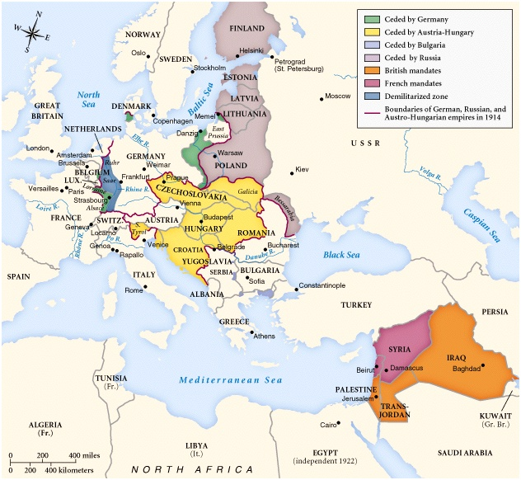
Europe in 1919

Slide 33
^{Russia}

Slide 34
Russia
Conducting the war amidst rising internal problems proved too much for the Russian czar's government.
In 1917, the czar resigned and was replaced by a provisional democracy. But it quickly fell to a communist uprising.(see next slide)
Bolshevik leader Vladimir Lenin negotiated an early withdrawal from the war with the German government and thus fighting on the Eastern front ended.
As payback for quitting the war early (and because they feared the new communist government), the Allied Powers pretended Russia had never been on their side and refused to give them a seat at Versailles.

Slide 35
Russian Civil War and the New Economic Policy
Russians continued to fight for over three years after WWI
Civil War broke out between Communists and Counter-Revolutionaries
Allies supported Counter-Revolutionaries
Forces refused to combine efforts, eventually lost to Communists
Communists reclaimed many lands lost in WWI
Economy fell to 1/6th of prewar levels
Lenin announced New Economic Policy (NEP)
Allowed for private ownership of land, ability to sell crops, etc.
Big business still controlled by Communists
Production increased
Did not provide overall results
Peasants were forced to pay for industrialization processes

Slide 36
Stalin and the Five Year Plans
First Five Year Plan: Heavy Industry
1928: to expedite the industrialization of Russia and increase production of coal, steel and iron.
ex:Dams, railroads, canals, factories, etc
Each business or factory was required to meet a quota through a system called Collectivization.
Most quotas were unrealistic
No parts to repair machines, unskilled workers
Mostly built by prisoners/peasants
Second Five Year Plan: Transportation
1932: aimed to triple coal, iron and steel output.
Attempted to make consumer goods
Fear of Nazi power forced USSR to shift emphasis to heavy industry and military
The success of the second five year plan put an end to food rationing and the USSR became a major world economic power.
Avoidance of Great Depression led others to believe in Communist system

Slide 37
Collective Farms
The collective farms forced peasants to work on farms and hand over most of the crop to the government.
The peasants had to live off what was left of the crop
Most went to feed industry workers
Brought peasants under control of government
The collective farms forced peasants to work on farms and hand over most of the crop to the government.
The peasants had to live off what was left of the crop
Most went to feed industry workers
Brought peasants under control of government
The "kulaks", rich peasants created by Land Reforms in 1906, were destroyed as a middle class from starvation or death.
The Kulaks instead of the government imposed death chose to destroy their farms to rebel against the Soviet Union requisitioning their crops.
Due to the extreme tactics used by Stalin, agricultural production failed to increase and instead, fell more than 10%.
Killed 5 million after bad harvests in 1933-1934

Slide 38
Why did they do it?
Idealistic Youth
Propaganda
Rewards
Pay by result
Punishment

Slide 39
Flaws in the Five Year Plans
Parts for industrial machinery were hard to get and some factories were kept idle for weeks on end simply because they did not have parts to repair worn out machines.
Ex-peasants were used as skilled workers.
many machines were damaged because those using them had no idea on how to correctly use these machines.

Slide 40
Germany

Slide 41
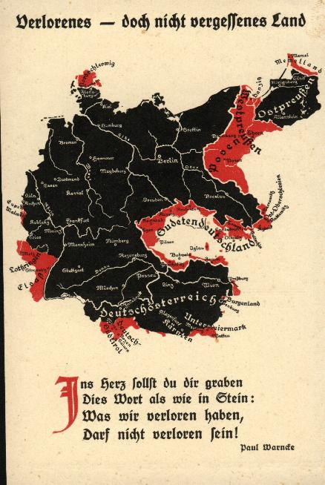
From the German Point of View
← Lost—but not forgotten country.
Into the heart You are to dig yourself these words as into stone: Which we have lost may not be truly lost!

Slide 42
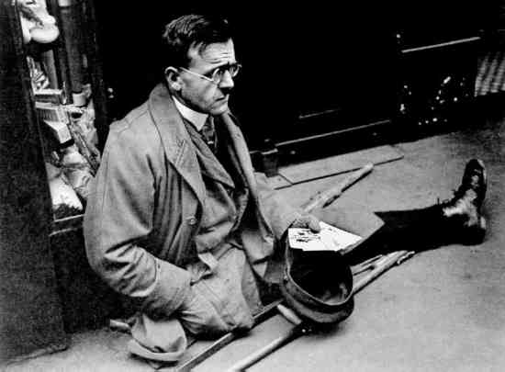
Maimed German WW I Veteran

Slide 43
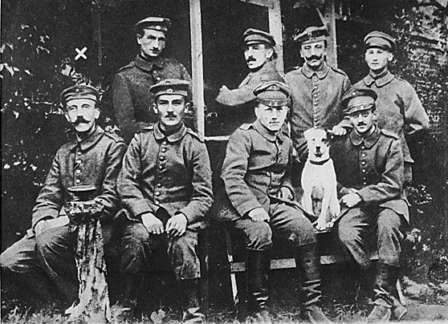
The “Stabbed-in-the-Back” Theory
Disgruntled German WWI veterans

Slide 44
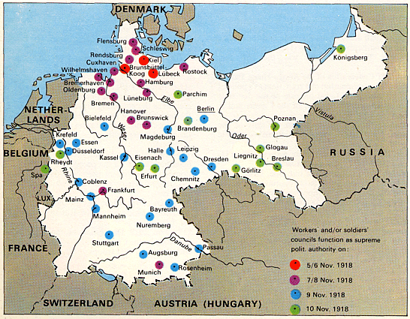
German “Revolutions” [1918]

Slide 45
German Revolutions
In October 1918, the constitution of the German Empire was reformed to introduce a parliamentary system similar to the British, but this soon became obsolete.
On 29 October, rebellion broke out.
sailors, soldiers and workers began electing worker and soldier councils modeled after the soviets of the Russian Revolution of 1917
The revolution spread throughout Germany, and participants seized military and civil powers in individual cities.

Slide 46
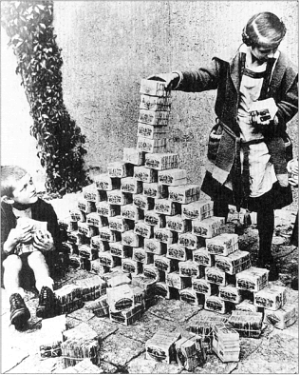
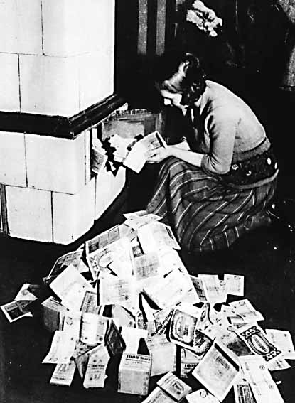
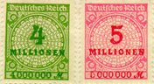
The German Mark

Slide 47
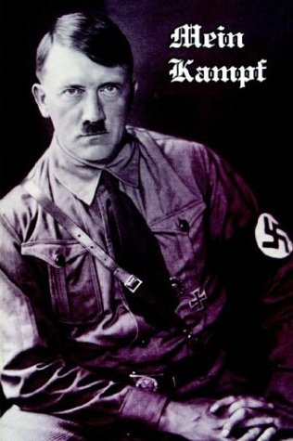
Mein Kampf [My Struggle]

Slide 48
Hitler’s Rise to Power
Germany hard hit by Depression and inflation
Blamed Jews, Socialists and foreigners
Hitler:
Austrian born artist
Yes, his grandmother was Jewish
Led Nazi’s in several unsuccessful uprisings—Beer Hall Putsch 1923
Goals:
Repeal humiliation of WWI and Treaty of Versailles
Annex German territories
Eliminate all Jews

Slide 49
Hitler Controls Germany
After Depression hit, many turned to Hitler’s extreme ideas
Appealed to unemployed—offered jobs!
Scared of Communism
Put Nazi’s in charge of all governmental orders/offices
Threw opposition into concentration camps
Deprived Jews of citizenship
Public works projects
Militarization

Slide 50
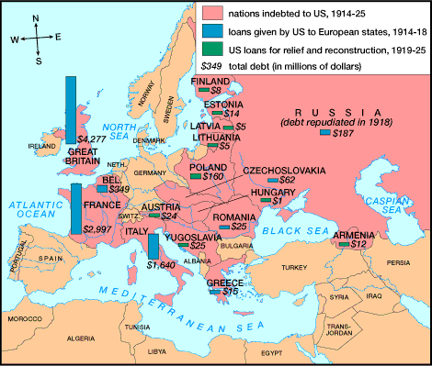
European Debts to the United States

Slide 51
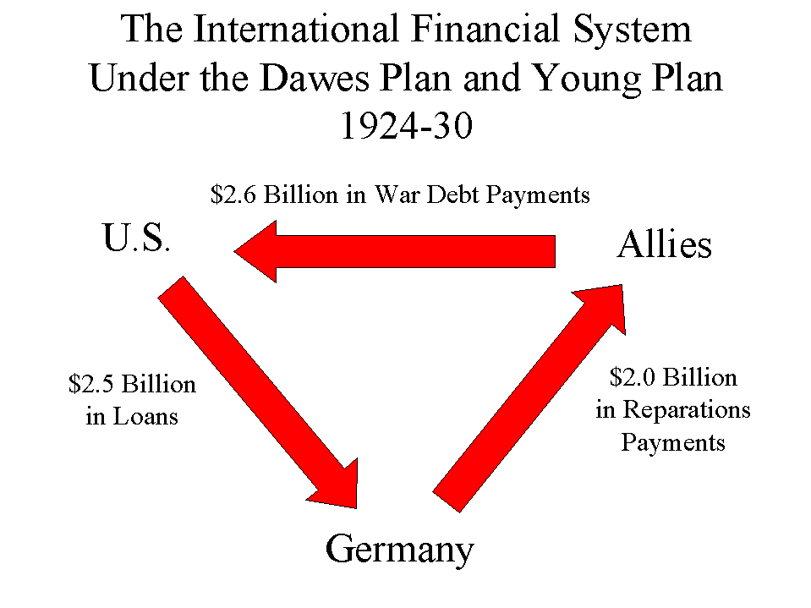
The Dawes Plan (1924)

Slide 52
Italy

Slide 53
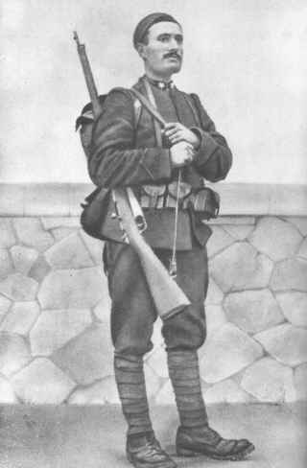
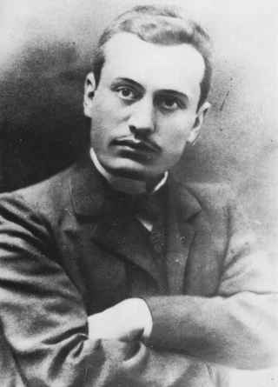
Benito Mussolini [1883-1945]

Slide 54
Fascism
political ideology, generally tied to a mass movement, that considers the individual subordinate to the interests of the state, party or society as a whole.
Fascists seek to forge a type of national unity, usually based on (but not limited to) ethnic, cultural, racial, and/or religious attributes.)

Slide 55
Control of Italy
Installed Fascists into all govt positions
Jailed all opposition
Took over press
Lowered living standards
Provided jobs, social security, public works

Slide 56
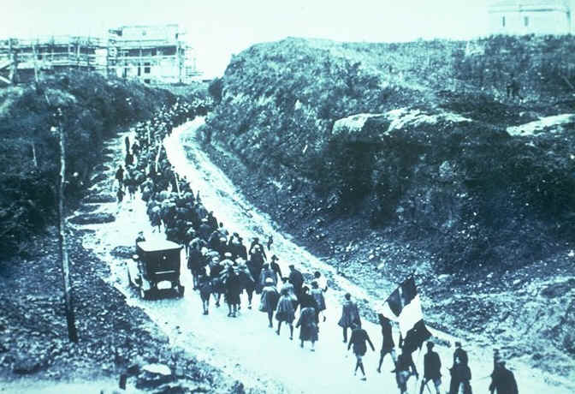
March on Rome [1922]

Slide 57
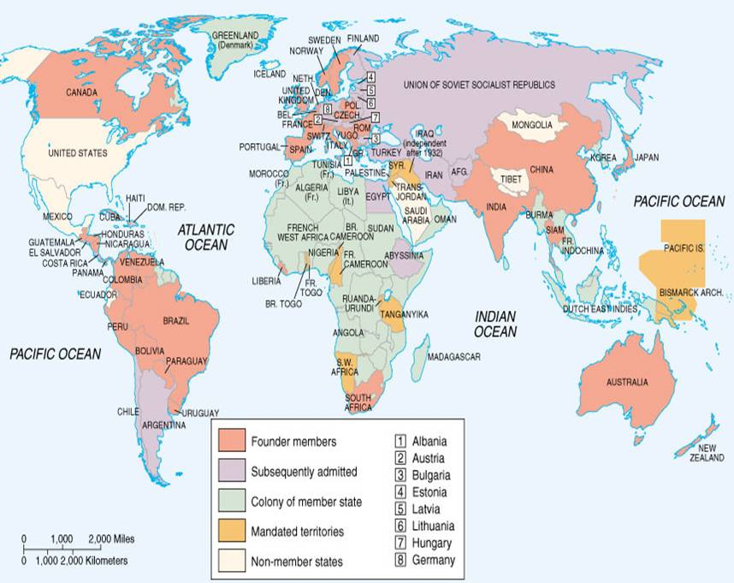
League of Nations Members

Slide 58
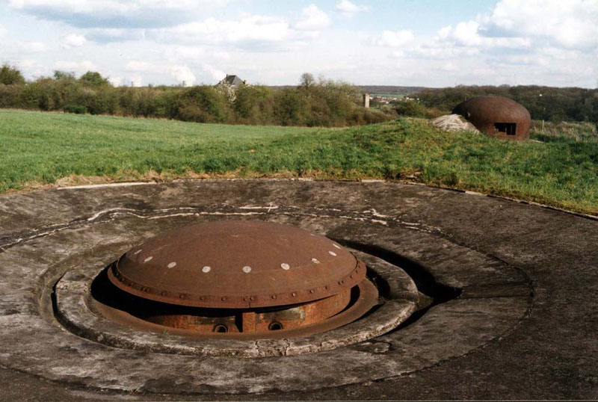
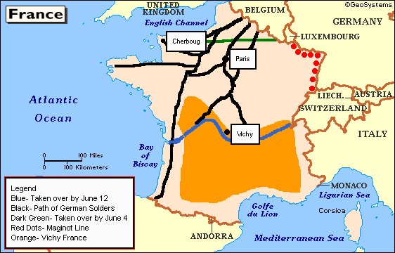
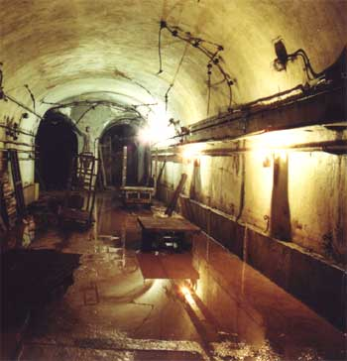
The Maginot Line

Slide 59
Maginot Line
a line of concrete fortifications, tank obstacles, artillery casemates, machine gun posts, and other defenses, which France constructed along its borders with Germany and Italy, in the light of experience from World War I
The French established the fortification to provide time for their army to mobilize in the event of attack and/or to entice Germany to attack neutral Belgium to avoid a direct assault on the line.

Slide 60
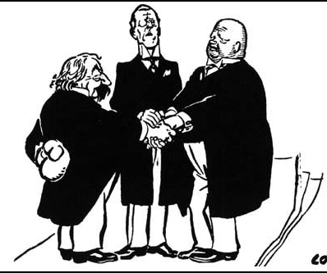
Locarno Pact: 1925
Austin Chamberlain (Br.)
Gustave Stresemann (Ger.)
Aristide Briand (Fr.)
Guaranteed the common boundaries of Belgium, France, and Germany as specified in the Treaty of Versailles of 1919.
Germany signed treaties with Poland and Czechoslovakia, agreeing to change the eastern borders of Germany by arbitration only.

Slide 61
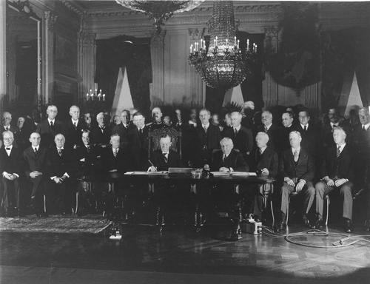
Kellogg-Briand Pact: 1928
15 nations committed to outlawing aggression and war for settling disputes.
Problem → no way of enforcement.

Slide 62
The
Great
Depression

Slide 63
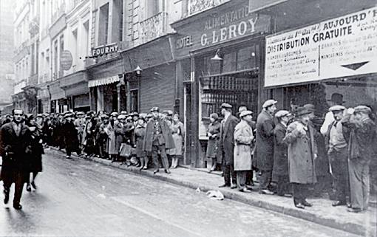
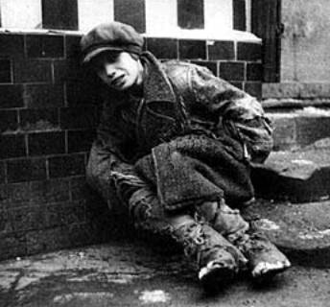
The Great Depression [1929-1941]
London in 1930
Paris in 1930

Slide 64
Start of the Depression
Stock market crash of New York stock exchange October 29, 1929
caused a chain reaction in which consumers cut their purchases, companies laid off workers and small farms failed
International:
New York banks recalled loans to Germany and Austria
ended reparations to France and Britain
They could not repay war loans to U.S.
1930: Smoot-Hawley Tariff—attempt to protect U.S. industries with a protective tariff on all foreign trade
other countries followed suit
world trade declines 62% between 1929-1932

Slide 65
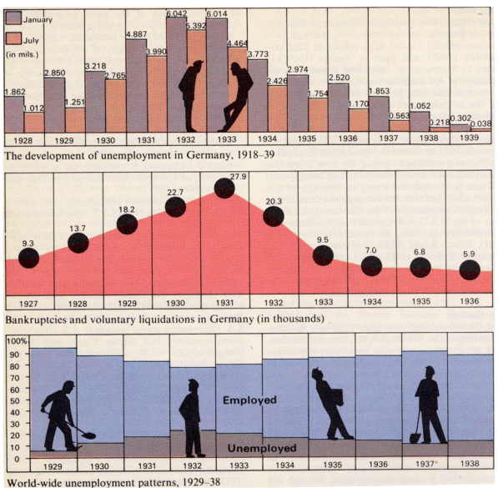
German Unemployment: 1929-1938

Slide 66
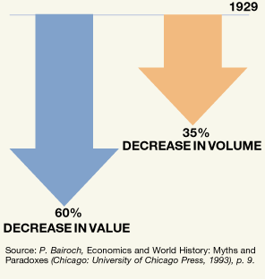
Decrease in World Trade: 1929-1932

Slide 67
WWII

Slide 68
1. Causes of World War II
i. Primarily a continuation of unresolved issues from World War I, World War II outdid its predecessor in duration, global scope, use of military technology, and death.
The treaty of Versailles required Germany to accept full guilt for the war, reduce its military forces, hand over its colonies, and pay billions in war reparations to England and France. Germany however, was rocked by overwhelming economic collapse. These humiliations left many Germans seeking vengeance.
One man in particular, Adolf Hitler, tapped into these emotions and exploited them as a means of gaining power.

Slide 69
ii. Starting in late 1929, the Great Depression shook the foundations of the global economy. However, Western European nations had suffered all through the decade after the war.
The United States was the chief financer of England, France, and Germany steps in the 1920s, and when those nations struggled to repay their loans, US banks began to falter, setting off chained reactions that damaged global financial markets.
Another cause of the Great Depression was over production of goods in the United States – especially farm products. More produced meant lower prices to farmers; lower prices meant farmers default on bank loans, banks closed, and money supplies dried up.

Slide 70
iii. The result in the industrialized nations was that, in the 1930s, they all recognized their governments to be more active in financial matters, including government programs, unemployment compensation, bank regulation, and many others.
Italy, Germany, and Japan were the most prominent nations that radically changed their governmental and financial systems. These systems were changed to fascism to address economic crises in these three countries.
Russia – known as Soviet Union after 1922 – was isolated from the global economy. Europe and the United States wanted nothing to do with the new communist government.

Slide 71
iv. Italy introduced fascism in the 1920s as a political and social means to address its post World War I economic woes.
Which was also the case in communism – but it allowed private ownership of business and other property – as was the case in capitalism. One catch – all decisions ultimately came from a single dictator with enormous power, and dissent was severely punished. Anyone considered "outside" the accepted fascist model faced unemployment, jailed, or death.
Before the international meltdown of the Great Depression, Italy's fascist system – led by Benito Mussolini – appeared to be on and upswing in the 1920s.
Fascism appealed to many people around the world – Germany, Spain, and then Japan followed Italy's political model.

Slide 72
v. In Germany, Nazism was Adolf Hitler's version of fascism. The national Socialist (abbreviated "Nazi") German workers party was a fringe group in the early 1920s, at a time when the Weimer Republic was floundering. It claimed opposition to both democracy on one hand and communism on the other, and promoted past and future German glories.
After a failed coup in 1923 landed Hitler in jail, he decided to undermine the Weimer government from within the system. Impassioned speeches about German glory gained Hitler popular support, and the Nazis rose in power in the Weimer legislature. Careful cultivation of sympathetic government and business leaders helped Hitler's cause.
Using propaganda, lies, and murder, the Nazis and Hitler were in absolute control of Germany by 1934.

Slide 73
The AP world history exam doesn't concern itself with details about Hitler's life beyond those found here.

Slide 74
vi. Fascism requires conquest to obtain cheap labor and raw materials – and to unite its people against enemies, real or invented.
Except for Spain, the fastest nations of the 20th century attacked their neighbors.
Italy invaded North Africa in Ethiopia in the 1930s.
Germany invaded Czechoslovakia and Austria about the same time.

Slide 75
vii. Japan began attacking its neighbors even before it officially turned to fascism. Some historians argue that World War II really started in 1931 – eight years before the official date – when Japan invaded Manchuria, enslaved or killed its people and, and occupied their coal mines and factories. Not satisfied with the conquest alone, Japan invaded China in 1937.

Slide 76
viii. The well intentioned but weak league of Nations did little to stop aggression by Italy, Germany, and Japan in the 1930s. European leaders hoped that fascists would be satisfied after limited conquests and seek no more territories.
This policy of appeasement only seemed to encourage the attackers, who showed no respect for the league of Nations pleas for peace.
The appeasement policy of the 1930s had long term effects: after World War II, one of the biggest lessons the United States and the USSR took from the prewar Iraq was to reject appeasement in favor of "peace through strength" during the confrontational Cold War.

Slide 77
2. Features of World War II
i. Like World War I, there were two sets of alliances in World War II: the Allies and the Axis Powers.
Germany, Italy, and Japan formed the Axis starting in the late 1930s.
England, France, Poland, and most of Western Europe formed the Allies by 1940s. The Allies grew in number as they were attacked by Axis nations.
A year later, the USSR and the United States joined the Allies

Slide 78
ii. Unlike World War I, which featured trench war and little movement of forces, World War II began with fast – moving fronts. This change occurred because technology improved the machines that were introduced in World War I.
Tanks and airplanes moved much faster by the 1930s, and defensive trenches were impractical.
Germany introduced the blitzkrieg ("lightning war"), which involved bombing from airplanes and swift advances by tanks and support vehicles. Only then did foot soldiers entered the battle – if there were still people left to fight back. This method of fighting stunned early victims of Nazi aggression.

Slide 79
iii. In the European theater, the war started in 1939 when Germany invaded Poland. England had appeased the German fascist dictator Hitler in his conquest of central Europe. But it finally drew a line at Poland.
After war was declared, Germany swiftly conquered most of Western Europe, including France, by 1940.
Russia and Germany had announced a peace treaty in 1939, so England faced Nazi aggression alone.
Two significant events in 1941 turned the tide against Nazi Germany: Hitler's surprise invasion of Russia went poorly, and the United States entered the war against the axis powers after Japan attacked Pearl Harbor.
Unlike its position in World War I, Russia state with the Allies to the end of the war, despite suffering more than 25 million deaths.

Slide 80
iv. The first Allied offensive against the axis powers was in North Africa. From there, the Allies invaded Italy but were still fighting there when the war in Europe ended.
The turning point of the war in Europe was the Allied invasion of Normandy (in France) in 1944. Steadily pushed back to their homeland on both the Eastern and Western France, the Germans surrendered in May 1945.

Slide 81
v. World War II's battlefiels were on a greater global scale than were those of World War I.
Campaigns throughout the Pacific were added to those in Europe and Africa.
Japan's attack on China from 1937 to 1945 was particularly brutal, causing approximately 20,000,000 deaths.
In addition, in 1941 Japan attacked much of Southeast Asia and islands throughout the Pacific, including Hawaii's Pearl Harbor in 1941. United States entered the Pacific war and, with Britain as its main ally, slowly pushed the Japanese empires perimeter back towards its homeland.
Significant battles occurred in the Dutch East Indies (modern Indonesia) and in island chains in the central and South Pacific.
Starting in 1945, US planes repeatedly firebombed Japanese cities in an effort to force unconditional surrender from the government.
In August 1945, the United States dropped two atomic bombs, first on Hiroshima and then on Nagasaki, and the war at corruptly stopped.

Slide 82
3. Consequences of World War II
i. The United Nations (UN) replaced the league of Nations after World War II.
Two key differences: the UN headquarters was in the United States, not Europe – a sign of the United States postwar influence – and, unlike the League, the United Nations Security Council had military authority that could be used to stop aggression by nations.
United Nations forces were employed in combat in the Korean War (1950 to 1953) and the Persian Gulf war (1990 – 9091).

Slide 83
ii. The use of atomic power was a major controversy after World War II.
Military and government supporters of its use on Japan claimed its overwhelming destruction saved lives that would have been lost in a conventional attack on Japan's homeland.
Critiques questioned the morality of its use at all and raised concerns about the specter of a world armed with nuclear weapons.

Slide 84
iii. Western Europe's reign as the world's strongest economic and political force ended with World War II.
Two devastating wars crippled Europe, while the United States emerged as the only major power whose economy and society was relatively unscathed.
Aided by the United Nations, Europe's colonies in Africa and Asia gained independence, one by one, starting soon after the war. These colonies included the Dutch East Indies, Indochina, India, and Ghana.

Slide 85
iv. The Holocaust was the worst facist treatment of "outsiders." Hitler's "final solution" targeted Jews and other groups that did not fit into his perverted vision for Germany. 6 million of the 10 million people killed in the Holocaust were Jews from Central and East Europe.
After the war, the United States and Britain steered UN support for the establishment of a democratic Jewish homeland (Israel) in Palestine.

Slide 86
v. The Cold War started almost immediately after World War II. Global tensions arose between the victorious Allies, with the USSR leading one side and the United States leading the other.

Slide 87
Cold War 1946-1989

Slide 88
The conflict that best meets the description of "World War III" was the Cold War
The capitalist United States and its allies in the West competed with the communist USSR and its allies for global superiority.
What made it "cold" war was that the main antagonists did not fight each other directly on a battlefield. However, everything else involved in a "hot" war was in play:
threats of destruction
gathering of military allies
arms buildup
spy networks
and propaganda campaigns
exploration of outer space
Olympic competitions
were part of the Cold War

Slide 89
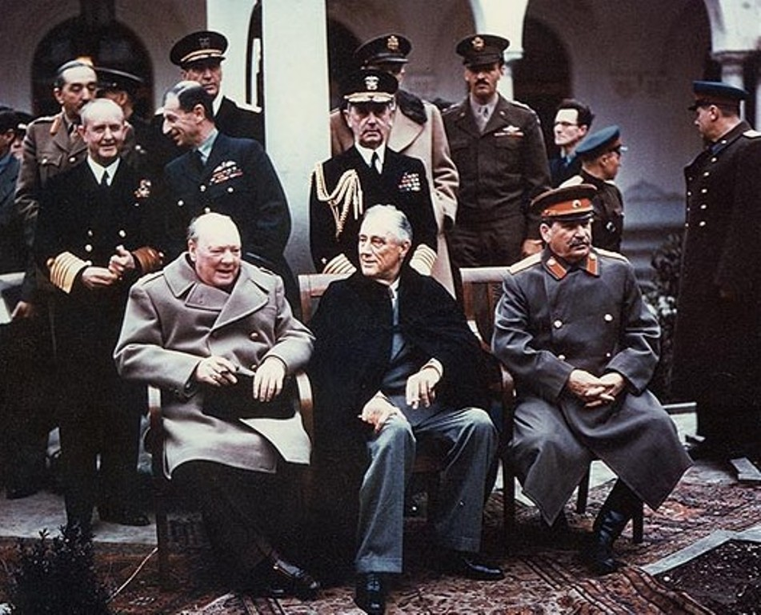
Causes of the Cold War
The Yalta Conference
The big three allies -United States, Britain, and USSR met on the Crimean Peninsula to redraw the maps of Europe and Asia for the postwar world.
Winston Churchill
Woodrow Wilson
Joseph Stalin

Slide 90
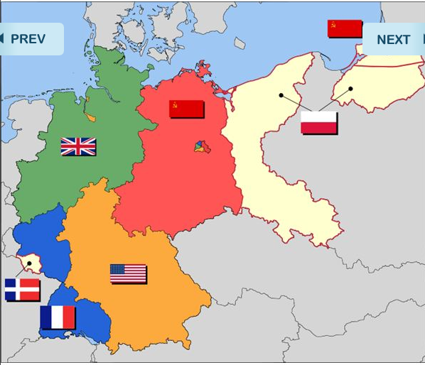
What was decided in the Yalta Conference?
Germany and its capital, Berlin, were divided into Weston and Soviet regions.
The USSR to control of most of Eastern Europe (now a separate entity from Western Europe), after promising the United States and Britain it would allow of self-determination.
When the pledge failed to materialize and Soviet forces began to occupy Eastern Europe, the West became highly suspicious of Soviet intentions.
For its part, leaders in the USSR feared of US – led invasion to Germany or Japan.

Slide 91
Divided Korea into communist North and capitalist South nations. Japan was put into the US sphere of influence. The United States replaced Japan's government with the Democratic constitutional monarchy and placed military bases there.

Slide 92
The USSR gained nuclear weapons a few years after the end of World War II. This event stirred great concern among the Western allies, but the Soviet Union claimed the weapons were for self-defense purposes.

Slide 93
Features of the Cold War
Led by the United States, NATO and its allies enacted diplomatic and military policy of containment to keep the Soviets from spreading communism beyond Eastern Europe. World events challenge this policy around the globe for 45 years

Slide 94
Berlin Airlift
In 1946, the USSR attempted to cut off Western access to Berlin, which was in Soviet controlled East Germany. For a year, the United States and Britain flew supplies into Western sector of Berlin. Soviets realized the futility of their blockade and lifted it.

Slide 95
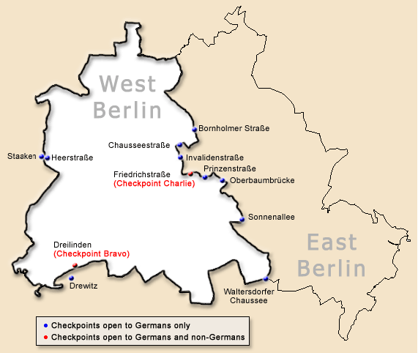
Berlin airlift
This event increased Cold War tensions between the two sides in 1961, communist East Germany built a wall dividing the pro-West sector of Borland from its communist half.

Slide 96
The Berlin wall
The Berlin wall lasted until 1989, when the anti-Communist East Berliners rose up and began tearing it down on live television
http://www.history.com/topics/cold-war/berlin-wall/videos/deconstructing-history-berlin-wall

Slide 97
The Marshall plan
As part of the US containment doctrine to limit the expansion of communism, and to help its Western European allies recover from the war, the United States sent billions of dollars in economic and construction aid to West Germany, England, France, and other Western European nations. Japan also received massive amounts of reconstruction assistance
The Marshall plan was lauded as a “brilliant success” that rebuilt factories and roads.
By the early 1950s, Western Europe and Japan had booming economies.
The USSR attempted a similar aid package for Eastern Europe called Comecon, but it’s efforts were less successful.

Slide 98
NATO versus the Warsaw Pact
In 1949, the United States formed an alliance with Western European nations called the North Atlantic Treaty Organization (NATO). It was designed to contain Soviet aggression in Europe. Canada and Turkey were also included.
The USSR responded with the military and lines of its own, the Warsaw Pact, which most Eastern European nations were compelled to join.
For decades, most experts assumed World War III would be fought in central Europe – probably over East or West Germany – between these two sites. Almost no forecasters in the 1960s and 1970s expected the USSR to disintegrate by the early 1990s.

Slide 99
China during Cold War
Led by Mao Zedong, communist to control of China in 1949. The 20th century Chinese revolutions and China’s Cold War relationship with the USSR and the West are discussed in more depth later in this ppt.

Slide 100
The Korean War
In 1950, communist North Korea invaded pro-West South Korea and, for the first time, the United Nations sent soldiers from members nations to push out the aggressor.
The United States led the UN forces in this war, which included a surprise massive surge from communist Chinese soldiers into Korea.
After three years of constant fighting, the adversaries negotiated new boundaries the two Koreas near the previous borders. The United States and its military allies announced a global plan of containment designed to keep communism from spreading beyond its 1950 borders.

Slide 101
Vietnam War
Just after World War II, a war for independence in French colonial Indochina became a Cold War battle for that region, which was divided in the early 1950s into four nations, including pro-communist North Vietnam (led by Ho Chi Minh), pro-West South Vietnam, Laos, and Cambodia.
Much like and coria, North Vietnam soon invaded South Vietnam to unified the country under communist rule. Vietnam became the focus of US containment policy, and the US government committed its military to fighting a limited war until running out of resolve.
In 1975 the communist off North Vietnam defeated and absorb South Vietnam, creating a unified socialist nation. Hundreds of thousands of South Vietnamese migrated to France, Australia, and the United States over the next two decades to escape the communist system.

Slide 102
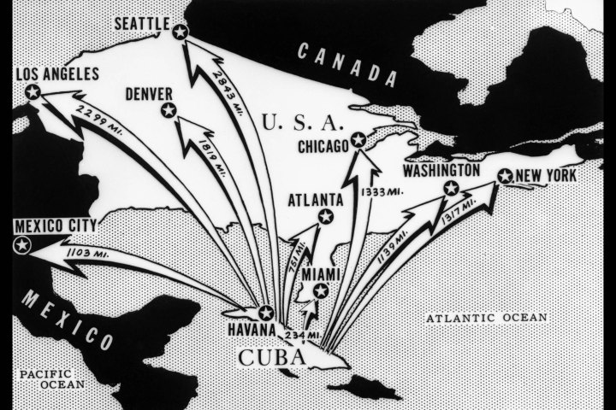
In Latin America
Cold War tensions were at their peak during the Cuban missile crisis in 1962

Slide 103
Cuba
Cuba became a communist nation in 1959. In the early 1960s, the USSR secretly placed missiles with nuclear capabilities that the United States discovered the missiles and brought the issue to the United Nations. On the brink of a nuclear war, cooler heads prevailed in the crisis eased.
A direct line of communication was created to link the white house and Soviet office in Moscow, and the USSR removed the controversial missiles from Cuba.
https://www.youtube.com/watch?v=Ig8UdfQKXSY

Slide 104
Consequences of the Cold War
Cost
The Cold War involved expenditures of many billions of dollars on both sides, especially by the main antagonist: the United States and the USSR.
Proponents argued that the money spent was much less than what would have been appropriated if there had been a hot war between the rivals, not to mention the cost in human lives.

Slide 105
Nuclear legacy
The enormous destructive nature of nuclear bombs may well have been rectified a factor in the Cold War remaining cold. The major rivals may have avoided using nuclear weapons, but after the Cold War, many nations developed or try to build their own nuclear arsenal.
Few of them responded to calls from the United States, the former USSR, or the United Nations to curtail their nuclear programs.
India, Pakistan, Israel, and Iran are some examples of countries that have developed their own nuclear programs.

Slide 106
the features and consequences of the Cold War have appeared on every AP world history exam

Slide 107
The post-Cold War world 1989 to the present
Decline of communism
under the leadership of Soviet president Mikhail Gorbachev and pushed along by a military buildup by US Pres. Ronald Reagan, the USSR softened its strict communist philosophies and military aggression by the mid-in 1980s. These events gave rise to anti-Soviet and pro-democracy movements in Eastern Europe.
The success of these movements was symbolized by the uncontested tearing down of the Berlin wall in 1989.
Faced with the failing economy, loss of international prestige, nationalist revolts from within Soviet Union, and an attempt by members of his own government overthrow him in a coup attempt, Gorbachev announced the breakup of USSR in 1991, and a Russian Federation was established.
The 13 non-Christian members of the USSR split off to form their own governments

Slide 108
Latin America
The decline of communism and it’s authoritarian methods affected Latin America in that most military dictatorships were replaced by Democratic government starting in the 1980s. Argentina and Chile are two examples.

Slide 109
The AP world history exam greatly asks questions about political events after the end of the Cold War.
Not all political movements were in the direction of the Democratic fold after the Cold War.
In the Middle East, dictatorships and kingdoms remain in some nations, for example, in Saudi Arabia and Iran.
In China a pro-democracy movement led by students in 1989 was brutally crushed by the government in Beijing’s Tiananmen square, even as the communist regime there was permitting limited capitalism.

Slide 110
Decolonization

Slide 111
Twentieth Century Decolonization
After World War I European nations, such as England and France, gained an immense amount of territory with Germany’s loss. As well, England and France retained colonial territories they had established in the Age of Imperialism during the nineteenth century.
Much like the North American colonies and Latin American colonies did in the eighteenth and nineteenth centuries, African and Asian colonies would begin to decolonize and gain their independence from nations, such as England and France, after World War II.
-Why was empire ending?
-What processes were there in the decolonization of African and Asian societies in the late twentieth century?
-What were the effects of decolonization in Asia and Africa?

Slide 112
“To develop friendly relations among nations based on respect for the principle of equal rights and self-determination of peoples, and to take other appropriate measures to strengthen universal peace…”
- Charter of the United Nations, 1945

Slide 113
“All peoples have the right to self-determination; by virtue of that right they freely determine their political status and freely pursue their economic, social and cultural development.”
- UN Declaration on Granting Independence to Colonial Countries and Peoples, 1960

Slide 114
Decolonization after World War II
I. South Asian Independence
A. India’s Independence
1. Indian nationalism intensified during and in between World Wars
2. Gandhi’s continued use of satyagraha or “soul force,” civil disobedience, and passive resistance
3. Independent India, 1947, divided into Muslim Pakistan and Hindu India
4. Indian nationalism was divided, so to would South Asian nations and politics

Slide 115
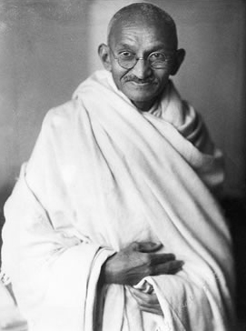
Mohandas Gandhi

Slide 116
“Passive resistance is a method of securing rights by personal suffering; it is the reverse of resistance by arms. When I refuse to do a thing that is repugnant to my conscience, I use soul-force. For instance, the Government of the day has passed a law which is applicable to me. I do not like it. If by using violence I force the Government to repeal the law, I am employing what may be termed body-force. If I do not obey the law and accept the penalty for its breach, I use soul-force. It involves sacrifice of self.”
-Gandhi on Hind Swaraj (Indian Home Rule) and passive resistance, c. 1945

Slide 117
Decolonization after World War II
I. South Asian Independence
B. India’s political and economic development
1. Nonalignment emerged as attractive alternative to a cold war alliance
2. Indian prime minister Nehru favored policy of nonalignment, the "third path"
3. At Bandung Conference in Indonesia, 1955, twenty-nine nonaligned nations met (India among the major leaders)
4. Movement lacked unity; many members sought aid from United States or USSR
5. India’s democracy stabilized
6. India’s agrarian “Green” revolution and developing industrial and service economy sustain second largest national population

Slide 118
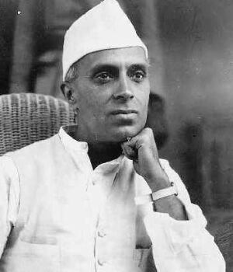
Jawaharlal Nehru, First Prime Minister of India

Slide 119
“ ‘India’s salvation consists’, he wrote in 1909, ‘in unlearning what she has learned during the last fifty years. The railways, telegraphs, hospitals, lawyers, doctors, and suchlike have all to go; and the so-called up-classes have to learn consciously , religiously, and deliberately the simple peasant life, knowing it to be a life giving true happiness.’
All this seems to me utterly wrong and harmful doctrine, and impossible of achievement. Behind it lies Gandhi’s love and praise of poverty and suffering and the ascetic life.”
- Jawaharlal Nehru on Gandhi’s position on Indian independence from his autobiography, 1942

Slide 120
“Present day civilization is full of evils, but it is also full of good; and it has the capacity in it to rid itself of those evils. To destroy it root and branch is to remove that capacity from it and revert to a dull, sunless, and miserable existence. But even if that were desirable it is an impossible undertaking. We cannot stop the river of change or cut ourselves adrift from it, and psychologically we who have eaten of the apple of Eden cannot forget that taste and go back to primitiveness.”
- Jawaharlal Nehru on his own position of a modern India from his autobiography, 1942

Slide 121
Decolonization after World War II
I. South Asian Independence
C. Religious division in South Asia
1. Muslim and Hindu rivalries historical in South Asia
2. Nationalistic interests of the Indian National Congress and the Muslim League influence independence efforts
3. UN Partition recognizes religious differences (Islamic Pakistan and Hindu India)
4. Continued tensions between Pakistan and India w/nuclear weapons scare

Slide 122
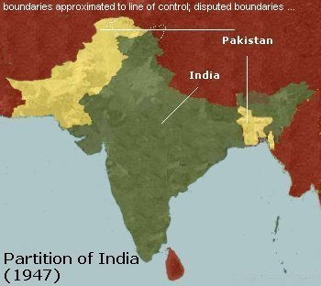
UN Partition of India, 1947

Slide 123
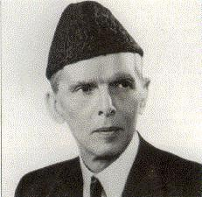
Muhammad Ali Jinnah, leader of the Muslim League

Slide 124
“If the British government are really in earnest and sincere to secure the peace and happiness of the people of this subcontinent, the only course open to us all is to allow the major nations separate homelands by dividing India into ‘autonomous national states.’ There is no reason why these states should antagonistic to each other.”
- Muhammad Ali Jihnnah, of the Muslim League, Two Nations, 1940

Slide 125
“The ideal conditions, therefore, under which a nation can attain perfect solidarity and cohesion would, other things being equal, be found in the case of those people who inhabit the land they adore, the land of whose forefathers is also the land of their Gods and Angels, of Seers and Prophets; the scenes of whose history are also the scenes of their mythology.
The Hindus are about the only people who are blessed with these ideal conditions that are at the same time incentive to national solidarity, cohesion, and greatness.”
- Vinayak Savarkar, Hindu nationalist and suspect in Gandhi’s assassination, c. 1940

Slide 126
“India cannot cease to be one nation because people belonging to different religions live in it. The introduction of foreigners does not necessarily destroy the nation: they merge in it. A country is one nation only when such a condition obtains in it. That country must have a faculty for assimilation. India has ever been such a country.”
-Gandhi on Hind Swaraj (Indian Home Rule) and a unified India between Muslims and Hindus, c. 1945

Slide 127
Decolonization after World War II
II. African Independence
A. Ghana, Algeria, Kenya, South Africa
1. Ghana achieves independence from Britain in 1957 under leadership of Kwame Nkrumah (peaceful)
2. Violent independence movements in Algeria (from France) and Kenya (from England)
3. White settler dominance and Apartheid in South Africa until 1989

Slide 128
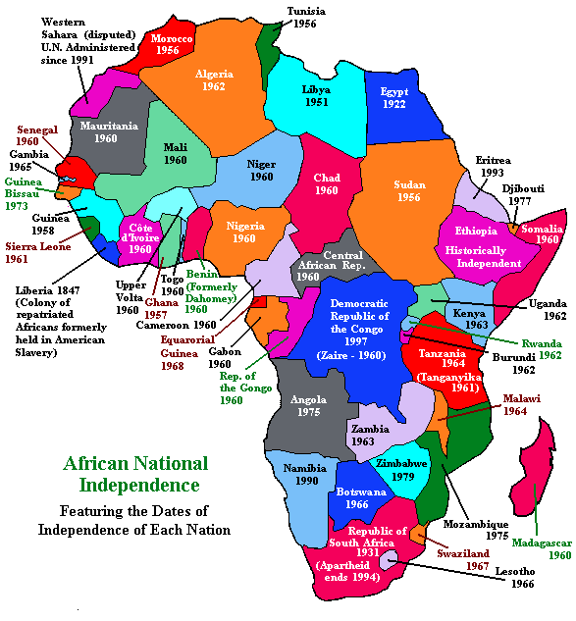

Slide 129
“For centuries, Europeans dominated the African continent. The white man arrogated to himself the right to rule and to be obeyed by the non-white; his mission, he claimed, was to "civilize" Africa. Under this cloak, the Europeans robbed the continent of vast riches and inflicted unimaginable suffering on the African people.
All this makes a sad story, but now we must be prepared to bury the past with its unpleasant memories and look to the future. All we ask of the former colonial powers is their goodwill and co-operation to remedy past mistakes and injustices and to grant independence to the colonies in Africa….
It is clear that we must find an African solution to our problems, and that this can only be found in African unity. Divided we are weak; united, Africa could become one of the greatest forces for good in the world.”
- Kwame Nkrumah’s speech I Speak of Freedom, 1961

Slide 130
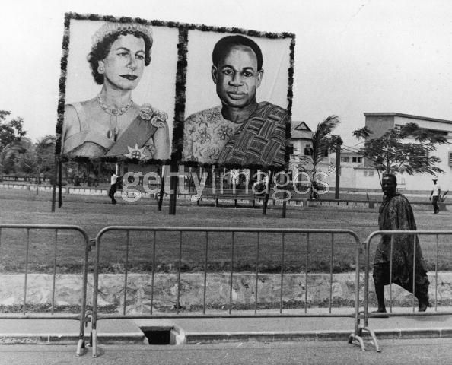
President Kwame Nkrumah and Queen Elizabeth II billboard prior to the Queen’s visit, 1961

Slide 131
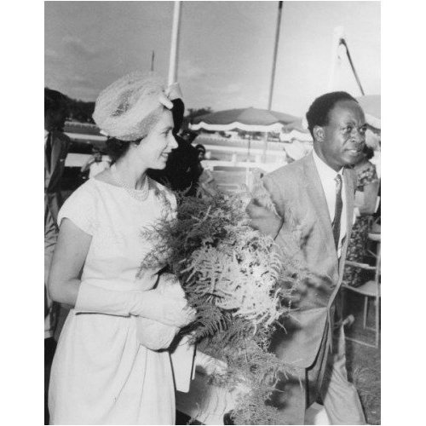
President Kwame Nkrumah and Queen Elizabeth II

Slide 132
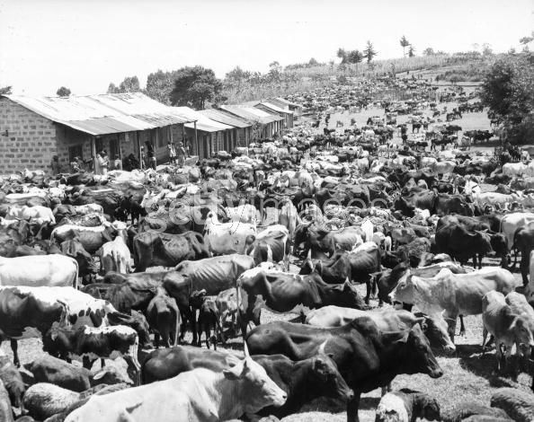
Confiscated Kikuyu cattle in Kenya, 1953

Slide 133
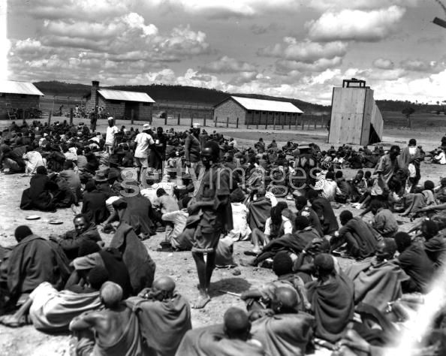
Kikuyu tribesmen suspected as Mau Mau terrorists in a prison in Kenya, 1953

Slide 134
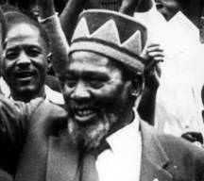
Jomo Kenyatta, nationalist leader of Kenya

Slide 135
“The African is conditioned, by the cultural and social institutions of centuries, to a freedom of which Europe has little conception, and it is not in his nature to accept serfdom forever. He realizes that he must fight unceasingly for his own complete emancipation, for without this he is doomed to remain the prey of rival imperialisms, which in every successive year will drive their fangs more deeply into his vitality and strength.”
- Jomo Kenyatta on African Nationalism, c. 1961

Slide 136
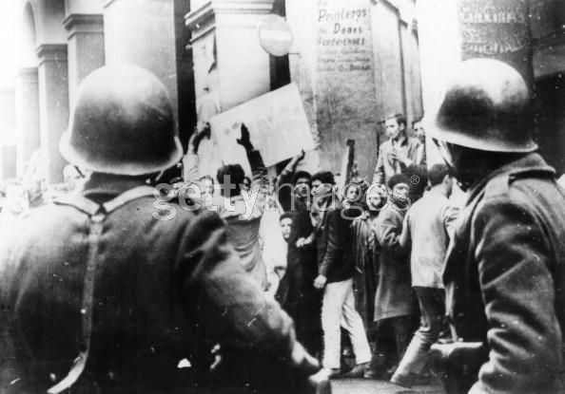
Muslim supporters of the FLN demonstrate against French soldiers, 1960

Slide 137
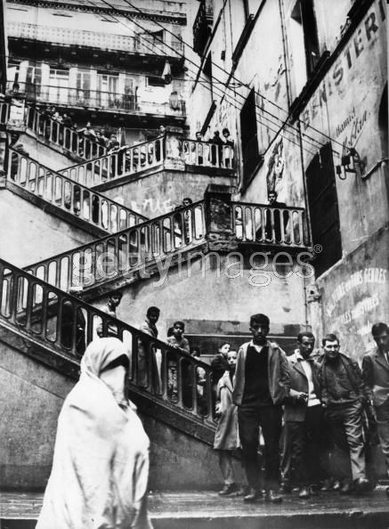
Image of the Casbah in Algiers, 1962

Slide 138
“Need I say more to show that this policy of Partnership (as oppose to Apartheid) could, in South Africa, only mean the eventual disappearance of the white South African nation? And will you be greatly surprised if I tell you that this white nation is not prepared to commit national suicide, not even by slow poisoning? The only alternative is a policy of apartheid, the policy of separate development.”
- A.L. Geyer, The Case for Apartheid, 1953

Slide 139
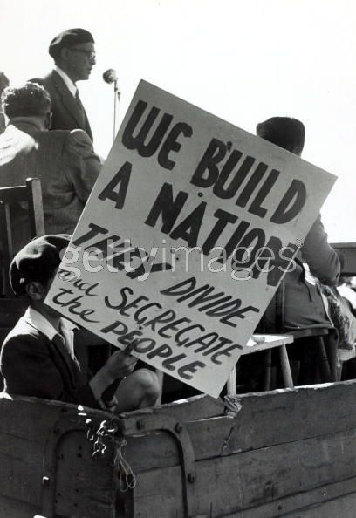
Demonstration against Apartheid in South Africa, 1952

Slide 140
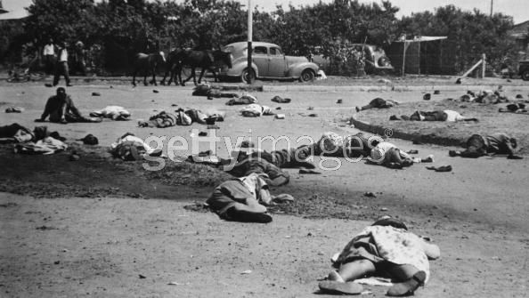
Image from the Sharpeville Massacre,1960

Slide 141
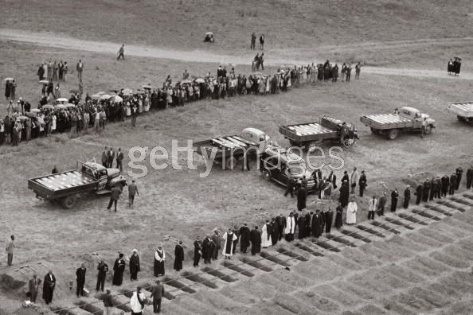
Image from the Sharpeville Massacre, Funeral for the Victims, 1960

Slide 142
Nelson Mandela, leader of ANU and former President of South Africa (first black President)

Slide 143
“And what of the white minority? For years they have been misled by racialist politicians, dominees and fascists who told them they were the superior. They have followed the Vorsters (PM of South Africa and former Nazi supporter) and now they are being called upon to fight and die in defense of apartheid. Let them ask themselves: is it worth it? Has it brought anything but uncertainty and fear, isolation and contempt at home and abroad? Is this a future to fight and die for – a life in an armed camp, surrounded by the hate and anger of the oppressed non-white people?”
- We are at war!; published by the Spear of the Nation and the African National Congress, led by Nelson Mandela, shortly after the Sharpeville Massacre, 1960

Slide 144
Decolonization after World War II
II. African Independence
B. Economic and political legacies in Africa
1. Pan-African nationalism to support peace, security, and sovereignty in Africa
2. Rise of one-party dictatorships (Ghana, Algeria, etc.)
3. Apartheid: harsh legal system imposed in 1948 in South Africa, designed to keep races separate
4. African National Congress, led by Nelson Mandela, launched campaign to protest apartheid in the 1950s and 1960s
5. Africa’s developing economies
6. Africa has 10 percent of world's population but less than 1 percent of industrial output
7. Rich in minerals, raw materials, agricultural resources
8. Lacking in capital, technology, foreign markets, and managerial class
9. Rapid population growth compounds problems

Slide 145
Decolonization after World War II
III. Middle Eastern Independence
A. End of League Mandate System
1. Established after World War I per the League of Nations
2. Ended after World War II per the United Nations
a. British mandates abandoned
i. Palestine, 1947
ii. Israel, 1947
iii. Jordan, 1946
b. French mandates abandoned
i. Syria, 1946

Slide 146
Decolonization after World War II
III. Middle Eastern Independence
B. Zionism (Israel): Desire to establish a Jewish homeland
1. Supported by British after World War I
2. Inter-war and World War II migration to British mandate of Palestine
3. World War II and Holocaust creates more sympathy
4. Realized in 1947 with UN Partition
5. Zionism as antithesis to Arab nationalism

Slide 147
“The Jewish people are at present prevented by the Diaspora from conducting their political affairs themselves. Besides, they are in a condition of more or less severe dis- tress in many parts of the world. They need, above all things a gestor . This gestor . cannot, of course, be a single individual. Such a one would either make himself ridiculous, or -- seeing that he would appear to be working for his own interests -- contemptible.
The gestor of the Jews must therefore be a body corporate.
And that is the Society of Jews.”
- Theodor Herzl’s The Jewish State, 1896

Slide 148
British Mandate of Palestine, 1922-1948

Slide 149
UN Partition, 1947
Red – Palestine; Yellow – Israel; Jerusalem - International

Slide 150
“In the midst of wanton aggression, we yet call upon the Arab inhabitants of the State of Israel to return to the ways of peace and play their part in the development of the State, with full and equal citizenship and due representation in its bodies and institutions - provisional or permanent.
We offer peace and unity to all the neighboring states and their peoples, and invite them to cooperate with the independent Jewish nation for the common good of all.”
- Israel’s Declaration of Independence, 1948

Slide 151
Israel’s Conquest, 1948-49

Slide 152
Israel – Yellow
Brown & Red controlled by Israel after Six Days’ War, 1967
Territories later returned to Palestine & Egypt

Slide 153
Decolonization after World War II
III. Middle Eastern Independence
C. Arab Nationalism (Palestine, Egypt)
1. Grew during World War I w/British support
2. Denied after World War I and stalled due to League Mandates
3. Intensifies during Inter-War period due to Mandates
4. Nations seek to protect lands and resources
a. Suez Canal, 1956
b. Arab-Muslim/Israeli conflicts over territory (Sinai Peninsula, Gaza Strip, West Bank, Lebanon)
c. Organization of Petroleum Exporting Countries (OPEC)
d. rise of political dictatorships (old Iraq, new Palestine)
e. aggression toward other nations (Iraq – Kuwait)

Slide 154
Gamal Nasser, Egyptian leader and nationalist

Slide 155
“In these decisive days in the history of mankind, these days in which truth struggles to have itself recognized in international chaos where powers of evil domination and imperialism have prevailed, Egypt stands firmly to preserve her sovereignty. Our country stands solidly and staunchly to preserve her dignity against imperialistic schemes of a number of nations who have uncovered their desires for domination and supremacy.”
- Egyptian leader Gamal Nasser’s Speech on the Suez Canal, 1956

Slide 156
Decolonization after World War II
III. Middle Eastern Independence
D. Islamic fundamentalism (Iran)
1. American interest in Iran since 1950s
2. American support of Shah Pahlavi
3. American oust of communist threats, 1950s
4. Pro-Western, pro-modern Iran as trade partner w/USA until 1979
5. Iranian Revolution, 1979 sought instill fundamental Islamic values
6. Islamic Republic of Iran still in place today
7. Extremely anti-American and anti-Western

Slide 157
Ayatollah Khomeini, leader of Iranian Revolution

Slide 158
Outcome of Declonization
1. Some former colonies had economic success and political stability after decolonization – India, Singapore, and Indonesia are three examples.
however, many colonies struggled, facing civil wars, crumbling infrastructures, and continued economic hardships. Malawi and Zaire are but two examples in Africa alone. One continuity over the centuries has been Africa's lack of industrial production. It remained an exporter primarily of natural resources such as oil, coal, and other minerals.

