Slide 1
Reformation Across Europe
How did the Protestant Reformation evolve as it spread?

Slide 2
The ideas of the Reformation (religious, political etc.) soon spread throughout the continent
Reformation in Switzerland
Loose group of states - “cantons”
Some Protestant, some Catholic, some both
Opposition to military mercenary service
Desire for church reform based on Luther’s ideas, but with many key differences

Slide 3
Ulrich Zwingli (1484-1531)
Student of humanism who preached from Erasmus’ edition of the New Greek Testament
Like Luther, believed that the Bible should be the sole authority regarding religious practice
Believed in right of priests to marry
Whatever was not directly and literally supported in the Bible was indefensible
Zwingli established what amounted to a theocracy in Zurich
In contrast to Luther, he saw the Eucharist (bread and wine) as only symbolic, and that Luther’s view of the “Real Presence” was too Catholic in its foundation
This became the first doctrinal dispute among Protestants
Colloquy of Marburg (1529): Zwingli officially split with Luther over issue of Eucharist

Slide 4
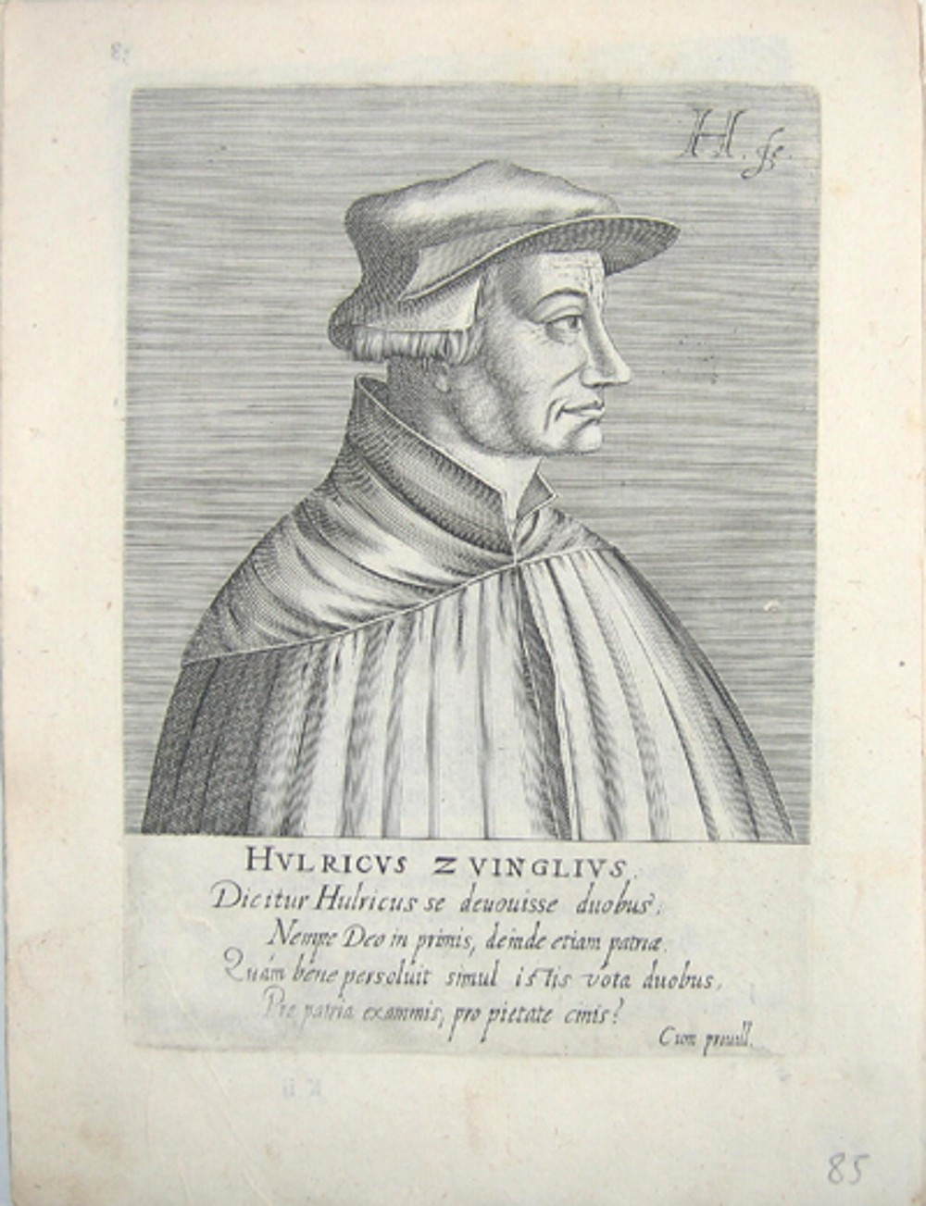

Slide 5
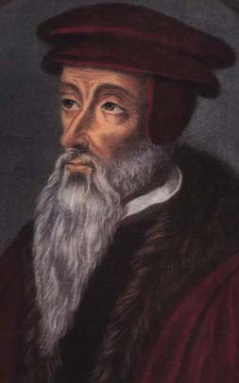
John Calvin (1509-1564)
1536 - moved from France to Geneva
after Philip oppressed Protestants
Geneva removed Bishop and prince, became Protestant
Calvin created rules for the new church (Institutes of the Christian Religion)
Set doctrine for thousands of Protestants who moved to Geneva after expulsion from home countries

Slide 6
Calvin's Doctrine of Predestination
Everyone and everything is controlled by all-knowing God
Your life, and afterlife, is set out for you before you are born - there is no free will
If you are one of the “elect” (ie. a Calvinist), then you go to heaven
Can become an “elect” through a conversion experience, good works demonstrate your role
Elect had to live by stern moral code (drinking, gambling, singing, dancing, lending money were banned)
Governed and judged by council of elected elders (the consistory)

Slide 9
Protestantism Across Europe
Denmark: Christian II and Hanseatic League of merchants led imposition of Protestantism
Sweden: King Gustavus Vasa seized Church lands and embraced Lutheranism
Poland: splintered country found room for all faiths
Netherlands: Charles (Duke of Burgundy) crushed Protestants, movement went underground
Scotland: John Knox establishes Presbyterianism (1560)
France: Huguenots – French Calvinists; brutally suppressed

Slide 10
The German Civil Wars: 1530-1555
Germany broke out in religious-based civil wars :
1530 – Diet of Augsburg: Princes of the Schmalkaldic League (P) – led by Phillip of Hesse - reject Charles’ demand to return to Catholisicm, win early victories, declare Augsburg Confession as expression of beliefs
1546- Battle of Muhlberg: Charles crushes princes, announces plans to take away prince’s power.
1552- Battle of Innsbruck: new alliance of princes (C and P) defeats Charles
1555- Peace of Augsburg: Charles and princes reach a compromise with Lutherans
Curius regio, eius religo: whatever the religion of the prince, that will be the religion of his people
Didn’t satisfy Anabaptists or Calvinists (became leaders of future resistance)

