Slide 1
Lecture 10 The Protestant Reformation Begins
In what ways did the Protestant Reformation represent a challenge to tradition?

Slide 2
What was the Reformation?
The Protestant Reformation was the 2nd major division of the Christian church (after Roman v. Orthodox)
Challenges to the power and authority of the Roman Catholic Church led to the creation of new forms of Christian worship, many of which are still around today
Began in the German states, but soon spread
The Reformation also had important political and social implications

Slide 3
Religious Causes of the Reformation
1. Crises of the 14th and 15th centuries hurt the prestige of the clergy (see unit 2)
Babylonian Captivity, 14th century (Avignon Papacy)
Great Schism: 1377-1417
Failure of the Conciliar Movement to reform the Church and give a council more power than the pope

Slide 4
2. Corruption in the Catholic Church
A. Sin of “simony”: sale of church offices (benifices)
For example, in 1487 the pope sold 24 offices
Reformers were outraged that unqualified people would become bishops or cardinals
B. Pluralism: an official holding more than one office at a time
C. Absenteeism: an official not participating in benefices but receiving payment and privileges
D. Nepotism: favoring family members in the appointment of Church offices
Two popes (Leo X and Clement VII) were sons of Florentine Medici rulers
Pope Paul III made two of his grandsons cardinals
E. Sale of indulgences: people paying money to the Church to absolve their sins or sins of their loved ones

Slide 5
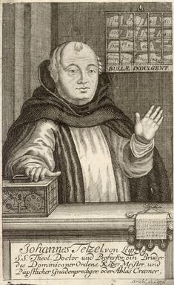
John Tetzel
Preacher and Commissioner of Indulgences for Pope Leo X
Raised money for St. Peters in Rome and for local archbishop’s debts
“As soon as a coin in the coffer rings,
the soul from purgatory springs."

Slide 6
3. Moral decline of the Papacy
Pope Alexander VI (r. 1492-1503) had numerous affairs and children out of wedlock
20% of all priests in the diocese of Trent kept concubines during the early 16th century
Some abused their power such as trading sexual favors for the absolution of sins during confession.

Slide 7
Effects of the Religious Criticism
People longed for simpler, purer religious experience (“lay” movements)
Love, self-sacrifice, equality, spirituality became the ideals
Desired a personal relationship with God – no more Church “middle man” (preaching in the vernacular)
Revived ideas of Lollards, Hussites, Brothers of the Common Life (“Modern Devotion”)

Slide 8
Other Causes of the Reformation
Social and Political
Although the break from the Church was religious-based, many of the reasons for the success of the Reformation were social and political
Centralized power had meant loss of freedoms for cities and towns, Reformation ideas touched a nerve
New guilds were increasing in power (printers)
Increasingly literate, worldly population
Rulers coveted the wealth of Church institutions and resented the tax and court-exempt status of Church officials

Slide 9
From your textbook (pages 320-322)
What made the German states such prime breeding ground for Reformation ideas?
Who was Martin Luther? Describe his early life.
Discuss Luther’s idea of sola fide. How did it differ from Church doctrine?

Slide 10
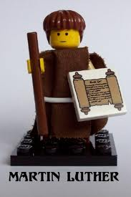
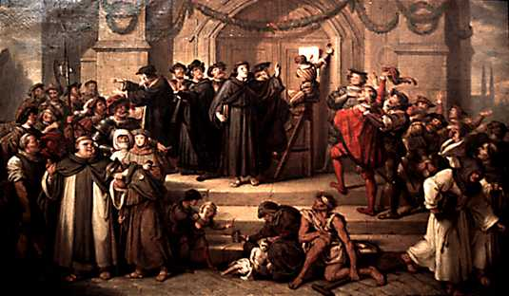
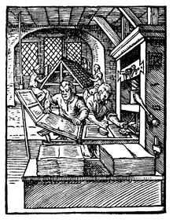
The Spread of Luther’s Ideas
On October 31, 1517 Luther posted his 95 Theses to the door of a Church in Wittenberg, Saxony
They were widely reprinted and circulated around the German states
Luther became a symbol of German desire for independence from Italian control

Slide 11
From your Document Booklet
Reading 11.2 Luther’s 95 Theses
1. Choose 3 particular statements from the Theses that would have most challenged Church doctrine. Be prepared to defend your choices!

Slide 12
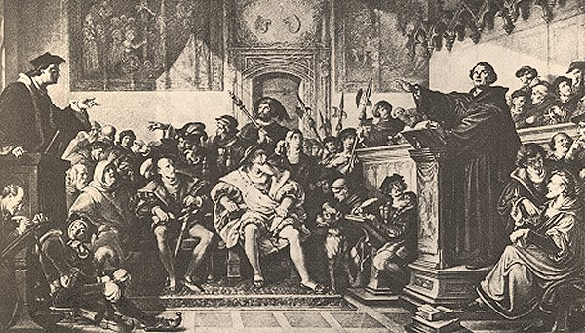
Traditionalists reacted against Luther, Eck of Leipzig challenged him to a debate
Luther questioned Pope’s authority, claimed execution of Jan Hus was a mistake
Pope Leo X excommunicated Luther, but he was protected by Frederick the Wise, Elector of Saxony (who had helped Charles V get elected HR Emperor)

Slide 13
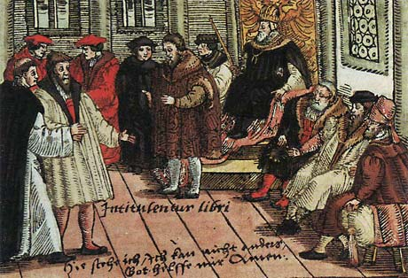
Diet of Worms
Charles V held Diet (summit meeting of German princes) at city of Worms in 1521
Luther refused to recant his statements:
“Here I stand, I can do no other. God help me.”
Charles placed Luther under the “Ban of the Empire” forcing him into hiding (Squire George)

Slide 14
While in hiding, Luther wrote new pamphlets and letters, translated the New Testament into German (“priesthood of all believers”)
Charles became more concerned with fighting French and Ottomans, allowed German princes to keep Luther safe (Diet of Speyer, 1529)
Protestant princes began enforcing religious changes (mostly for political gain), formed Schmaldkaldic League to defend new order

Slide 15
Peasant Revolts
Protestantism itself began to split – Radicals vs. Moderates, Peasants vs. Princes
Zwickau Prophets: declared that all princes must be eliminated (it’s in the Bible!) and idols destroyed, people went on an orgy of violence and destruction.

Slide 16
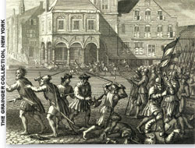
Anabaptists: turned Munster into a “godly republic”, punished sin by death and abolished private property, allowed polygamy
Peasants revolted in 1524, Luther condemned the revolt and it was crushed (religious, not social crusade)

