Slide 1
REVOLUTIONS AND NATIONALISMS CH14 SEC
KHAN

Slide 2
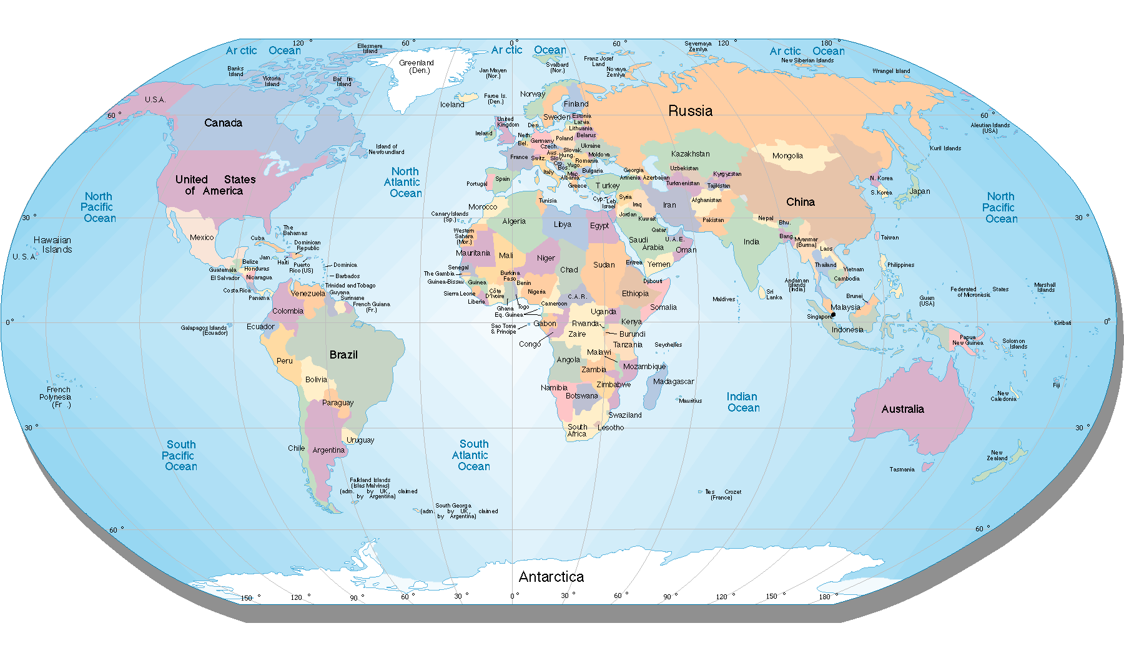
CHAPTER 14 SECTION 3
Imperial China Collapses

Slide 3
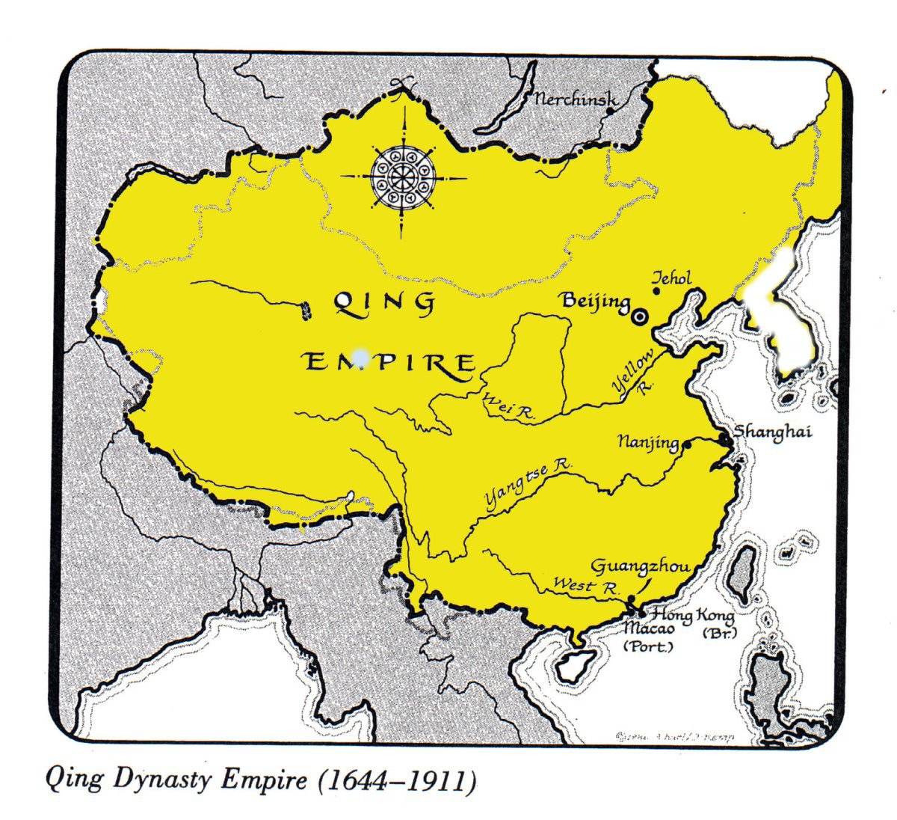

Main Idea
Revolution after the fall of Qing dynasty, nationalist and Communist movements struggle to power.

Slide 4
Why it matters now?
The seeds of China’s last 20th century political thought, communism, were planted at this time.

Slide 5
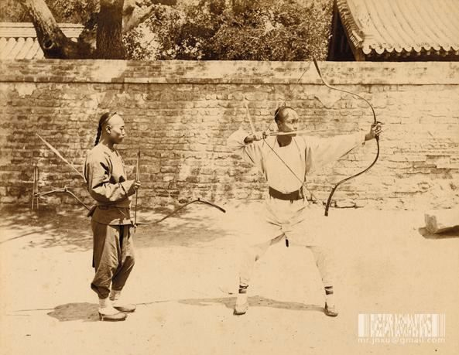
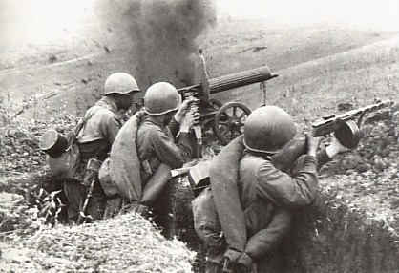
Setting the stage
1n the early 1900s, China was ripe for revolution.
-lack of modernization and nationalism
-lack of industry
Some others thought the China’s greatness lay in its traditional ways

Slide 6
Formation of the Chinese Republic
The Qing Dynasty had been in power since 1644
The people of China, under nationalist leader Sun Yixian, demanded:
  “Nationalism”  The end of foreign domination & influence
  “Democracy”  Formation of a representative government
  “People’s Livelihood”  A modernized & industrialized economy to provide security for the people of China

Slide 7
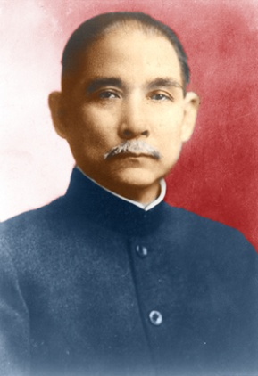
Formation of the Chinese Republic
Sun Yixian (Yatsen)
  Leader of the Kuomintang
    Kuomintang  China’s Nationalist Party
    Overthrows Qing Emperor in 1911 and becomes China’s first president, but…
    “The Chinese people…do not have national spirit. Therefore, even though we have four hundred million people gathered together in China…they are just a heap of loose sand.”
      Sun could not unite China
      Turns over presidency to a top general who overturns democratic reforms
      China becomes a military dictatorship overrun by warlords

Slide 8
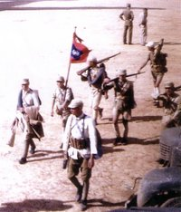
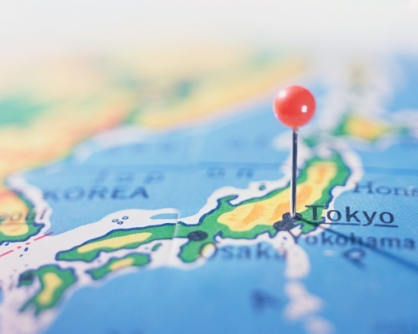
World War I & The Treaty of Versailles
In 1917, China declares war on Germany
  China believed by fighting for the allies that at the end of the war, territories controlled by Germany would be returned to the people of China
  Treaty of Versailles gave Japan the former German territory

Slide 9
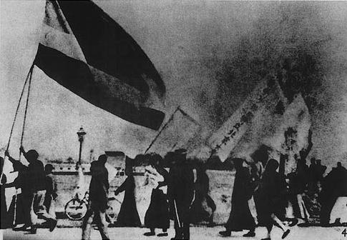
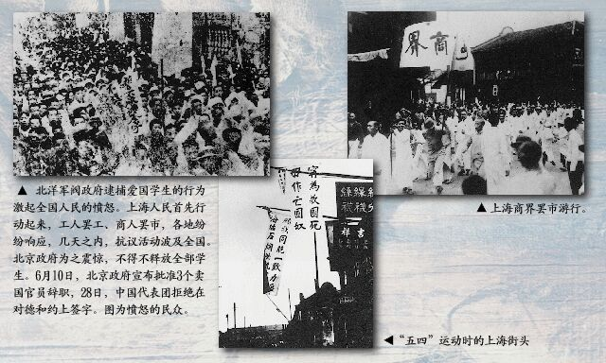
May Fourth Movement
On May 4, 1919 over 3,000 angry Chinese students gathered in Beijing to protest the Treaty of Versailles
  Demonstrations spread to other cities throughout China
  Sun Yixian believes he can regain power, but…

Slide 10
The Communist Party in China
Many intellectual Chinese turned against Western Democracy (as you might imagine they would considering how the democracies treated China
Communist Party
  Lead by former university asst. librarian Mao Zedong
  Influence by the Russian Revolutions of 1917

Slide 11
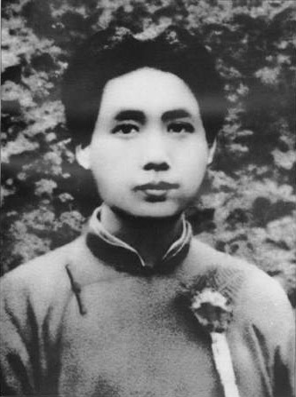
Mao Zedong
Student of Marxism
  However, he believed the communist revolutions would not begin with urban factory workers, but with RURAL PEASANTS
  “The force of the peasantry is like that of the raging winds and driving rain. It is rapidly increasing in violence. No force can stand in its way. The peasantry will tear apart all nets which bind it…They will bury beneath them all forces of imperialism, militarism, corrupt officialdom, village bosses and evil gentry.”

Slide 12
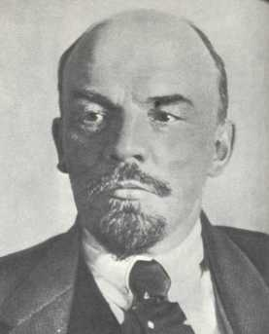
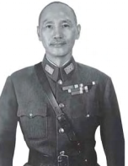
Lenin befriends china

Slide 13
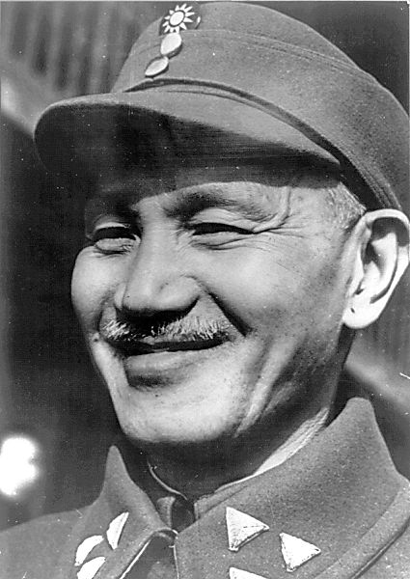
Jiang Jieshi & the Nationalists
After Sun Yixian’s death in 1925, Jiang Jieshi becomes the head of the Kuomintang
Jiang
  Feared communism
  Supported by bankers and businessmen
  Over saw a corrupt government

Slide 14
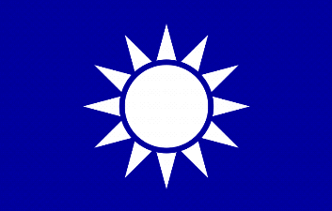
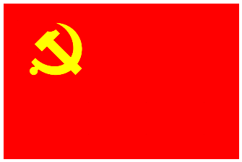

Nationalists and Communists Clash-Chinese Civil War
Jiang Jieshi starts a campaign against communists
  Has troops and armed gangs kill members of the Communist Party and union members on the city streets of Shanghai
    Nearly wipes out all members of the Communist Party
In 1928 the US and Britain recognize Jiang Jieshi as president of China
  The Soviet Union does not due to persecution of Communist Party in China

Slide 15
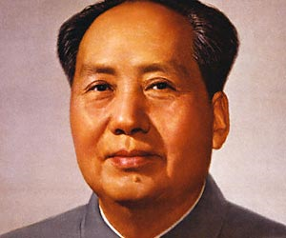
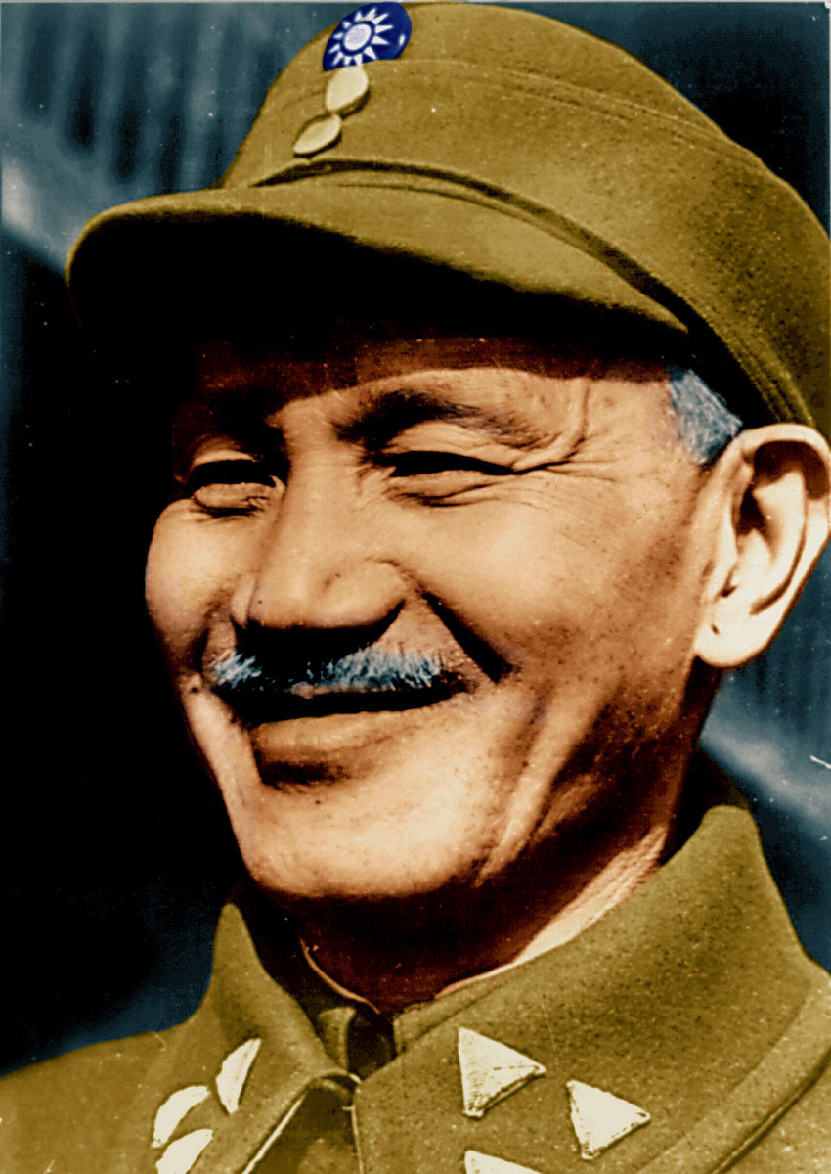
Chinese Civil War
Mao forms the Red Army by recruiting peasants
  Established themselves in the countryside of south-central China
  Trained Red Army in guerilla warfare with help from Soviet Union
Jiang sends Nationalists soldiers after them, but can’t completely wipe them out due to guerilla warfare
Vs.

Slide 16
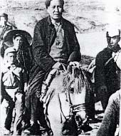
The Long March
  Jiang sends 700,000 men after Communists and surrounds them
  100,000 Communists flee and begin a 6,000 mile-journey (The Long March)
    Tens of thousands die due to
      Starvation
      Battle wounds
      Exposure to the cold
  Mao and 8,000 survivors take shelter in the caves of northwestern China.

Slide 17
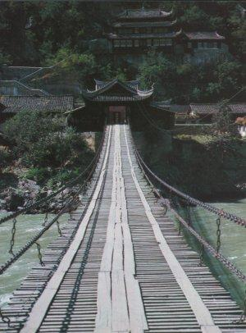
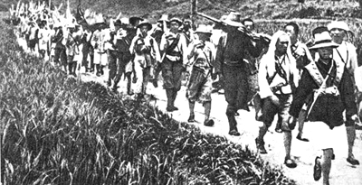
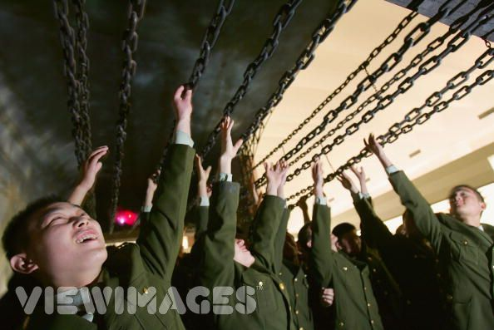
Red Army soldiers marching part of the 6,000 miles
Luding Bridge

Slide 18
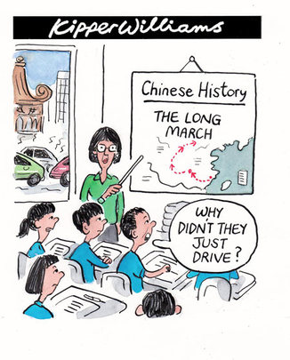

Slide 19
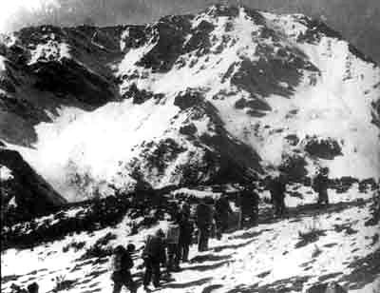
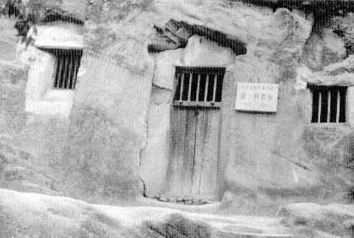
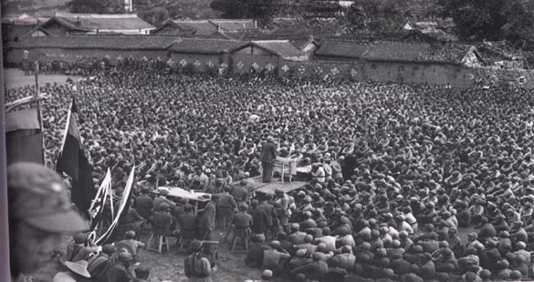
Cave dwellings in Shaanxi
Red Army troops crossing the snowy mountains
Mao on the Long March
Communist leader addresses the survivors of the Long March

Slide 20
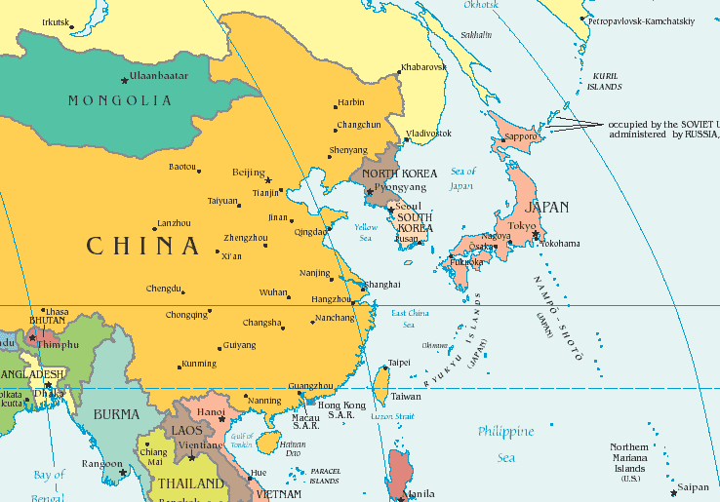
Civil War Suspended
In 1931, Chinese fought Chinese
Japan took advantage of the situation and invaded Manchuria
1937, Japan launched an all out invasion of China
By 1938 Japan took control of large part of China.

Slide 21
THEREFORE-
The Nationalists and Communists united to fight the common enemy, JAPAN.
The Agreement-
National Assembly agreed to promote Sub Yixian;s “Three Principals of the People”– nationalism, democracy, people’s livelihood.

Slide 22
Chinese Song –Long March
http://www.youtube.com/watch?v=8tqNzraNmvo
While I play the song, write on the exit ticket ( post it)
(Choose any 1)
Nationalist vs. Communist struggle for power after fall of qing dynasty
May 4th Movement
Long March
Must Do 1. I learned today about the event ___________________ which was about ______________ and the cause of the event was because of _____________ and the final result was _________________ (stick this on the green stop sign)
Optional 2. I considered this question or idea or perspective _____________ and I need more clarification on this topic _______________( stick this on the yellow sign)
Optional 3. I stopped learning because ______________( stick this on the red sign)

