Slide 1
DO NOW!!
Page 3: Glue in the tracking sheet
Page 4: title it Chapter 14 Vocabulary pictures
Page 5: Title it Chapter 14 Vocabulary
Page 6: Write DNA Question and your answer
Page 7: Title it Chapter 14 Notes

Slide 2
Chapter 14
Russian Revolutions

Slide 3
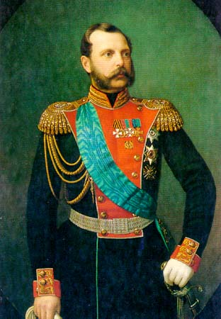
Czarist Regimes before the Revolution
Alexander II
  Reforms and modernization ex. Freeing serfs
  Assassinated in 1881

Slide 4
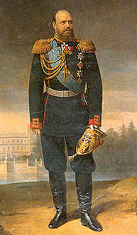
Alexander III
  strengthens government with harsh methods
    Enemies sent to Siberia
    Stops reforms and creates a police state
    Spies, pogroms- legal racism against Jews

Slide 5
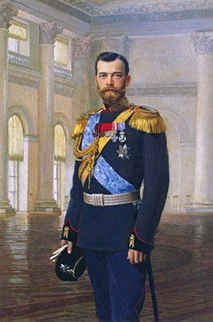
Write here
Nicholas II
  Crowned in 1894
  Slow industrialization
    Did create Trans-Siberian Railroad – longest in world

Slide 6
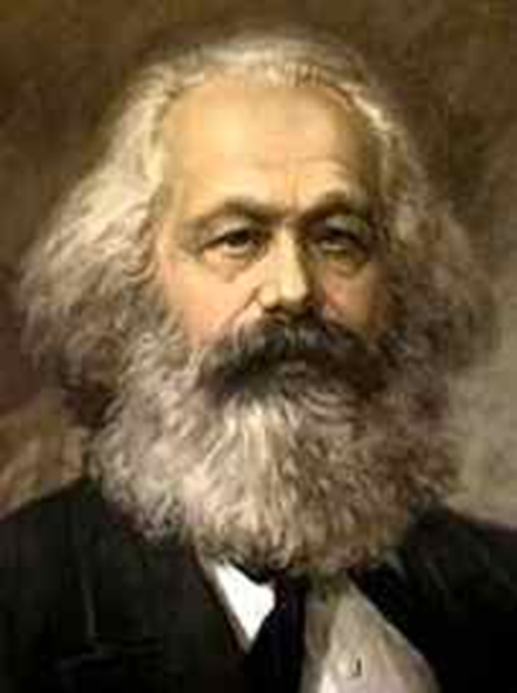
Discontent
Write here
Factories brought new problems
  Wages, working conditions, hours
  Low standard of living
  Gap between rich and poor grew
Karl Marx – Communist Manifesto
  Workers will revolt, overthrow government
  Common people will be equal

Slide 7
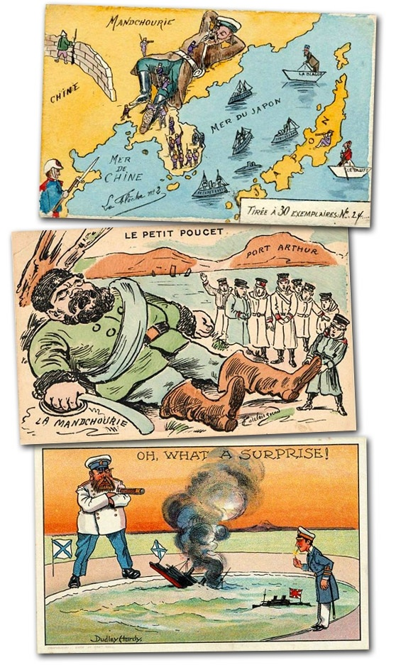
Crises at Home
Russo – Japanese War
  fought for control of Korea and Manchuria
Japan destroyed the Russian Navy
Russia is humiliated
Czar becomes more unpopular
Government seen to be weak and incompetent
Write here

Slide 8
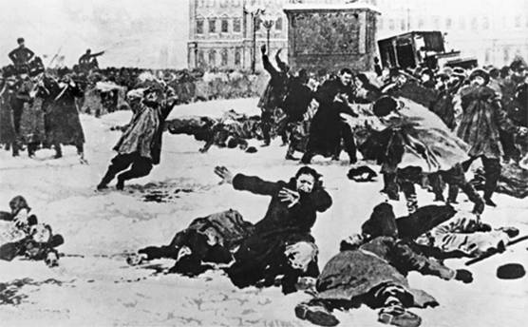
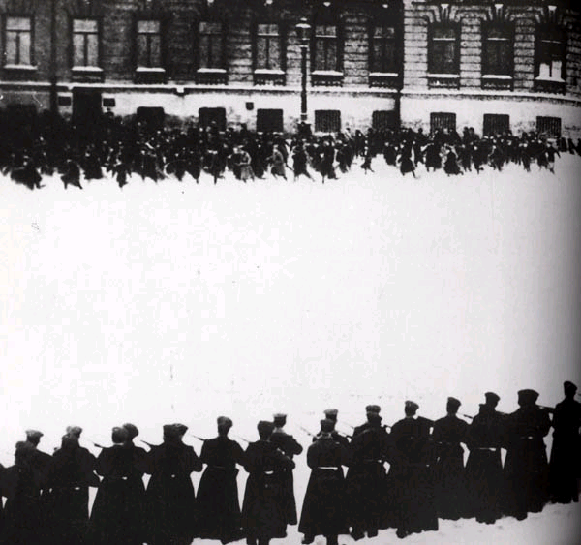
Crises at home
Write here
Bloody Sunday – 1905
  Workers march to the Winter Palace
  Demands - Better living and working conditions - end to war - a parliament
  Soldiers fire on crowd killing 500
Sets off a wave of riots, strikes and murders

Slide 9
Title –
Analyzing Causes Assignment
Write here
Complete the following question under the DNA.
Use complete sentences.
  Page 434: Why did industrialization in Russia lead to unrest?

Slide 10
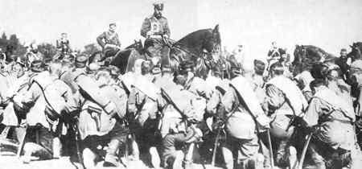
Crisis at Home
World War One Impact
  Poorly trained/equipped army
  4 million died the first year
  Economy could not keep up with demand
  Continuously Defeated
  Nicholas II goes to the warfront to led troops
Write here

Slide 11
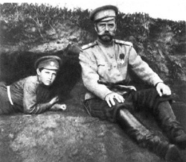
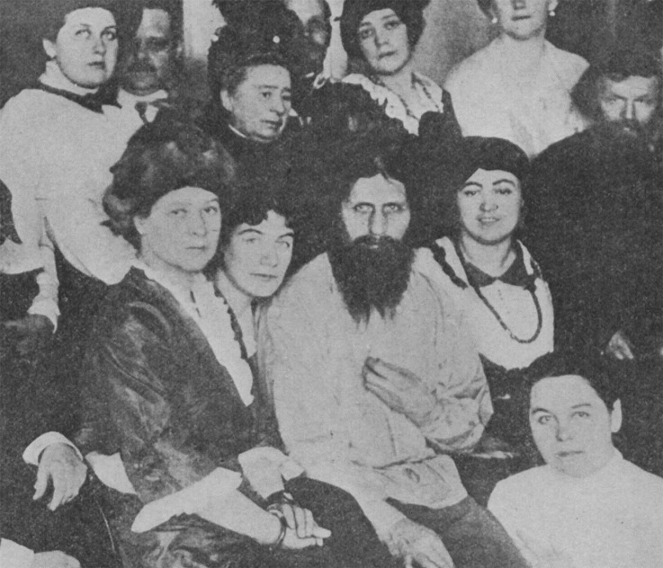
Criticism of the Czar
Poor military commander
Poor political leader
Left the Czarina in charge
Refused to accept advice from the Duma
Criticism of the Czarina
Inexperienced and incompetent ruler
Under the influence of Rasputin
Unpopular because she was German
Impact of WWI
Write here
Role of Rasputin
Claimed to be a healer
Disliked by many yet held influence over both the Czar and Czarina

Slide 12
Postcard from the Past
A postcard is a photograph that people often send while on vacation. It shows the people back home what they are missing and allows for a brief note.
Your task: On an index card create a postcard that you would send home to tell your family about one of the events from the Russian Revolution.
  The front of your postcard should have a colored picture of the event and a quote.
  The back of the card should have a short note describing the event and a
  Stamp that represents a famous person from Russia .

Slide 13
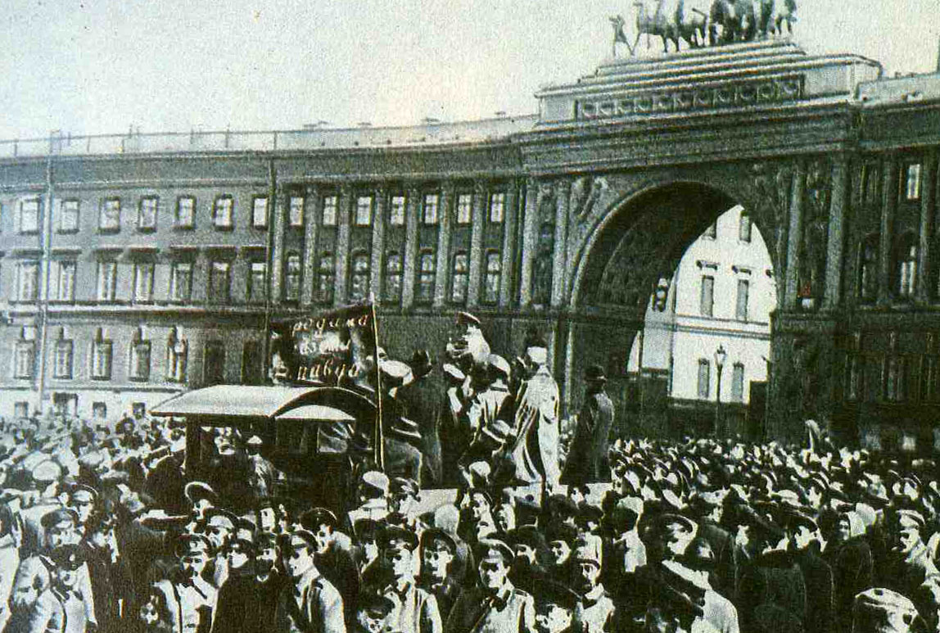
Revolutionary Groups
Mensheviks
  moderates
  wanted support of the people to change government
Bolsheviks
  small group of radicals
  deeply committed to making changes at any cost
  Leader – Vladimir Lenin
Write here

Slide 14
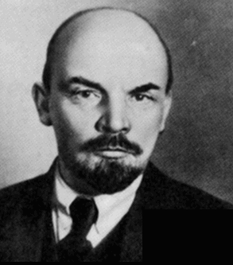
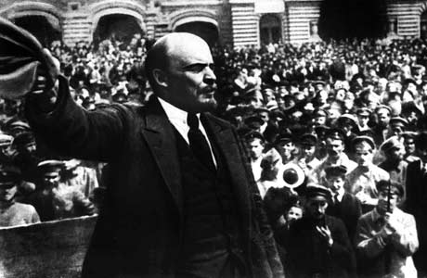
Vladimir Lenin
Excellent speaker, organizer.
Forced to flee Russia.
Waited for an opportunity to return.
Write here

Slide 15
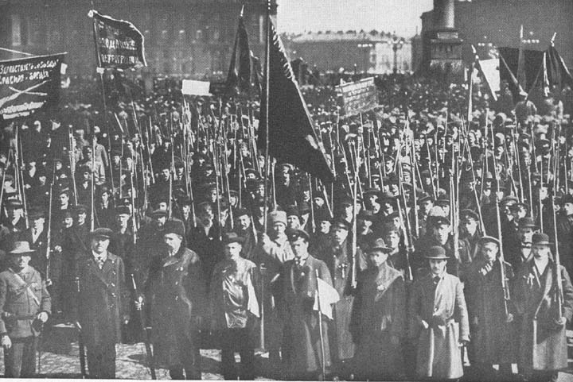
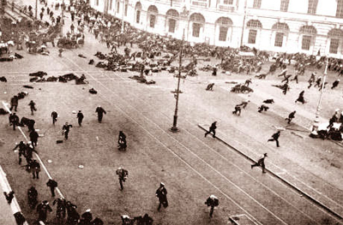
March Revolution
Write here
Shortage of food, shelter, fuel
Russian factory workers upset and strike
Workers marched to protest in Petrograd
Soldiers now joined protests
Czar abdicates (gives up) thrown (1917)

Slide 16
Provisional Government
Refuses to end fighting in World War I
  Loses public support
Soviets- local city governments
  very powerful
Write here

Slide 17
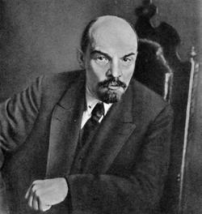
Lenin Returns
Write here
April 1917- smuggled in by the Germans
promises to end fighting if in power

Slide 18
DNA – Page 10 of IntNotebook
Communism or Capitalism is an ideology that seeks to establish a classless, stateless social organization, based upon common ownership of the means of production.
What is the difference between equality and equal rights?
Is it possible for everyone to be equal?
Write here

Slide 19
Bolshevik Revolution
Slogan: “Peace, Land, and Bread”
Nov. 1917- took over government
  Gave farmland to peasants
  Gave factories to Workers
  Signed Treaty of Brest-Litovsk
    lost land and $$ to Germany
    Causes Civil War to break out in Russia
Write here

Slide 20
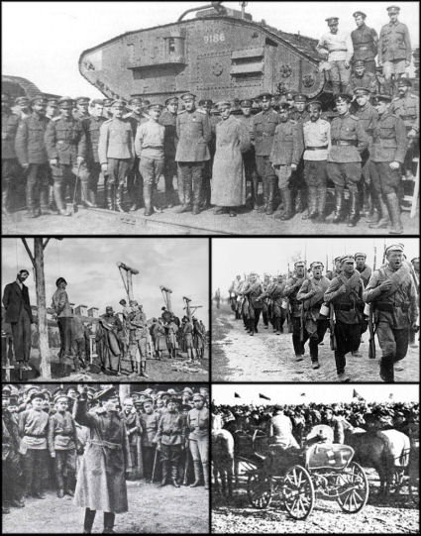
Russian Civil War
Write here
Red Army (Bolsheviks) vs. White Army
1918 to 1920
14 million died
  fighting
  famine
  the Flu
Bolsheviks won
Lenin in Power
July 1918 – Czar and family
executed

Slide 21
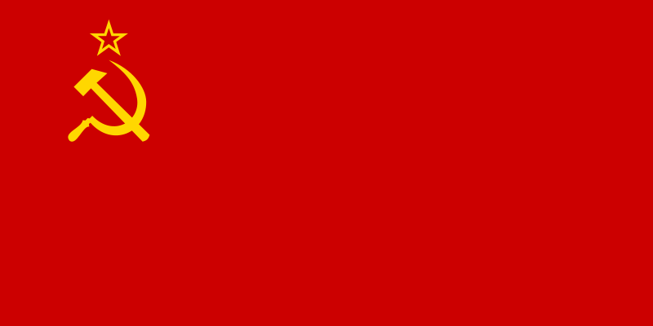
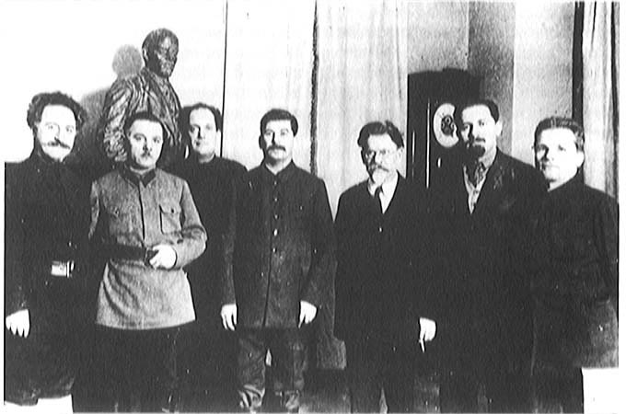
Lenin Restores order
Gov’t controls all major industries, banks, & media
Bolsheviks = Communist Party
  Held all power, a dictatorship
Renames the country -Union of Soviet Socialist Republics (USSR)
Write here

Slide 22
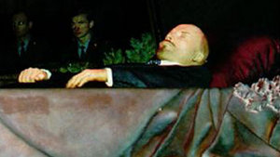
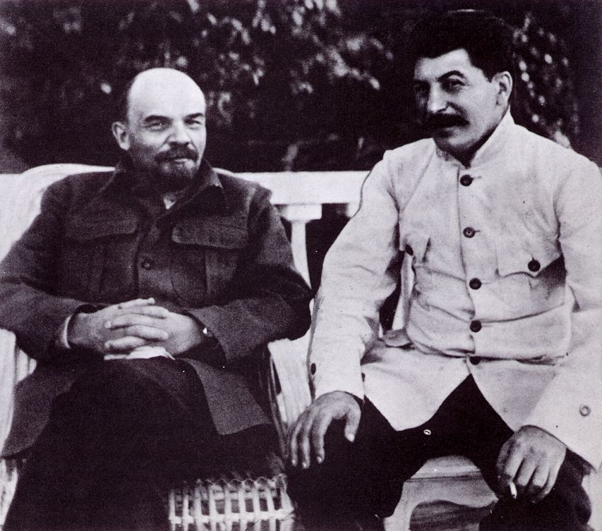
Power Change
  Lenin dies in 1924
Write here
1928 -Joseph Stalin in power
  All opponents killed or in exile

Slide 23
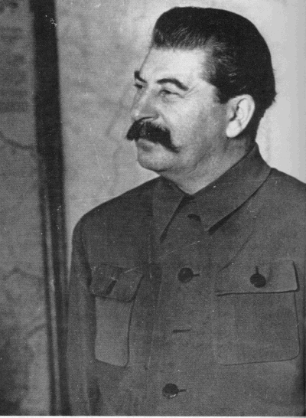
Totalitarianism
Stalin created a totalitarian state – a government that controls all aspects of life
Kills or arrests anyone that threatened his power
  Trotsky forced into exile by 1929
Write here

Slide 24
Industrial and Agricultural Revolution
Five year plan
  Rapid industrialization in steel, coal, oil, & electricity
People were given jobs, specific hours, forced to work and could not move
Collective Farms - gov’t seized 25 mil farms
  Peasants refused to work – 10 mil die or sent to Siberia

Slide 25
Police Terror
Stalin’s secret Police
  Monitored telephones, mail, and planted spies
Enemies were jailed, sent to Siberia, or killed
Great Purge – Bolsheviks, army leaders, and other influential revolutionaries
8 to 13 million deaths
Write here

Slide 26
Change in life
Write here
Propaganda spread throughout radio, speeches, Books, and movies
Censorship of all material not involved in promoting communism
No religious practices allowed, all figures destroyed
Women given equal rights
Women in charge of working and raising loyal communists
All education and information controlled by government

Slide 27
Writing Activity – Page 12 of InterNotebook
Write a journal entry about your life under Stalin.
Choose one
An industrial worker
Female doctor
Russian Orthodox priest
Communist Party member

Slide 28
Communism is an ideology that seeks to establish a classless, stateless social organization, based upon common ownership of the means of production.
Government controls everything
No private property
Controls what people eat, watch, listen to, read, etc.
Positive side of communism
Everyone is given housing, jobs, a place to farm
Wealthy are stripped of their money and equal
No titles (Lord or Sir)
Borders don’t exist
Needs are met easier by government
People work together
Everyone is equal (theoretically)

