Slide 1
The Philosophy of the Scientific Revolution
How was the scientific revolution reflected in modes of thought?

Slide 2
All Scientific Revolution thinkers inspired by the concept of mechanism
Universe seen as a “clock” with God as divine watchmaker
Removed mystery, symbolism, etc. from understandings of life
Replaced by concepts of “utility” and “usefulness”
Knowledge of Nature for divine purposes replaced with knowledge of Nature for sake of conquering it, in order to improve life on Earth

Slide 3
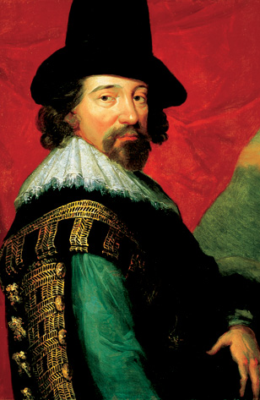
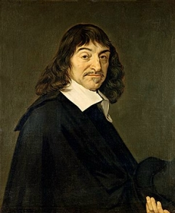
From Science to Philosophy
Francis Bacon (1561-1626)
René Descartes (1596-1650)

Slide 4
Bacon and Baconian Thought
True “Renaissance Man” - political advisor, philosopher, etc.
The Advancement of Learning (1605)
Novum Organum (1620)
Did not really participate directly in natural philosophy, but set the stage
Anti-scholasticism – believed in creation of “new” knowledge, questioning ancient authorities
Empiricism (theory, experiment and observation)
Knowledge should produce useful results (betterment of life, and more power for the monarch!)
Idea of a changing, and improving, world (sea voyages)
Champion of inductive reasoning
Start with specific observations, use your senses, end with a general certainty

Slide 5
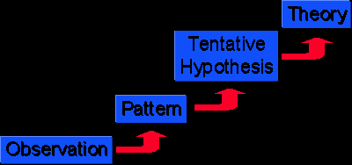
Inductive Reasoning – bottom up

Slide 6
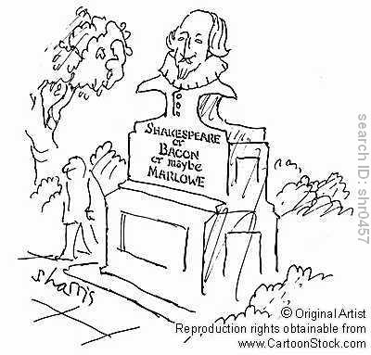

Slide 7
(De)Cartesian Thought
Math-focused
Discourse on Method (1637)
Systematic doubt and rationalism, rejected all authority but his own reason
“Cogito ergo sum” (I think, therefore I am)
Deductive reasoning - from general to specific
“Cartesian Dualism” – separation of mind and body (thinking and being), nothing of the mind was reasonable or worth studying

Slide 8
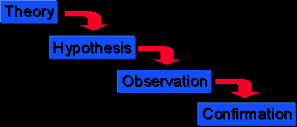
Deductive Reasoning – top down

Slide 9
Modern Application
Baconian empiricism and induction
+ Cartesian rationalism and deduction
= The modern scientific method

Slide 10
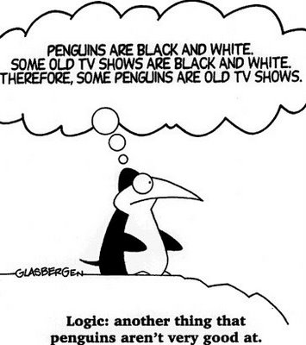

Slide 11
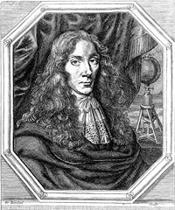
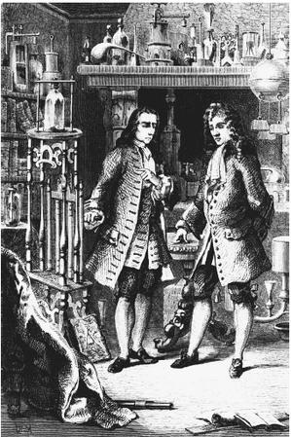
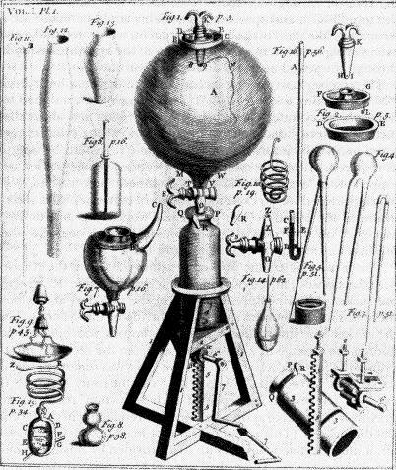
How Science was Done
Generally non-institutional, no “labs” (universities were humanist)
Some noble patronage, but work was often done in private homes of the upper class, others were witnesses
Boyle’s air pump (vacuum)

Slide 12
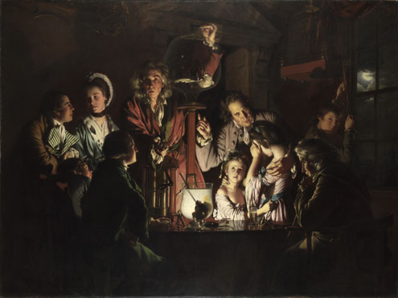
An Experiment on a Bird in the Air Pump 1768, Joseph Wright

Slide 13
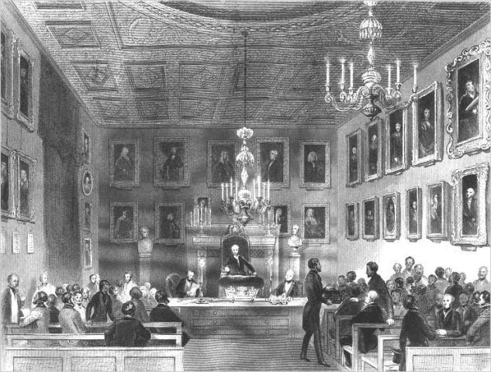
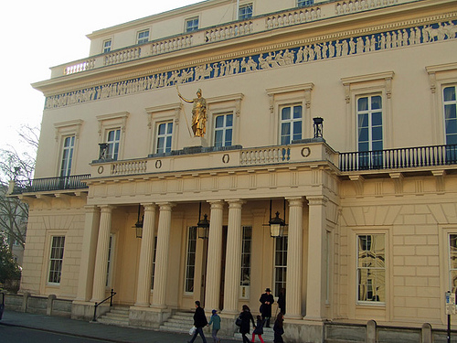
Scientific Institutions
Establishment of “institutions of sharing”, where natural philosophers could gather, share ideas and debate
Royal Society of London (1660)
Upper class men’s clubs
Social respectability = trustworthiness = scientific success

Slide 14
Women in the Scientific Revolution
With rare exceptions, women were generally not allowed to participate in the new sciences
Banned from Academies of Science throughout Europe
Any who did, acted through their husbands social circle (Margaret Cavendish)
Women did play a peripheral role as artisans, helping husbands with astronomy/math, etc.

Slide 15
Political Empiricism
The new ideas about theory, experimentation, and the use of Reason began to influence the theory of human relationships
Many thinkers began examining the nature of Man and government using the language of the natural philosophers
Three of the most important political theorists of the 17th century were Thomas Hobbes, John Locke and Jean Jacques Rousseau
These theories laid the foundation for Classical Liberalism (SOCIAL 30-1 big idea)

Slide 16
Legal and Moral Rights
Legal rights: recognized in law
Vary with place and time
May be too limited or too extensive
Moral rights: what ought to be recognized in law
Don’t vary with time or place (much)
Allow for critique of legal system

Slide 17
General Rights
Often we speak of a right to life, or to a fair trial, without saying who has the obligation
Michael has a right to life <=>
Others have a perfect obligation not to kill Michael =>
Others shouldn’t kill Michael

Slide 18
Examples: US Bill of Rights
Speech: others shouldn’t interfere with your speaking
Assembly: others shouldn’t interfere with your gathering
Exercise of religion: others shouldn’t interfere with your worshiping
Arms: others shouldn’t interfere with your keeping and bearing arms

Slide 19
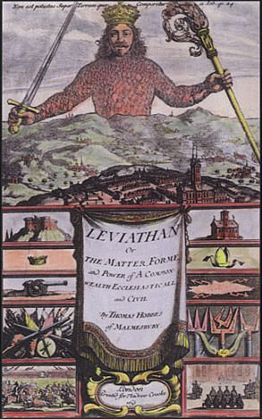
THOMAS HOBBES (1588-1679)
Applied new empiricism to society
Negative, mechanistic view of human nature
Strong sovereign necessary to control conflicting desires
Social Contract Theory: People create government for mutual protection
Hobbe’s Leviathan

Slide 20
Thomas Hobbes
Empiricism
"All that is real is material, and what is not material is not real." – Hobbes

Slide 21
Thomas Hobbes (1588-1679)
All general rights follow from a right to liberty
Others shouldn’t interfere with me
Others shouldn’t interfere with my doing what I want to do

Slide 22
Thomas Hobbes
Government
"[Early man was] solitary, poor, nasty, brutish, and short... [and in a constant state of] warre, [living in] continual fear and danger of violent death.“ – Leviathan
Absolute monarchy sent by God to help mankind
Hobbes' concepts used to justify colonialization

Slide 23
Hobbes’s state of nature
Equality of ability —>
Equality of hope —>
Conflict (most goods are private) —>
War —>
Poverty
To escape this, we’d agree to a government

Slide 24
Social Contract Theory
A government is legitimate if people would voluntarily submit to its authority
Central idea: government (and its authority) are rational
Often results in authoritarian government

Slide 25
Hobbes’s Social Contract
You would give up
Liberty
To gain
Security

Slide 26
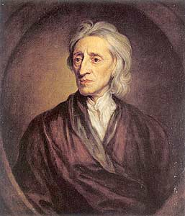
JOHN LOCKE (1632-1704)
TABULA RASA: humans born with blank slate
Natural Laws: Two Treatise of Government
Social Contract Defined: Government exists to protect life, liberty, and property
Early foundations of the enlightenment

Slide 27
John Locke
Influenced American writers of constitution
Attacked by Charles II
Friend of Newton
Influential in American revolution

Slide 28
John Locke
Government
Second treatise of Civil Government
Chaos without government
God gave mankind natural rights
Life, liberty, pursuit of property
Innate goodness of mankind led to formation of governments
Governments, which were formed by the people, must guarantee the rights of the people
People have a right to rebel against tyrannies

Slide 29
John Locke
Rationality justifies government
But also limits its authority

Slide 30
John Locke
Theory of Knowledge
Essay Concerning Human Understanding
Reasoning puts man above animals
Rejected concept that ideas are innate
Tabula rasa
Outer ideas from experience
Inner ideas from contemplation
Mankind can attain all knowledge

Slide 31
Locke’s state of nature
Equality of power and jurisdiction
Liberty, not license
Law of nature: no one ought to harm another is his life, health, liberty, or possessions

Slide 32
Locke’s state of nature
You have natural rights in the state of nature:
Rights to life, health, liberty, and property
Right of self-preservation
Right to execute the law of nature
Not a state of war

Slide 33
Voluntary Slavery
Hobbes thinks you would give up liberty even to an absolute monarch
But, for Locke, that would be like selling yourself into slavery
You can’t surrender your rights to life, liberty, and property
But you can be placed under laws that limit them (taxation, punishment)

Slide 34
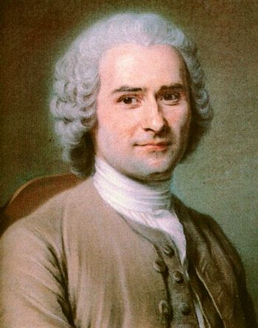
Jean-Jacques Rousseau
Contest: "Does progress in the arts and sciences correspond with progress in morality?"
No!
As civilizations progress, they move away from morality
Examples: Romans, Greeks, Egyptians
Civilization itself leads away from true fundamentals
Technology and art give false desires
Social Contract
“Noble Savage” Had read reports of explorers in North America

Slide 35
Jean-Jacques Rousseau
The social contract justifies government
But also limits it
The limit is established by the general will
General will = common good

Slide 36
Jean-Jacques Rousseau
Influence on French and American revolutions
"Liberty, Equality, Fraternity"
Invest all rights and liberties into a society
Compare to a corporation

Slide 37
Summary of Rousseau's Teachings
Old System (Powerful Ruler or Chaos) | New System (Social Contract Concepts)
Instinct | Justice
Strength and intelligence | People equal on moral rights
Might | Right
Natural inclinations | Reason
Personal liberty | Civil liberty

Slide 38
“Man is born free, yet everywhere he is in chains.”
Rousseau

