Slide 1
Silver
From 1571 to 1750

Slide 2
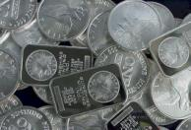
What was the impact of silver in all places?
Throughout the Ming Dynasty in China, China desperately wanted silver as silver was a hot commodity in Japan at the time (1/3 of all silver was in Japan)
China refused to trade for anything other than the precious silver, and once the Spanish uncovered the silver mines in Potosi in the newly conquered Peru, global trade was in place
Silver was the main focus of China’s economy, and paper money was replaced with silver, where people could now also pay taxes with silver. Silver was key to the success of China during a period of the Ming Dynasty.
However, during the end of the Ming Dynasty, the constant trading of silver across the Atlantic to Europe, Asia (China and Spain) and the Americas caused inflation and the value of silver sharply fell as a result. Trade decreased and China’s economy collapsed because silver was the main focus of it.

Slide 3
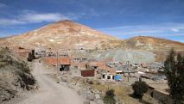
Where was silver most impactful?
Silver was at first most important to China, who used silver to trade specifically with Japan who had 1/3 of all silver in the world at the time
However, silver was extremely important for the Spanish, particularly the Philippines and Potosi, Peru, once the mine in Potosi that had an enormous amount of silver was uncovered by the Spanish
The Atlantic Ocean was used constantly when the Philippines traded with Spain, who traded 5/7 of all the available silver they had on the Atlantic Ocean to each other and help the cause of global trade
Spain wanted to go to Mexico to find the direct passage that would connect the Americas to China in 1571, so they would have access to Chinese markets and American silver. As a result, China, Peru/the Americas, Spain, and parts of Asia were most impacted by the silver!

Slide 4
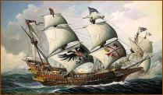
How did silver impact the world?
Once the Spanish took over the city of Manila in the Philippines in 1521, the Spanish sent ships once the silver mines were uncovered to collect the silver in a fast and effective way from the Philippines
The ships could hold up to 2,000 tons of silver at once, meaning that they would make few, yet effective trips over the Atlantic to receive silver and trade in general
Now, with the Manila galleon ships in place, silver was able to be traded through the trade routes from the Americas to Europe and Asia without problems
How much: The Peru mines in Potosi made 3,000,000 troy ounces of silver a year. That equals 3,284,250 American ounces, which is 205,265.625 pounds a year!

Slide 5
Why was silver Important?
Silver was the cause of the age of exploration in Europe and Global trade
Silver was becoming very valuable to China to the point where they would not trade with anyone for anything ,unless they had silver
Spain went to the Americas and mined for silver to trade with China creating the Manila Galleon connecting to Manila in the Philippines that Spain took over to trade with China
The immense amounts of Silver that now Spain and China had were being spent without saving causing Spain and China’s economies to crash and burn leaving China vulnerable and causing Spain to lose the Netherlands creating the first capitalist nation ever
J
Julian Briones

Slide 6
Who was involved in the trade of silver?
At first China with it’s high demand of silver traded with Japan
After Spain came into a large sum of silver China began trade with Europe
Spain to trade with China took the Philippines in 1521 and for trade created the city of Manila also creating The Manila Galleon trade
Potosi was where the mines where in Peru where Spain got their bountiful amounts of silver from
Julian Briones

Slide 7
When did these events occur
From 1571 to 1750 silver was especially important to China
Spain took the Philippines and created Manila in 1521 which they later used to trade their silver from Potosi to China
In 1492 age of Exploration began to start trading with China where Spain discovered the Americas and found silver which they used to trade with China because that is all china would accept
As a result of the inflation that came from Spain and China’s excessive spending of silver their economies crashed and they lost the immense power they had
Julian Briones

Slide 8
Slavery
By: Aaron Kreuter and Fiona King

Slide 9
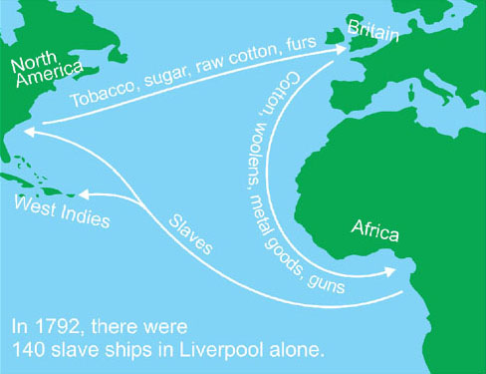
Where?
Africa: Salves were captured by rival tribes, then sold to Europeans for desirable goods.
The Americas: Slaves were used in Brazil for farming sugar cane and in Mexico and Chile for mining silver.
Europe: Europeans facilitated the triangular trade by supplying manufactured goods to trade in Africa for slaves.

Slide 10
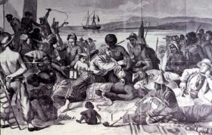
How? By: Aaron Kreuter
Slaves were captured by rival African tribes.
They were traded to Europeans for guns and gold.
They were shipped to the Americas on packed cargo ships, and as many as one eight died along the way
The slaves were used in the Americas for silver mining and sugar farming

Slide 11
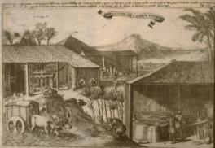
Why?
By: Aaron Kreuter
Colonies in North America needed slaves to fuel industries such as farming and mining.
Cheap labor was needed, and many of the native people had died from European diseases such as smallpox and mumps.
The goods produced with the slaves were used to trade for goods and eventually, more slaves.

Slide 12
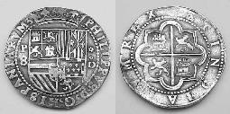
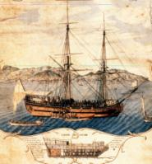
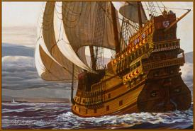
Why?
Silver was produced in the Americas
It was shipped to Europe
It was traded for slaves in Africa
Slaves were shipped to the Americas
Slaves were sent to work in the mines

Slide 13
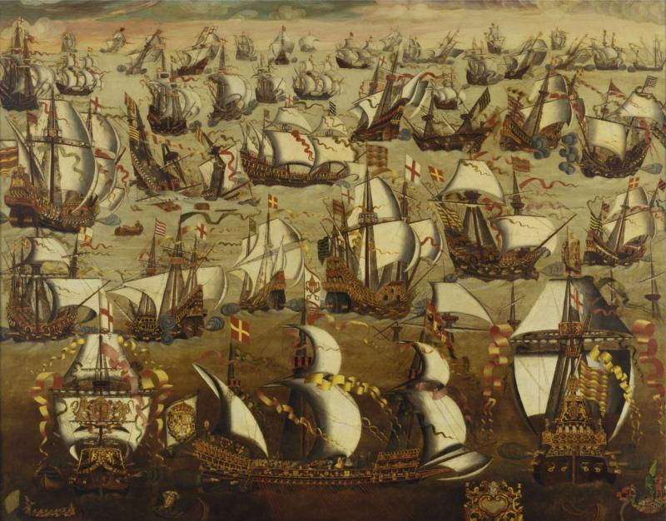
Positive Impacts
By: Aaron Kreuter
The Americas were colonized, leading the development of Brazil ,Mexico, and eventually the United States
Europe directly benefited, as the goods they produced by using slave labor could be traded to China at a huge profit
African slave sellers benefited from the goods they received in trade from the Europeans.

Slide 14
What
Trans-Atlantic Slave trade: This trade took place in the mid-Atlantic region. Slaves from Africa were bought by European slave traders and shipped to the New World.
Middle Passage: Millions of people, primarily from Africa, were shipped to the New World as part of the Atlantic Slave trade. Millions died during the journey and the few that made the journey were forced into labor when they reached their destination.
Uses for Slaves: Most slaves brought to the new world were used for labor in tobacco, coffee, cotton and sugar plantations, rice fields, construction, and gold and silver mines.

Slide 15
Who
Slaves: The vast majority of slaves were brought from Africa. Their villages were destroyed, they were seperated from their familes, and they were often treated very cruel.
Slave traders/ Merchants: Many traders bought slaves from Africa and shipped them to the New World, making a profit from their sales. The Portuguese, the British, the French, the Spanish, the Dutch, the Americans and more were all involved in the buying and selling of slaves.
Slave owners: Slave owners usually treated their slaves like animals. They used their slaves for many sources or labor, and often raped and beat their slaves.

Slide 16
When
1440-
Slave trade becomes prominent, with
Portugal having a monnolopy on the
exports of slaves
from Africa
1632-
King Charles I grants English merchants a license to transport slaves from West Africa
1807-
Thomas Jerferrson signed the Act Prohibiting Importation of Slaves into law in the United States
1562-
British slave
Trade begins
1619-
African slaves
Were brought to
America
1700-
The Middle Passage
Began to become
prominnant

Slide 17
Negative Impacts
An estimated 15% of the African slaves died at sea with mortality rates higher in Africa itself in the process of capturing and transporting indigenous people to ships for transportation.
Around 12 million slaves were forcibly relocated to the Americas, away from their families and the lives they once knew.
Slavery lasted until the mid 19th century, when the practice was finally abolished.

Slide 18
Sources Page
Sterns Text Book
Ethel Wood Book
http://www.learner.org/courses/worldhistory/unit_video_15-3.html
http://www.metmuseum.org/toah/hd/mgtr/hd_mgtr.htm
http://afe.easia.columbia.edu/chinawh/web/s5/s5_4.html
www.slavevoyages.org/tast/assessment

