Slide 1
Super Power Face Off
The Cold War

Slide 2
Lesson Objective The opposing economic and political philosophies of the United States and the Soviet Union led to global competition . What do I want to learn? | Learning Activity/Vocabulary Why did the following concepts come into place during 1945 to 1989? United Nations Iron Curtain Containment Truman Doctrine Marshal Plan Cold War NATO Warsaw Pact Brinkmanship
Assessment Slide Presentation Quiz How do I know I have learned ?

Slide 3
Allies Become Enemies
Yalta Conference: A Postwar Plan
Creation of the United Nations
Differing U.S and Soviet Goals

Slide 4
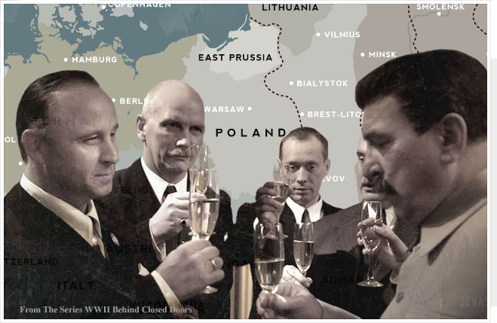
Allies Become Enemies
Non Aggression Pact-angered Britain, France and USA
3:04

Slide 5
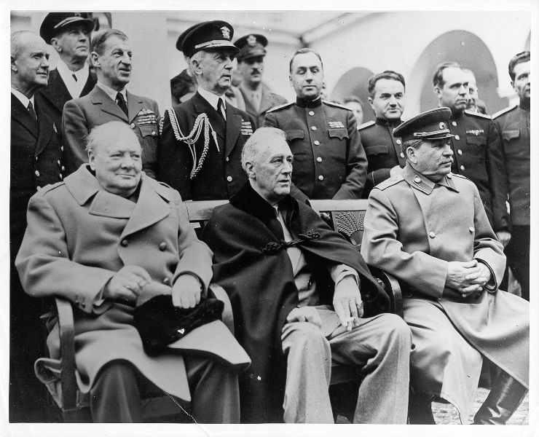
Yalta Conference=Post war plan
1:40

Slide 6
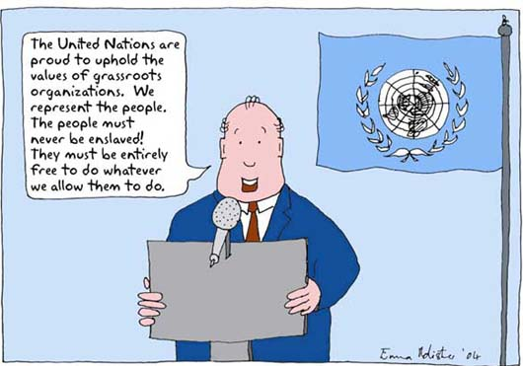
Creation of United Nations
3:11

Slide 7
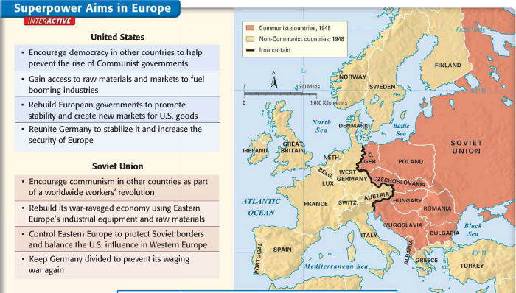
Differing U.S and Soviet Union’s Goals

Slide 8
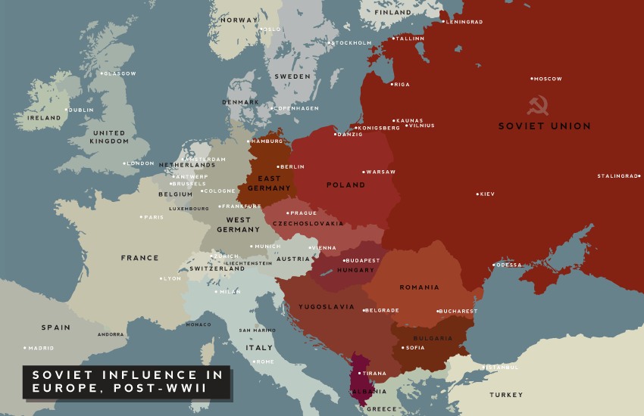
Eastern Europe’s Iron Curtain
Soviet Builds a Buffer
Potsdam Conference
Iron Curtain Divides East and West

Slide 9
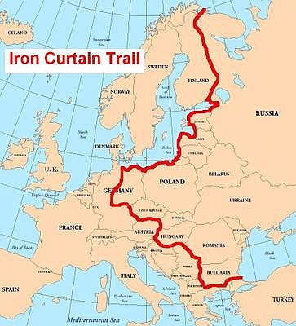
Soviets Build a Buffer

Slide 10
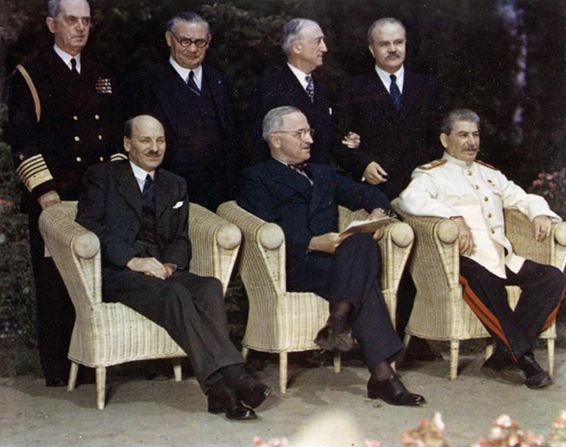
Potsdam Conference
9:54

Slide 11
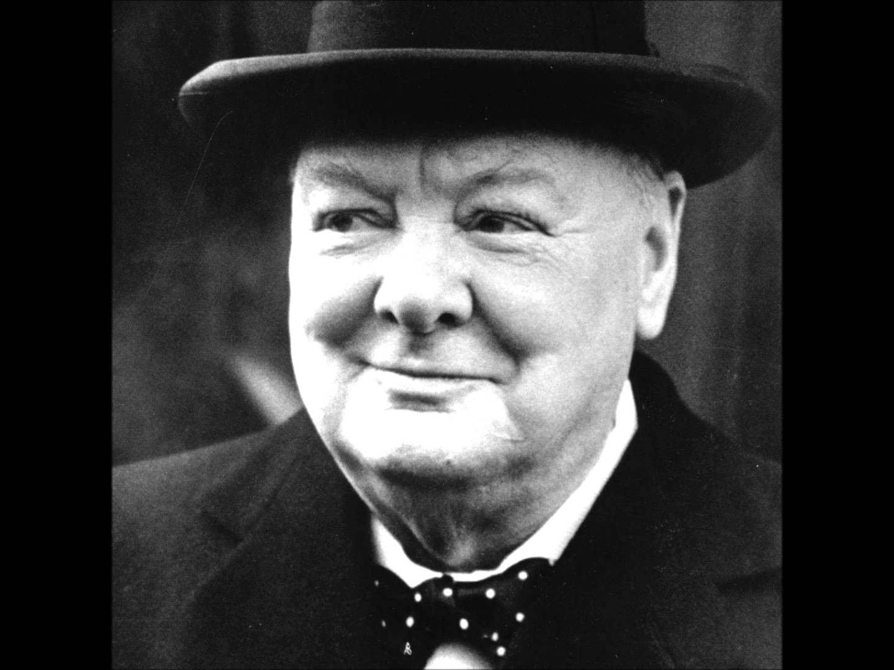
Iron Curtain Divides East and West
3:10

Slide 12
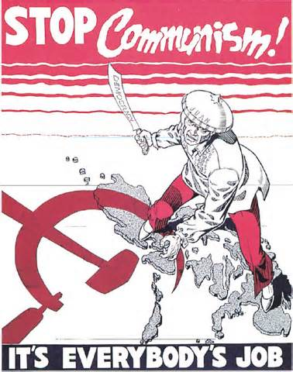
United States Tries to Contain Soviets
Containment Policy
Truman Doctrine
Marshall Plan
Berlin Airlift

Slide 13
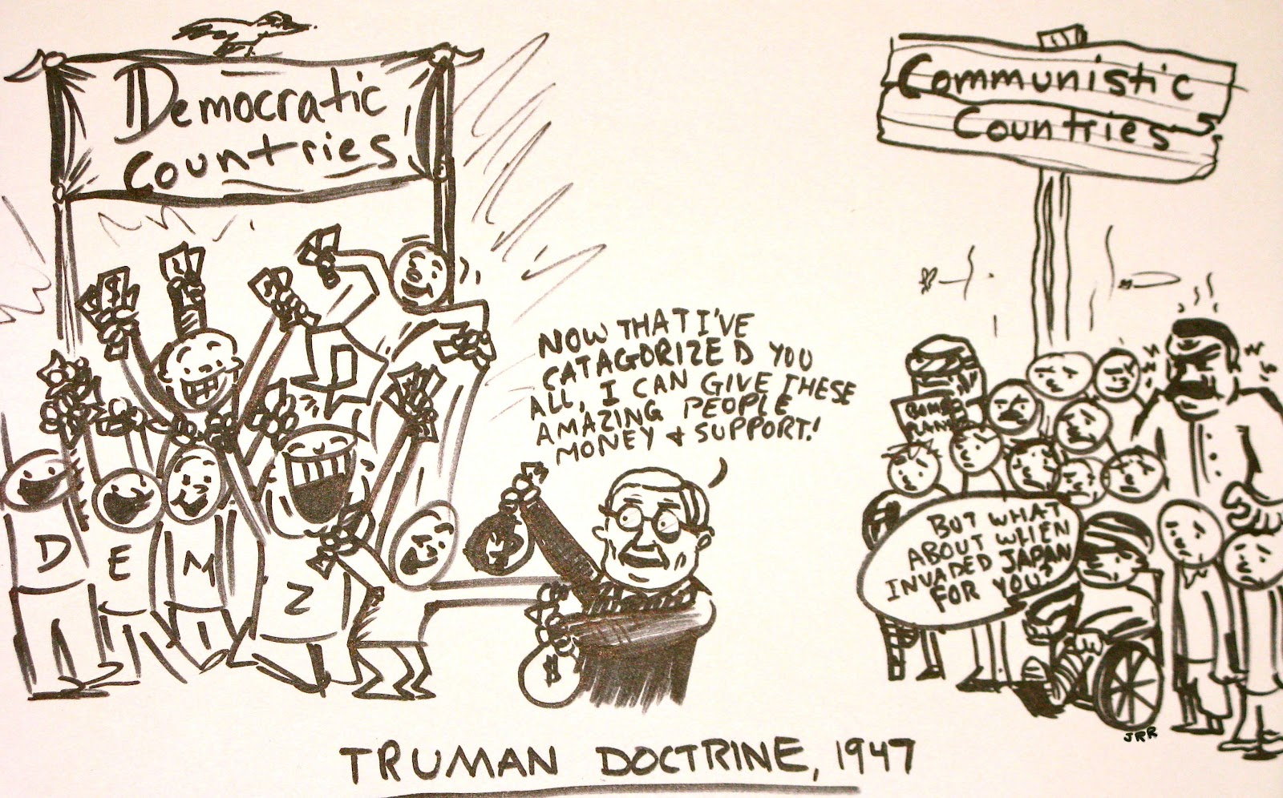
Truman Doctrine

Slide 14
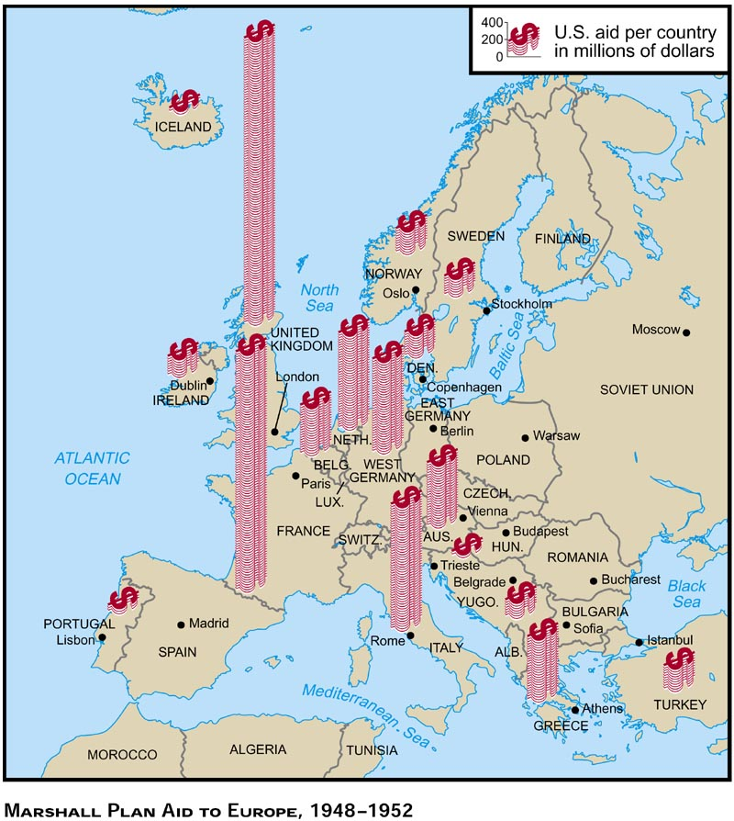
Marshall Plan

Slide 15
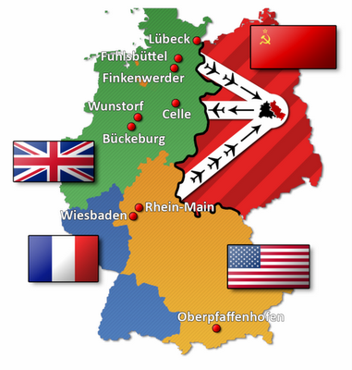
Berlin Airlift
10:13

