Slide 1
The Great War (WWI)
How did the War Begin?

Slide 2
Review of History
https://www.youtube.com/watch?v=8dapalh7BjM

Slide 3
M.A.N.I.A.

Slide 4
Review of Europe
The Roman Empire conquered most of Europe & parts of Asia & Africa
After the Fall of the Roman Empire there was the Dark Ages
After the Dark Ages came the Birth of the Renaissance Period

Slide 5
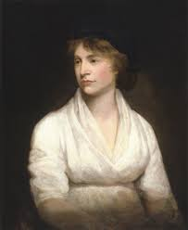
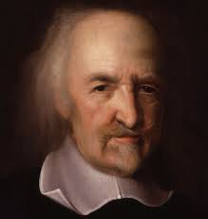
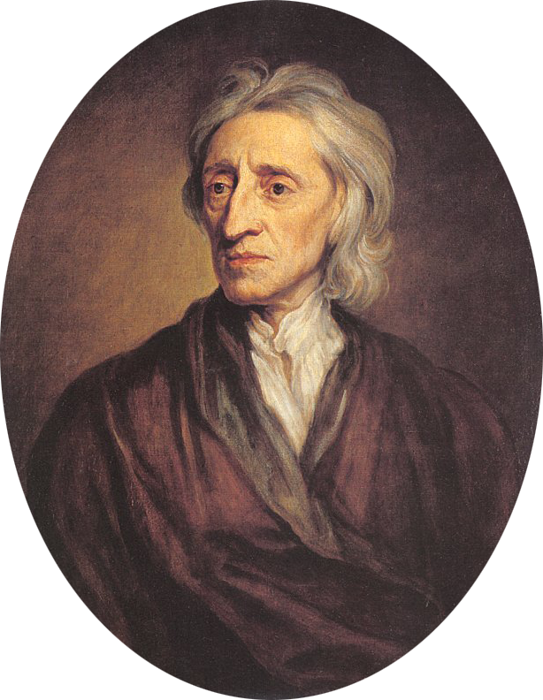
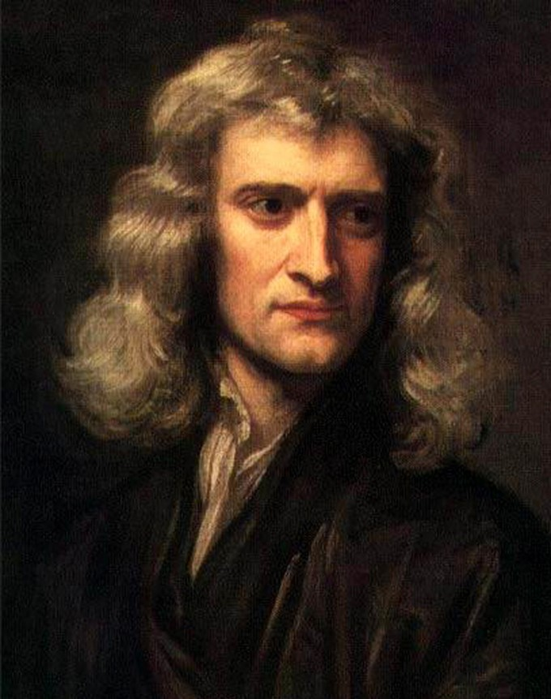
Review of Europe
After the Renaissance was the Enlightenment Period in Italy & France
The Enlightenment spread throughout the World eventually producing 2 Major Revolutions (United States v Britain & French Revolution)
Mary Wollstonecraft
Thomas Hobbes
John Locke
Galileo Galilei
Sir Isaac Newton

Slide 6
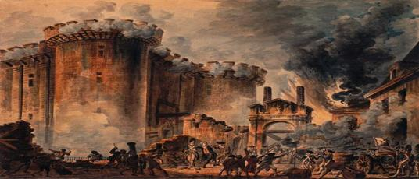
Review of Europe
Colonialists eventually won Independence from England and created a Constitution
Inspired by the Americans, France revolted against its Monarch, King Louis XVI

Slide 7
Review of Europe
From the ashes of the French Revolution came a soldier who rose through the ranks to become a Great General & Military Genius, Napoleon Bonaparte

Slide 8
Review of Europe
Napoleon eventually took political control of France & became Emperor of France
Napoleon’s lust for power eventually erupted into War in Europe conquering neighboring countries, and having major influence throughout Europe
A strong sense of Nationalism took hold throughout Europe

Slide 9
Review of Europe
Like the Roman Empire, Napoleon’s empire became too large and his ego was too large to control. Defeats in Russia & at the Battle of Waterloo (England) started the downfall of Napoleon
To prevent another empire gaining too much power, the Congress of Vienna was convened to break up France’s control throughout Europe
Many different Alliances were forged during this conference

Slide 10
Review of Europe
Technological breakthroughs led to the discovery of the Agricultural Revolution
New ways of farming led to a population explosion in Britain

Slide 11
Review of Europe
A perfect storm of circumstance evolved into the Industrial Revolution in England
A confluence of Population explosion (Labor), Resources, a stable Government, Capitol (Wealth), & Entrepreneurs (Investors) birthed a Technological Explosion that expanded through Europe & the World

Slide 12
Review of Europe
England’s boon called for a demand for more resources, wealth, labor, and trading partners
England and other European powers expanded to colonize different parts of the world in search for these hidden treasures
This expansion is known as Imperialism

Slide 13
Review of Europe
It was during this time of expansion that European Powers (France, England, Germany, Italy) began to arm themselves to protect their territories and their own national interests
This doctrine of Militarism spread through Europe & Asia

Slide 14
Prelude to War
Archduke Franz Ferdinand, was in Sarajevo, Bosnia with his wife Sophie.
The Archduke & his Wife were Assassinated by Gavrilo Princip. He was part of an organization known as the Black Hand

Slide 15
Group Assignment
Your assignment, is to take a specific country and discovery whether or not they would want to start War over this action? Why?
Who were these countries Ally(s)?
Who was the leader of this country?
Were there any animosity towards any specific country in the past? If Yes, Who & Why?
What does M.A.N.I.A. stand for?
Group 1 : Germany
Group 2: Russia
Group 3: Austria-Hungary
Group 4: Great Britain
Group 5: France
Group 6: Italy
Group 7: USA
Pg 404; Sect 1 & 2 Pg 407

