Slide 1
The Reformations
The Protestant and Catholic Reformations, 1517-1555

Slide 2
Agenda
Questions about the Renaissance test?
Opening Question/Roll
Discussion: The Reformations-Their Nature and Martin Luther
Closing Question
HW Reminder: as per the agenda on khanlearning.weebly.com

Slide 3
Opening question
What were the factors that led to the beginning of the Protestant Reformation?
https://www.youtube.com/watch?v=Z4RNYQscm0w

Slide 4
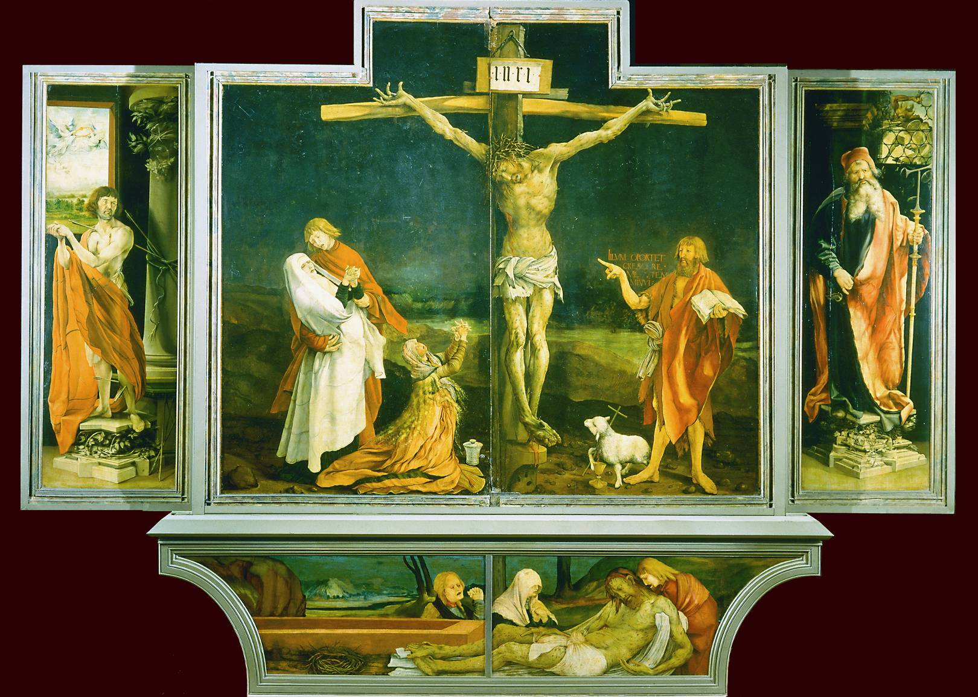
Notes:
Painted on the eve of the Reformation, Matthias Grunewald’s (ca. 1480–1528) Crucifixion shows a Christ who takes all the sins of the world into his own body, as his mother, Mary Magdalene, and John the Baptist share the pain of his afflictions.
Musee Unterlinden, Colmar, France/SuperStock

Slide 5
Reformation? Reformations?
Protestant reformation a watershed in Western civilization
Many religious movements in 16th century = reformation (Re-formation (make over), or Reformation (make better)?)
Protestants differ as sharply among selves as with Rome
Reformers initially do not see selves as anti-Catholic

Slide 6
Popular Religious Movements and Criticism of the Church
Reformation could not have happened without the earlier challenges to the Church’s authority:
Avignon papacy
The Great Schism
The Conciliar Period
The Renaissance papacy
Lay criticism of the church was growing
Many sought a more egalitarian church

Slide 7
Lay Control Over Religious Life
The benefice system, the sale of religious office to the highest bidder, was collapsing.
Communities were loudly protesting financial and spiritual abuses, such as the sale of indulgences.
City governments were endowing preacherships.
Magistrates were restricting the growth of ecclesiastical properties and clerical privileges.

Slide 8
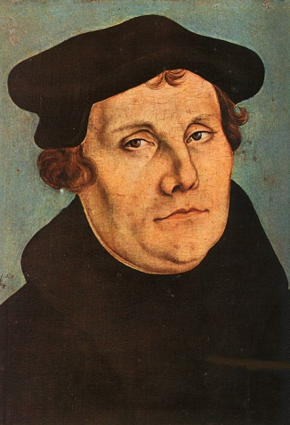
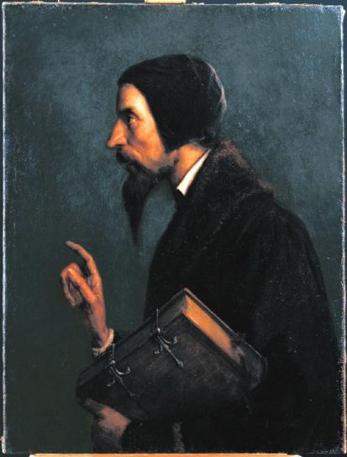
“Magisterial Reformers”: Luther and Calvin
Magisterial = “Master”, “Teacher”
Martin Luther (1483-1546)
John Calvin (1509-1564)

Slide 10
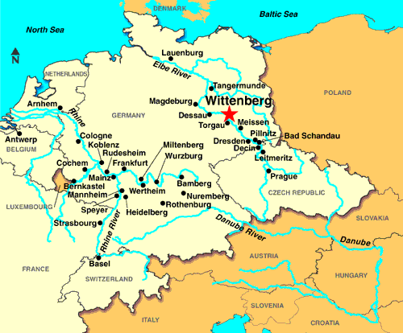
Martin Luther (1483-1546)
Born in small, N German town to miner family
Local education & University of Erfurt
Plans to go into law, does not
Augustinian monk
Visits Rome, confirms suspicions
Begins teaching at University of Wittenberg

Slide 11
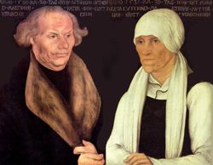

Slide 12
Luther’s Path to Reform
Influenced by Christian humanism and contemporary criticism of the church
Highly sensitive personality
Prone to deep doubts and pessimism
Could not convince himself that he was worthy of God, not that actions on his part could benefit
“Justification by Faith”
Concluded God does not demand charitable acts and religious ceremonies, but just faith in Jesus Christ as perfect righteousness. Good works expected, but did not earn one salvation.

Slide 13
https://www.youtube.com/watch?v=9IkqniF8AA8

Slide 14
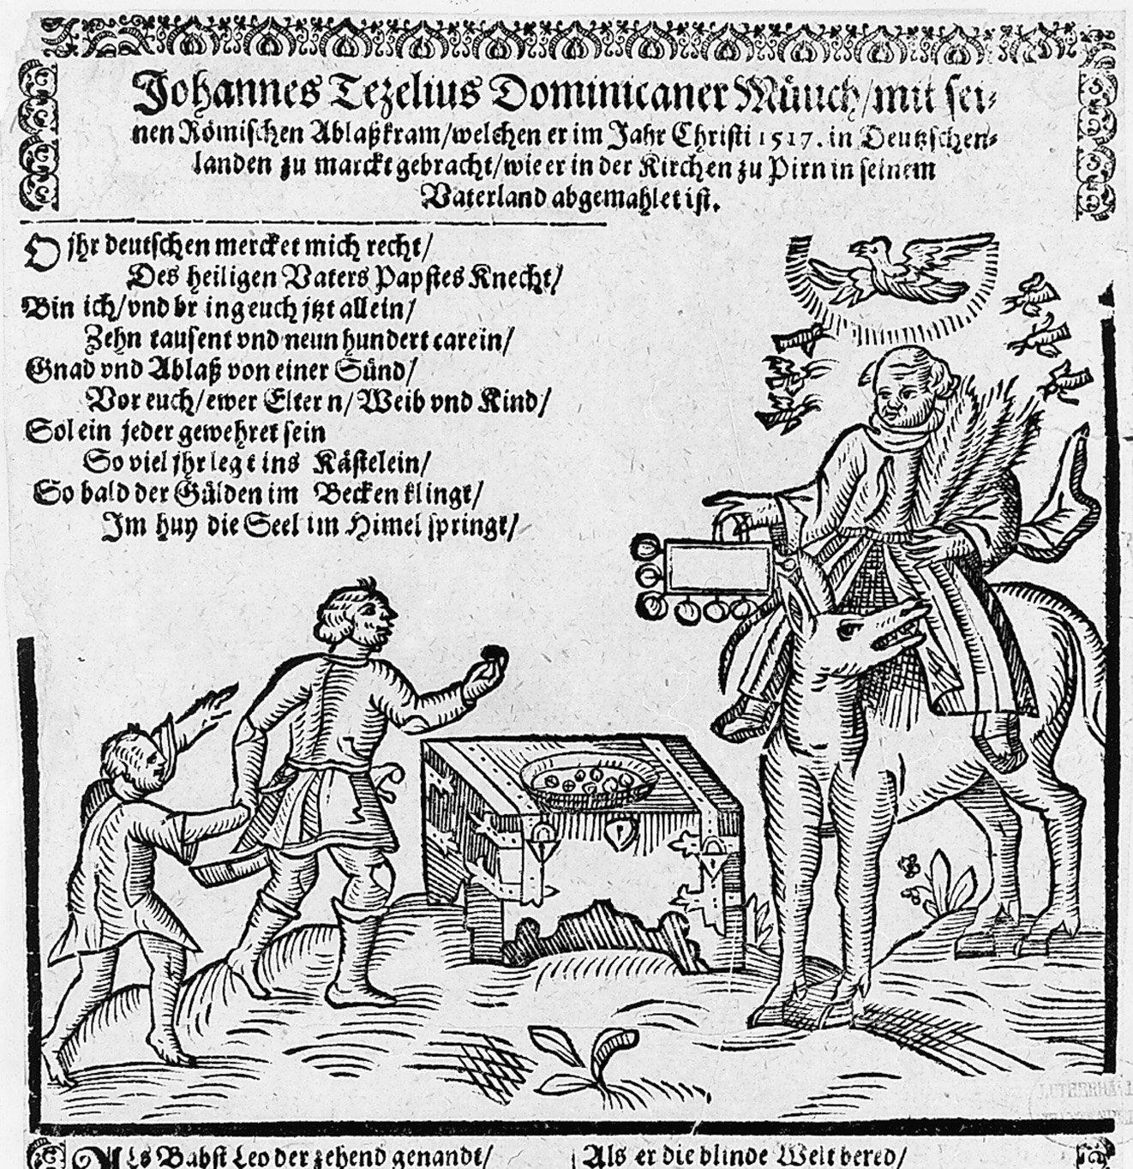
“So bald der Gulden im Becken klingt/Im huy die Seel im Himel springt.”
Notes:
A contemporary caricature depicts John Tetzel, the famous indulgence preacher. The last lines of the jingle read, “As soon as gold in the basin rings, right then the soul to Heaven springs.” It was Tetzel’s preaching that spurred Luther to publish his ninety-five theses.
Courtesy Stiftung Luthergedenkstaten in Sachsen-Anhalt/Lutherhalle, Wittenberg

Slide 15
Indulgences
Remission of temporal punishment in purgatory
Indulgence fairly typical aspect of medieval Catholicism = Became bloated
Johan Tetzel (1516), master indulgence salesman
Selling indulgences on behalf of Jubilee, rebuilding of St. Peter’s
Luther has two problems with indulgences:
Smacks of “good works”
Transfers German money through Austrian bankers to Rome
Ninety-five Theses (31 October 1517)
Probably not Luther, NOT a defiant act
Church tries to discipline through the order
Humanists rally

Slide 16
Reformation: Day 2

