Slide 1
Totalitarianism Vocabulary Review
Khan

Slide 2
The New vocabulary
Bolsheviks
V. I. Lenin
Rasputin
provisional government
soviet
Joseph Stalin
Totalitarianism
Command Economy
Five Year Plan
Collective Farm
Great Purge
*Franklin Delano Roosevelt
*New Deal
*Weimar Republic
*Dawes Plan
*Hyperinflation
*fascism
*Benito Mussolini
*Adolph Hitler
*Naziism
*Mein Kampf
*lebensraum
*appeasement
*Axis Powers
*Francisco Franco
*isolationism
*Third Reich
*Munich Conference

Slide 3
Bolsheviks*
A faction of Marxist Russian Social Democratic Labor Party who ultimately became the first Communist Party of the Soviet Union under the leadership of Vladimir Lenin*

Slide 4
Rasputin
A spiritual man who claimed to have special healing powers who , under the insistence of Czarina, tried to cure the ailing prince.
He became the advisor to Czarina in the absence of Czar Nicolas II when
he was away fighting the WW1 .
http://www.youtube.com/watch?v=UmKxKylgtmM
http://www.youtube.com/watch?v=0XvdMJ-KIZY

Slide 5
Totalitarianism
a form of government in which the ruler is an absolute dictator (not restricted by a constitution or laws or opposition etc.)

Slide 6
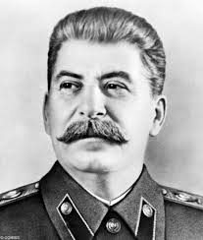
Joseph Stalin
Totalitarianian leader of Soviet Union who ruled Russia ruthlessly to accomplish his main goal- heavy industry.

Slide 7
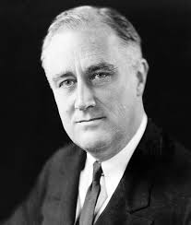
Franklin Delano Roosevelt
President of United States during the Great Depression and World War II

Slide 8
Isolationism
A policy of noninvolvement in world affairs.
Cut self off from rest of the world -non-involvement -put your own country's needs first

Slide 9
New Deal
FDR's program to alleviate the problems of the Great Depression, focusing on relief for the needy, economic recovery, and financial reform2.Was a series of domestic programs enacted in the United States between 1933 and 1938.

Slide 10
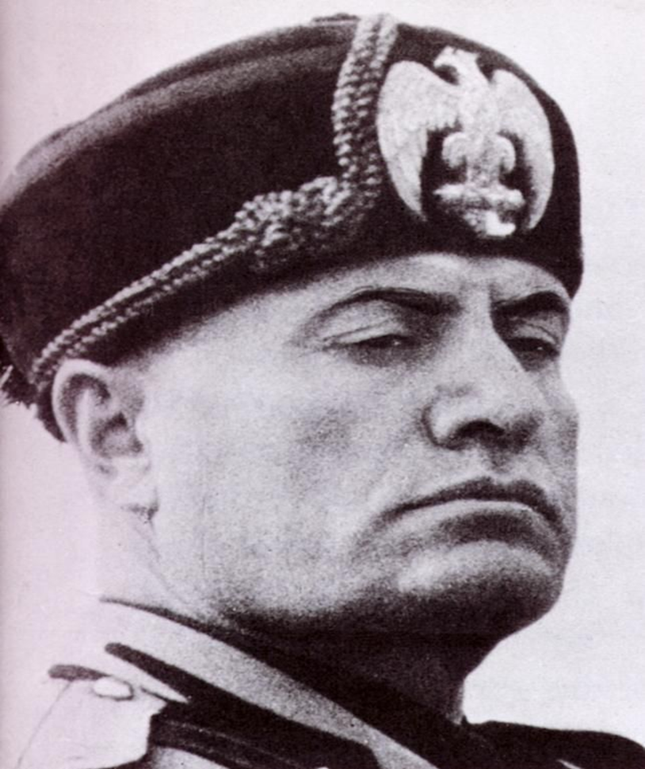
Facism
A political system headed by a dictator that calls for extreme nationalism and racism and no tolerance of opposition

Slide 11
Benito Mussolini
Italian fascist dictator (1883-1945)
He just wanted to rule Italy and be popular. He tried to do that by making Italians feel like the Roman Empire was back. He reestablished order through force and ran things like a Roman dictatorship. He invaded North Africa and Greece, the same places the Romans invaded. His mistake was getting involved with Hitler who dragged Italy into a war with the US.

Slide 12
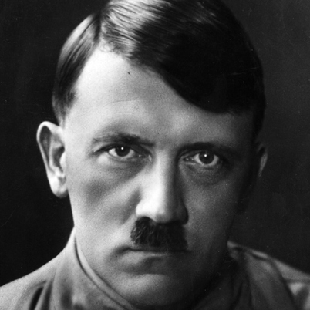
Nazism
a form of socialism featuring racism and expansionism

Slide 13
Adolf Hitler
German Nazi dictator during World War II (1889-1945)
Hitler’s goal (1) Wiping out all jews from the face of Earth to maintain purity of German race (2) brutal enslavement of all people in Poland , Russia , Easten Europe (3) Making Germany a super power (4) Finding new lands for Germans to settle. (5)Invading & Controlling whole of Europe.

Slide 14
Lebensraum
Hitler's expansionist theory based on a drive to acquire "living space" for the German people

Slide 15
Review
Hitler
Mussolini
Stalin

