Slide 1
Journal #5
For each of the following scenarios decide whether the action is done because the individual is more important or the group is more important. Give a reason for each.
An air traveler going through security is required to take off her shoes, put toiletries in plastic bags, and submit to a random full-body scan by a female security officer.
A high school wrestler is required to take a urine test before his state tournament match to see whether he has been taking drugs.
A war protester is arrested and taken to jail for refusing to leave a public park after curfew.
The government deports a law-abiding high school student who has lived illegally in the U.S. since the age of two.
A principal refuses to allow publication of a student’s controversial article in the school newspaper.

Slide 2
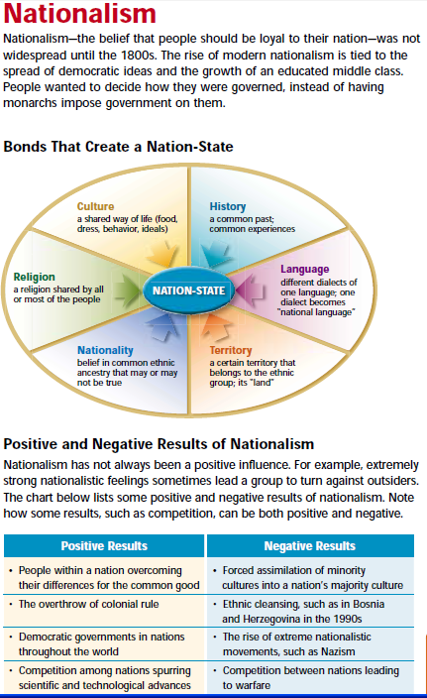
Journal #6
Using the chart
on the right,
identify how
the United States
has “Nationalism”
That is, give
examples of what
binds our people
together

Slide 3
Journal #7
Declaration of the Rights of Man and Citizen
Choose odd or even and rewrite/summarize/explain at least 5 of the “rights”. Then find a partner who chose the opposite set and explain them to each other in order.

Slide 4
Journal #8
From the Unit 2 Study Guide, identify 1 or 2 topics you believe you know nothing or very little about and write it out as a question.
Then find someone in class who can answer your question and write that answer in.

