Slide 1
Journal #17
Directions: Wars have been fought throughout history. The list below presents different reasons for going to war. Check whether you agree or disagree that the reason given is a good one. Be prepared to discuss your thoughts.
 | Agree | Disagree | Explain
1. Our nation is attacked by a foreign military.
2. A nation with whom we have a mutual defense alliance is attacked.
3. Our President is assassinated by a terrorist from an unfriendly nation.
4. Our President tells us that a country is planning an imminent attack on us.
5. A country has just had a fundamentalist revolution and is sending fighters into oil-producing nations in the region.
6. An unfriendly nation has just successfully tested a nuclear weapon in violation of a signed UN agreement.
7. A US naval vessel is sunk in a foreign harbor by government agents from that country.

Slide 2
Journal #18
Propaganda is a form of communication that is aimed at influencing the attitude of a community toward some cause or position so as to benefit oneself or one's group.
For each of the 13 images, take no more than 30 seconds to quickly describe what you see and what you believe the objectives may be.
Think of the Audience, Purpose, and Tone like in our SOAPStone
Describe What You See
Objective of Poster – these may repeat

Slide 3
1

Slide 4
2

Slide 5
3

Slide 6
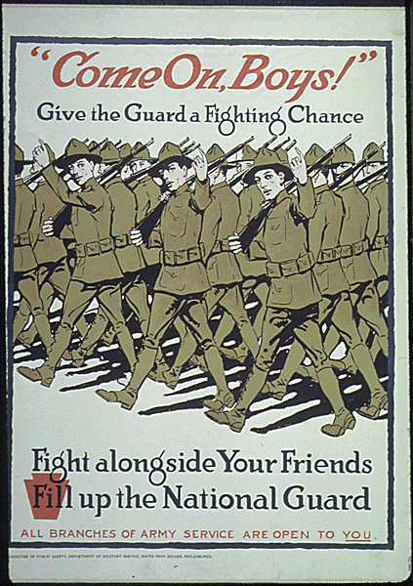
4

Slide 7
5

Slide 8
6

Slide 9
7

Slide 10
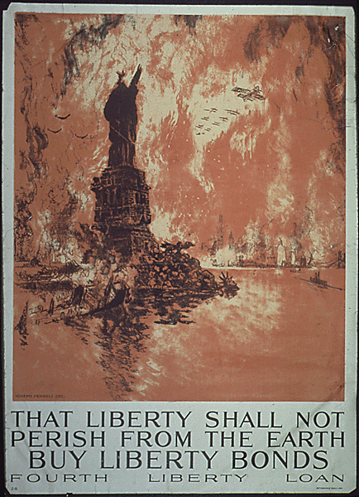
8

Slide 11
9

Slide 12
10

Slide 13
11

Slide 14
12

Slide 15
13

Slide 16
Journal #19
Read The Fourteen Points by Woodrow Wilson
Identify examples where he speaks of changes to 1. Imperialism, 2. Nationalism and territory, and 3. efforts to have a lasting peace. Use the numbers of the point and explain how they relate to the topics above.

Slide 17
Journal #20
From the Unit 5 Study Guide, identify 2 or 3 topics you believe you know nothing or very little about and write it out as a question. Make sure it is answered to receive credit.
Then find someone in class who can answer your question and write that answer in.
Use your section study guides and notes to help you and your classmates.

